Slide 1
IEEE Online Career & Talent Expo
Advancing IEEE Member Careers

Slide 2
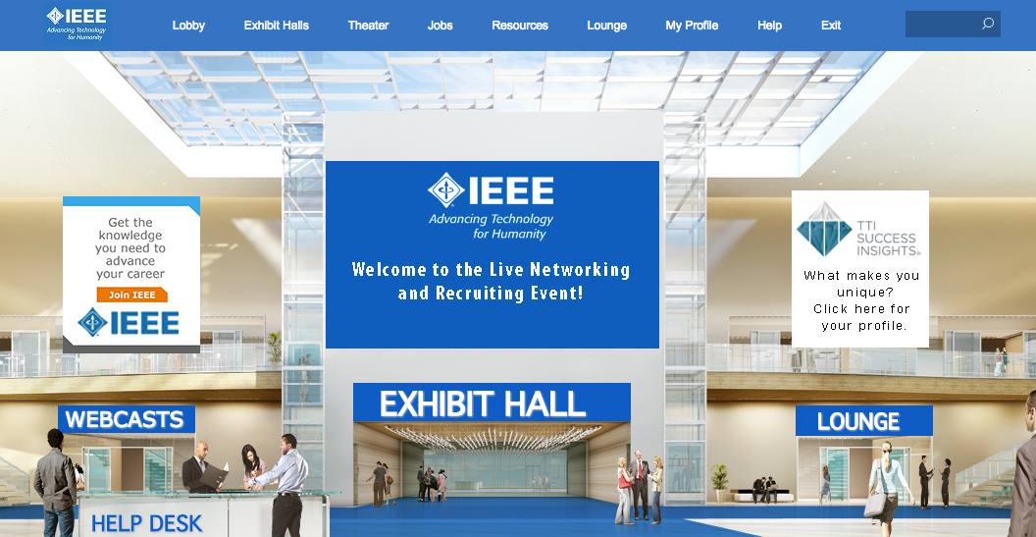
Our Mission
To provide members professional development and job leads through an online career fair with resources available 24/7 in a special interactive virtual environment.

Slide 3
Expo was created for…
Professional and personal development
Career resources and job leads for all experience levels
Expert tools to support your job search
Build network with Skype – LinkedIn and Collabratec-like features
Create relationships between IEEE and companies
Satisfy company employment and member needs

Slide 4
The Expo’s impact on individuals
Provides unique and personalized resources including self-assessment/DISC profile
Easy, convenient and fun to use
Direct access to employers and interviewers
All tools, resources and companies in one location
Access to webinar speakers (live Q&A)
Be expertly coached for your next career move
Employers recognize quality of IEEE members and place members as a hiring priority

Slide 5
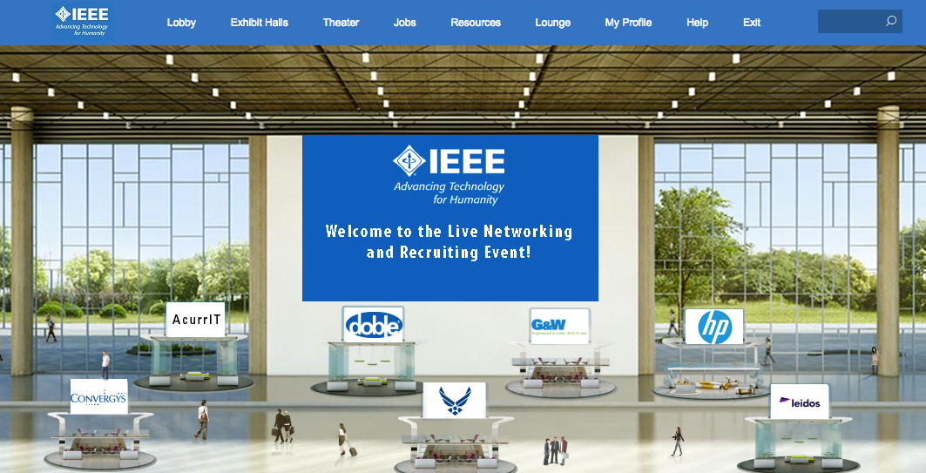
The Expo is the Largest STEM Job Fair
Has hosted over 2,500 people
Registrant engagement is over 97%
Live webinars average 150 people

Slide 6
Attendance is FREE for:
All IEEE members University Students
US Military Unemployed
Company guests

Slide 7
2017 Key Event Dates
Live dates always 3rd Wednesday of the month
Corporate and Tech Job events (schedule TBD)
Live Expo Job Fair scheduled dates – 2017
January 18
March 15
May 17
July 19
September 20
November 15

Slide 8
Resources for Your Career Advantage
Free self assessment based on DISC profile
Free eBook “7 Distinct Advantages for Your Job Search” that explains how to incorporate DISC results into the search
Live and on-demand webinars
Expert resume review and guidance
Video and book “must watch/read” resources
100 M personal storage for resume and videos

Slide 9
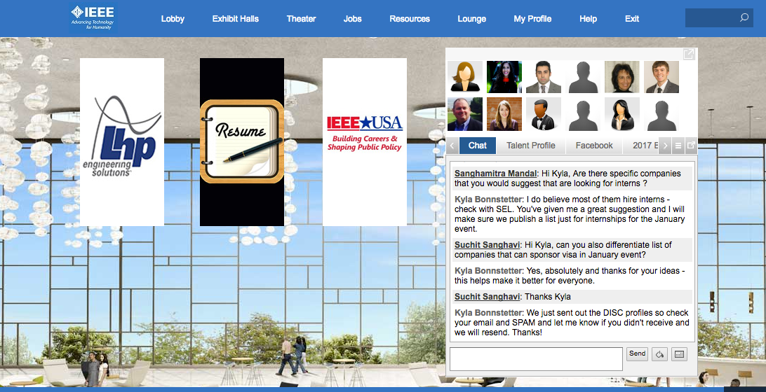
Hang Outs and Chat Rooms

Slide 10
Theater - Webinars

Slide 11
Outcomes – successes
Helps answer “Why did I join IEEE”
Provides personal self-discovery of strengths, potential employers and improvement opportunities
Comments include:
“Great tools, remarkable experience”
“Very interactive and fun”
“Got more visitors to our booth than expected”
“The Expo was an innovative way to find a job”

Slide 12
Future Expo Service
Job matching service – matching people to jobs considering:
Corporate Culture
Personal strengths, soft skills (including DISC) and competencies (55 factors)
Technical and hard skill requirements
Mobility and promotion opportunities
Flexibility in work environment
Compensation

Slide 13
Your Engagement Essential
Register and use the resources
Refer employers (Engineering/IT department and HR decision makers)
Recruit speakers and presenters
Identify universities and other partners
Tell people about the Expo
Connect on Facebook @IEEEexpo
LinkedIn, Twitter, Facebook, Collabratec
Invite guests
Inform your network, colleagues, friends

Slide 14
Contact Information
For more information please visit:
www.IEEEexpo.org
http://sites.ieee.org/r6careerexpo
Contacts:
Michael Andrews (m.andrews@ieee.org)
Kyla Bonnstetter at 602-373-3361
Email: r6technexpo@ieee.org

Slide 15
Region 6 Conferences
Region 6 hosts and sponsors four major events:
SusTech
GHTC
Rising Stars
Career and Talent Expo

Slide 16
Region 6 Conferences
SusTech – Sustainability Conference, October 9-11, Phoenix
GHTC – Humanitarian Conference, October 14-16, Seattle
Rising Stars – University and Young Professionals, Technical and Professional Development, January 2-4, Las Vegas

Slide 17
SusTech Technologies for Sustainability
Explores the development and application of science, engineering, and technology to promote sustainability.
Attendees are passionate about the environment and sustainability.
Many have responsibility for developing innovative solutions to drive sustainable development.
Some participants work for organizations where sustainable design is essential to all product designs.

Slide 18
SusTech Highlights
Remarkable keynote presentations
Participation from over 20 countries
Engage with experts about a “hot topic”
Address issues relating to a multidimensional, globally relevant topic

Slide 19
GHTC
GHTC takes the IEEE tag line “Advancing Technology for Humanity” to a new level of commitment.
GHTC brings a global audience together to address critical issues for the benefit of the resource-constrained and vulnerable populations in the world. Attendees represent for-profit and non-profit businesses, governmental and non-governmental organizations and academia to attend and present urgent needs, current research and innovative engineering solutions to humanitarian challenges and lessons learned from the actual deployment and application of humanitarian technologies.

Slide 20
GHTC Highlights
Major speakers include
Bartosz Wojszczyk, President and CEO, Decision Point Global
Walt Hubbard, Director of King County, Washington Office of Emergency Management
Alexis Bonnell, Division Chief-Applied Innovation and Acceleration, U.S. Global Development Lab, USAID
Maurizio Vecchione, Senior VP, Global Good
Dave Cook, Engineers Without Borders-USA 2016 President
Special Panels
Commercialization of Humanitarian Technology
Humanitarian Applications of Mobile Wireless Devices (Vodafone’s Wireless Innovation Project)
Poster sessions detailing deployed projects
Region 6 Director Award Ceremony

Slide 21
Rising Stars
Rising Stars is a conference directed an university students and young professionals.
The conference has two tracks:
Technical Innovations
Professional Development
The technical element of the program allow conference attendees to get real time exposure to topics like virtual reality, medical/wearable systems, learning systems and high speed computing from experts with a C-suite perspective.
The professional development topics range from entrepreneurism, networking, use of social media, resume building to creating an effective mentor relationship and the challenges related to working in a multi-cultural, multi-generational environment.

Slide 22
Rising Stars - Highlights
Icebreaker Sessions
Corporate mixer
Remarkable speakers
Emerging technology
Professional development
Excellent venue
CES

Slide 23
We promise a mix of technical innovation and professional development topics from experts representing a variety of perspectives

Slide 24
It’s important! Personally and professionally
Region 6 believes that every member wants the opportunity to network with other professionals, share ideas, be innovative.
These conferences provide you that chance!

