Slide 1
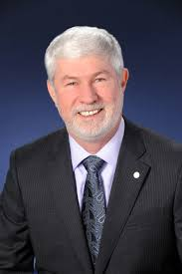
“People talk about job security. No one can give you that. Job security depends on the company. What IEEE can do – and I use the phrase carefully- is offer career security. You can be the most valuable engineer by being current in technology and by networking with others. If you take advantage of the products and services that IEEE offers, you will become the most valuable engineer in your organization. And if your job goes away, you’ll have no problem finding another.”
- Howard Michel, 2015 IEEE President

Slide 2
Member & Geographic Activities (MGA) and IEEE-USA
2016 Membership Development (MD) Training
Excalibur Hotel and Casino, Las Vegas, NV
30-31 January 2016

Slide 3
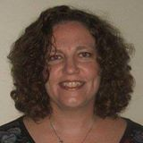

Introductions – MGA MD Staff
Map of New Jersey
Adrienne Hahn
a.hahn@ieee.org
Regions 1, 2, 4
Membership Development
Chris Wright
wright.c@ieee.org
Regions 3, 5, 6
Membership Development
Notes:
3

Slide 4
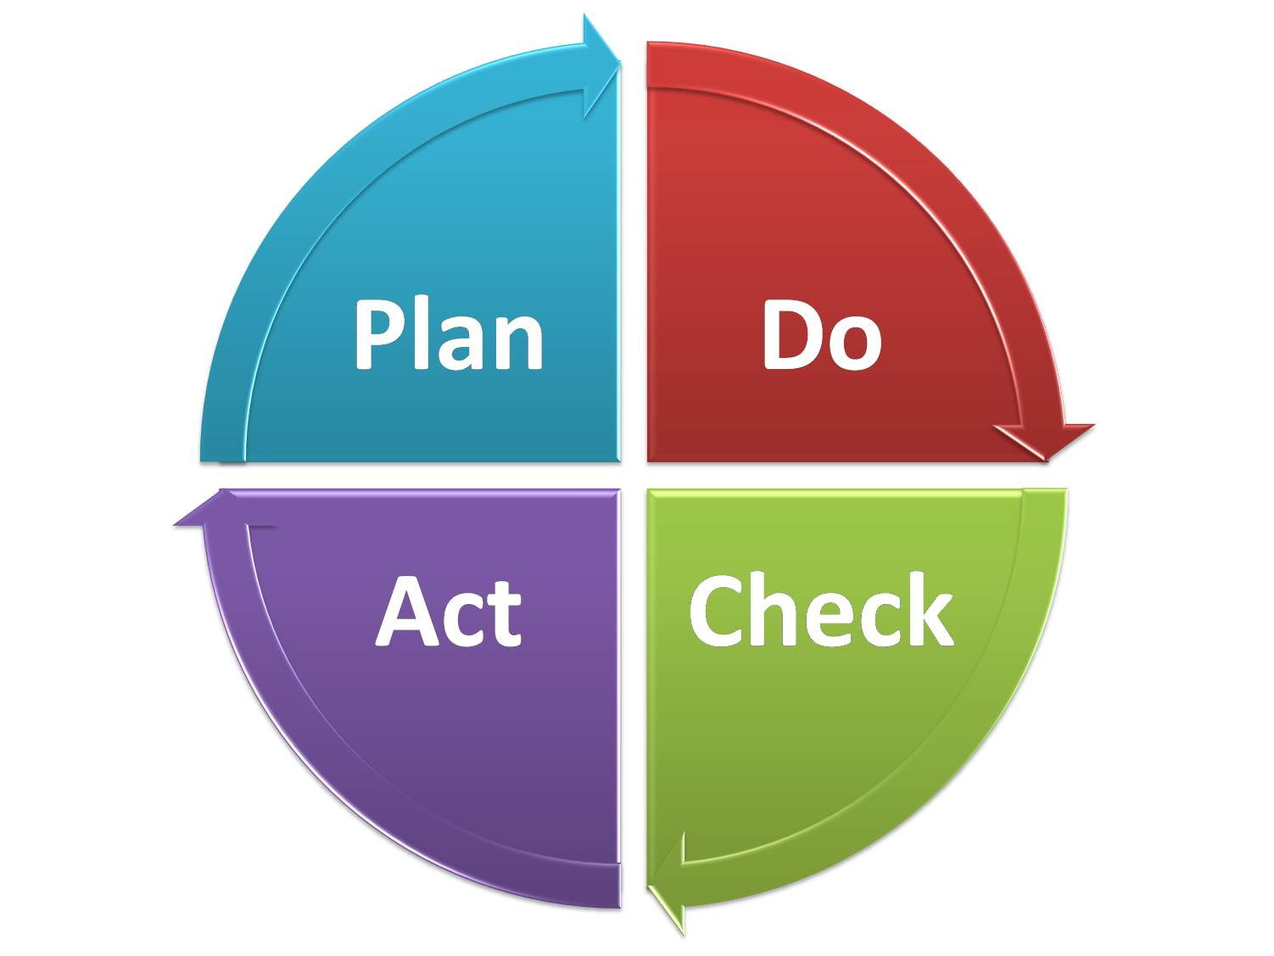
Objectives for This Session
Discuss how to develop a written plan for your Section
  Share with your ExCom
  Hand off to incoming volunteers
  Repeat/update every year!
Get your feedback on:
  How to increase membership development
  Potential activities and events to support membership engagement
Discuss how Regions and Sections can provide value to our members

Slide 5

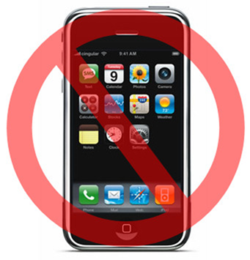
Session Expectations
Interactive working session
  Ask questions
  Share ideas
  Network with your fellow volunteers
Avoid using electronic devices
  When not doing a hands on exercise
  Leave the room if you need to,

Slide 6
The Role Of Membership Development

Slide 7
MGA Winning Aspiration
To be the best in class association for technical professionals in the world by:
  Delivering an exceptional membership experience (50% or more of members rating as IEEE membership “top box” or "very satisfied").
  Expanding IEEE's global membership presence.
  Developing and supporting a positive professional development experience for volunteers who deliver the IEEE experience.

Slide 8

Why is MD Important?
Directly supports the MGA winning aspiration
Increases the breadth of the member network
Provides larger pool of potential volunteers
Needed to sustain the future of IEEE Membership
Impacts Section finances

Slide 9
What is Membership Development?
  Lead Generation + Member Engagement
Not just about recruiting new members
Provide opportunities for current members so they want to stay
Most member involvement is at the local level
Provide an excellent member experience based on what they want, everything else will follow
We need to help our members advance in their profession to achieve their goals as well as support IEEE’s mission.

Slide 10
Section MD Role
Shepherd the activities pertaining to membership recruitment AND retention in order to deliver an excellent member experience.
Collaborative effort between:
  Section Chair and ExCom
  Sub-Committees within their Section
  IEEE Membership Marketing Specialist (staff)
Design and execute a Section Membership Plan for a given year.

Slide 11

Keys to MD Success
Be an IEEE “Champion”
Be passionate about:
  Serving the members’ needs
  Partnering with the various sub-groups within your Section
  Driving member engagement in both the short and long term
  Interested in networking/relationship building with people both within IEEE and externally

Slide 12

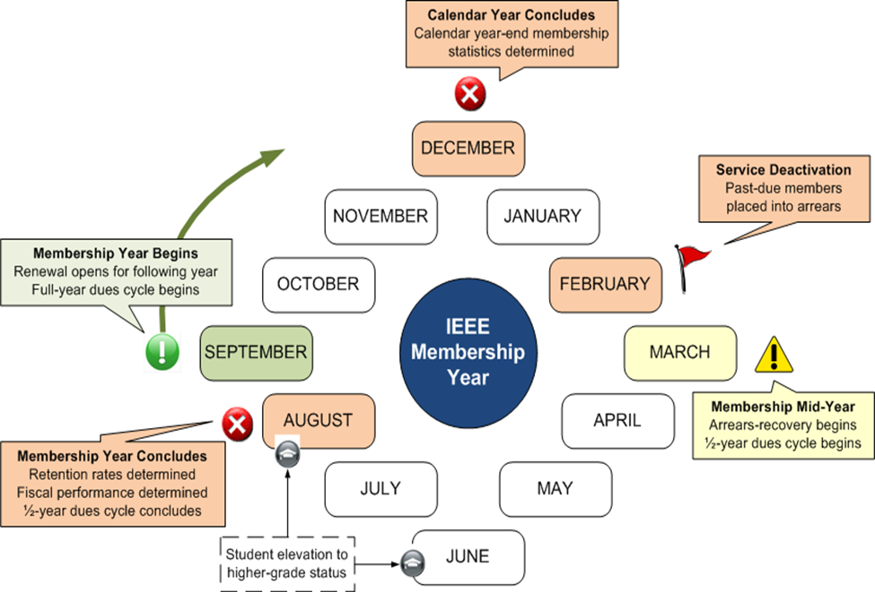
Membership Development Cycle
Start planning for coming membership year in July

Slide 13
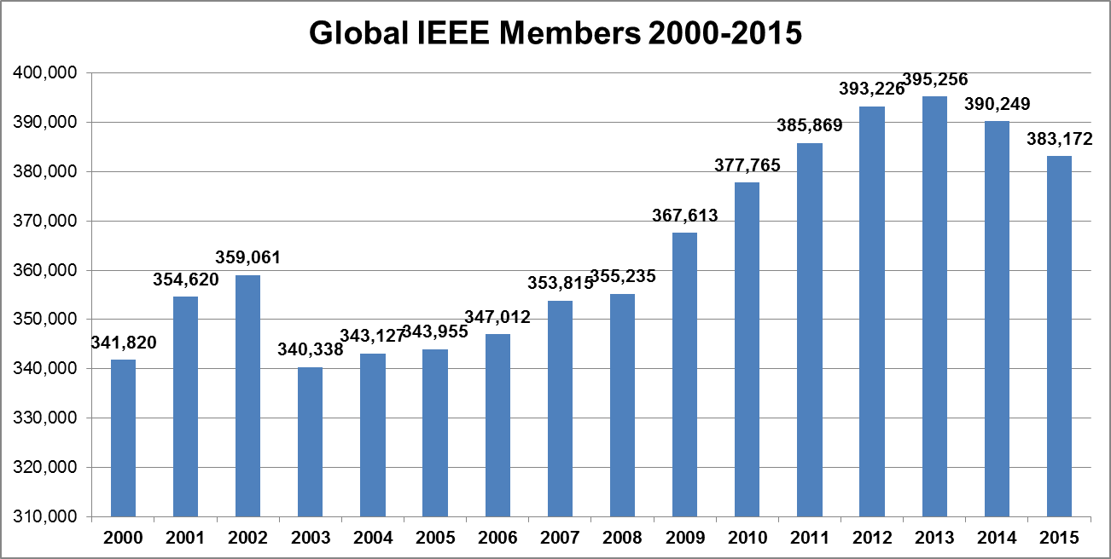
Overall Membership Trend as of August
Source: August Membership Stats (Membership Year End)

Slide 14

How Membership Grows
September thru August
2015 Renewals*
273,492
Reinstates
18,171
2016 Renewal Opportunity
380,735
New Recruits
89,072
* 2015 Renewal Opportunity: 388,478
Retention is the biggest determinant of whether or not total membership will grow year-over-year
  We lost 114,986 members* (higher grade + students)
  Of those roughly 60% were first year members
Total membership in August is the renewal opportunity for the following membership year
Notes:
Total membership in August is determined by the sum activity that has occurred September through August
Renewals of existing members – 2015 Opportunity: 388,478
Recruitment of new members
Reinstatement of former members
Retention is the dominant and probable determinant of whether or not total membership will grow year-over-year
Total membership in August is the renewal opportunity for the following membership year
Renewal is not just a student issue – showing same trends in higher grade

Slide 15
The Value of Membership

Slide 16

Definition of “Value”
Webster’s Dictionary offers eight variations in the definition of “value”. We’ll focus on:
a fair return or equivalent in goods, services, or money for something exchanged
relative worth, utility, or importance
something (as a principle or quality) intrinsically valuable or desirable

Slide 17
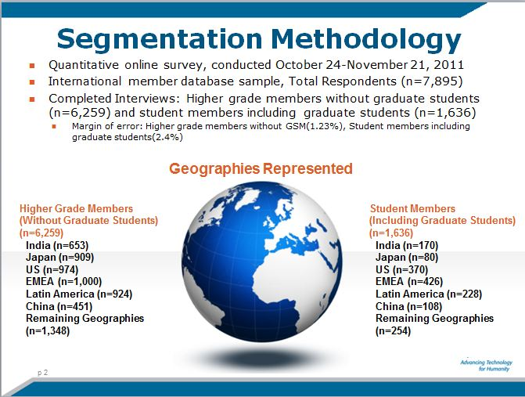
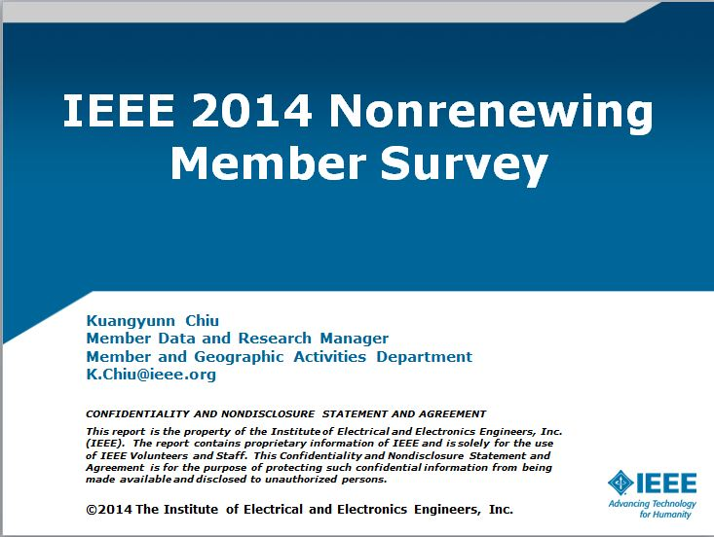
Member Research Studies
Segmentation study
  Every 3 years
  Identifies key segments of membership
Non-renewing member survey
  Relevancy based on the make up of the section

Slide 18

What We Learned…
Five areas consistently rated most important by members:
  Ability to Stay Technically Current
  Networking
  Continuing Education
  Career Services
  Discounts
These are very broad categories
Not all benefits are relevant to every Section or Member

Slide 19
We Need to Know…
What do your Members value?
  Deeper than the broad categories
  Everyone’s definition is different
Discussion Topic:
What do you “value” from your IEEE Membership?

Slide 20

Key Takeaways
Serving the needs of EVERY individual member requires multiple strategies
Plan around the specific interest categories of your members
Don’t go it alone
  Understand and serve your members’ needs so they can grow and develop in the profession.

Slide 21
Getting to Know Your MD Resources

Slide 22
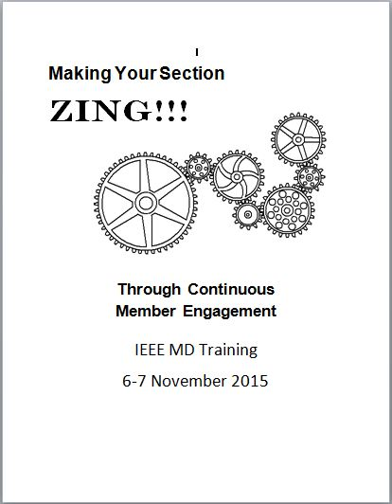
Making Your Section Zing
Presented at the 2015 IEEE-USA Annual Meeting
  Charles Lord, Region 3
Adapted for use during this training
Used to capture:
  Ideas you like
  Ideas you can implement

Slide 23

2016 MD Workbook
Membership Development Plan provided by IEEE Member Market Development
Designed to be an addendum to the Membership Development Manual
Workbook/Planning Guide for our MD efforts in the coming year.

Slide 24
MD Report Resources
Data is the backbone of understanding and growing membership
Membership Development Portal
  Tools, templates, links and resources
  www.ieee.org/md
Section Vitality Dashboard
  Pre-defined reports for your Section
  www.ieee.org/vitalitydb
MD Monthly reports
  Global, regional
Monthly MD Webcasts
Notes:
There is a Global report however we really want to focus on the Region and Sections.

Slide 25
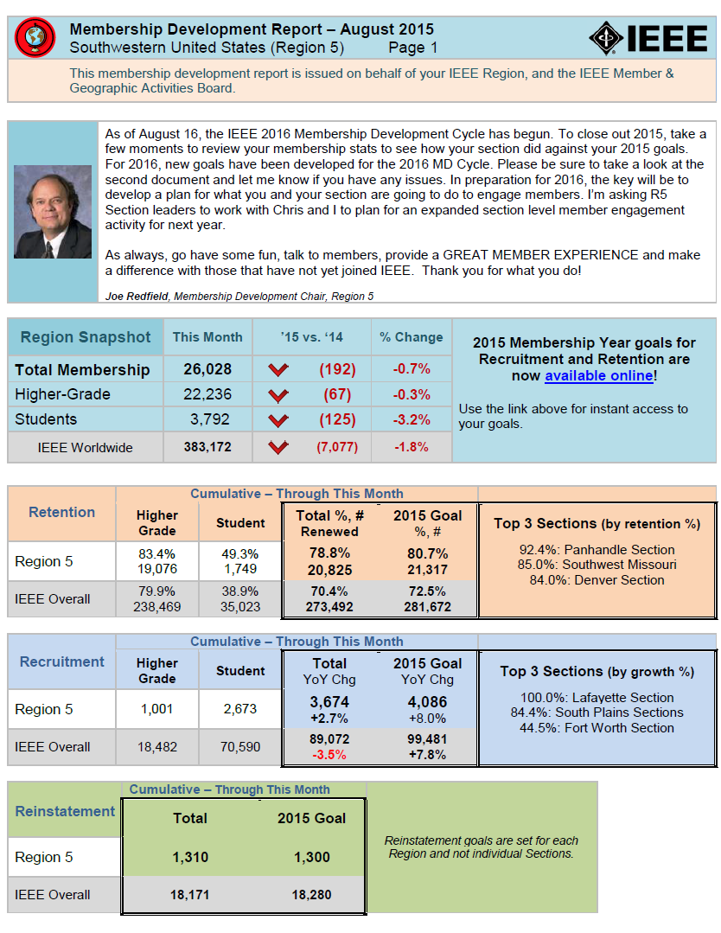
Region MD Reports
Region-specific data and trends
Section-level data
  Recruitment
  Retention
  Overall membership
Section-level progress to MD goals
Sent by Region MD Chair

Slide 26
Know Your IEEE Section

Slide 27

Step 1: Learn About Your Section
Research Your Section
  Identify meetings and events
  Perform SWOT Analysis
  Focus on factors impacting member engagement and recruitment
Generate a List of:
  What is Happening?
  When?
  Where?
  Who is responsible?

Slide 28

Identify Meetings/Events
vTools Meetings
  meetings.vtools.ieee.org
IEEE Events and Conferences
  www.ieee.org/conferences
Section Vitality Dashboard
  has a tab for each

Slide 29





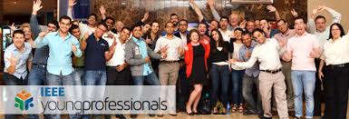
Step 2: Identify Chapters and Affinity Groups
Run Officer report in Vitality Dashboard
Make contact about potential partnership opportunities
  Upcoming meetings and events
  Create new programs
An absence of Affinity group(s) presents an opportunity

Slide 30


Step 3: Meet with Section
ExCom
Main Objectives:
  Get ExCom buy-in for plan
  Discuss past meetings/activities
  Identify upcoming meetings/activities
  Use MD Planning Workbook to collect data
Review or Execute SWOT Analysis

Slide 31
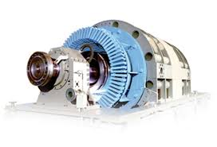
Step 4: Generate Your Plan
Map out a calendar of current activities
Identify opportunities for engagement and recruitment
Review the plan with your partners frequently
This is a living document that is meant to be passed down to future Section leaders.

Slide 32
Know Your Members

Slide 33
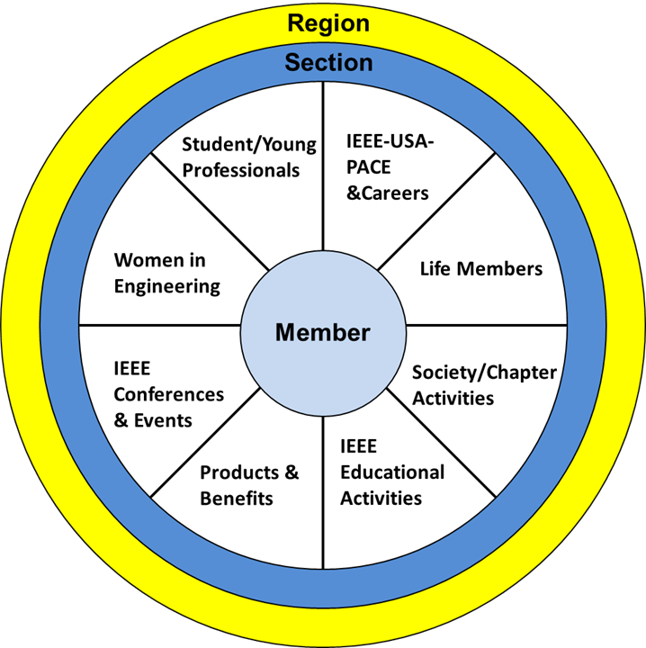
Member View of IEEE
We want to make IEEE our members’ professional home
Notes:
Underwent an overhaul based on discussions with your fellow volunteers
We know:
This isn’t a perfect model
Some Groups operate outside of the Geographic Paradigm
But these are still happening locally
Not all Sections are the same, just like members.
What may work in one, won’t work in another

Slide 34

Know Your Members
The average member:
  Interacts locally through
    Societies
    Section
  Will participate in activities that:
    Have practical applications
    Benefit their community
    Provide a benefit to them individually
You play a pivotal role in making IEEE your members’ professional home
Are you offering what your members “value”?
Notes:
Commit to projects without knowing details:
Time Constraints
Goals of project
Their Role

Slide 35
Managing Member Engagement
Need to understand how the member wants to interact with the Section
  Not just about member interests
  What type of activity will get them to engage
Best Practices:
Option 1:
Focus Group
Option 2:
Member interest Survey
Option 3:
Use Member Data

Slide 36
So How Do We Assess Member Needs and Interests?

Slide 37
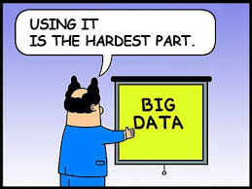
Step 1: Use the Available Data
Collected via the membership application
  Profile data is self-reported
Available via SAMIEEE/Section Vitality Dashboard

Slide 38
Member Interest Profile Data
Member Interests | Technical Interests | Subs & Pubs
Networking | TIPS Subjects | Society Memberships
Career Opportunities | TIPS Level of Interest | Tech Communities
Technical Info/Pubs | Line of Business | Technical Councils
Local Activities | Job Title | Publication Subscriptions
Humanitarian Programs | Job Function
 | Job Responsibility
 | Current Tech Focus
 | Other Tech Focus
Notes:
Member Interest and Technical Interest categories are the self-reported interests from the member application.
Subs & Pubs stands for Subscriptions and Publications
Based on what the members actually purchased

Slide 39
New SAMIEEE Queries
Under MD Pre-Defined Queries
  (MD) Member Interest Profile – Publication Subscriptions
  (MD) Member Interest Profile – Society Membership Pivot
  (MD) Member Interest Profile – Tech Community Membership
  (MD) Member Interest Profile – Tech Council Membership
  (MD) Member Interest Profile - TIPS
www.ieee.org/samieee

Slide 40
Other Useful Queries and Reports
    (GEO) Active Society Memberships for Active IEEE Members
(GEO) Potential Interest Profile of Member
(MD) New Member Interest Info for Active IEEE Members
For a list of 50 useful SAMIEEE Queries
  Speak to Ed Perkins or Ron Jensen

Slide 41

Step 2: Analyze the Data
Gap analysis for Section
  What is offered vs. member interests
  If needed add fields to queries
    Zip code, city, school, education
Use data in member engagement planning activities

Slide 42
Step 3: Advocate Data Update
Find opportunities to ask members to keep their profile data current
  TIP, address, employment, education, etc
Handled through myIEEE
  www.ieee.org/myieee

Slide 43
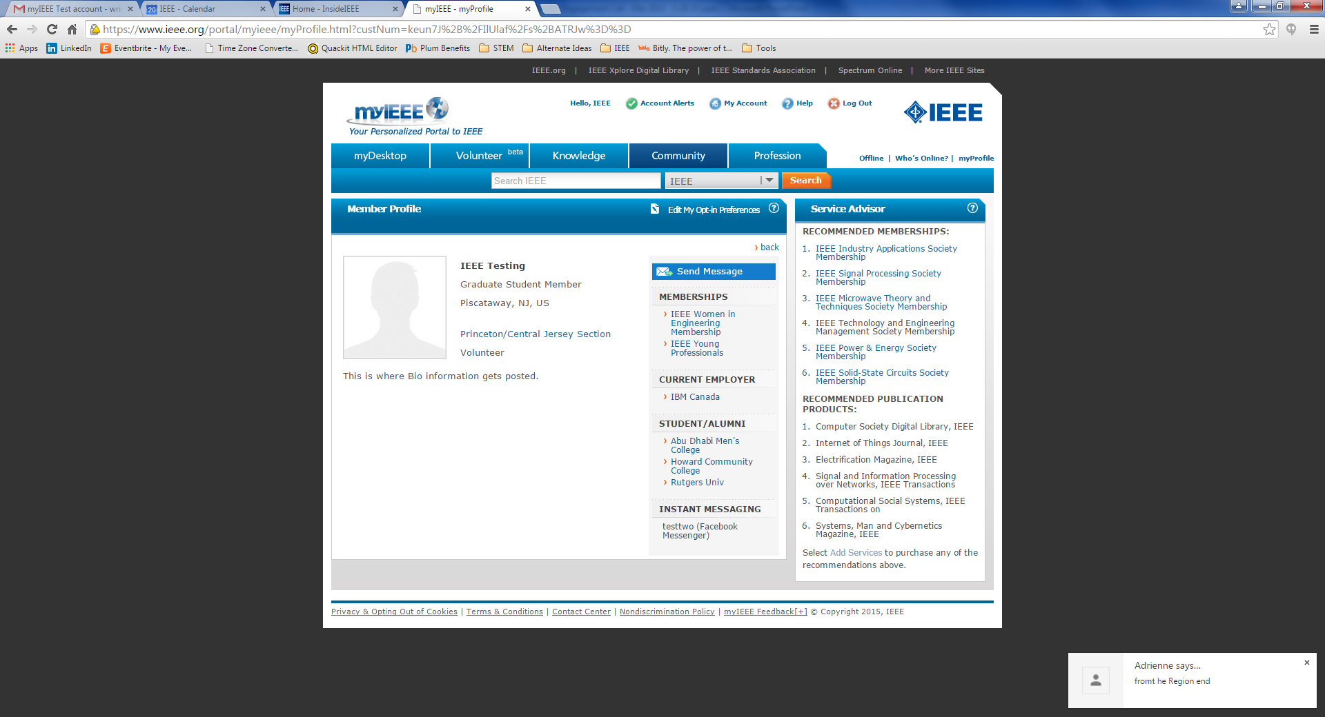
myIEEE Profile Page

Slide 44
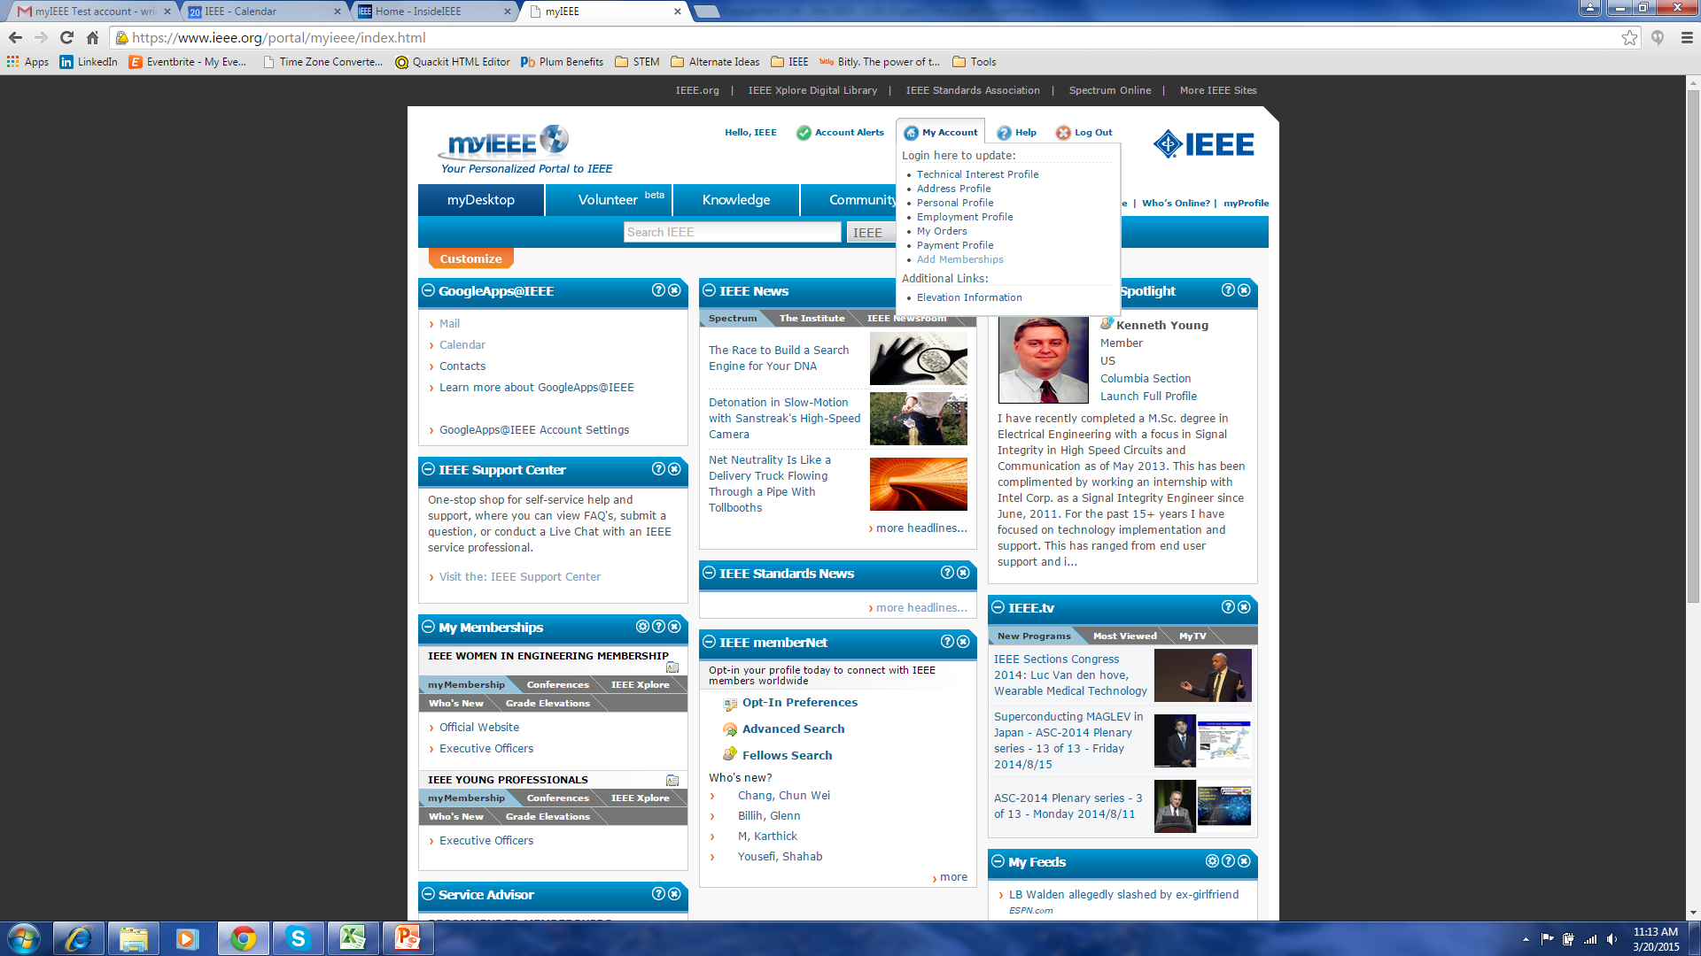
Updating myIEEE

Slide 45
Wrapping Up – What’s Next
Here’s what we’ve covered
Here’s what you need to do with it
Follow Up

Slide 46
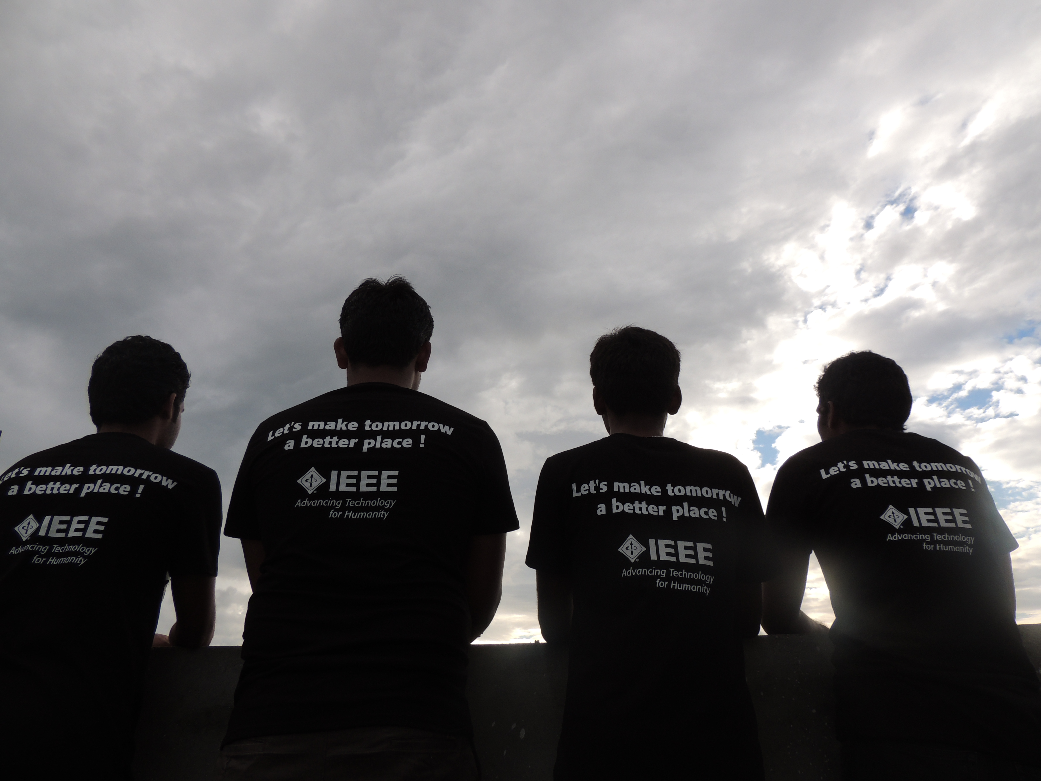
THANK YOU!
Thank You!!!

Slide 47
Appendix

Slide 48


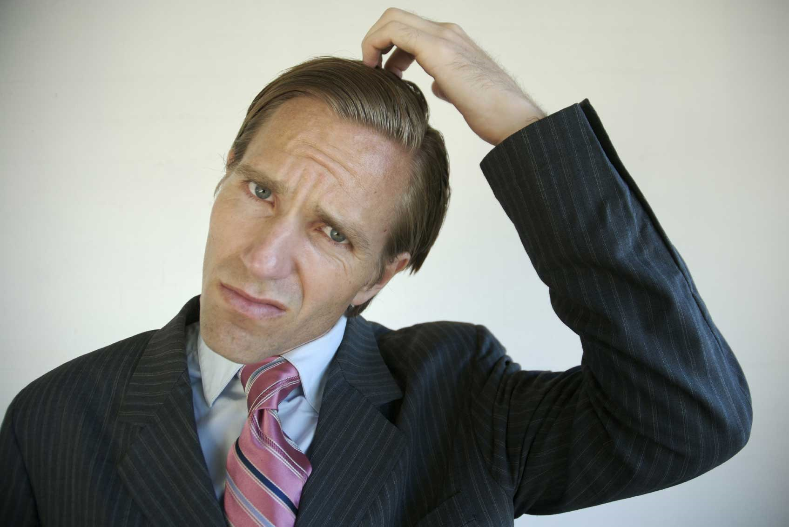
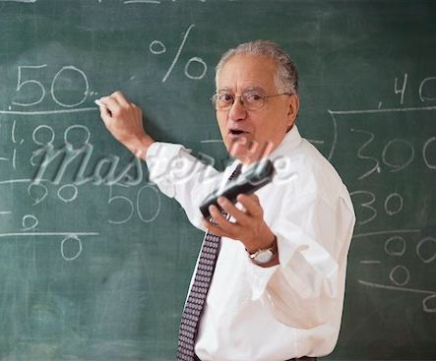
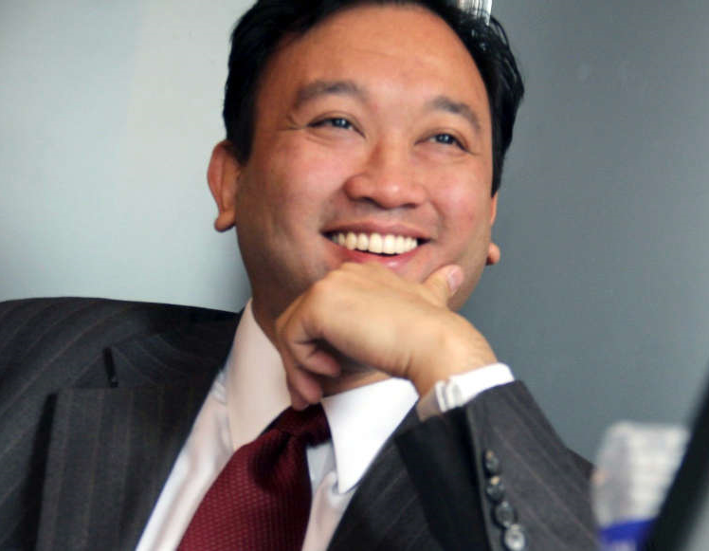
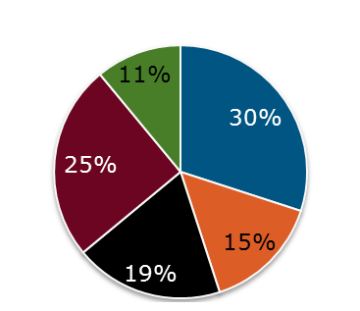
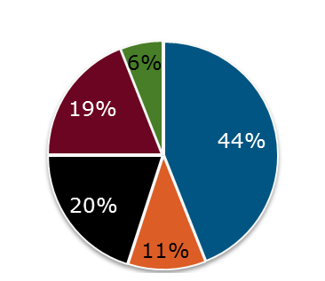
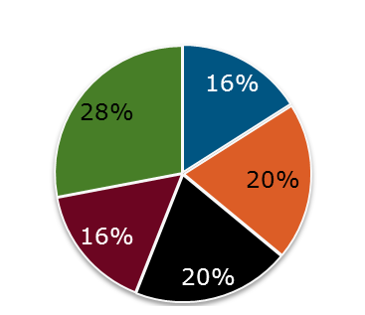
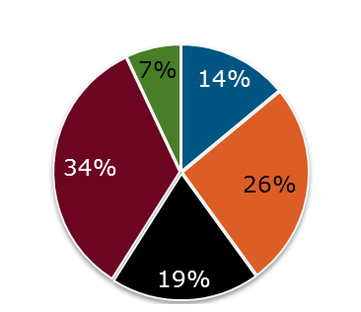

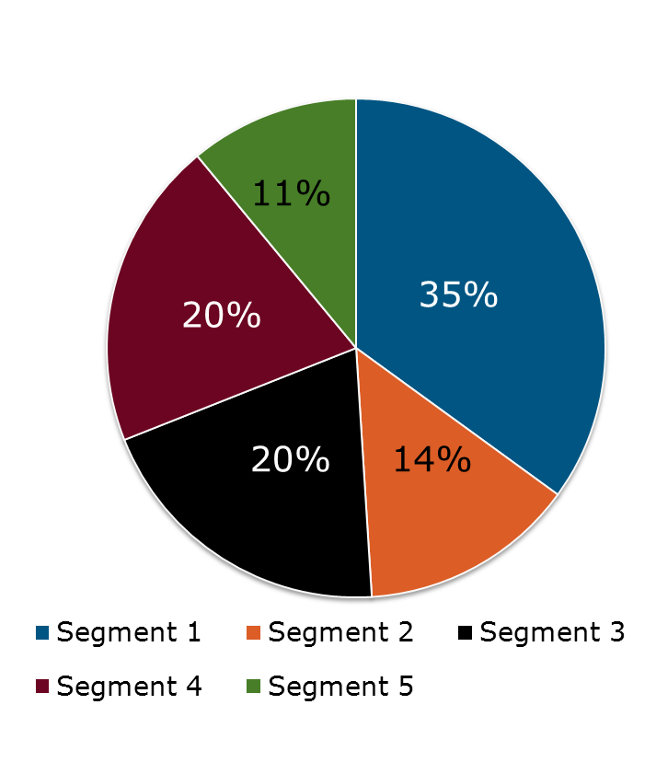
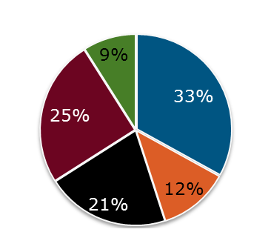
Higher Grade Segment Distribution by Region
USA
Canada
Total
Europe, Africa, Middle East (EMEA)
Latin America
Asia/Pacific

Slide 49


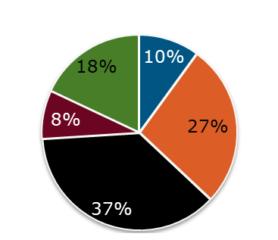
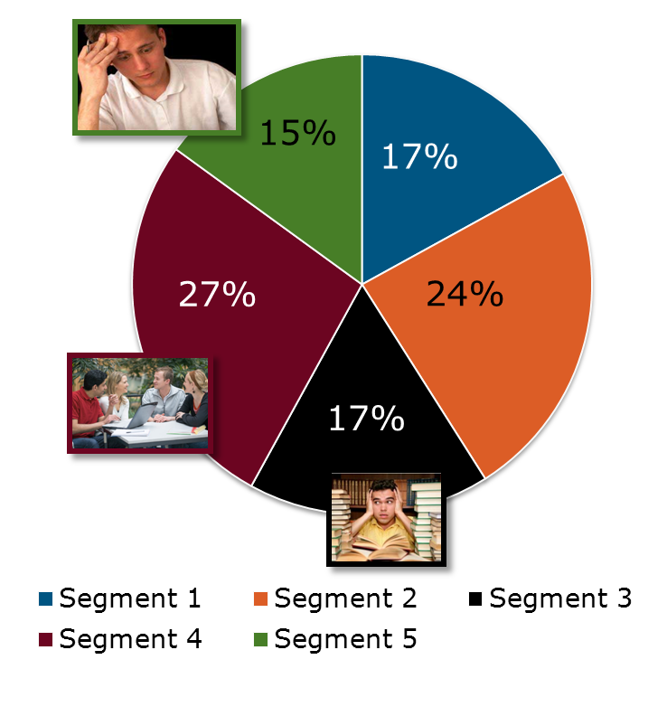
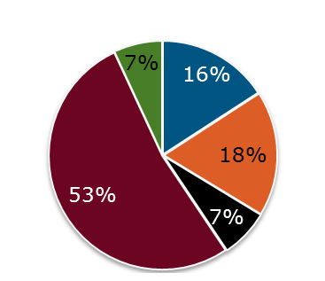
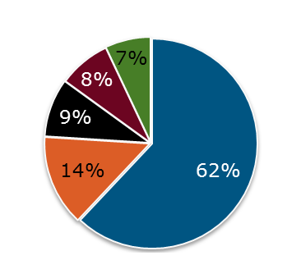
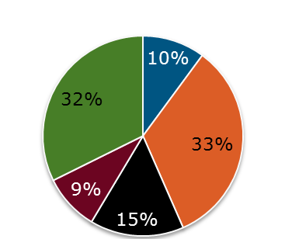
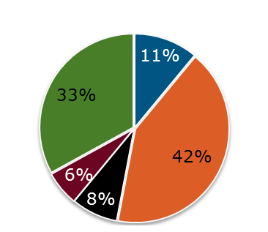
Students Including Graduate Students Segment Distribution
USA
Canada
Total
Europe, Africa, Middle East (EMEA)
Latin America
Asia/Pacific

Slide 50
How to Find and Leverage Volunteers
November 2015

Slide 51
Objective
Assist Section leaders in finding new volunteers
Overview of Volunteering
Where to Find Volunteers
How to Find Volunteers
Volunteer Job Descriptions
Open discussion

Slide 52
Why Volunteer?
As an IEEE volunteer, you can:
  Take pride in participating in activities that interest you
  Expand your technical
  knowledge
  Gain valuable management and leadership skills
  Connect with others in your profession
  Give back to your profession
  These are five key points to reinforce when soliciting volunteers

Slide 53
“6 Ways to Keep Volunteers Engaged”
Make your volunteers feel needed and appreciated.
Ask volunteers to help in specific, actionable ways.
Inspire your volunteers with the cause, not the organization.
Stay connected, and make sure your communication channels go both ways.
Develop a community of volunteers.
Show your volunteers how they made a difference.
Source: http://blogs.volunteermatch.org/engagingvolunteers/2013/01/31/6-ways-to-keep-your-volunteers-engaged/

Slide 54
“5 Surprisingly Easy Ways to Lose Volunteers”
Lack of clear organization
No concrete goals
Failing to recognize their contribution
No strong leadership
Lack of training or investment
Source: http://blogs.volunteermatch.org/engagingvolunteers/2015/02/23/5-surprisingly-easy-ways-to-lose-volunteers/

Slide 55
How Do We Find Volunteers?

Slide 56

Where to find Volunteers
How do you find those to talk to?
  At work events – internal and external
  Church or other organizational activities
  At IEEE (or other technical) meetings
Potential IEEE candidates
  Life members/ new Life members
  Members moving into the Section
  Student Members
  Recent graduates starting jobs in the Section
  From SAMIEEE searches

Slide 57
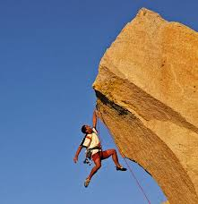
Challenges to finding volunteers
New members are asked to volunteer but…
  Asked to take on overwhelming tasks
  The task isn’t well defined
  Ultimately scare them off
Every Section has their needs
But do they match what the member needs/wants?

Slide 58
Step 1: Section Needs Assessment
So far, you have:
  Identified what you’re
  Section is doing
  Identified member interests
  The gaps where members
  are not being serviced
  Created a base plan
Need to identify:
  The tasks/jobs involved
  Where you need help

Slide 59
Step 2: Create Job Descriptions
Give details on:
  WHAT the opportunity is
    Clear vision of outcome
  WHERE it is
  WHAT is the time commitment
  WHAT the project means to the
  Section
  WHAT the member will contribute to IEEE by volunteering
Break projects down into manageable tasks – don’t make it overwhelming
  Be creative in the opportunities offered

Slide 60

Step 3: Match Section Needs to Potential Volunteers
Use the member interest data from your planning
From conversations and member analysis
  Identify member skills sets
  Match the opportunity to the
  member’s:
    Interests
    Experience
    Needs
Need to engage members and ASK
Have a few opportunities in mind, but be FLEXIBLE
Notes:
Appropriate: Speaking to a Senior Leader of Industry who is skilled at strategy development, maybe ask them to help with the strategy of the Section.
Maybe not-appropriate: Ask that senior Leader to be a greeter at the door.
Appropriate “Ask” will most likely lead to further Section involvement and volunteering

Slide 61
Know Your Volunteer Pool
The average volunteer DOESN’T want to:
  Commit to a project without knowing the time constraints
  Volunteer without a clear understanding of:
    The goals
    The role they play
  “Administrative” duties
They DO want to:
  Participate in practical projects
  Help themselves as well as their community
  Feel pride in their organization

Slide 62
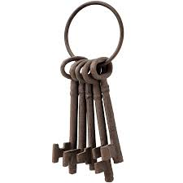
Keys to Remember:
Some members won’t want to do what the Section needs
Knowing what the other sub-groups/chapters in your Section are doing offers more opportunities for volunteer suggestions
Go ASK your members to do SOMETHING

Slide 63
Volunteer Job Examples

Slide 64
Job #1: Event Greeter
Section XYZ needs one or two volunteers to greet people coming to ABC Meeting.
Key Activities include:
  Make sure all attendees feel welcome
  Introduce new members
Location: University of Texas, Student Union
Time commitment: 2 hours

Slide 65
Job #2: New Member Advocate
Section XYZ needs someone to send email /call/etc new members as they join the Section
Key Activities
  Welcome new members
  Listen to what they want to get out of membership
  Provide details on activities and events that may interest them
  If we don’t have one, suggest that they might volunteer to start one
Time commitment: Once a week for 2 hours

Slide 66
Collecting Volunteer Information

Slide 67
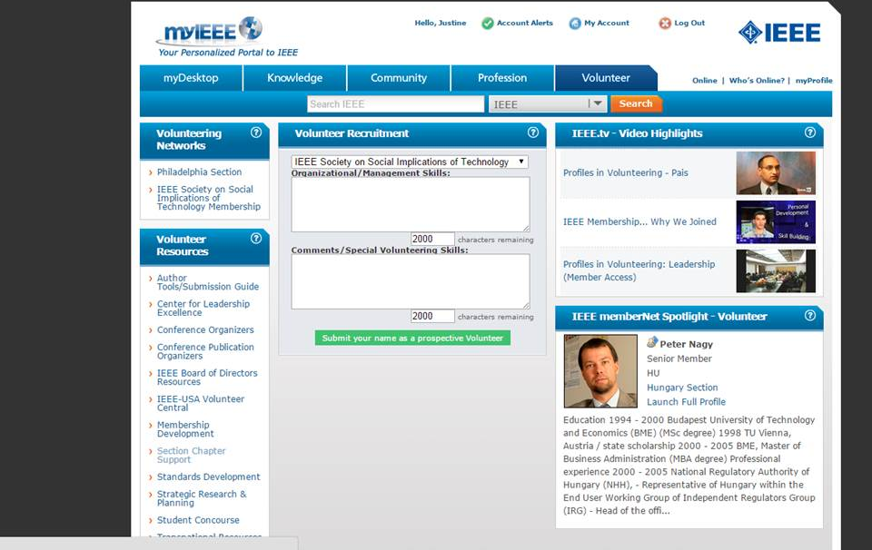
MyIEEE - Member Volunteer Tab
Tab in myIEEE available to members to raise their hand to volunteer
Notes:
This tab should be socialized and promoted to the members as it is a lead generation tool for Section leadership

Slide 68
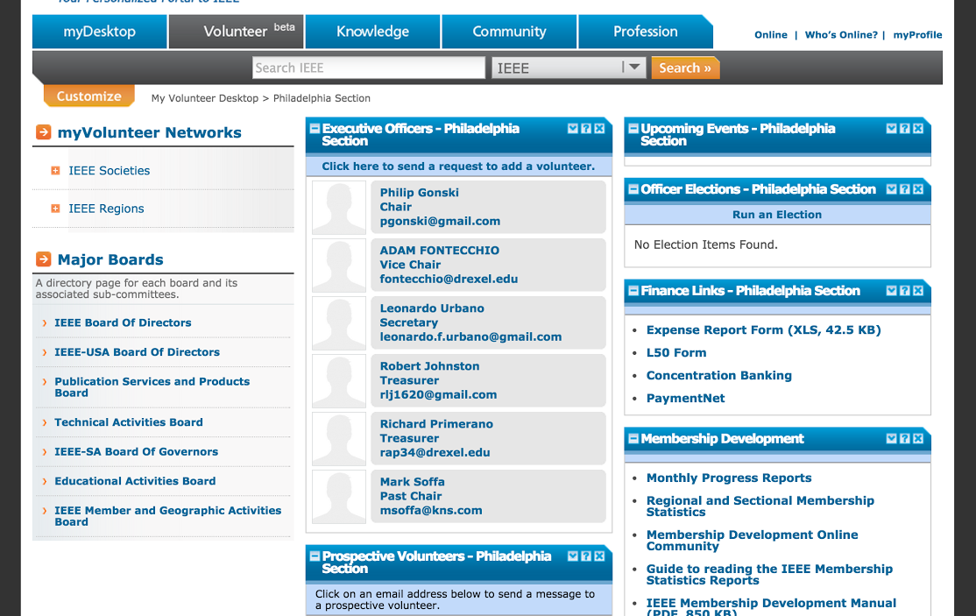
Volunteer Tab of myIEEE
Tab in myIEEE available to Section leaders which lists those members willing to volunteer

Slide 69
Create a Volunteer Form
Simple form capturing:
  Volunteer Name
  Contact Info
  Interests
Locate it on the Section Home Page
Region 6 used this for a Region-wide Volunteer Opportunity

Slide 70
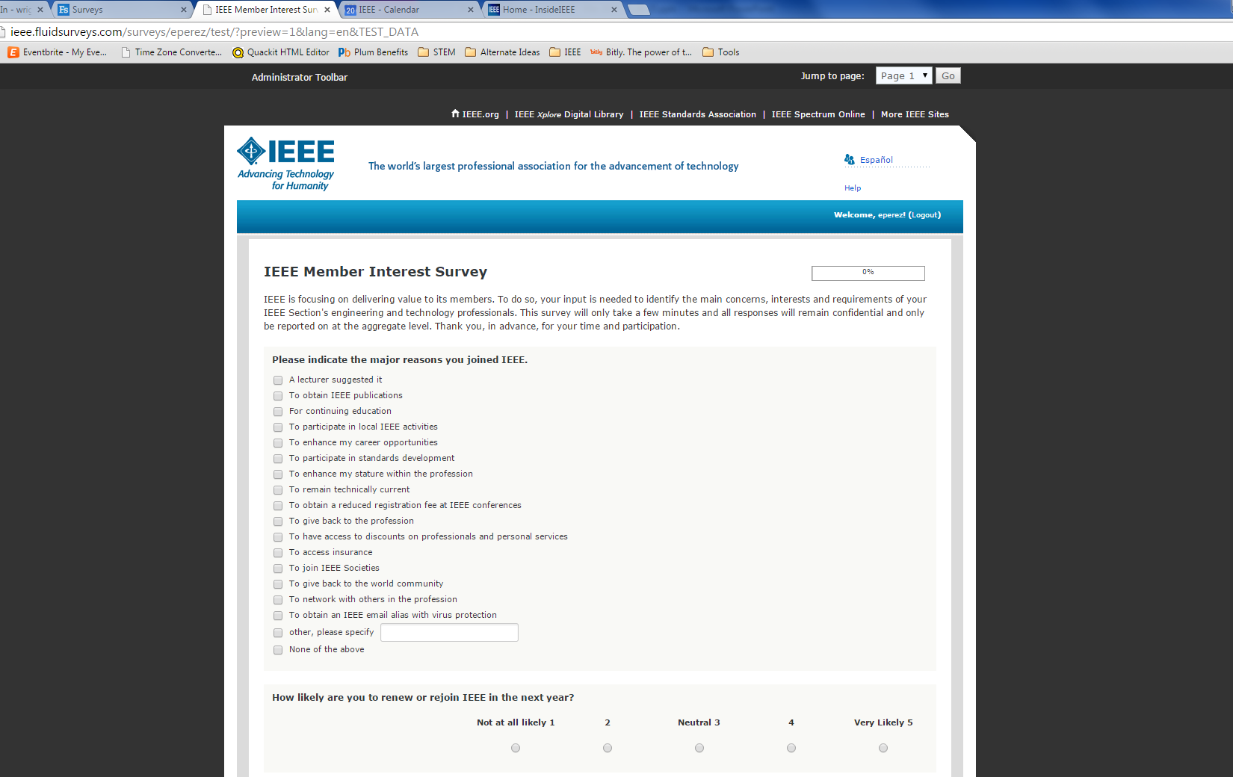
Volunteer Interest Survey
Could run a survey to active members on volunteering
Available through vtools surveys:
https://surveys.vtools.ieee.org/

Slide 71
Action Plan… Where do we go?
Assess your Section needs
Start creating volunteer job descriptions
Get to know your members
Go ASK your members to do SOMETHING
Can start this NOW…
  Volunteers are cultivated over time!

Slide 72
MD Best Practices
November 2015

Slide 73
Communication Best Practices

Slide 74
Where Do You Start?
Develop a multi-channel communications strategy focusing on the following groups:
Current Members
Non-Members
1st Year Members
Renewals/
Arrears
Prospects
Former Members

Slide 75
Basics of Membership Planning
Map out your Section’s calendar of events
Tailor your messages to members’ interests
Monthly Section outreaches to:
First Year Members | Prospective Members | Renewed Members
Welcome them to the Section | Invite prospects to join | Thank you for renewing
Inform them of upcoming events | Reach out to inactive members | Communicate Section activities
Encourage them to attend New Member Orientation |  | Emphasize the value of membership

Slide 76


Communication to Current Members
Start the Conversation…
  Learn about their interests first
  Communicate the value of membership based on interests
    Local value vs Global value
  Allow time for feedback
    Communication works two ways
Timing
  New Members: Monthly
  Renewals: Oct – Feb
  Arrears: Mar - July

Slide 77
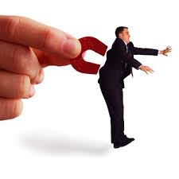
Communication to Non-Members
Prospects
  Invite them to join
  Detail the benefits and activities in your Section
Inactive Members
  Why did they leave?
  Allow time for their feedback
  Invite them Back

Slide 78
Personalized Communication
Do not hesitate to add the personal touch
  Why do you remain an IEEE Member?
  What do you value in your membership?
  Be sincere – you know how you want to be treated
Use data to tailor your communications by:
    Member interests
    Member grade
    Affinity group

Slide 79
E-mail “101”
Subject line: short and direct (< 50 characters)
Test content, personalization
  Include a headline
  First paragraph contains call to action – link to Join page
  Member testimonials when possible
  What is going on in the Section
Avoid heavy text and lots of paragraphs
  Let web pages do the heavy lifting
  Avoid attachments, use links

Slide 80


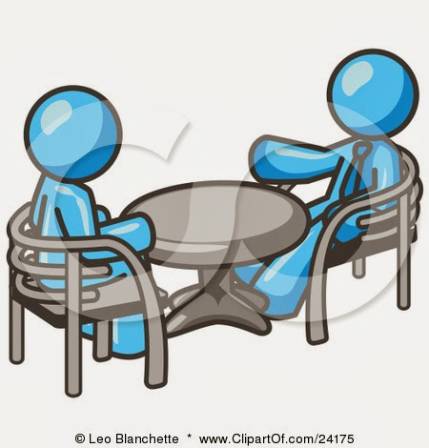
eNotice Communications
Enterprise e-mail tool accessible through vTools
eNotice requests take 5 days to process
Build in extra time for the request
  Don’t submit the request 5 days prior to the meeting/deadline
  Need to build in time to allow people to plan for the event

Slide 81

Keep the conversation going
Reach out more than once
  Ask when is a good time to follow up
  Pick different topic and/or benefit during each contact point
  Allow for questions
  ENGAGE!!!

Slide 82

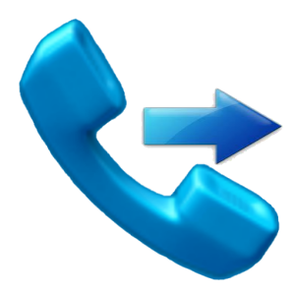







Communication Channels
Need to go beyond typical e-mail, but it still works
  So does postal mail!
Try a phone call!
  Utilize LM’s, students
Collabratec ^{T M} for MD
Rotating slide shows at meetings/events
Try social media

Slide 83
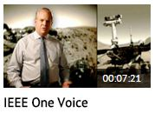


Promotional Resources
MD Portal
  www.ieee.org/md
IEEE Branding Resources
  Videos, templates and logos
  www.ieee.org/go/brand
IEEE Promotional Library
  Warehouse of ads for use in print and web
  Access via www.ieee.org/md
IEEE Experience channel on IEEE.tv
Membership Development Kits
  www.ieee.org/mdsupplies

Slide 84
Meetings/Events Best Practices

Slide 85

Meetings 101
Why do people come?
  Interesting topic and/or speaker
  Content relevant to their work (practical information)
  Opportunity to Network
  Location, location, location
  FUN, FUN, FUN

Slide 86
Conference Member Recruitment Program (CMR)
Incentive program for those who join at an IEEE technical conference
  One free Society membership with higher grade membership
  Set up in advance by event planner
For details, visit: www.ieee.org/cmr

Slide 87
Engagement Event/Activity ideas
Networking Events
Senior Member Elevation events
Technical Event with a Local Company
Socials/Happy Hour
Have members bring a friend
Host a Metro Area Workshop

Slide 88

Enhancing the Experience
Ensure satisfaction for attendees
  Have Support Staff to answer questions
  Have Volunteers to greet attendees
Identify/engage audience segments
  New members
  Non-members
Utilize video – IEEE.tv - IEEE Experience Channel
  https://ieeetv.ieee.org/channels/ieee-experience

Slide 89

Make It Easy to Join/Renew
Best Practices
  Best Option: Wi-Fi enabled device, linked to Join and Renew Page
  Better Option: Paper Applications
  Good Option: Capture those interested on a list for follow-up
Why use Wi-Fi Option?
  The enhanced join process takes less than 3 minutes to fill out
  Mobile optimized too

Slide 90
Retention Best Practices

Slide 91

First Year Engagement
Retention begins the day a member joins
Don’t forget “Welcome”
communications
Recognize them in:
  Newsletters
  Section website
Host a Welcome Event
  Not Possible? Invite them to upcoming events
  Make sure someone welcomes them

Slide 92
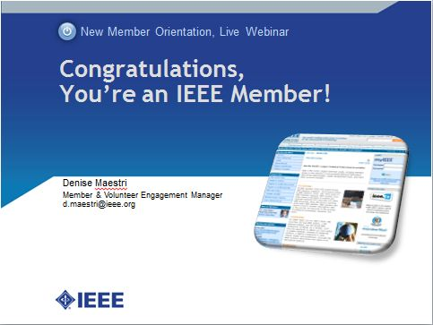
New Member Orientation
Hosted by MGA Staff
Held monthly, typically on
the 4th Thursday
30 minute presentation,
30 minute Q & A
  Getting Connected/Participation
  Benefits
  Member Discounts
  Check out www.ieee.org/start for details

Slide 93


Member Loyalty Program
Recognize members for their years
of service as a member
  Lapel pin and certificate
Increase member loyalty and retention
  Specifically within the first five years
  Distinct from grade advancement
Tiers by cumulative years of service
  2, 5, 10, 20, 25, 30, 40, 50
For Details: www.ieee.org/loyalty

Slide 94

Senior Member Elevation
Get more Senior Members, increase retention!
Senior Members renew at a much higher rate
  96.0% versus 70.7% overall retention in 2014
Regions have annual goals (1% of eligible members)
New brochures and web ads are available
Online resources for holding SM elevation events
www.ieee.org/seniormember

Slide 95
Recruitment
Best Practices

Slide 96
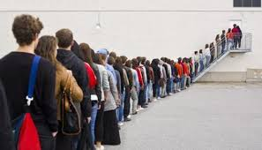
Do You Have A List?
Build a contact list of non-members
Collect at meetings, activities or from those who reach out to your Section
Use Inactive Members list from the Section Vitality Dashboard

Slide 97

Member-Get-a-Member (MGM) Program
20% of IEEE annual recruitment
Members earn rewards for referring new members
  Use toward renewal, other products
  Annual max. award of $90 per member
For details, visit: www.ieee.org/mgm

Slide 98

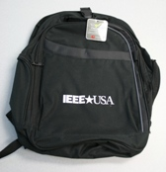
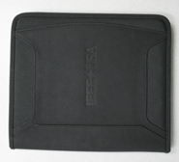
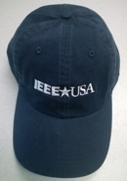
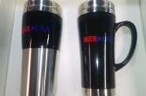
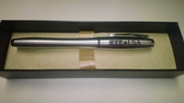
Member-Get-A-Member
Program
Refer a member
Referral receives $25 incentive to join
If they join, referrer receives a piece of IEEE-USA Merchandise
Incentives are in addition to the regular MGM program
ieee.fluidsurveys.com/s/ieee-usa/

Slide 99


Revamp Your Section Website
Have a prominent link to join
  Use the ad graphics in the IEEE Promo Library
Include member testimonials
Cross-promote your Section website
  Online forums, blog posts, etc
  LinkedIN groups
  CollabratecTM
  Chapters and student branches

Slide 100
Case Study: Plans and Processes for Success
IEEE Columbia Section
Jacquelyn D. N. Cunningham, Chair
jdnc@ieee.org

Slide 101
Understanding the Section: 10 Point Plan
Compare and contrast the global view of IEEE with the local view of the Section.
Evaluate the Section within its environment, identifying its passions, shortcomings, opportunities, competitors. and internal/external threats.

Slide 102
Understanding the Section: 10 Point Plan
Align/Re-align the Section with IEEE, ensuring every member is connected to the Section via a clear path; every position has a description; and every position has manageable, finite tasks.
Set achievable goals and objectives for the Section that are grounded by members' profiles and IEEE ideals.

Slide 103
Understanding the Section: 10 Point Plan
Build a multi-tier, diverse leadership team that will help align the Section with IEEE.
Train the team to conduct the alignment, giving each volunteer flexibility to grow into his/her position.
Equip the team with knowledge, technology, and funds and/or a funding approach.

Slide 104
Understanding the Section: 10 Point Plan
Ensure effective and targeted communications with members.
Leverage SAMMIEE, VTools, a strategic Web presence, email, surveys, etc.
Attribute critical decisions, outcomes, and accomplishments as the work of the Section, as benefits to members and the communities being served.

Slide 105
Understanding the Outcomes
Consistently executing the business rules has impacted the following:
  IEEE Brand
    Influence, prestige, reach, customer service
    Other societies, boards, industries, pre-university, partners, programs, distinguished speakers
  IEEE Membership
    Value, benefits, growth, re/engagement, diversity, retention
  IEEE Member
    Passionate, development, micro-volunteer, community
  IEEE Resources Adoption
    MemberNet, JobSite, GoogleApps, MentorCenter, Funding, SAMIEEE, vTools

Slide 106
Retention & Growth
Plans | Year-to-Date 2015
2013 Volunteers (5) | 38
2013 Member Dev (466) | 534
2013 Student Branches (2 active, 1 inactive) & Chapters (2) | Branches (2a, 1i, 1 tba) Chapters (3)
2013 Substantive Meetings, Socials & Outreach (4); Avg Attend. (8) | Completed (9) & Upcoming (12) Technical Sessions (avg att. 65) Town Hall (exp. 50+) Middle School Sci-Fair (3 IEEE judges awarded $750 for “Best Distribution of Power” in SC Regional Future City Cmp)
2013 Relationships (3 Eds) | 17 = Boards (3), Eds (3), Sci-Fair (1), Industries (10 with 3 donors)
2016 Planned Activities | Technical Sessions with Network Receptions (24), Town Halls (2), Outreach (3), Conferences (4), Student Paper (3-5), Prof. Dev. (4), Socials (5-6)

Slide 107
Additional IEEE Resources Adopted
Columbia has also embraced:
  Member elevation
  CollabratecTM
  Young Professionals
  Women In Engineering
  EAB guidance for PDHs
  Support for PE licenses
  Interdisciplinary engineering and membership
  Our strategic website.

Slide 108
Member Segmentation Analysis

Slide 109

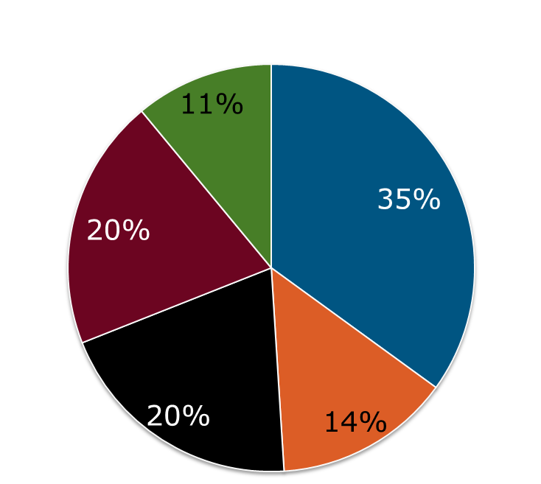
2012 Member Segmentation
Higher Grade Members
Segment 5
  - At IEEE for Technical Content.
  - Not connected to mission of IEEE
  - Tend to have language barriers
  Segment 1
  - Disengaged older members
  - Not inclined to give back to IEEE
  - Prefer others to lead
  - IEEE mission is less relevant
Segment 4
Younger members
Want to be more involved
  Do not know how
  Don’t feel invited
Feel products difficult to use
Lowest satisfaction
Segment 3
Engaged Older members
More concentrated in educational institutions
Interested in sharing with others
They are actively involved with both networking and volunteering.
Most satisfied with IEEE
Segment 2
  Young members
  Connected to IEEE’s vision
  Want to be more involved
  Career services, networking, continuing education are very important
  Use Social Media

Slide 110





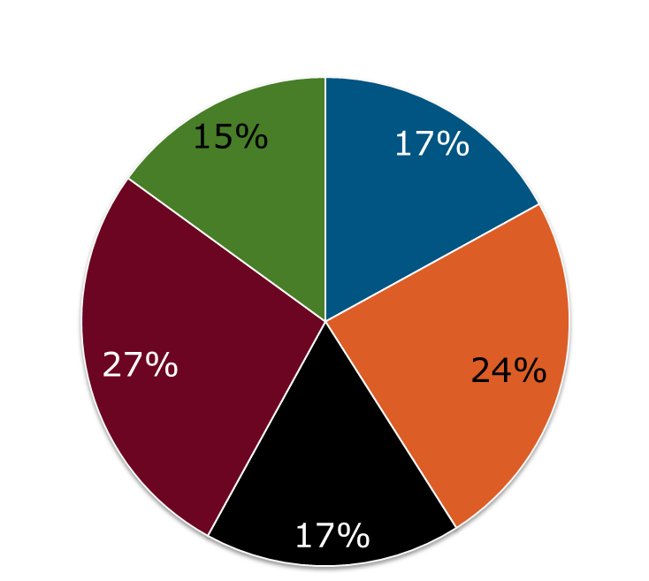
2012 Member Segmentation
Students Including Graduate Students
Segment 5
  Dissatisfied with IEEE.
  Unclear on the benefits offered
  Feel the role of IEEE is unimportant.
  Segment 1
  Highly engaged
  Take on leadership roles.
Segment 4
Satisfied with their current connection to IEEE.
Feel the activities are expensive
Have interest in continuing education and networking.
Segment 2
  have both the time and desire to be more active in volunteer and leadership roles, but…
  …have not been asked and do not know how to get involved.
Segment 3
Undergraduate students with part-time employment
Value IEEE’s career resources
Do not feel it is essential to be involved with the organization.

Slide 111


A Primer: The Experience Cycle
Satisfaction Continuum
Advocacy
Awareness
Where do you think the majority of IEEE members would fall?
Passive Satisfaction
Interest
Action
Ambivalence
Passive Dissatisfaction
Active Dissatisfaction
Notes:
Note: At IEEE we have two additional steps of the cycle that relate directly to engagement: Influence and Ownership.

Slide 112
Satisfaction drives a healthy business
Increased Retention
Every 1% Increase in Higher Grade Retention = ~$200,000 in Dues
Increased Referrals
Currently 65% of recruitment is driven by referrals
“Great” satisfaction will drive a higher percentage of referrals from a larger number of members
Larger number of members to purchase societies, optional publications, and other services
Economies of Scale
Allows fixed costs of membership to be spread across a larger number of members
Improved Satisfaction

Slide 113

Satisfaction alone is not enough!
It matters how, and how often, experiences occur
Satisfied
Engaged
Image from Bain & Company: http://www.bain.com/publications/articles/what-it-takes-to-win-with-customer-experience.aspx

Slide 114
Sum of the touch points is important
New Join
Discovery
Communications
Product Use
Satisfaction
Relevant welcome calls from IEEE my Section/Chapter
Elegant well designed interfaces across IEEE that save me time
Communications relevant to my needs, in the method & timing I want
Consistently relevant high quality products that I need
-or-
-or-
-or-
-or-
No order errors, and an e-mail welcome
I eventually get to what I need, but it is clunky or cluttered
I get some e-mails, but not too many, and sometimes they are relevant
Some products are good, others are not valuable
-or-
-or-
-or-
-or-
Memberships incorrect and difficulty finding help
I can’t even get help with what I’m looking to find
I feel like I’m getting Spammed and I can’t do anything about it
Products are out of date or irrelevant, and waste of my time

Slide 115
Sum of the touch points is important
New Join
Discovery
Communications
Product Use
Satisfaction
Relevant welcome calls from IEEE& my Section / Chapter
I eventually get to what I need, but it is clunky or cluttered
Some products are good, others are not valuable
I feel like I’m getting Spammed and I can’t do anything about it

Slide 116
Shouldn’t the experience be...?
New Join
Discovery
Communications
Product Use
Satisfaction
Relevant welcome calls from IEEE & my Section
Elegant well designed interfaces across IEEE that save me time
Communications relevant to my needs, in the method & timing I want from my section, chapter, etc.
Consistently relevant high quality products that I need

