Slide 1
Region 6 Fall Excom Briefing
Tom Coughlin
Region 6 Director
November 2015

Slide 2
Outline
Today’s Meeting
2015 Region 6 Accomplishments
2016 Region 6 Plans

Slide 3
Today!!!

Slide 4
Vol-un-teer
My definition: A really generous person who contributes their time, passion and vision to help get things done and change the world
Dictionary: A person who freely offers to take part in an enterprise or undertake a task.

Slide 5
IEEE Region 6 Objectives, 2015
Respect and enable the volunteer
Enhance membership and improve retention
Enhance our on-line experience
Create active alliances with industry and VCs
Create active alliances with academia
Create active alliances with technically oriented cultural groups and STEM
Recognize and celebrate our history
Region 6 recognition—get your MGA & IEEE award nominations in now
Make IEEE Region 6 cool, be creative

Slide 6
Region 6 - 2015 Initiatives
Membership in arrears recruitment and membership recognition
Region 6 conferences
On-line conferences
Chapter meeting recording
Program management for Region 6 activities
Creating alliances with industry and academia
Student and STEM Support
Region 6 IEEE Eng. Milestone Coordinator
Notes:
30,000 for ghtc, 2500 Sustech, 15000 Rising Stars

Slide 7
Region 6 PACE Highlights
We spent all our budgeted PACE money by June—first time ever! Great job to all the sections and branches that planned activities
We want all sections to do at least one PACE funded activity in 2015
We asked IEEE USA for some extra money this year for more PACE projects—we are getting some to help fund Rising Stars Attendence and some additional PACE activities
Can we do this again in 2016?

Slide 8
Region 6 - High Grade Members 2000-2014

Slide 9
Membership Initiative – Member to Member Renewal
Towards the end of February 2015 IEEE terminated membership for folks that didn’t renew their membership
From March 2015 to the end of May 2015 Region 6 began a pilot micro-volunteer program, with IEEE Membership Recruitment, to get IEEE volunteers to sign up to make calls to a list of 10 people in their section
We created an incentive program for callers who are able to get terminated members to renew
We had over 60 people who signed up to do these calls
Based upon the results of these calls we intend to repeat this activity next year

Slide 10
Member to Member Renewal Results
Region 6 volunteers reached out to 285 non-renewing members. Of the calls made 31.6% connected and 42.5% had a message that was left via voicemail or followed up with an email.
The effort paid off in that 19% of these contacts ultimately ended up renewing. The team was also able to gleen some valuable insights into why members did not renew.
Partially due to this effort our membership renewal numbers are much higher than in past year.

Slide 11
2015 Reinstatements Up in Region 6
September 2015 MD Report

Slide 12
Membership Initiative – Elevations
Associate to Member elevation information (this Is a very simple process): http://www.ieee.org/membership_services/membership/grade_elevation.html
Senior membership elevations
Let’s organize local activities to get eligible members elevated
This recognizes our members for their experience and may help with retention
We are close to making our senior members objectives for 2015
We need programs to encourage students to become full IEEE members

Slide 13
Senior Member Goal for 2015
We only need 86 more SMs!

Slide 14
Region 6 Conferences
WIE – May 23-24, 2016, Santa Clara
IEEE On-Line Career and Talent Expo (on-going)
GHTC – October 2016, Seattle, WA
SusTech –October 2016, Phoenix, AZ
Rising Stars—January 2-4, 2016, Las Vegas
SUSTECH 2013
Women in Engineering
International Leadership Conference
1st I E E E Co n f e r e n c e o n T e c h n o l o g i e s f o r Su s t a i n a b i l i t y

Slide 15
Virtual and Hybrid Conferences
IEEE Region 6 has acquired a license for a program available from the IEEE EAB for hosting virtual events
We used this capability for the first time for the 2015 Rising Stars Conference—also at RS 2016
This was used in the Career and Talent Expo and will be used for Rising Stars 2016
This functionality can be used for many different types of events…
Let’s start leveraging this, after the event if not during
This could give us a real presence even after the event is finished

Slide 16
Create an On-Line Collection of Technical Chapter Meeting Recordings
IEEE New Initiatives Comm. (NIC) funding of a pilot program in Region 4 and Region 6 into the Fall of this year
We are hosting these recordings—they are available for free to all IEEE members on our beta site
We intend to sell access to these recordings to non-members--enhance IEEE membership
We could have 100’s of these in a year’s time, 1000’s in 5 year’s time—this is cutting edge material
We are offering discounts for microphone packages and offering Camtasia licenses. We are doing training to section and chapter leaders—Contact Scott Tamashiro if you are interested in these packages (Scott Tamashiro (tamashiro@ieee.org) .

Slide 17
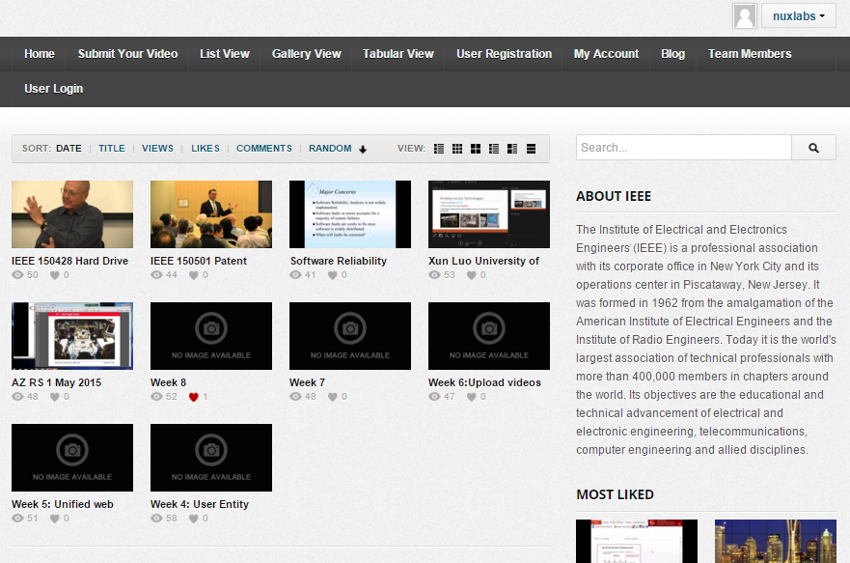
Recorded Meetings Initiative
Recording OU (Section/Chapter Meetings using Camtasia software and microphone sets
Videos are archived and can be easily searched with filter criteria
Phase I attracted 58 recorded meetings and 5032 total views
SSO and IEEE Cart Integration in progress for membership benefit differentiation and potential revenue generation

Slide 18
Contents Contribution (August 18, 2015)
- 57 recorded meetings contributed
Technical, Social, Administrative
32 recordings from R6
25 recordings from other regions/international conferences
5032 total views to streaming content, from 328 unique IP addresses
- 1282 views to steaming content from registered users = 33 views per registered user

Slide 19
Student Branch Rebates – Good news is that R6 is #1
Region | # Branches | Rebates | Rebate Rate
6 | 95 | 20 | 21.1%
8 | 449 | 91 | 20.3%
9 | 411 | 80 | 19.5%
7 | 57 | 10 | 17.5%
10 | 1061 | 146 | 13.8%
3 | 106 | 14 | 13.2%
4 | 68 | 7 | 10.3%
5 | 97 | 8 | 8.2%
2 | 84 | 5 | 6.0%
1 | 88 | 3 | 3.4%

Slide 20
Region 6 Student-Targeted Efforts
Improve student branches by improving section relations with their student branches.
Communication and supporting involvement in wider IEEE activities.
Improve effectiveness of area meetings for student members
Revising Student Leadership Training.
Making student competitions more relevant and appealing.

Slide 21
Region 6 is committed to STEM outreach
Funding for STEM outreach
It’s our future
It can be 3% or 33%...but not 0!
Even if it’s not YOUR cup of tea--Delegate! Frequently but not exclusively, a PACE function
Sections provide and communicate options to members, encourage involvement, publicize successes
Appoint a Pre-college Outreach Chair
Hold at least ONE precollege STEM event in 2015
Tell your Region about it!
See our website: http://ieee-region6.org/k-12-programs/

Slide 22
R6 Precollege Outreach Timeline for 2015
January: Commit my section to SOME outreach
February: Identify a PreCollege Outreach Chair
March: Region’s first mailing / mail list needed!
April: Have a plan for a visit, an event, an effort
May: Post each Section’s plan to Region website
June: Execute the visit, event, effort. Take pictures!
July: Provide at least one picture to Region
September: Post pictures to Region Website
October: Encourage further events
December: Recognize the Pt, Au, and Ag sections!

Slide 23
Other Initiatives
We are trying to use project management tools as well as micro-volunteering to make it easier for professional volunteers to help Region 6.
Region 6 has money available for local sections to host breakfasts or lunches with local industry leaders. In the Santa Clara Valley section they do this about once a quarter with about 30 companies participating
We are seeking IEEE Engineering Milestones in Region 6 and have a Region 6 Milestone coordinator who can help you with this process—Brian Berg, brianberg@gmail.com

Slide 24
Region 6 Assessment Increase
Region 6 had the lowest regular member assessment of any region ($1 per member)
Region 6 was able to increase this to $3 per member in 2016 (a gain of $2 per member)
This could give us over $90,000 more for the region 6 budget starting in 2016
We can use this to help fund new initiatives and also to start saving for the 2017 Sections Congress

Slide 25
Buy Region 6 Gear

Slide 26
Objectives for 2016 (1)
Expand the chapter recording effort to other regions but have Region 6 lead the way
Improve web site
Develop a culture of Region 6 chapter recording and uploading in 2016
Funding approved for continuation in 2016
Stop the membership decline in Region 6
More micro-volunteer opportunities—continue and expand effort for reinstatement in 2016
Target students and graduate students—student to full member transition
Our goal is to reverse the trend of R6 membership decline starting in 2016

Slide 27
2015 September Membership Info

Slide 28
Objectives for 2016 (2)
Streamline and organize R6 conferences
Doing this for GHTC and intend to expand this for our other conferences
Expand our joint regional OpCom to include Region 6, Region 4 and the Region 5 ExCom. Include IEEE USA awards on Saturday night
Generate 4 non-SF Bay Area IEEE Engineering Milestones in Region 6 in 2016
Expand our PACE spending in 2016 from its level in 2015—some Region 6 money and solicit additional memory from IEEE USA

Slide 29
Objectives for 2016 (3)
Create a link with Maker Faire, Science Fiction writers and other visionaries
Create a coordinated R6 SIGHT committee and incorporate humanitarian projects in our new student training initiatives
Create strong alliances between IEEE Region 6 and industry—create Region 6 Industrial Advisory Board
In general: More PACE, more STEM, more industry, more FUN!

Slide 30
Region 6 Partnership with Global Innovation Exchange

Slide 31
2016 Joint Region Meeting
Will include Region 6, Region 4 and the Excom from Region 5
Date for meeting is Friday 1/29/16 through Sunday 1/31/16
Location is the Excalibur Hotel in Las Vegas, Nevada
IEEE USA awards on Saturday
More information is forthcoming
Also we need to set up our dates for Spring and Fall Area meetings

Slide 32
Your IEEE Resources
ieee.org
ieee-usa.org
ieee-region6.org
students.ieee-region6.org

Slide 33
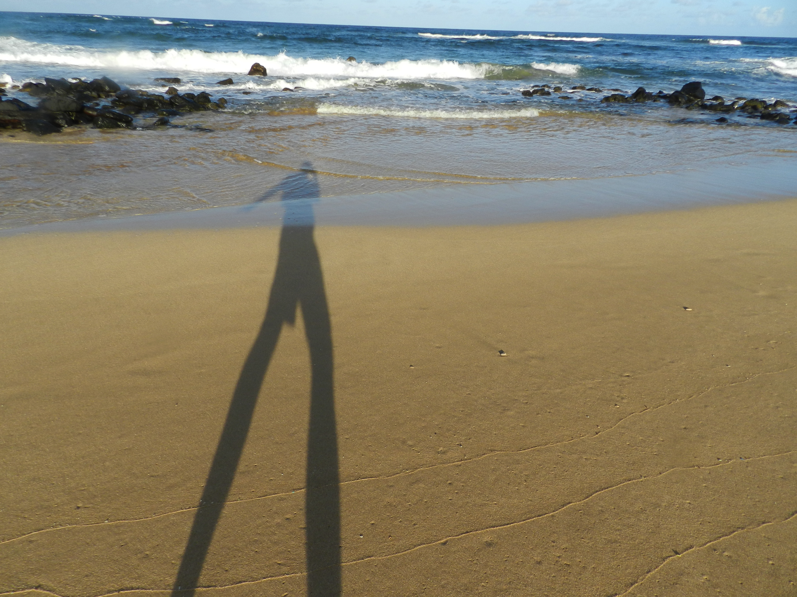
Thanks

