Slide 1
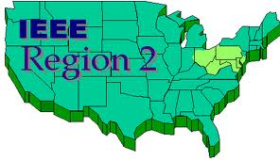





Slide 2

And then there’s Region 6…

Slide 3
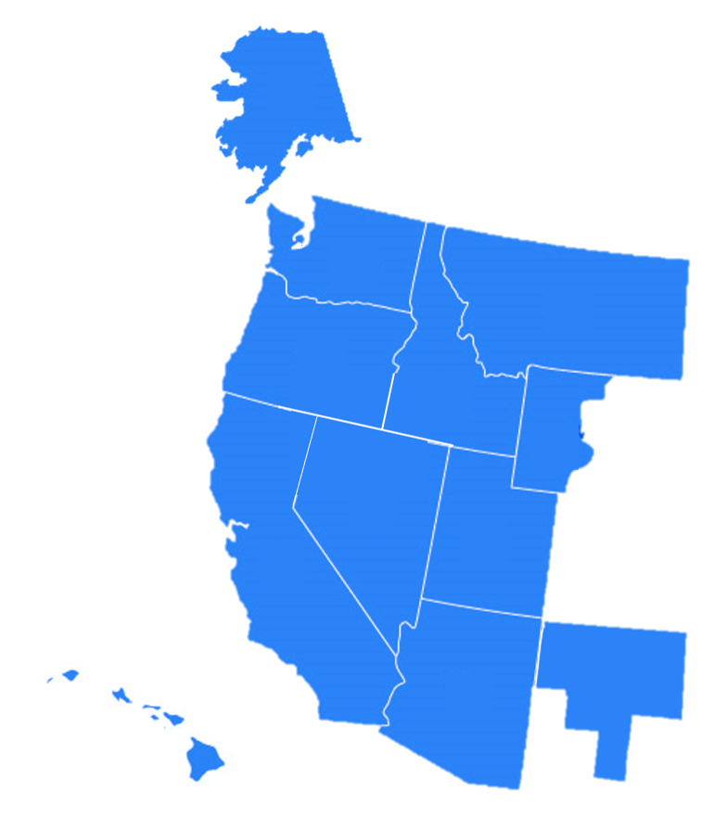

Region 6

Slide 4
Region 6

Slide 5
Region 6

Slide 6
Region 6

Slide 7
