Slide 1
Region 6 Fall Area Meeting Update
Tom Coughlin
Region 6 Director
October 2015

Slide 2
Outline
Obligatory IEEE Intro Slides
IEEE in 2030 Initiative
Region 6 Initiatives
Region 6 Conferences
Plans for 2016

Slide 3
IEEE Organization
MEMBERS
Board of Directors
Assembly
Member & Geographic Activities
Technical Activities
PSPB*
Executive Comm.
Standards Assoc.
Regions & Sections
Societies & Technical Councils
Educational Activities
Staff & Society Executive Directors
IEEE-USA
*Publication Services & Products Board

Slide 4
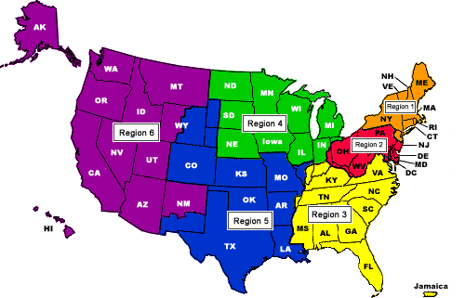
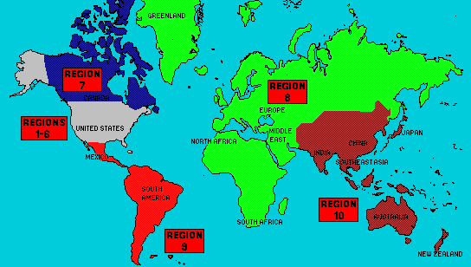
10 Regions, more than
300 Sections and
1,450 Student Branches, 38 Societies, 7 Councils, plus a growing number of Networks and Communities
425,000 members

Slide 5
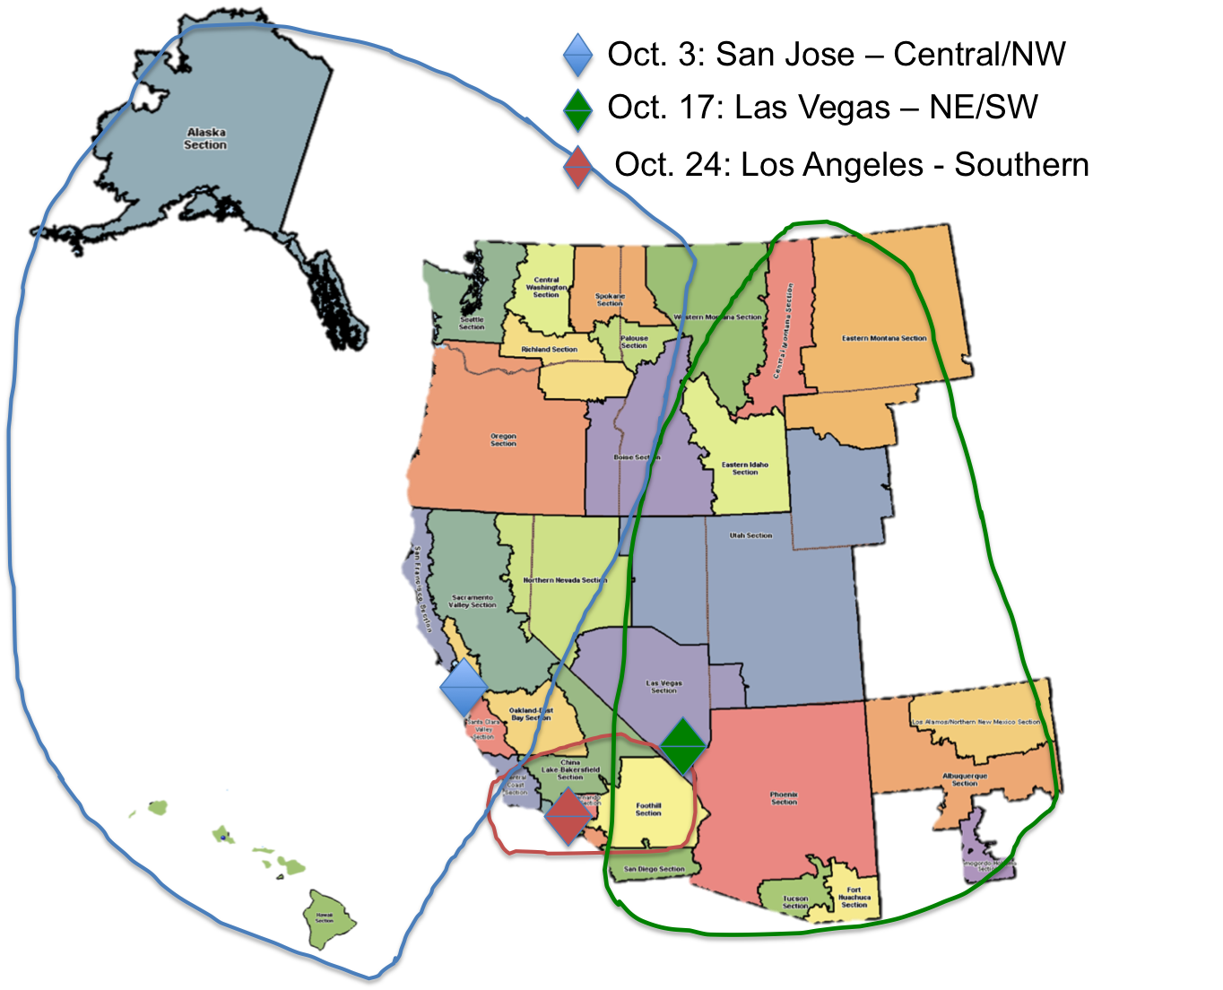
5 Areas
35 sections, 2 subsections, 2 councils
Over 228 chapters and affinity groups
95 Student Branches
About 55,000 members

Slide 6
IEEE Region 6 Objectives, 2015
Respect and enable the volunteer
Enhance membership and improve retention
Enhance our on-line experience
Create active alliances with industry and VCs
Create active alliances with academia
Create active alliances with technically oriented cultural groups and STEM
Recognize and celebrate our history
Region 6 recognition—get your MGA & IEEE award nominations in now
Make IEEE Region 6 cool, be creative

Slide 7
IEEE in 2030 Initiative
Participants
Board of Directors
Management Council
Selected guests (age, geography and technical diversity)
Supported by the 2015 and 2016 IEEE Presidents to focus on how best to evolve IEEE to meet the diverse challenges of the world in 2030
Driving question: What changes must we make now to best position IEEE for success in 2030, while still supporting the needs of technologists between now and then?

Slide 8
Proposed Structure: Three Major Bodies
Board of Directors (restructured)
13 members; 12 IEEE Senior Members or Fellows elected by the full IEEE membership; Executive Director as non-voting member
Three-year term; limit of two terms except for President who may have one additional “term” as President
President Chairs and serves a two year term (6 total)
Focused on strategy
Enterprise Board (a new body)
22 members; 10 voting members (Immediate Past President, Treasurer, Secretary, Executive Director; Vice Presidents/Presidents of EA, MGA, PSPB, SA, TAB, IEEE-USA; 12 non-voting members – Management Council)
Immediate Past President Chairs
Focused on enterprise-wide operations (rationalizes operational issues across OUs)
Assembly (same composition, new role)
No change to current structure - President, President-Elect, Immediate Past President, 10 Region Delegates, 10 Division Delegates
President Chairs
Focused on IEEE constituency
Transition over the next five years ensuring balance each year

Slide 9
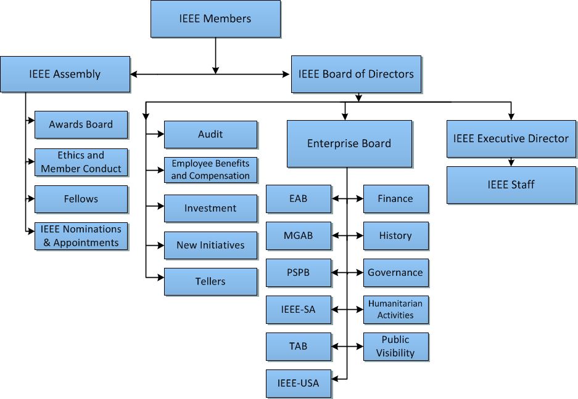
Proposed Structure
Apple
Apple and

Slide 10
Major benefits
Provides an adaptive governance structure to meet the uncertainties and increasing complexity of the future
Board of Directors will be:
composed of a smaller group of our best and brightest members
able to engage in generative discussions focused on strategy
informed by a stronger voice of the member because all members will be asked to vote on each individual BoD director
Enterprise Board will:
Create opportunities for representatives from each major OU to meet, socialize, and discuss challenges and opportunities while providing OUs a louder voice in IEEE-wide activities
Able to rationalize operational issues and enable effective operational management
Assembly will serve as the important check and balance of Board of Directors composition and provide linkage to our constituency

Slide 11
Board Slate will be Critical
Goal is to attract great leaders from the wide breadth of IEEE membership to serve on the Board of Directors
Goal is for a very well-rounded Board. N&A will focus on:.
1) skills and experience in both IEEE & non-IEEE
2) individual attributes
3) diversity factors:
Including but not limited to: sectors (private, academia, other); lines of operation (currently EA, MGA/USA, Pubs, SA, TA); technical areas (leadership experience distributed across Societies/ Councils/ Communities); geographic areas; gender
See IEEE in 2030 slide deck at: http://ieee-region6.org/2015/ieee-in-2030-b-o-d-presentation/

Slide 12
Region 6 PACE Highlights
We spent all our budgeted PACE money by June—first time ever! Great job to all the sections and branches that planned activities
We want all sections to do at least one PACE funded activity in 2015
We have asked IEEE USA for some extra money this year for more PACE projects—we have received some already
Can we do this again in 2016?

Slide 13
Region 6 - Initiatives
Membership in arrears recruitment and membership recognition
Region 6 conferences
On-line conferences
Chapter meeting recording
Program management for Region 6 activities
Creating alliances with industry and academia
Student and STEM Support
Region 6 IEEE Eng. Milestone Coordinator
Notes:
30,000 for ghtc, 2500 Sustech, 15000 Rising Stars

Slide 14
Region 6 - High Grade Members 2000-2014

Slide 15
Membership Initiative – Member to Member Renewal
Towards the end of February 2015 IEEE terminated membership for folks that didn’t renew their membership
From March 2015 to the end of May 2015 Region 6 began a pilot micro-volunteer program, with IEEE Membership Recruitment, to get IEEE volunteers to sign up to make calls to a list of 10 people in their section
We created an incentive program for callers who are able to get terminated members to renew
We had over 60 people who signed up to do these calls
Based upon the results of these calls we intend to repeat this activity next year

Slide 16
Member to Member Renewal Results
Region 6 volunteers reached out to 285 non-renewing members. Of the calls made 31.6% connected and 42.5% had a message that was left via voicemail or followed up with an email.
The effort paid off in that 19% of these contacts ultimately ended up renewing. The team was also able to gleen some valuable insights into why members did not renew.
Partially due to this effort our membership renewal numbers are much higher than in past year.

Slide 17
Member to Member Renewal Results (cont)
The team was able to gleen some valuable insights into why members did not renew.
22% of the members that were contacted cited that they simply forgot to renew.
11% cited financial reason/expense as the major reason they did not renew.
The remaining reasons ranged from changes in technical interests to the fact they were just too busy.

Slide 18
2015 Reinstatements Up in Region 6
September 2015 MD Report

Slide 19
Membership Initiative – Elevations
Associate to Member elevation information (this Is a very simple process): http://www.ieee.org/membership_services/membership/grade_elevation.html
Senior membership elevations
Let’s organize local activities to get eligible members elevated
This recognizes our members for their experience and may help with retention
We need programs to encourage students to become full IEEE members
Sections can order member loyalty recognition pins from the IEEE, www.ieee.org/loyalty

Slide 20
Region 6 Conferences
WIE – May 23-24, 2016, Santa Clara
IEEE On-Line Career and Talent Expo (on-going)
GHTC – October 2016, Seattle
SusTech – Sept/October 2016, Phoenix, AZ
Rising Stars—January 2-4, 2016, Las Vegas
SUSTECH 2013
Women in Engineering
International Leadership Conference
1st I E E E Co n f e r e n c e o n T e c h n o l o g i e s f o r Su s t a i n a b i l i t y

Slide 21
Career & Talent Expo (Ongoing)
Combining 2 highly effective technologies to provide scientific job matching on a virtual platform environment
14 Industry disciplines showcased in related exhibit halls
Global and national reach – All IEEE members invited
Validated talent assessment offered to all participants
3 Corporate sponsorship packages available—looking for sponsors
Free to IEEE members, non-members pay or become members both in Region 6 and elsewhere

Slide 22
Career & Talent Expo Member Benefits
Free personal skills assessment report provides 7 advantages in career development
Take the DISC [personal skills assessment test at: http://www.ttisurvey.com///230492JME and find out what your employable strengths are
Supporting career and industry content provided at the event
Active and passive seekers, or those looking to build a network for future advancement are all welcome to tap into the world- class resources
When job matched, statistics show people have more success
Finding the right home for one’s unique abilities brings happiness, less stress and more productivity
More Information: http://ieee-region6.org/2015/career-and-talent-expo-2015

Slide 23
Virtual and Hybrid Conferences
IEEE Region 6 has acquired a license for a program available from the IEEE EAB for hosting virtual events
We used this capability for the first time for the 2015 Rising Stars Conference—also at RS 2016
This was used in the Career and Talent Expo and will be used for Rising Stars 2016
This functionality can be used for many different types of events…

Slide 24
Create an On-Line Collection of Technical Chapter Meeting Recordings
IEEE New Initiatives Comm. (NIC) funding of a pilot program in Region 4 and Region 6 into the Fall of this year
We are hosting these recordings—they are available for free to all IEEE members on our beta site
We intend to sell access to these recordings to non-members--enhance IEEE membership
We could have 100’s of these in a year’s time, 1000’s in 5 year’s time—this is cutting edge material
We are offering discounts for microphone packages and offering Camtasia licenses. We are doing training to section and chapter leaders—Contact Scott Tamashiro if you are interested in these packages (Scott Tamashiro (tamashiro@ieee.org) .

Slide 25
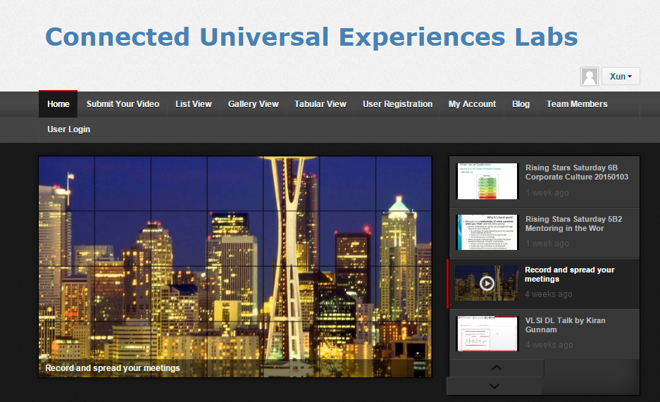
Chapter Meeting Recording Website At a Glance
Create an account and participate at: http://www.nuxlabs.org
25
6/15/2015

Slide 26
Contents Contribution (August 18, 2015)
- 57 recorded meetings contributed
Technical, Social, Administrative
32 recordings from R6
25 recordings from other regions/international conferences

Slide 27
Views and Usages (August 18, 2015)
- 5032 total views to streaming content, from 328 unique IP addresses
- 1282 views to steaming content from registered users = 33 views per registered user
Views top 5
129: VLSI Distinguished Speaker Talk (San Diego Section)
123: Recorded Meeting Initiative Introduction (R6)
90: Ocean Technology in India (San Diego Section)
53: IEEE R6 NE Area Spring Meeting (R6)
51: Rising Stars Corporate Culture Talk (R6)
- 14 users saved 53 videos in “my videos” list
Average portfolio size is 3.79 videos/user

Slide 28
Streaming Content Visitors Map – Global (August 18, 2015)

Slide 29
Streaming Content Visitors Map - Americas

Slide 30
Student Branch Rebates – Good news is that R6 is #1
Region | # Branches | Rebates | Rebate Rate
6 | 95 | 20 | 21.1%
8 | 449 | 91 | 20.3%
9 | 411 | 80 | 19.5%
7 | 57 | 10 | 17.5%
10 | 1061 | 146 | 13.8%
3 | 106 | 14 | 13.2%
4 | 68 | 7 | 10.3%
5 | 97 | 8 | 8.2%
2 | 84 | 5 | 6.0%
1 | 88 | 3 | 3.4%

Slide 31
Region 6 Student-Targeted Efforts
Improve student branches by improving section relations with their student branches.
Communication and supporting involvement in wider IEEE activities.
Improve effectiveness of area meetings for student members
Revising Student Leadership Training.
Making student competitions more relevant and appealing.
Career & Talent Expo – launched in June 2015, ongoing
More from Mike Andrews!
Rising Stars – January 3 and 4, 2016
More from Emily Cheung!

Slide 32
Sections and Their Branches
Student branches belong to their section
On average, sections provide more than 3x as much financial support to branches as IEEE HQ.
How to help students? Yes, support their activities… but also:
Treat them in ways that establish them as an org unit of your section (chapters, affinity groups,…)
Check that you have current officer information and that IEEE HQ has it too.
This supports both communication and student membership
Invite student branch reps to your ExCom.
More…

Slide 33
Sections and Student Branches in the North-East Area
Section | Branches
Boise | Boise State Northwest Nazarene University (new!)
Central Montana | Montana State University – Bozeman
Eastern Idaho | Brigham Young University - Idaho Idaho State University
Utah | Brigham Young University – Provo Utah State University University of Utah Utah Valley University Weber State University
Western Montana | Montana Tech

Slide 34
Sections and Student Branches in the Southwest Area
Section | Branches
Albuquerque | New Mexico Institute of Mining & Technology University of New Mexico
Fort Huachuca | University of Arizona South - new
Las Vegas | University of Nevada, Las Vegas
Phoenix | Arizona State University – Polytechnic Arizona State University –Tempe Devry University – Phoenix Embry Riddle Aeronautical University Northern Arizona University
San Diego | San Diego State University University of California, San Diego University of San Diego
Tucson | University of Arizona

Slide 35
Rebates – Not Hard to Get
Two reports per year
Officer reporting: https://officers.vtools.ieee.org
This one should be done by May/June but you have until September
Just 3-5 minutes! Hardest part is knowing member numbers of your officers
Activity reporting: https://sbr.vtools.ieee.org
Due November 1
Only asks for number of meetings each month in past calendar year
Just 2 minutes! Not the same as the extensive reporting for sections.

Slide 36
Rebate – How Much?
Payment = Rebate + Allotment
Based on membership statistics as of 31 December.
The rebate is $2 per Student member of the Student Branch
The allotment is
$50 for branches with 49 or fewer members
$100 for branches with 50 or more members
30 member SB would get payment $50+$2x30= $110
50 member SB would get payment of $100+$2x50=$200
500 member SB would get $100+$2x500=$1100.

Slide 37
Region 6 is committed to STEM outreach
Funding for STEM outreach
It’s our future
It can be 3% or 33%...but not 0!
Even if it’s not YOUR cup of tea--Delegate! Frequently but not exclusively, a PACE function
Sections provide and communicate options to members, encourage involvement, publicize successes
Appoint a Pre-college Outreach Chair
Hold at least ONE precollege STEM event in 2015
Tell your Region about it!
See our website: http://ieee-region6.org/k-12-programs/

Slide 38
R6 Precollege Outreach Timeline for 2015
January: Commit my section to SOME outreach
February: Identify a PreCollege Outreach Chair
March: Region’s first mailing / mail list needed!
April: Have a plan for a visit, an event, an effort
May: Post each Section’s plan to Region website
June: Execute the visit, event, effort. Take pictures!
July: Provide at least one picture to Region
September: Post pictures to Region Website
October: Encourage further events
December: Recognize the Pt, Au, and Ag sections!

Slide 39
Other Initiatives
We are trying to use project management tools as well as micro-volunteering to make it easier for professional volunteers to help Region 6.
Region 6 has money available for local sections to host breakfasts or lunches with local industry leaders. In the Santa Clara Valley section they do this about once a quarter with about 30 companies participating
We are seeking IEEE Engineering Milestones in Region 6 and have a Region 6 Milestone coordinator who can help you with this process—Brian Berg, brianberg@gmail.com

Slide 40
Buy Region 6 Gear

Slide 41
2016 Joint Region Meeting
Will include Region 6, Region 4 and the Excom from Region 5
Date for meeting is Friday 1/29/16 through Sunday 1/31/16
Location is the Excalibur Hotel in Las Vegas, Nevada
IEEE USA awards on Saturday
More information is forthcoming
Also we need to set up our dates for Spring and Fall Area meetings

Slide 42
Objectives for 2016
Expand the chapter recording effort to other regions but have Region 6 lead the way
Improve web site
Funding requested for major expansion in 2016-2017
Stop the membership decline in Region 6
More micro-volunteer opportunities
Streamline and organize R6 conferences
Doing this for GHTC and intend to expand this for our other conferences
More PACE, more STEM, more industry, more FUN!

Slide 43
Your IEEE Resources
ieee.org
ieee-usa.org
ieee-region6.org
students.ieee-region6.org

Slide 44
Thank you !

