Slide 1
Region 6 STEM/ Pre-College Outreach: Summer Update
Region 6 Strategic Planning Meeting
Bill DeHope, Mahbub Khan, & Ramesh Nair Region 6 Pre-college Outreach Chairs
August 8, 2015 Region 6 Strategy/Planning Meeting SFO Hampton Inn & Suites

Slide 2
Region 6 is committed to STEM outreach
It’s part of our IEEE jobs to devote some fraction of time, effort, publicity, and funding to STEM outreach
It’s our future…of our profession, our institute, our community
It can be 3% or 33%...but not 0!
Even if it’s not YOUR cup of tea
Delegate! Frequently but not exclusively, a PACE function
Sections need to provide and communicate options to members, encourage involvement, publicize successes
Appoint a Pre-college Outreach Chair
Hold at least ONE precollege STEM event in 2015
Tell your Region about it!
Region needs to motivate sections, communicate opportunities, and document our successes
See our website: http://ieee-region6.org/k-12-programs/

Slide 3
R6 Precollege Outreach Original 2015 Plan
January: Each section commits to SOME outreach
February: Identify a PreCollege Outreach Chair
March: Region’s first STEM mailing
April: Each section plans a visit, event, or effort
May: Post each Section’s plan to Region website
June: Execute the visit, event, effort. Take pictures!
July: Provide at least one picture for Region website
September: Post pictures to Region Website
October: Encourage further events
December: Recognize the Pt, Au, and Ag sections!

Slide 4
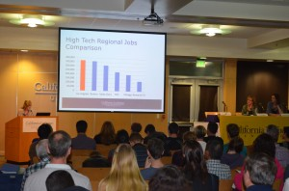
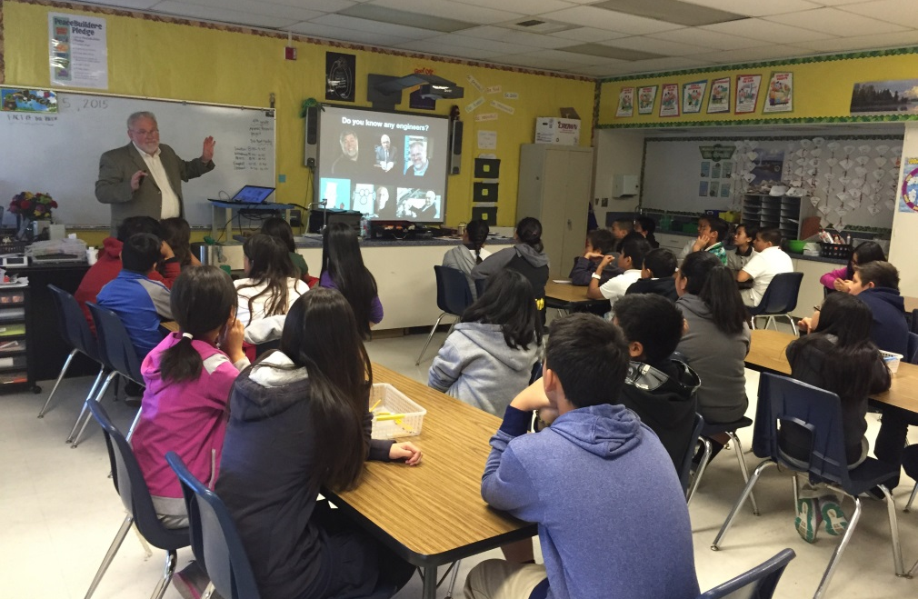
Examples of Section events
Buenaventura Section: STEM Career Night
Oakland/East Bay Section: Spangler Elementary Engineer Visit
Send your event to: rameshnair@ieee.org
Ideas for outreach at http://ieee-region6.org/k-12-programs/

Slide 5
How are we doing?
Plan | August Status
Every Section Commitment | By golly, who isn’t committed?!?!
Each Section identifies a STEM Chair | 40% have explicitly given names
STEM mailing | Mailings in February, March, April
Each Section plans an event | 11% have given us plans
Post plans on R6 website | One completed event posted
Have an event, visit, or effort | 5% have reported
Photodocument the event on R6 | 3% are on website

Slide 6
How do we get back on track?
Sections with distinct STEM Coordinators are doing better in Outreach
Chairs have plenty to do already, right?
So how do we get dedicated coordinator names?
Do Sections need help finding volunteers?
Will the Region consider an every-member email?
Or are good things happening and we just don’t know about it?
This may not all happen in a year!
Let me know your thoughts: w.dehope@ieee.org

