Slide 1
IEEE Internet of Things (IoT) Initiative
Name, Title
Date
iot.ieee.org

Slide 2
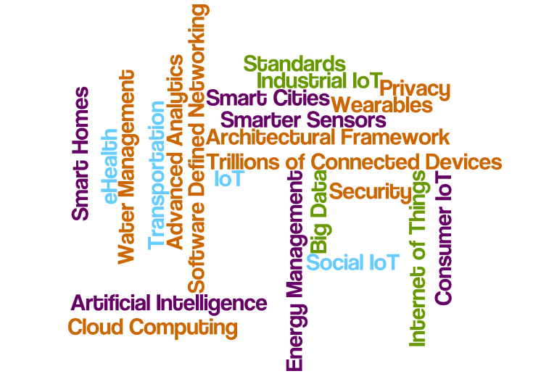
The Global Internet of Things
2
Be part of the sweeping convergence of technologies, markets, applications, and the Internet through the IEEE Future Directions Internet of Things (IoT) Initiative

Slide 3
IEEE IoT: A Collaborative Gathering Place for Technologists
3
The mission of the IEEE IoT Initiative is to serve as the gathering place for the global technical community working on IoT; to provide the platform where IoT professionals learn, share knowledge, and collaborate on this sweeping convergence of technologies, markets, applications, and the Internet, and together change the world.

Slide 4
4

Slide 5
The IoT is Driving Markets
5
Connected-home device shipments will grow at a compound annual rate of 67% over the next 5 years.. and hit 1.8 billion units shipped in 2019 – BI Intelligence
IoT-connected wind and solar installations will grow at a CAGR of 21% from 2014 -2020 with total number of connections growing from almost 2 million in 2014 to 6.3 million in 2020 - ABI Research

Slide 6
6

Slide 7
7
Notes:
Prior to the launch of the IoT Initiative, IEEE IoT activities and offerings were siloed; making it a challenge for members and non-members seeking a “one-stop-shop” for globally-relevant IoT intelligence and to navigate and connect the dots
The activities that comprise the IEEE IoT Initiative provide a global view and a platform for ideas exchange and knowledge

Slide 8
8
The IEEE IoT Initiative
Brings people together
Is a thought leader essential to the IoT community
Enables discussion
and engagement
amongst the broad
span of IoT disciplines
Notes:
02/08/10
8

Slide 9
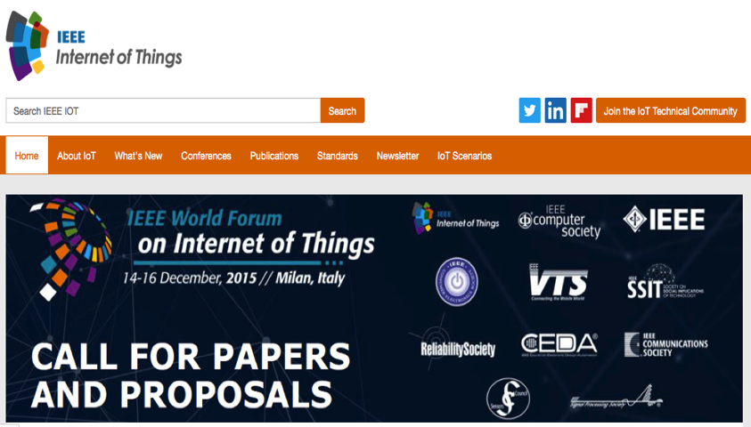
Thought Leadership: IEEE IoT Web Portal
9
Learn, Talk, Contribute, Share
Integrated gateway to IoT intelligence, education, news from IEEE experts and other expert sources
Essential resource for anyone involved in IoT
Educational Videos
IEEE Talks IoT Q&A series with IoT Experts
IoT Webinars
Insightful Articles
Conferences and Events
IoT Standards
IoT.IEEE.org

Slide 10
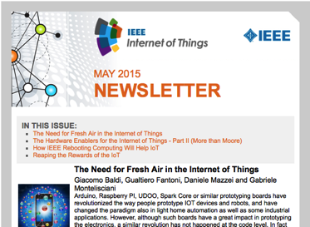
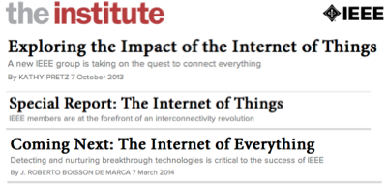
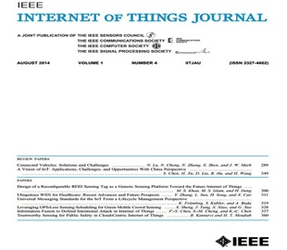
IEEE IoT Thought Leadership: Newsletter & Publications
10
IEEE IoT Newsletter
Bi-monthly, technically focused electronic publication highlighting important IoT-related technology developments, innovations, and trends from the world’s top subject matter experts, researchers, and practitioners
The Institute Special Report: The Internet of Things, March 2014
Internet of Things Journal
Four issues; 33 papers
IEEE Xplore Digital Library
~125,000 Internet-related documents

Slide 11
IEEE IoT Experts Webinar Series
11
Learn from recognized industry experts about critical aspects of the IoT ecosystem.
IEEE IoT experts are available to speak, answer questions, and connect interested professionals to the world of IEEE IoT.
Roberto Saracco, President, EIT ICT LABS Italy and Italy Node Director European Institute of Innovation and Technology; senior member IEEE; chair IEEE Future Directions Committee
Roberto Minerva, head of Innovative Architectures, Future Centre, Strategy Department, Telecom Italia; chair IEEE Future Directions Committee Working Group
Dr. Chung-Sheng Li, Director, Commercial Systems Department, PI IBM Research Cloud Initiatives, executive sponsor, Security 2.0 strategic initiative, IBM T.J. Watson Research Center; IEEE Fellow
Oleg Logvinov, Chair, IEEE P2413 Working Group, Architectural Framework for IoT ; Director, Special Assignments, STMicroelectronics' Industrial & Power Conversion Division
Dr. Chuck Adams, President, IEEE Standards Association (IEEE-SA) 2009-2010; BoD IEEE-SA; founding member IEEE IoT development program; Distinguished Standards Strategist Huawei Technologies
YK Chen, IEEE Fellow; Principal Researcher, Intel Corporation; Associate Director Intel-National Taiwan University Connected Contest Computing Center
Antonio Manzalini, Senior Manager, Strategy & Innovation, Future Centre - Telecom Italia; IEEE member; chair, IEEE Software Defined Networks Initiative

Slide 12
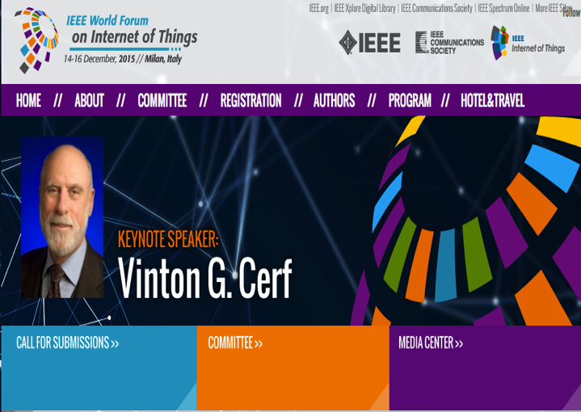
IEEE IoT Brings People Together: Events
12
IEEE World Forum IoT Conference 2014
Inaugural event March 2014; Seoul, South Korea
Attendees and Representation from 60+ global organizations
IEEE World Forum IoT Conference 2015
14-16 December 2015; Milan, Italy
http://www.ieee-wf-iot.org/

Slide 13
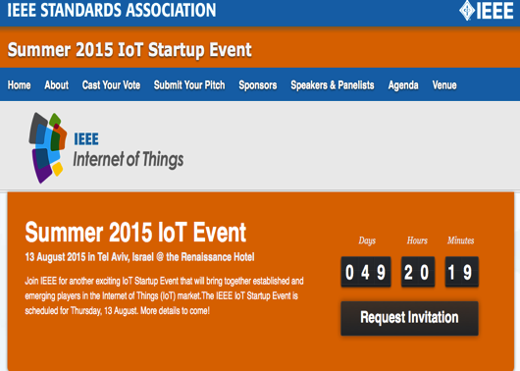
IEEE IoT Brings People Together: Events
13
IEEE IoT Workshops
Gathering of global IoT experts, leaders, and other participants to explore new technologies, IEEE standards, applications, and future business models
September 2014, Silicon Valley
April 2013, Shenzen, China
November 2013, Silicon Valley
November 2012, Milan, Italy
IEEE IoT Soiree & Startup Events
Bringing together established and emerging players in IoT. Fostering IoT innovation. A catalyst for expansion and growth of the IoT ecosystem
Startup “Hot Seat”: Startup companies introduce themselves to potential partners and investors
Past
January 2015, Co-located with Consumer Electronics Show, Las Vegas, NV, USA
May 2015, San Jose, CA, USA
Summer 2015 IoT StartUp Event
Aug 13, 2015, Tel Aviv, Israel

Slide 14
IEEE IoT Enables Discussion & Engagement: IoT Use Cases
14
A collaborative space for IoT Scenarios & Use Cases
http://iot.ieee.org/iot-scenarios.html

Slide 15
Turn to IEEE IoT for Content, Knowledge, Collaboration
15
The Internet of Things (IoT) Definitions Document
A “living document” in a collaborative space on the IEEE IoT web portal
Baseline definitions of IoT
Gain and contribute knowledge and ideas
To facilitate better understanding of IoT
Lead to further research
Advance understanding of IoT
Get involved in the universal discourse underway now!
http://iot.ieee.org/about.html

Slide 16
IEEE Enables Discussion: Diverse IoT Community
16
IEEE
More than 426,000 members in more than 160 countries, more than 50 percent of whom are from outside the United States
IEEE IoT Technical Community
9,000*+ members and growing
Join today via iot.ieee.org
IEEE IoT on Twitter
Top-tier voice and resource in social media
Large community of meaningful followers
Reaching >2.1* million Twitter users
Follow us twitter.com/IEEEIoT
LinkedIn Group: IEEE Internet of Things
Connect with thousands of senior-level and engineering community members interested in IoT
Join: https://www.linkedin.com/grp/home?gid=5148323
Flipboard: IEEE Internet of Things
7,800* Viewers,1100* Followers, 2,300* Articles
Follow us via https://flipboard.com/@stogner/ieee-internet-of-things-rsqdr8tjy
*As of 7 July, 2015

Slide 17
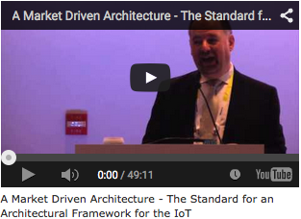
Creating an Ecosystem Through Standards: IEEE P2413
17
This draft standard defines an architectural framework for the Internet of Things (IoT), including descriptions of various IoT domains, definitions of IoT domain abstractions, and identification of commonalities between different IoT domains.

Slide 18
18
IEEE IOT Initiative Organization
Chair
(R. Minerva)
Industry Engagement Track
(O. Logvinov)
Conferences Track
(V. Piuri)
Standards Track
(C. Adams)
Publications Track
(Y.K. Chen)
Content / Community Dev. Track
(L. Stogner)
Scenarios
Track
(H. Berndt)
Education Track
(A. Pears)
Education Working Group
Publications Working Group
Ind. Engag. Working Group
Conferences Working Group
Standards Working Group
Content / Cmmty Dev. Working Group
Scenarios Working Group
Staff Sr. Program Director
(H.Tepper)
Staff FDC
Sr. Director
(W. Tonti)
Notes:
02/08/10
18

Slide 19
Engage With IEEE in IoT Today!
19
The IEEE:
www.ieee.org
IEEE Internet of Things (IoT) Initiative:
iot.ieee.org
Email: iot-info@ieee.org
IEEE Standards Association (IEEE-SA) – Internet of Things:
standards.ieee.org/innovate/iot
IEEE Xplore Digital Library:
ieeexplore.ieee.org/Xplore/home.jsp
19

Slide 20
20
iot.ieee.org

