Slide 1
IEEE in 2030 – Optimizing for Full Impact
February 2015

Slide 2
Notes about this deck
This deck can be shared freely within the IEEE community
It outlines the strategy work being done at the IEEE Board of Directors level in early 2015 for the whole of IEEE
Feedback should be sent to feedback2030@ieee.org

Slide 3
Process

Slide 4
Timing
IEEE engaged Syntegrity Group services in late 2014
Proprietary, unique, consensus building approach
List of prestigious clientele including:
USAA, Novartis, RTI International, AMD, Toyota
Formed Ad Hoc Committee for IEEE in 2030 to manage project in early 2015
Developed overarching question to be explored
Notes:
Syntegrity Group is a strategic planning facilitation group based in Toronto, Canada. They have previous experience with IEEE – 2 years ago they facilitated a strategic planning effort with Educational Activities.

Slide 5
Project Sequence
Syntegration
Duration: 3 Days
Purpose: Understanding, Planning, and Mobilization
Participants: Up to 48
Post Syntegration Session
Duration: 1 Day
Purpose: Decision Making and Action Planning
Participants: Up to 15
IEEEin2030
OUs
Committees
Notes:
The sequence of events began with a 3-day IEEE Board Retreat held 8-10 January 2015 in San Juan, Puerto Rico USA with the IEEE Board of Directors, the IEEE Management Council, and several other individuals to provide additional geographic, technical, and age diversity. The Post-Syntegration session was a 1-day effort held on Tuesday, 3 February 2015 at the beginning of the February IEEE Board Series in New Orleans, Louisiana USA with the IEEE in 2013 Ad Hoc Committee members and several other members. IEEE is now taking the outcomes of the Post-Syntegration session and operationalizing them.

Slide 6
Syntegration Session Overview
Define Question
Select Participants
Syntegration
Agenda Setting
Participants agree on 12 topics to discuss
Topic Discussions
Participants are assigned to topic discussions
Recommendations
Participants make topic recommendations
Notes:
Prior to the actual Syntegration session a question is defined that frames the strategic positioning of the organization at some time in the future and then identifying participants for the Syntegration session. The Syntegration process itself begins with the entire group setting the agenda and then, based on the number of participants, identifying topics of discussion. The topics are discussed in groups and ultimately recommendations are made for the most impactful topics to move the organization forward to achieve the strategic positioning identified in the original question.

Slide 7
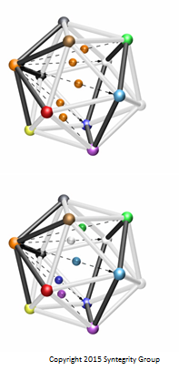
Getting to Solutions
During 3 rounds over 3 days, the group collectively shares information, ideas, and results
The network allows the information and discussions from all 12 topics to be shared with the entire group in order to inform all the final recommendations
At the end, each topic team presents recommendations back to the group
Notes:
The geometric figure graphically represents the process. Topics are represented by the nodes and individuals serve as the connections. The Syntegration process ensures that the entire group has either direct input or knowledge of all of the topics and how they support the future state question.

Slide 8
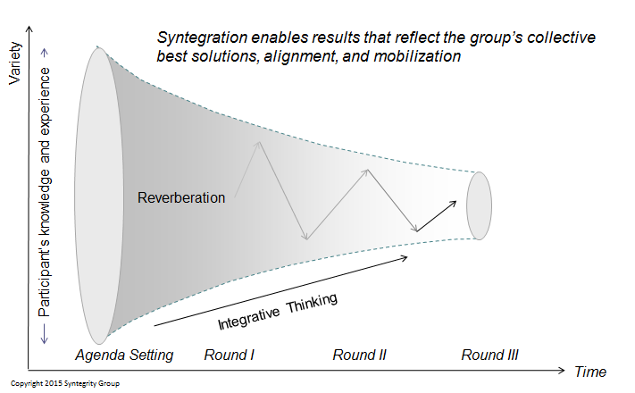
Syntegration Extracts the Most from the Group
Notes:
The Syntegration process takes input from all participants and, in an iterative process, refines the solution through integrative thinking and participation. While “Reverberation” is Syntegrity Group/s term, think of it as a small-scale crowd-sourcing effort.

Slide 9
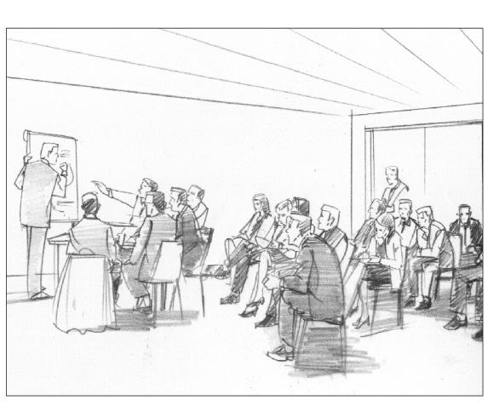
Syntegration Breakout Roles
Members are responsible for discussing the topic at the table
Own the topic and have full discretion to use any or all feedback as they see fit
Critics provide concise
critique of the discussion
Only speak when prompted by the Facilitator at specific points in the meeting
Observers listen, reflect, and form feedback to provide at a later time
Move between meetings occuring simultaneously

Slide 10
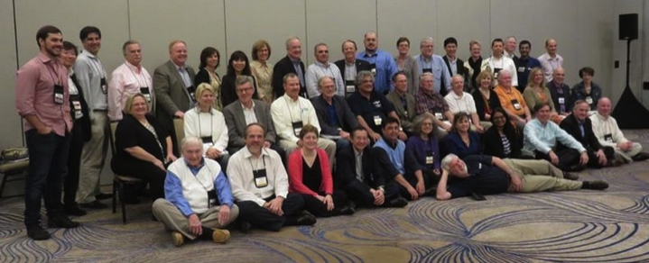
January Retreat

Slide 11
2015 Strategic Direction and Beyond
Participants
Board of Directors
Management Council
Selected guests (age, geography and technical diversity)
Began with a presentation about the world in which we convene, network, publish, and interact, so we could then focus on how best to evolve IEEE to meet the diverse challenges of that world

Slide 12
Objectives
Focus on high-level direction, justification, implications for IEEE, and key strategic objectives
Arrive at a holistic understanding of what a flourishing IEEE would consist of in the future
Identify and agree on the steps we need to take to move in that direction over the next 2 years

Slide 13
Driving Question for Entire Event
What changes must we make now to best position IEEE for success in 2030, while still supporting the needs of technologists between now and then?
Notes:
This is the question that was used throughout the entire Syntegration and Post-Syntegration processes that frames the strategic positioning of the organization in the future.

Slide 14
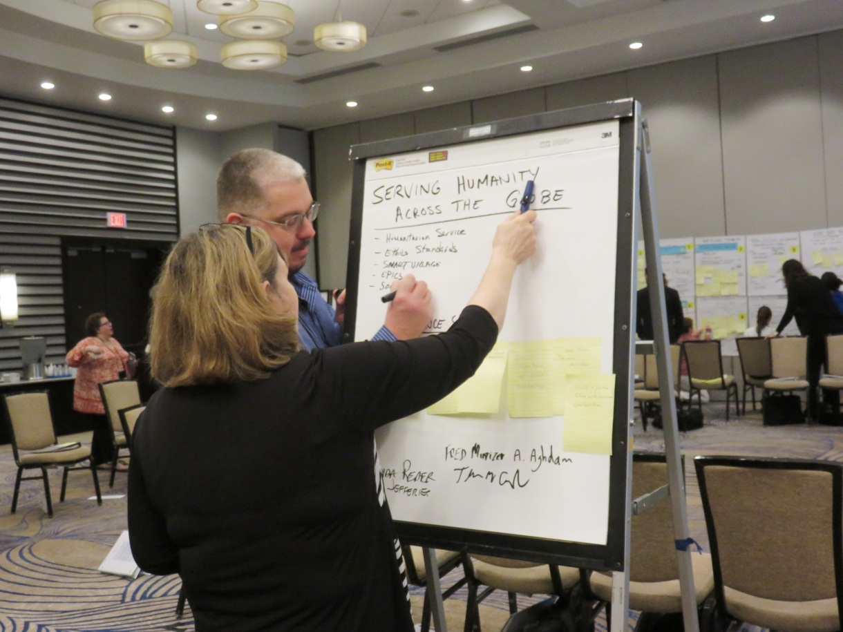
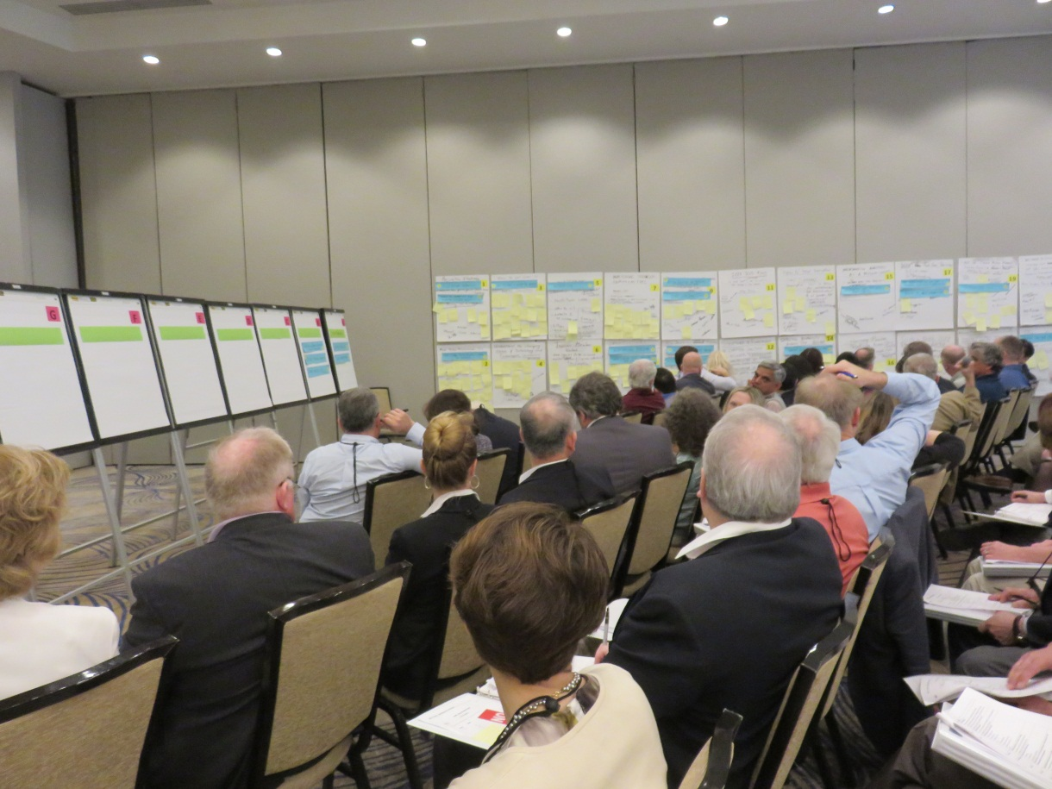
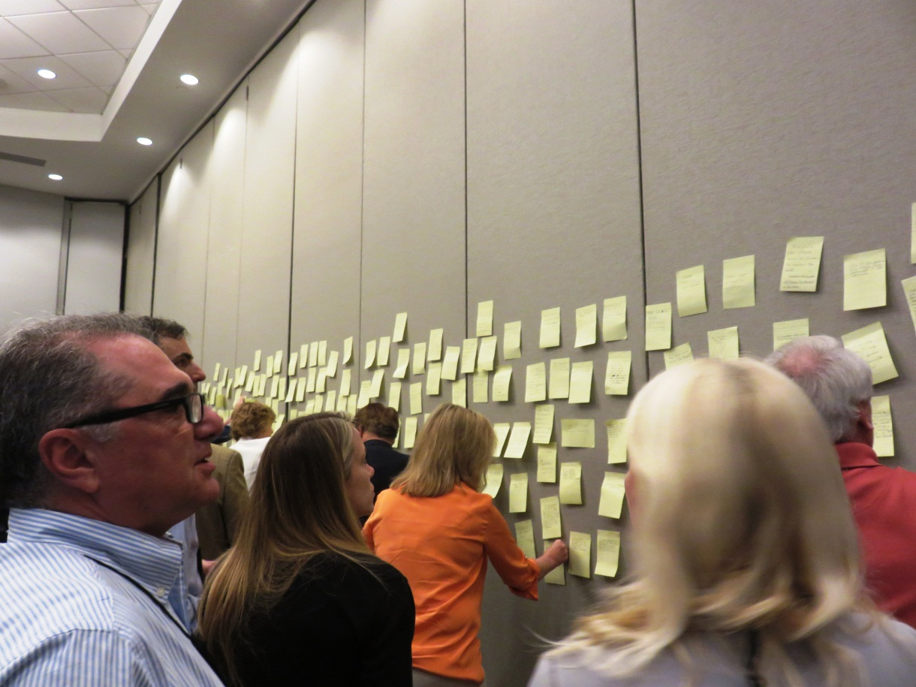
Setting the Agenda
The group started with no agenda - just the overarching question. During the first morning:
Individuals rapidly came up with over 300 statements of importance
Which, after a few iterations by the group, turned into 12 topics that should be explored in order to address the question
Over the next 2 ½ days the group rotated in and out of an iterative 3-stage process to fully discuss each topic
7 Signatures
Over 30 Focus Areas
Over 300 Statements of Importance
Marketspace
Reduction—12 Topics
Notes:
The 48 participants generated >300 Statements of Purpose which identified what was things IEEE was doing right, what was not working well, what key things in the environment were impacting our businesses, etc. In the Marketspace individuals advocated the importance of specific Focus Areas to the group to gain support. The entire group then reduced the 30 Focus Areas to 12 Topics of key importance.

Slide 15
Agenda Formed Around Resulting 12 Topics
Identifying our Core Businesses for 2030 (Light Blue)
Anticipating the Future of Information (Gold)
New Products and Services for 2030 (Red)
2030 Member Engagement (Silver)
Embrace the Future of Technology (Yellow)
Influence Public Policy Globally (White)
Communities in 2030 (Black)
Optimize Our Governance Processes to Enable Strategy (Brown)
Organizational Structure (Green)
Get Closer to Industry (Purple)
Making IEEE More Diverse (Orange)
What is Our Public Imperative in 2030 (Dark Blue)
Notes:
These were the 12 final Topics – in no specific order.

Slide 16
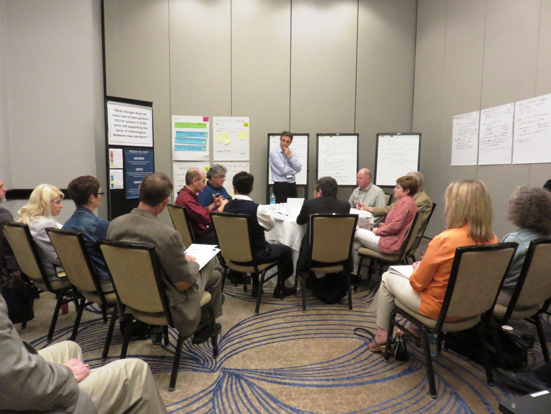
3 Rounds of Breakout Sessions
Notes:
This picture shows how the process works. There was a Syntegrity Facilitator with each group who kept the group on-time and captured the notes. The Members who owned a specific topic sat at the round table and discussed, debated and argued about the Topic refinement. The next group in the first ring served as the Critics – they listened to the Member’s discussions and then, at times selected by the facilitator, were asked to critique the discussions – were the Members being sufficiently bold in their thinking? Were they missing anything? Were they on the right track? The last group in the back were the Observers and their role was to listen to the Members and Critics and understand and form their feedback to provide at a later time.

Slide 17
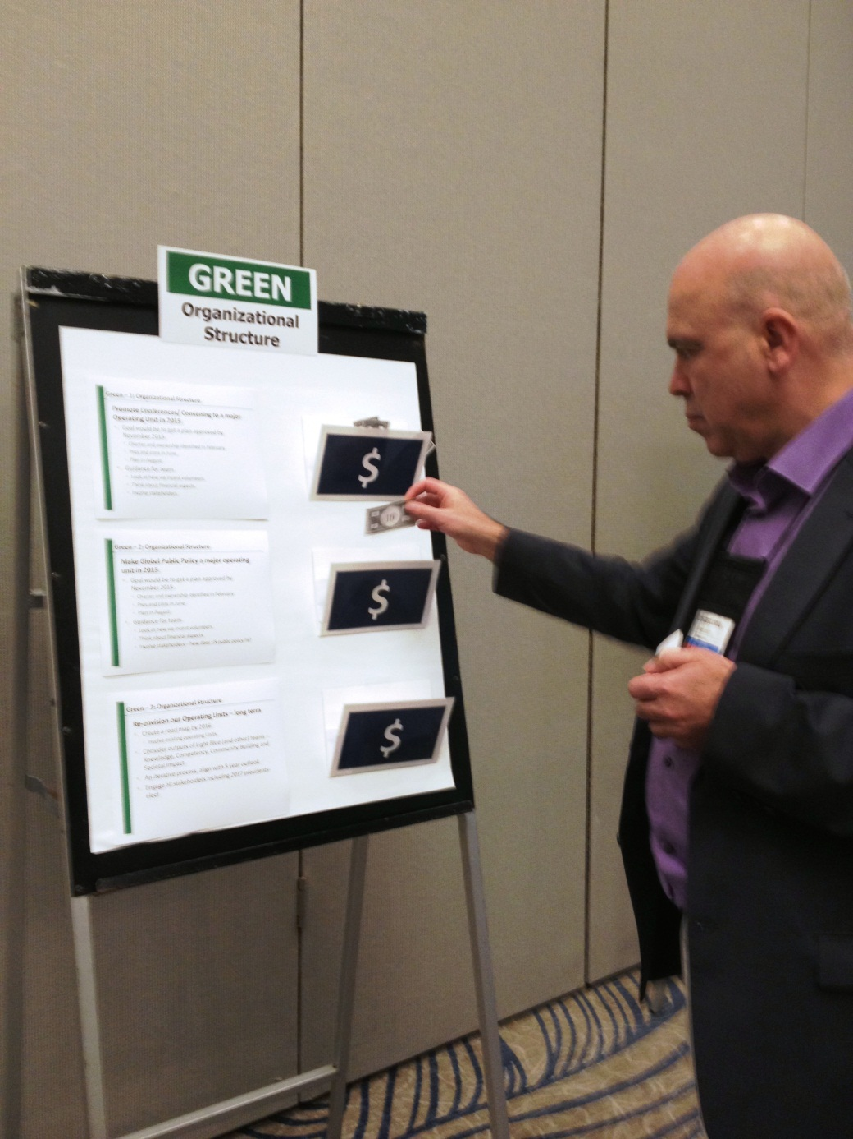
Recommendations
After 3 rounds, topic teams presented recommendations on Day 3
Each individual was asked to “vote” for items they perceived as most important

Slide 18
Prioritization Exercise Results by Topic
Topic Color | Topic Name | %
Brown | Optimize Our Governance Processes to Enable Strategy | 12.4%
Green | Organizational Structure | 12.0%
Black | Communities in 2030 | 10.2%
Dark Blue | What is Our Public Imperative in 2030 | 8.7%
White | Influence Public Policy Globally | 8.2%
Purple | Get Closer to Industry | 8.0%
Red | New Products and Services for 2030 | 7.3%
Gold | Anticipating the Future of Information in 2030 | 7.1%
Orange | Making IEEE More Diverse | 7.1%
Yellow | Embrace the Future of Technology | 7.1%
Light Blue | Identifying our Core Businesses for 2030 | 6.2%
Silver | 2030 Member Engagement | 5.8%
Notes:
This was the resulting prioritization of the 12 topics – prioritized by the entire 48 participants.

Slide 19
We started, in Puerto Rico, with a blank page and one compelling question We ended with 12 strategic topics, each with recommendations and perceived importance of recommendations We then reconvened in New Orleans

Slide 20
Post Syntegration Session
One day session on 3 February
A smaller group of 14 people
Ad Hoc Committee for IEEE in 2030 +
The group started with the synthesized content from January provided by Syntegrity Group
Working in four teams – focused on four strategic objectives
Refined and scoped the recommendations into a draft roadmap that honors the work done in Puerto Rico while adding clarity and realistic timelines and expectations

Slide 21
Post Syntegration Process
Goal
Strategic Objective 2
Strategies
Strategic Objective 1
Recommendations
Strategic Objective 3
Recommendations
Strategies
Recommendations
Strategies
Strategic Objective 4
Strategies
Recommendations
Notes:
This is a macro-level perspective of what work was done at the Post Syntegration Session. The Syntegrity Group took all of the output from the 3-day Syntegration Session and looked for overlap, commonality and essential threads and made recommendations on how to move from the 12 Topics to the 4 Strategic Objectives. Then the Post-Syntegration participants developed individual strategies and recommendations for actions and milestones.

Slide 22
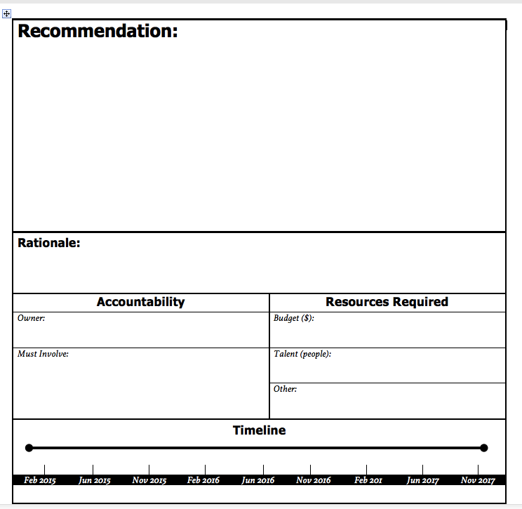
Each group completed this form for each recommendation

Slide 23
What emerged …
IEEE is well-positioned for success in 2030 and continues to serve the needs of technologists between now and then.
[1] Create a Nimble, Flexible, Forward-looking Organization | [2] Foster Public Imperatives | [3] Foster Diverse Technical Communities with Industry, Government, and Academia | [4] Empower the Discovery, Development and Delivery of Cutting-edge Products and Services
Strategies

Slide 24
What emerged …
Colors and numbers refer back to recommendations from January. This process ensures there are links between each session so nothing is lost.
IEEE is well-positioned for success in 2030 and continues to serve the needs of technologists between now and then.
[1] Create a Nimble, Flexible, Forward-looking Organization | [2] Foster Public Imperatives | [3] Foster Diverse Technical Communities with Industry, Government, and Academia | [4] Empower the Discovery, Development and Delivery of Cutting-edge Products and Services
Strategies
Brown 1, 2 Light Blue 1 Green 1, 3 | White 1, 2, 3 Dark Blue 1, 2, 3, Other Ideas Green 2 Revised PS session recommendations | Purple 1, 2, 4 Black 1, 2, 3 Orange 2, 3, Other Ideas Revised recommendations from Orange 1, 2, 3, Other Ideas, Purple 1, 2, 3, Black 1, 2 | Silver 1 Red 1 Purple 1 Gold 1, 2, 3 Yellow 1, 2, 3, Other Ideas Includes Reworked content from Silver 2, 3, Gold Guidance, Orange Other Ideas

Slide 25
What emerged…
IEEE is well-positioned for success in 2030 and continues to serve the needs of technologists between now and then.
[1] Create a Nimble, Flexible, Forward-looking Organization | [2] Foster Public Imperatives | [3] Foster Diverse Technical Communities with Industry, Government, and Academia | [4] Empower the Discovery, Development and Delivery of Cutting-edge Products and Services
Strategies
Determine our core priorities and define the Board structure we need to maintain our role as the world’s leading association serving technologists Align our business operations to our evolving priorities | Support humanitarian efforts Socialize Public Imperative Activity Consider a Public Imperative OU by 2018 Provide critical information to support public policy decisions worldwide | Engage to build and maintain strong connections with professionals working in industry and industry Provide "the place" where communities gather across a diverse field of technologies and technologists Cultivate, nurture, and strengthen our relevance to the technologists of the future | Know what is important to "IEEE activity participants," align our products and services to serve them and recognize their engagement Serve and generate a surplus by turning information into knowledge in formats that technologists need Leverage and promote our position as leading Global technologists
Notes:
The strategies shown here are representative and are still a work-in-progress by the IEEE in 2030 Ad Hoc Committee.

Slide 26
Draft Plan will be developed by IEEE in 2030 Ad Hoc Committee
IEEE in 2030 Committee: High-Level Roadmap
Feb 2015
Feb 2016
June 2015
Nov 2015
June 2016
Nov 2016
Beyond
Create a Nimble, Flexible, Forward-looking Organization
Foster Public Imperatives
Milestones
Owners
Budget
DRAFT
Foster Diverse Technical Communities with Industry, Government, and Academia
Empower the Discovery, Development and Delivery of Cutting-edge Products and Services
Notes:
Draft milestones were developed at the Post Syntegration Session but like the strategies are still being refined by the IEEE in 2030 Ad Hoc Committee.

Slide 27
The Way Ahead
IEEE Ad Hoc Committee on 2030 has been given responsibility for this work. We have been tasked with monitoring progress and reporting back to the Board and OUs
In March we will develop detailed roadmaps
We will work with the Board, OUs, standing committees, ad hoc committees, and other teams to execute plans
We are committed to transparency, an open process, and providing regular communications
Feb 2015
Feb 2016
June 2015
Nov 2015
June 2016
Nov 2016

Slide 28
Goals for 2015
Roadmaps will be developed for each of the four Strategic Objectives proposed to the IEEE Board of Directors for adoption
Roadmaps will include milestones, owners, budget, etc.
Significant progress will be driven by IEEE Ad Hoc Committee on 2030 on Strategic Objectives 1 and 2
[1] Create a Nimble, Flexible, Forward-looking Organization
[2] Foster Public Imperatives
Substantial work will be adopted by logical “home” Organizational Units, teams, affinity groups, etc. in Strategic Objectives 3 and 4
[3] Foster Diverse Technical Communities with Industry, Government, and Academia
[4] Empower the Discovery, Development and Delivery of Cutting-edge Products and Services
An IEEE Strategic Plan will be developed by the IEEE Ad Hoc Committee on Strategic Planning based on outcomes from the efforts described in this deck and other strategic work
Please send feedback to: feedback2030@ieee.org

