Slide 1
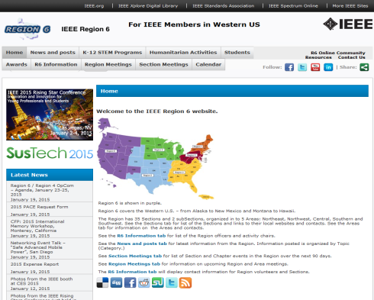
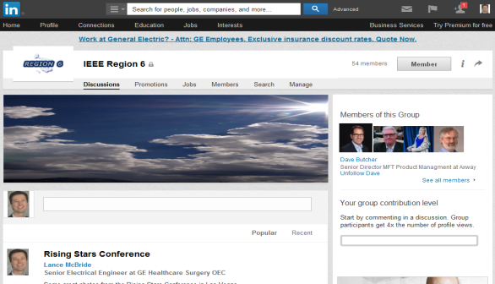
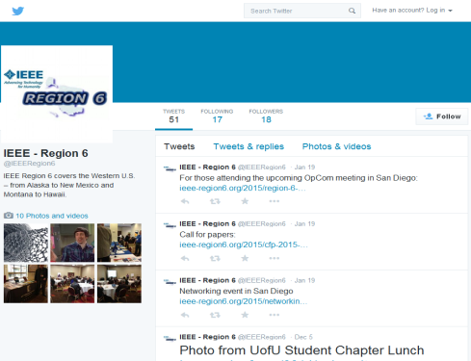
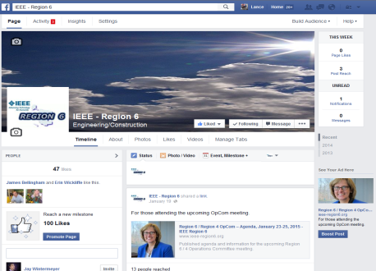
Region 6 Electronic Communications Social Media - Statistics
Website
46 posts created, ~4 per month
LinkedIn
54 members
Twitter
18 followers, 51 tweets
Facebook
47 “likes”

Slide 2
Region 6 Website – Statistics
Traffic (last 30 days)
3098 unique visitors/month
up from ~40/yr. last year
17986 page views
18:00 = most hits for hours of the day
Most searched keyword: “region images”
Most popular pages
1.) Home 2.) 2012 Life Member 3.) Calendar 4.) Bill Murray passing 5.) K-12 STEM
Most Visiting Countries
1.) US 2.) China 3.) France 4.) Ukraine 5.) Israel

Slide 3
Region 6 Website – to do
Move site to new IEEE template
Work with IEEE to get conference feed to calendar
Fix the automated calendar feed updates so it’s actually automated
Add volunteer interest page
Add/maintain “resources” page

Slide 4
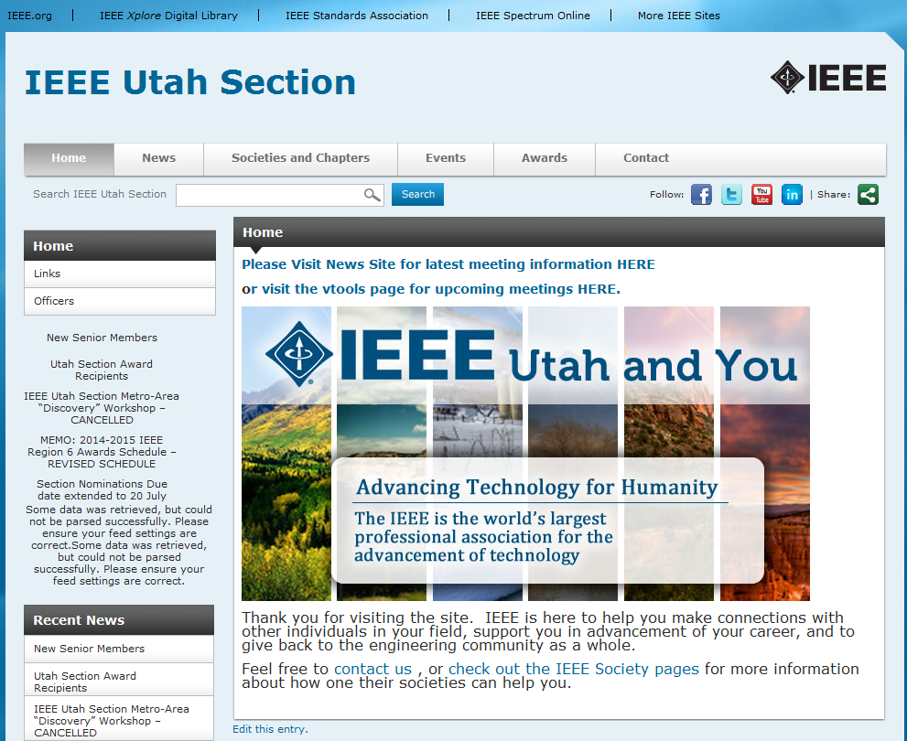
Utah Section Website – to do
Remove duplicate information
Organize for better access to information
Create site for upcoming conference at Weber State

Slide 5
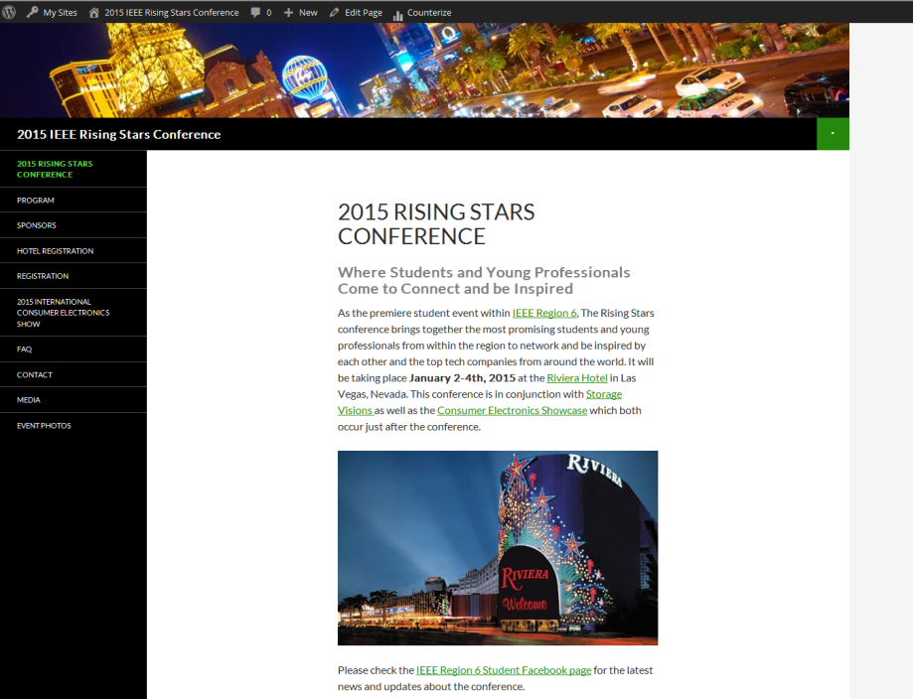
Rising Stars 2016 Website
Statistics
3478 Unique Visitors (total)
17467 Page Views (total)
Most popular pages
1.) Registration
2.) Program
3.) Presenter Biographies
Update with 2016 information
Speakers, Program, etc…
Find new template that better accommodates page formatting desires

