Slide 1
Treasurer’s Report
Russ Kinner, PE -> Scott Tamashiro
Region 6 Treasurer
r.kinner@ieee.org -> tamashiro@ieee.org
Region 6 OpCom
Spring (->Winter) 2015

Slide 2
IEEE Center for Leadership Excellence Volunteer Training
Section: Treasurer
Timeline:
As the Section Treasurer, there is a very strict timeline to follow in submitting some key financial reports back to IEEE Headquarters.
Two extremely important dates that a Section Treasurer should have in their calendar:
date to submit the sections financials [2/15 10%+, 3/31] and the second is the
date to submit your Sections Annual Budget for the next financial year [varies].
Both financial responsibilities should be completed using NetSuite.
http://ieee-elearning.org/CLE/course/view.php?id=20

Slide 3
Center for Leadership Excellence
Treasurer and Finance training available at:
http://ieee-elearning.org/CLE/course/category.php?id=14
Includes
Financial Management for Section and Chapters
and
NetSuite

Slide 4
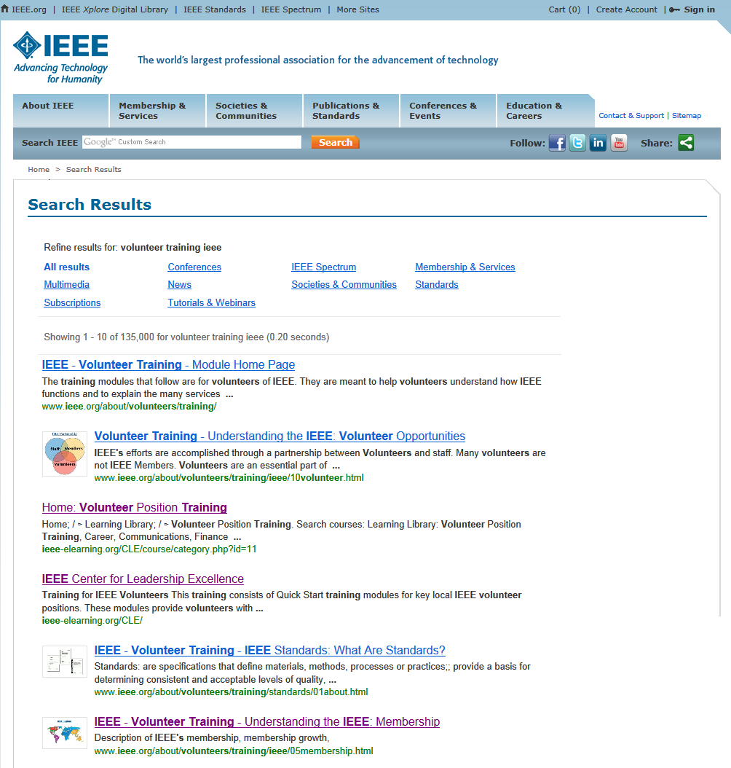

Slide 5
Section Rebate
Each Section receives US $2,000 plus:$3 / member (including Students, Associate Grade members)
$4 / Senior Member & Fellow
$1.50 / Affiliate
$200 / eligible Chapter & Affinity Group
$500 / eligible Subsection
10% bonus for reporting on time (Feb 15)
Activity bonus possible
Unit & sub-units must comply with activity & annual reporting requirements.

Slide 6
IEEE Concentration Banking
The IEEE Concentration Banking account works like a standard checking account. You make deposits, write checks, earn interest on the daily ending balance and you can view your statements online.
The features include:
banking supplies are provided free of charge
Bank by Mail: if a Wells Fargo branch is not in your area, postage-paid, Bank by Mail envelopes are provided for your convenience
access to online statements 24/7
no fee, incoming wire transfers
easy transfer of funds between Concentration Banking accounts
IEEE Concentration Banking Program Staff
E-mail: concentration-banking@ieee.org Phone: 732.562.5363

Slide 7
IEEE Financial Management & Control
IEEE and all Geo Units are exempt from US Federal Tax per section 501(c) 3. Documentation is available upon request for donors – contact the Region Treasurer.
IEEE is responsible for maintaining the financial records for all Geo Units worldwide
Compliance with IEEE Policies is important; in particular to IEEE maintaining the Institute’s nonprofit tax-exempt status in the U.S.
IEEE’s Fiscal Year is the calendar year (1 January through 31 December) as it is for Geo Units
Controls are established to ensure that the interests of the IEEE, its units and their officers are protected through Financial Reporting and Compliance

Slide 8
IEEE Financial Management & Control
Funds for geographic unit activities come directly & mostly from member dues
Treasurers & Section leaders make significant contributions to IEEE’s financial management by maintaining appropriate records & timely annual financial reporting
IEEE Geographic Units are not independent organizations, but instead are consolidated components of IEEE
Subsections, Chapters & Affinity Groups are sub-units of Sections & their financial activities should be incorporated in the Section’s financials (L-50)
Audits, Banking and Compliance Reviews are included in the annual processes

Slide 9
Asset, Expense & Cash Controls to be performed by the local unit leaders
Bi-annually:
Review check register
Monthly:
Review accounts
Annually:
Review & update bank signature cards, Conduct local Section audit & Assist in IEEE Audit if requested
Consider IEEE Concentration Banking program / custody account
Easiest way to be compliant with most of the IEEE processes & policies
Both outgoing & incoming Section Chairs / Treasurers review and sign off on annual L-50 Financial Report
Why?
Ensures the smooth transition of officers & mutual understanding of the unit’s financial status by both sets of officers
Protection for both outgoing & incoming Volunteer Officers

Slide 10
Contract Administration
Contracts in excess of US $5,000 & less than U.S.$25,000 can be executed (signed) locally with a copy sent to IEEE Procurement Department
All contracts with a stated or expected value at or above U.S. $25,000 ... negotiated & approved locally, executed (signed) at the Operations Center, after review by subject matter experts
Review by subject matter experts: Staff, Legal, Volunteers (as appropriate)
www.ieee.org/contractsonline
contracts@ieee.org

Slide 11
Insurance and Liability Insurance
General Insurance – Certificate Required
Serves as evidence for a 3rd party we are engaged with
Prepared by IEEE Insurance staff – 1-3 day process time
Name, address, event, description, etc. will be needed
Liability - Coverage is extended to IEEE’s Organizational Units, and to sponsored and co-sponsored activities.
Provides coverage in the event of liability due to bodily injury, personal injury, or damage to the property of others
Volunteers are included as additional insured while acting within scope of authorized duties
Contact ieeeinsurance@ieee.org or +1.732.562.5541

Slide 12
Expense Claims
Always use the current IEEE expense form with major item receipts and vouchers attached. The current form can be found on the IEEE Web site by searching for “20xx Expense Report” http://www.ieee.org/about/volunteers/committee/finance/finance_expense_report.html
Claims more than 30 days after travel may be disallowed
Auto mileage reimbursement requires at least three students per vehicle
All expenses exceeding $25 must have a receipt attached to the expense report to be approved

Slide 13
Expense Claims
Travel over 50 miles one-way will be reimbursed at the IRS approved mileage rate for business travel
Students living within a 50-mile radius of the Area meeting location do not normally receive any travel or meal reimbursements
Be sure to sign your expense report
Members who require submitting forms to Region 6 where a signature is required can optionally use an Electronic Signature technology. Any software package that meets the requirements for the UETA is acceptable

Slide 14
Expense Claims
All claims for travel (students and faculty advisors) should be e-mailed to the Area Chair with a copy to the Region 6 Student Activities Chairman and a copy to the Region 6 Treasurer.
If you don’t sign the Expense Report, you won’t get you money!!!

Slide 15
When do I get paid?
We are trying to get regular submittals to cut checks in batches and prefer to do it every 2 weeks to reduce labor costs at our Accounting firm
However, if you need $$ now, send an email for an expedited check
First batch of checks will be submitted Monday, January 26 and sent out later that week
HOP transfers also done in batches but more often as necessary
First batch of transfers will be submitted Monday, January 26

Slide 16
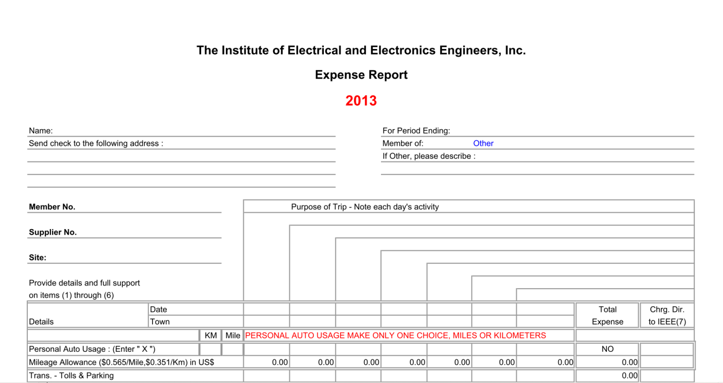
Select from drop down menu
Town where activity is being held– fill in each day
Address, if available, add Zip+4
Member number for audit requirements
X here for Personal Auto Mileage in miles
Enter each day’s miles

Slide 17
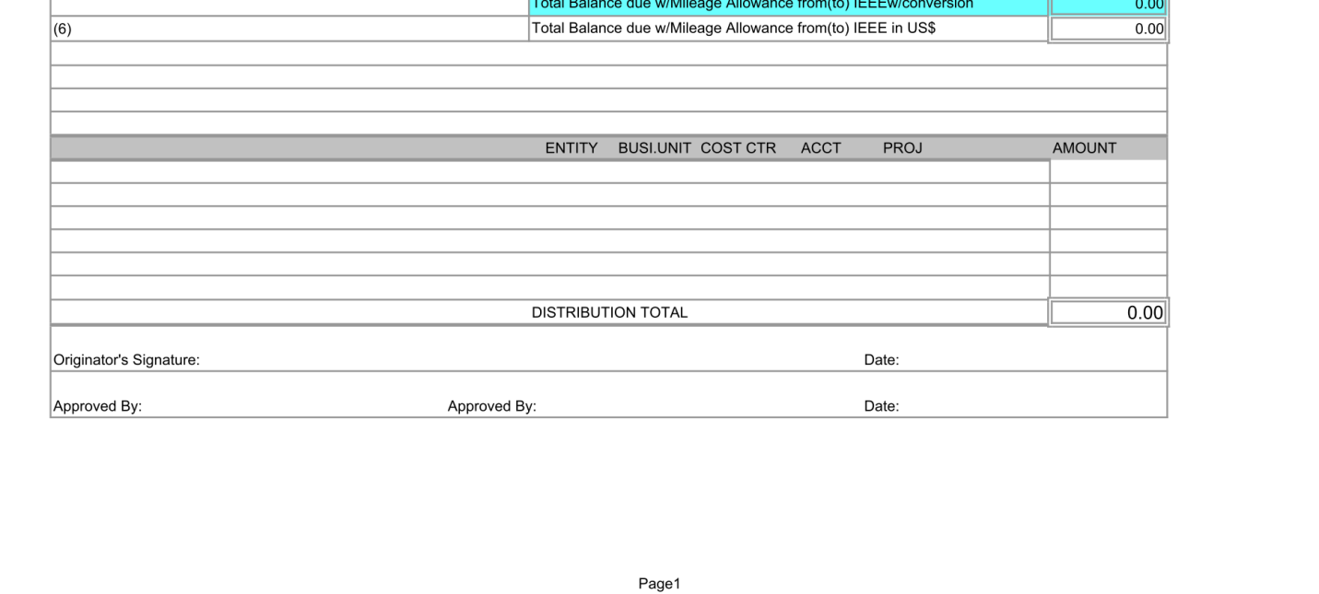
Don’t forget to sign – electronic signatures are OK meeting UETA requirements

Slide 18
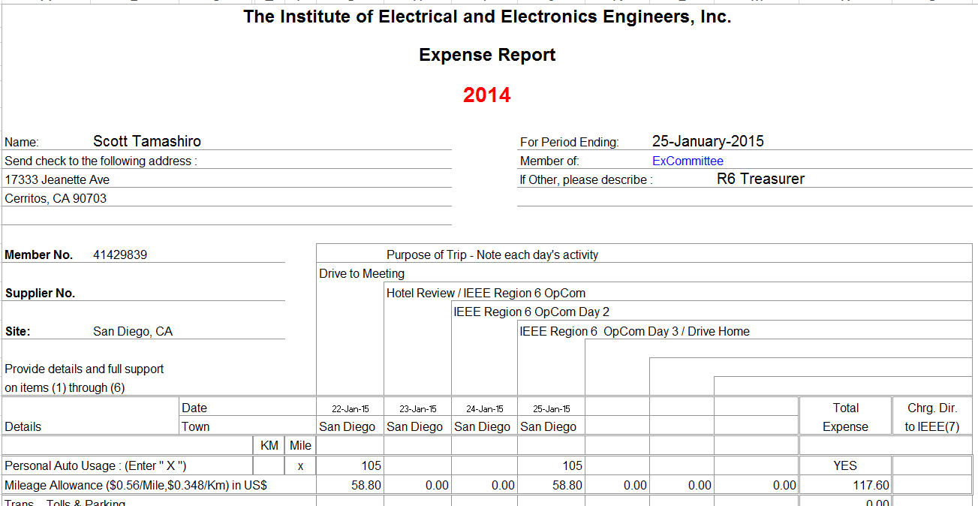
Example
5

Slide 19
What do I send to tamashiro@ieee.org and tom@tomcoughlin.com?
Since you asked, here’s my preference
ONE .pdf file consisting of:
Signed 1st page of Expense report
2nd page of Expense report (meals, parking, taxi, etc.)
Receipts of expenses over $25.00
Other
You may optionally send the XLS Expense report file, receipts under $25.00, supporting documentation, etc.
Brownie points:
PDF file name: Last-First_Event_Amount (Tamashiro-Scott_R6OpCom_$2.22.pdf)
Use common sense for expenses – we serve the membership
Take pictures of receipts or signed copy and convert to pdf (e.g., CutePDF)
Please note all exceptions or unusual circumstances or costs on Expense report (e.g., Late at night, safest option was taxi; hotel full, R6 director approved higher room rate; screenshot of Orbitz showing lowest airfares not so low!, etc.)

