Slide 1
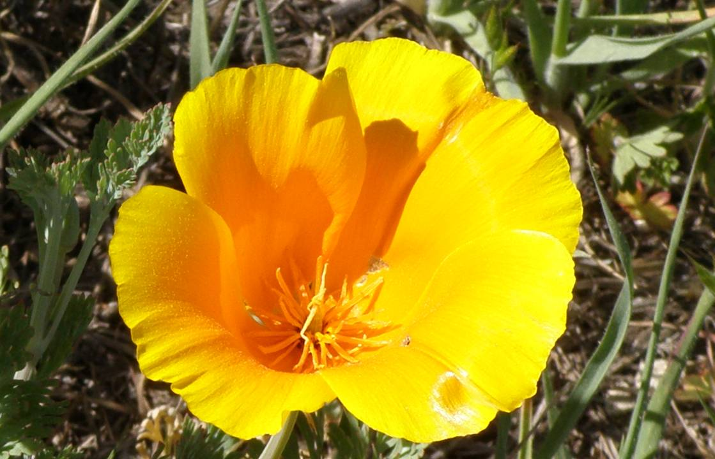
Letting a Thousand Flowers Bloom
Tom Coughlin,
IEEE Region 6 Director
2015-2016

Slide 2
Outline
IEEE Region 6 Objectives
The IEEE and Region 6
Region 6 Resources
Pursuing the Visions of Engineering
IEEE Region 6 Plans

Slide 3
IEEE Region 6 Objectives, 2015
Respect and enable the volunteer
Enhance membership and improve retention
Enhance our on-line experience
Create active alliances with industry and VCs
Create active alliances with academia
Create active alliances with technically oriented cultural groups and STEM
Recognize and celebrate our history
Make IEEE Region 6 cool, be creative

Slide 4
The IEEE and Region 6

Slide 5
IEEE Organization
MEMBERS
Board of Directors
Assembly
PSPB*
IEEE-USA
Educational Act.
Standards Assoc.
Member & Geographic Act.
Technical Act.
Executive Comm.
Regions & Sections
Societies & Tech. Councils
Staff & Society Executive Directors
*Publication Services & Products Board

Slide 6
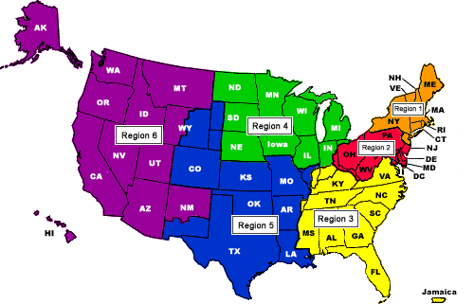
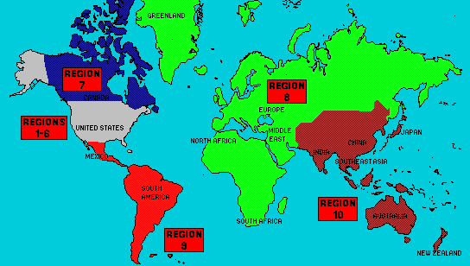
10 Regions, more than
300 Sections and
1,450 Student Branches, 38 Societies, 7 Councils, plus a growing number of Networks and Communities
425,000 members

Slide 7
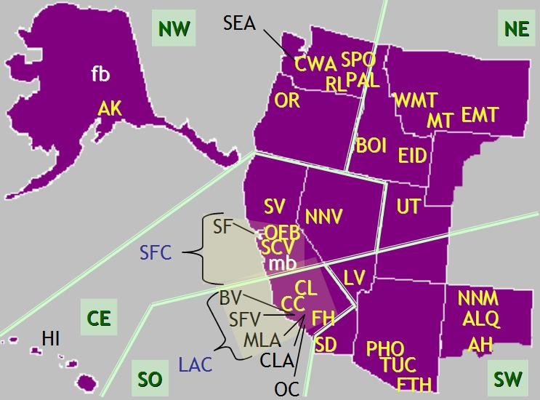

Slide 8
Region 6 - High Grade Members 2000-2014

Slide 9
Region 6 - Student Members 2000-2014

Slide 10
STATISTICS – Region 6
Region 6 – December 2014
Grade | Dec-14 | Dec-13 | Change | % Change
Honorary | 9 | 8 | 0 | 0
Fellow | 1,392 | 1,356 | 36 | 2.7%
Senior Member | 5,840 | 5,823 | 17 | 0.3%
Member | 39,044 | 39,703 | -659 | -1.7%
Associate | 1,199 | 1,375 | -176 | -12.8%
GSM | 2,987 | 3,432 | -445 | -13.0%
Undergraduate | 4,692 | 4,911 | -219 | -4.5%
Total | 55,163 | 56,608 | -1,446 | -2.6%

Slide 11
Can We Reverse this Trend?
What can we do to stem the decline of IEEE members in Region 6?
Is there an opportunity to retain more student members?

Slide 12
STATISTICS – Region 6, Sections
Region Code | Section Name | Total Members |  | Region Code | Section Name | Total Members
R6 | Alamogordo-Holloman Section | 16 |  | R6 | Orange County Section | 3065
R6 | Alaska Section | 459 |  | R6 | Oregon Section | 3796
R6 | Albuquerque Section | 1206 |  | R6 | Palouse Section | 339
R6 | Boise Section | 546 |  | R6 | Phoenix Section | 3239
R6 | Buenaventura Section | 797 |  | R6 | Richland Section | 368
R6 | Central Coast Section | 993 |  | R6 | Sacramento Valley Section | 1665
R6 | Central Montana Section | 157 |  | R6 | San Diego Section | 4382
R6 | Central Washington Section | 88 |  | R6 | San Fernando Valley Section | 1156
R6 | China Lake-Bakersfield Section | 243 |  | R6 | San Francisco Section | 2030
R6 | Coastal Los Angeles Section | 2345 |  | R6 | Santa Clara Valley Section | 11972
R6 | Eastern Idaho Section | 199 |  | R6 | Seattle Section | 4306
R6 | Eastern Montana Section | 127 |  | R6 | Spokane Section | 283
R6 | Foothill Section | 1202 |  | R6 | Tucson Section | 838
R6 | Fort Huachuca Section | 102 |  | R6 | Utah Section | 1344
R6 | Hawaii Section | 685 |  | R6 | Western Montana Section | 153
R6 | Las Vegas Section | 556
R6 | Los Alamos/Northern New Mexico Section | 271
R6 | Metropolitan Los Angeles Section | 1699
R6 | Northern Nevada Section | 375
R6 | Oakland-East Bay Section | 4161

Slide 13
Region 6 Society Memberships
 | 2014 / 12
 |  |  | Number of Assets |  |  |  |  |  |  |  |  |  |  | Total Memberships
Society |  | Acronym | H | LF | F | LS | SM | LM | M | AM | GSM | StM | AF
IEEE Aerospace and Electronic Systems Society Membership |  | AES010 |  | 28 | 10 | 62 | 79 | 131 | 399 | 5 | 25 | 33 | 5 | 777
IEEE Antennas and Propagation Society Membership |  | AP003 |  | 50 | 34 | 63 | 150 | 121 | 594 | 15 | 55 | 12 | 4 | 1098
IEEE Broadcast Technology Society Membership |  | BT002 |  | 8 | 4 | 12 | 20 | 42 | 132 | 8 | 3 | 3 | 5 | 237
IEEE Computer Society Membership |  | C016 | 1 | 109 | 148 | 155 | 580 | 666 | 4880 | 196 | 299 | 390 | 1513 | 8937
IEEE Circuits and Systems Society Membership |  | CAS004 |  | 50 | 79 | 33 | 182 | 117 | 1014 | 15 | 71 | 39 | 6 | 1606
IEEE Consumer Electronics Society Membership |  | CE008 |  | 9 | 11 | 28 | 94 | 74 | 546 | 16 | 18 | 34 | 3 | 833
IEEE Computational Intelligence Society Membership |  | CIS011 |  | 9 | 13 | 13 | 65 | 33 | 339 | 14 | 40 | 26 | 12 | 564
IEEE Communications Society Membership |  | COM019 |  | 61 | 138 | 158 | 541 | 391 | 3400 | 98 | 338 | 309 | 87 | 5521
IEEE Components, Packaging, and Manufacturing Technology Society Membership |  | CPMT021 |  | 14 | 22 | 20 | 107 | 45 | 413 | 13 | 13 | 7 | 5 | 659
IEEE Control Systems Society Membership |  | CS023 |  | 31 | 43 | 30 | 107 | 54 | 547 | 10 | 79 | 23 | 8 | 932
IEEE Dielectrics and Electrical Insulation Society Membership |  | DEI032 |  | 7 | 2 | 14 | 16 | 15 | 75 | 4 | 3 | 1 | 1 | 138
IEEE Education Society Membership |  | E025 |  | 14 | 10 | 23 | 51 | 28 | 137 | 1 | 8 | 5 | 1 | 278
IEEE Electron Devices Society Membership |  | ED015 |  | 83 | 95 | 86 | 387 | 172 | 1306 | 17 | 57 | 14 | 11 | 2228
IEEE Engineering in Medicine and Biology Society Membership |  | EMB018 | 1 | 22 | 28 | 49 | 131 | 75 | 646 | 7 | 91 | 60 | 51 | 1161
IEEE Electromagnetic Compatibility Society Membership |  | EMC027 |  | 18 | 3 | 38 | 86 | 51 | 370 | 15 | 7 | 4 | 5 | 597
IEEE Geoscience and Remote Sensing Society Membership |  | GRS029 |  | 19 | 20 | 13 | 52 | 34 | 195 | 14 | 12 | 4 | 10 | 373
IEEE Industry Applications Society Membership |  | IA034 |  | 20 | 11 | 95 | 158 | 125 | 657 | 7 | 14 | 10 | 4 | 1101
IEEE Industrial Electronics Society Membership |  | IE013 |  | 9 | 8 | 8 | 33 | 19 | 183 | 4 | 13 | 6 |  | 283
IEEE Instrumentation and Measurement Society Membership |  | IM009 |  | 14 | 6 | 21 | 54 | 40 | 288 | 12 | 9 | 4 | 4 | 452
IEEE Information Theory Society Membership |  | IT012 |  | 27 | 62 | 11 | 52 | 39 | 213 | 6 | 59 | 5 | 2 | 476
IEEE Intelligent Transportation Systems Society Membership |  | ITSS038 |  | 2 | 4 | 5 | 17 | 4 | 81 | 2 | 13 |  | 1 | 129
IEEE Magnetics Society Membership |  | MAG033 |  | 24 | 20 | 13 | 63 | 41 | 210 | 3 | 19 | 9 | 7 | 409
IEEE Microwave Theory and Techniques Society Membership |  | MTT017 |  | 72 | 63 | 95 | 295 | 165 | 1211 | 12 | 84 | 14 | 6 | 2017
IEEE Nuclear and Plasma Sciences Society Membership |  | NPS005 |  | 36 | 34 | 33 | 110 | 52 | 332 | 4 | 17 | 15 | 10 | 643
IEEE Oceanic Engineering Society Membership |  | OE022 |  | 9 | 7 | 12 | 32 | 30 | 140 | 10 | 17 | 15 | 3 | 275
IEEE Professional Communication Society Membership |  | PC026 |  | 1 |  | 3 | 9 | 13 | 69 | 5 | 2 | 2 | 15 | 119
IEEE Power & Energy Society Membership |  | PE031 |  | 72 | 32 | 240 | 377 | 292 | 2504 | 97 | 174 | 192 | 45 | 4025
IEEE Power Electronics Society Membership |  | PEL035 |  | 10 | 8 | 32 | 101 | 57 | 529 | 10 | 36 | 17 | 3 | 803
IEEE Photonics Society Membership |  | PHO036 |  | 32 | 52 | 38 | 149 | 53 | 553 | 9 | 55 | 10 | 20 | 971
IEEE Product Safety Engineering Society Membership |  | PSE043 |  | 4 |  | 8 | 28 | 7 | 131 | 8 | 4 | 3 | 1 | 194
IEEE Robotics and Automation Society Membership |  | RA024 |  | 9 | 27 | 14 | 108 | 33 | 755 | 12 | 110 | 93 | 9 | 1170
IEEE Reliability Society Membership |  | RL007 |  | 5 | 3 | 17 | 37 | 28 | 199 | 4 | 9 | 2 | 1 | 305
IEEE Society on Social Implications of Technology Membership |  | SIT030 |  | 15 | 2 | 16 | 20 | 23 | 112 | 4 | 12 | 4 |  | 208
IEEE Systems, Man, and Cybernetics Society Membership |  | SMC028 |  | 10 | 8 | 11 | 44 | 24 | 180 | 4 | 14 | 19 | 2 | 316
IEEE Signal Processing Society Membership |  | SP001 |  | 37 | 97 | 44 | 325 | 119 | 1227 | 16 | 132 | 26 | 20 | 2043
IEEE Solid-State Circuits Society Membership |  | SSC037 |  | 38 | 70 | 37 | 286 | 156 | 2043 | 33 | 150 | 24 | 22 | 2859
IEEE Technology and Engineering Management Society Membership |  | TEM014 |  | 4 | 2 | 18 | 32 | 34 | 145 | 4 | 2 | 2 | 3 | 246
IEEE Ultrasonics, Ferroelectrics, and Frequency Control Society Membership |  | UFFC020 |  | 15 | 8 | 16 | 43 | 30 | 202 | 6 | 13 | 2 | 2 | 337
IEEE Vehicular Technology Society Membership |  | VT006 |  | 22 | 12 | 22 | 47 | 41 | 276 | 6 | 14 | 10 | 3 | 453
Total Memberships |  |  | 2 | 1019 | 1196 | 1606 | 5068 | 3474 | 27233 | 726 | 2091 | 1448 | 1910 | 45773

Slide 14
STATISTICS - Total
Geographic IEEE Membership Summary - December 2014
REGION | Higher-Grade w/o GSM |  |  |  | Graduate Students |  |  |  | Undergraduate Students |  |  |  | TOTAL MEMBERS
 | 2014 | 2013 | Change |  | 2014 | 2013 | Change |  | 2014 | 2013 | Change |  | 2014 | 2013 | Change
 |  |  | # | % |  |  | # | % |  |  | # | % |  |  | # | %
1 | 28,743 | 29,840 | (1,097) | -3.7% | 2,065 | 2,243 | (178) | -7.9% | 2,531 | 2,419 | 112 | 4.6% | 33,339 | 34,502 | (1,163) | -3.4%
2 | 25,362 | 25,890 | (528) | -2.0% | 1,975 | 2,082 | (107) | -5.1% | 1,994 | 2,060 | (66) | -3.2% | 29,331 | 30,032 | (701) | -2.3%
3 | 24,227 | 24,366 | (139) | -0.6% | 2,398 | 2,557 | (159) | -6.2% | 3,573 | 3,729 | (156) | -4.2% | 30,198 | 30,652 | (454) | -1.5%
4 | 18,177 | 18,227 | (50) | -0.3% | 2,045 | 2,096 | (51) | -2.4% | 2,220 | 2,320 | (100) | -4.3% | 22,442 | 22,643 | (201) | -0.9%
5 | 23,583 | 23,880 | (297) | -1.2% | 1,997 | 2,016 | (19) | -0.9% | 2,897 | 3,024 | (127) | -4.2% | 28,477 | 28,920 | (443) | -1.5%
6 | 47,484 | 48,265 | (781) | -1.6% | 2,987 | 3,432 | (445) | -13.0% | 4,692 | 4,911 | (219) | -4.5% | 55,163 | 56,608 | (1,445) | -2.6%
R 1-6 | 167,576 | 170,468 | (2,892) | -1.7% | 13,467 | 14,426 | (959) | -6.6% | 17,907 | 18,463 | (556) | -3.0% | 198,950 | 203,357 | (4,407) | -2.2%
7 | 13,821 | 13,719 | 102 | 0.7% | 2,149 | 2,252 | (103) | -4.6% | 1,926 | 2,082 | (156) | -7.5% | 17,896 | 18,053 | (157) | -0.9%
8 | 55,908 | 55,652 | 256 | 0.5% | 11,607 | 12,036 | (429) | -3.6% | 10,691 | 10,909 | (218) | -2.0% | 78,206 | 78,597 | (391) | -0.5%
9 | 10,557 | 10,614 | (57) | -0.5% | 1,513 | 1,516 | (3) | -0.2% | 6,830 | 6,937 | (107) | -1.5% | 18,900 | 19,067 | (167) | -0.9%
10 | 61,557 | 60,349 | 1,208 | 2.0% | 16,661 | 15,624 | 1,037 | 6.6% | 34,318 | 36,144 | (1,826) | -5.1% | 112,536 | 112,117 | 419 | 0.4%
R 7-10 | 141,843 | 140,334 | 1,509 | 1.1% | 31,930 | 31,428 | 502 | 1.6% | 53,765 | 56,072 | (2,307) | -4.1% | 227,538 | 227,834 | (296) | -0.1%
TOTAL | 309,419 | 310,802 | (1,383) | -0.4% | 45,397 | 45,854 | (457) | -1.0% | 71,672 | 74,535 | (2,863) | -3.8% | 426,488 | 431,191 | (4,703) | -1.1%
% R7-10 | 43% | 43% |  |  | 52% | 50% |  |  | 64% | 64% |  |  | 49% | 49%

Slide 15
IMPORTANT LINKS
Member Loyalty Program
Recognize members for their years of service as a member with a Pin
Local units purchase at cost and present to members
Tiers of recognition for cumulative years of service in any official IEEE Membership Grade
Learn more at www.ieee.org/loyalty
Geographic Units FAQ’s
One-stop contact point for Geo-unit related questions and answers https://supportcenter.ieee.org
IEEE Resume Lab
Online service that allows IEEE members to develop a resume or curriculum vitae using a wide array of resume templates www.ieee.org/membership_services/membership/resumelab.thml

Slide 16
DEADLINES
Call for Fellow Nominations – The nomination period for the 2016 Fellow Class is open until 01 March 2015. Learn more at www.ieee.org/fellows
MGA Award Deadlines
15 May 2015
MGA Outstanding Large, Medium, and Small Section Awards
15 October 2015
MGA Larry K. Wilson Transnational Award
MGA Innovation Award
MGA Leadership Award
MGA Achievement Award
MGA Young Professionals Achievement Award
Anytime
Friend of IEEE MGA
Learn more at:
http://www.ieee.org/mga-awards

Slide 17
DEADLINES
MGA Nomination Deadlines
15 March 2015
2016 Vice President-MGA/MGA Board Chair
2016 MGA Treasurer and MGA Vice Chairs
2016 MGA Committee Chairs
01 August 2015
2016 MGA Committee Members
2016 MGA Liaisons appointed by VP-MGA
Nominate yourself or a colleague at:
https://mga-nomination-form.fluidreview.com/

Slide 18
DEADLINES
2014 Annual Reporting and Rebate Requirements
31 March 2015
Additional information can be found at www.ieee.org/societies_communities/geo_activities/mga_news.html

Slide 19
Region 6 Resources

Slide 20
Region 6 Roster (1)

Slide 21
Region 6 Roster (2)

Slide 22
Region 6 Roster (3)

Slide 23
Typical Spring Area Meeting
Focus is on section leader meetings and Section/Area/Region initiatives and committee reports
PACE
Student Activities
Awards
Others topics
Should focus more on future plans with less focus on past history—strategic and logistical focus

Slide 24
Typical Fall Area Meeting
Focus is on student training and student competitions
Student leader training
Student papers, micromouse, hackathons, etc.
Think about what we can do with these meetings to get the students to sign up and continue as full IEEE members

Slide 25
2015 Region and Area Meeting Schedule
Spring
Feb 23-25, 2015, Region 6 Meeting (Opcom)
March 21, NE Area Meeting
April 11, NW Area Meeting (Seattle)
April 18, SW Area Meeting
April 25, Central Area Meeting
May 2, Southern Area Meeting
Summer
August 15, Region 6 Strategy Meeting

Slide 26
2015 Region and Area Meeting Schedule (2)
Fall (Plan is to have at least 2 consolidated meetings—let’s decide today)
Oct 3, Area Meeting 1
Oct 17, Area Meeting 2
October 24, Area Meeting 3
Nov 6, Region 6 Excom

Slide 27
Pursuing the Visions of Engineering

Slide 28
Many IEEE Products to Keep You Current
Articles
Conferences
Technical Communities
Multimedia
Exhibits
BoKs
Periodicals
Training
Connect
Content and Coverage
Standards
Standards
Competency
Workshops
Curation
Training
Tutorials
Certification
Supported by all IEEE Functional Units
Webinars
Web Advertising
Dist Lecturers
Others (merchandise, books)
Notes:
BoK – body of knowledge

Slide 29
SXSW
Partners:
IEEE Standards Association
IEEE Technical Activities
Spectrum
Social Innovation team
Corporate Communications
Worked together to deliver
1 keynote
4 featured speakers
9 sessions
2 meetups
and a party

Slide 30
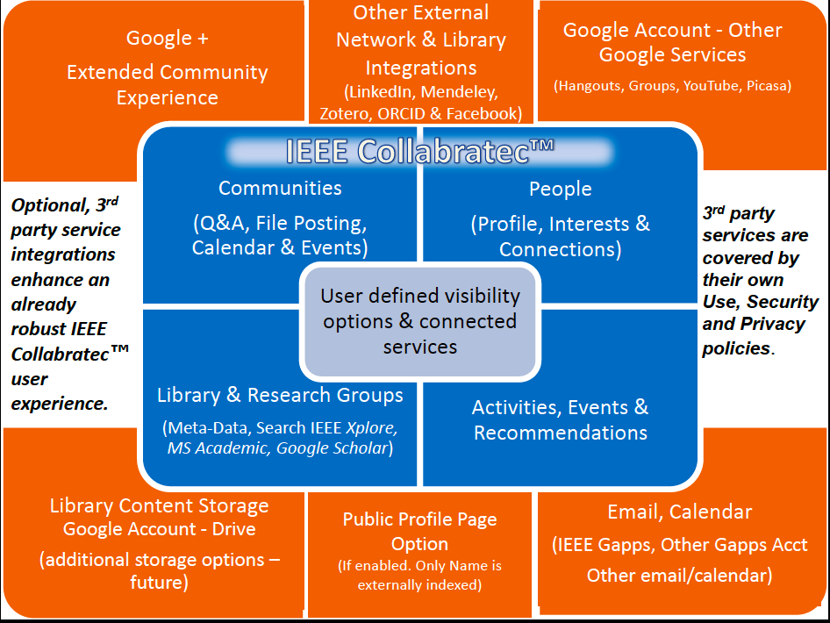

Slide 31
IEEE Can Be Cool, and Lead
We can bring in the best, be the best
We can get involved in worthwhile IEEE and non-IEEE activities
We can work to create a broader sense of the value and uses of technology—humanitarian as well as economic values
We can teach, inspire and mentor the next generation—yes, even IEEE Student Members
We can create the future you would like to live in—now that is cool!

Slide 32
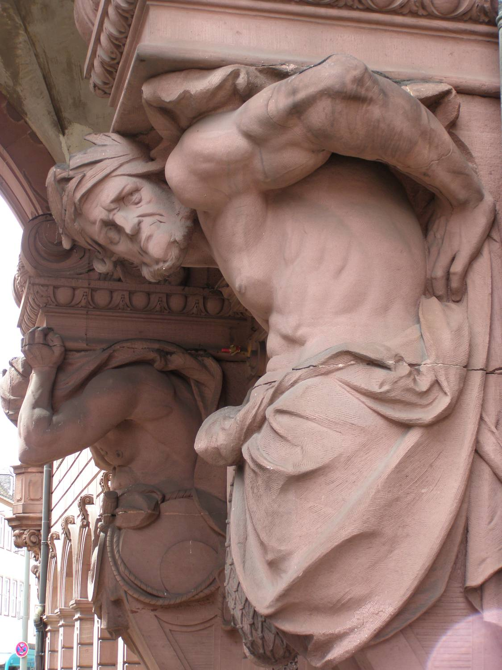
IEEE Region 6 Plans

Slide 33
Region 6 Conferences
WIE – April 23-25, 2015, San Jose
GHTC – October 2015, Seattle
SusTech – July/August 2015, near Salt Lake City
Rising Stars—January 3 & 4, 2016, Las Vegas
IEEE Day, October 6, 2015
SUSTECH 2013
Women in Engineering
International Leadership Conference
1st I E E E Co n f e r e n c e o n T e c h n o l o g i e s f o r Su s t a i n a b i l i t y

Slide 34
New Conference Ideas
We want to make the Region 6 web site the a resource for students, section leaders and IEEE members
Region 6 is looking at creating annual technology conferences with an industrial focus
Region 6 is looking into a conference on Intellectual Property
We will partner with other IEEE and non-IEEE entities on worthwhile events—like Techmanity, a SMPTE Conference, etc.

Slide 35
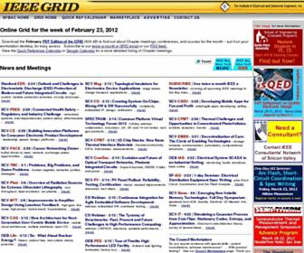
Create a Region 6 Meeting DataBase
We need a federated and easily searchable list of Region 6 meetings so IEEE members and others can find one where ever they go in R6
This could tie into our chapter meeting recording
Notes:
* Paul Wesling is already starting to work on teaching other sections how to do something like the SF BAC eGRID
* The value of such a federated list of meetings will become even more important as we have webinars of these meetings available—increases knowledge and thus participation in these meetings

Slide 36
Create an On-Line Collection of Technical Chapter Meeting Recordings
IEEE NIC funding of a pilot program in Region 4 and Region 6 starting this year
We will host these recordings with the IEEE Computer Society--available for free to all IEEE members
We intend to sell access to these recordings to non-members--enhance IEEE membership
We could have 100’s of these in a year’s time, 1000’s in 5 year’s time—this is cutting edge material

Slide 37
Virtual and Hybrid Conferences
IEEE Region 6 has acquired a license for VCopious, a program developed by the IEEE EAB for hosting virtual events
We are using this capability for the first time for this Rising Stars Conference
We plan to make this capability widely available for Region 6 events in 2015
This functionality can be used for many different types of events…

Slide 38
Schedule for the Weekend

Slide 39
Friday Schedule (1)
12:00 PM Lunch
1:00 PM Call to Order
Introduction
Review and vote on budget
2:00 PM Presentation and Discussion of Region 6 Strategies
Region and Area meeting agendas and schedules
Chapter Recording Initiative
Corporate Outreach
Academic Outreach
Conference Plans for Region 6 (including remote conference access plans)
Web Site Plans
Improving Section Meeting Publicity
Publications
STEM and Student Activities
Project Planning for initiatives
3:00 PM Break

Slide 40
Friday Schedule (2)
3:15 PM Committee Reports and Updates
Government Activities
PACE
Student Activities
Conferences
Education
Electronic Communication
Social Media/Webcasts
SAMIEEE
eGRID Propagation
WIE
Young Professionals
Membership Development
Pre-University
Awards and Recognition
Section/Chapter Report
Strategic Planning
Humanitarian Activities
Region Vitality
IEEE Engineering Milestones

Slide 41
Friday Schedule (3)
5:00 PM Break
5:15 PM R4/R6 Welcome, Introductions and Plans and Goals for the Weekend
6:00 PM Barry Shoop, IEEE President Elect (Joint R 4 and R 6)
6:15 PM Cecelia Jankowski, Managing Director, Members and Geographic Services
6:30 PM R6/R4 Mixer and Reception
7:00 PM Supper Region 4 and Region 6

Slide 42
Saturday (1)
Saturday January 24, 2015 (Region Meeting and Joint Training Day
7:30 AM Breakfast
8:30 AM Area/Section Breakouts, Region 6
Northeast Area
Northwest Area
Central Area
Southern Area
Southwest Area
9:45 AM Break
10:00 AM Region 6 and Region 4 Section Discussions:
Large Sections (>1,000 members)
Medium Sections (1,000 to 500 members)
Small Sections (<500 members)

Slide 43
Saturday (2)

Slide 44
Saturday (3)
6:00 PM IEEE President Elect Candidate Dialog
6:30 PM Lawrence Wong, Vice President, Member and Geographical Activities
6:45 PM Jeff Jeffries, IEEE USA President
7:00 PM IEEE USA President Elect Candidate Dialog
7:30 PM Supper on your own (or better with small groups from Region 6 and Region 4)

Slide 46
Create the Future of the IEEE

Slide 47
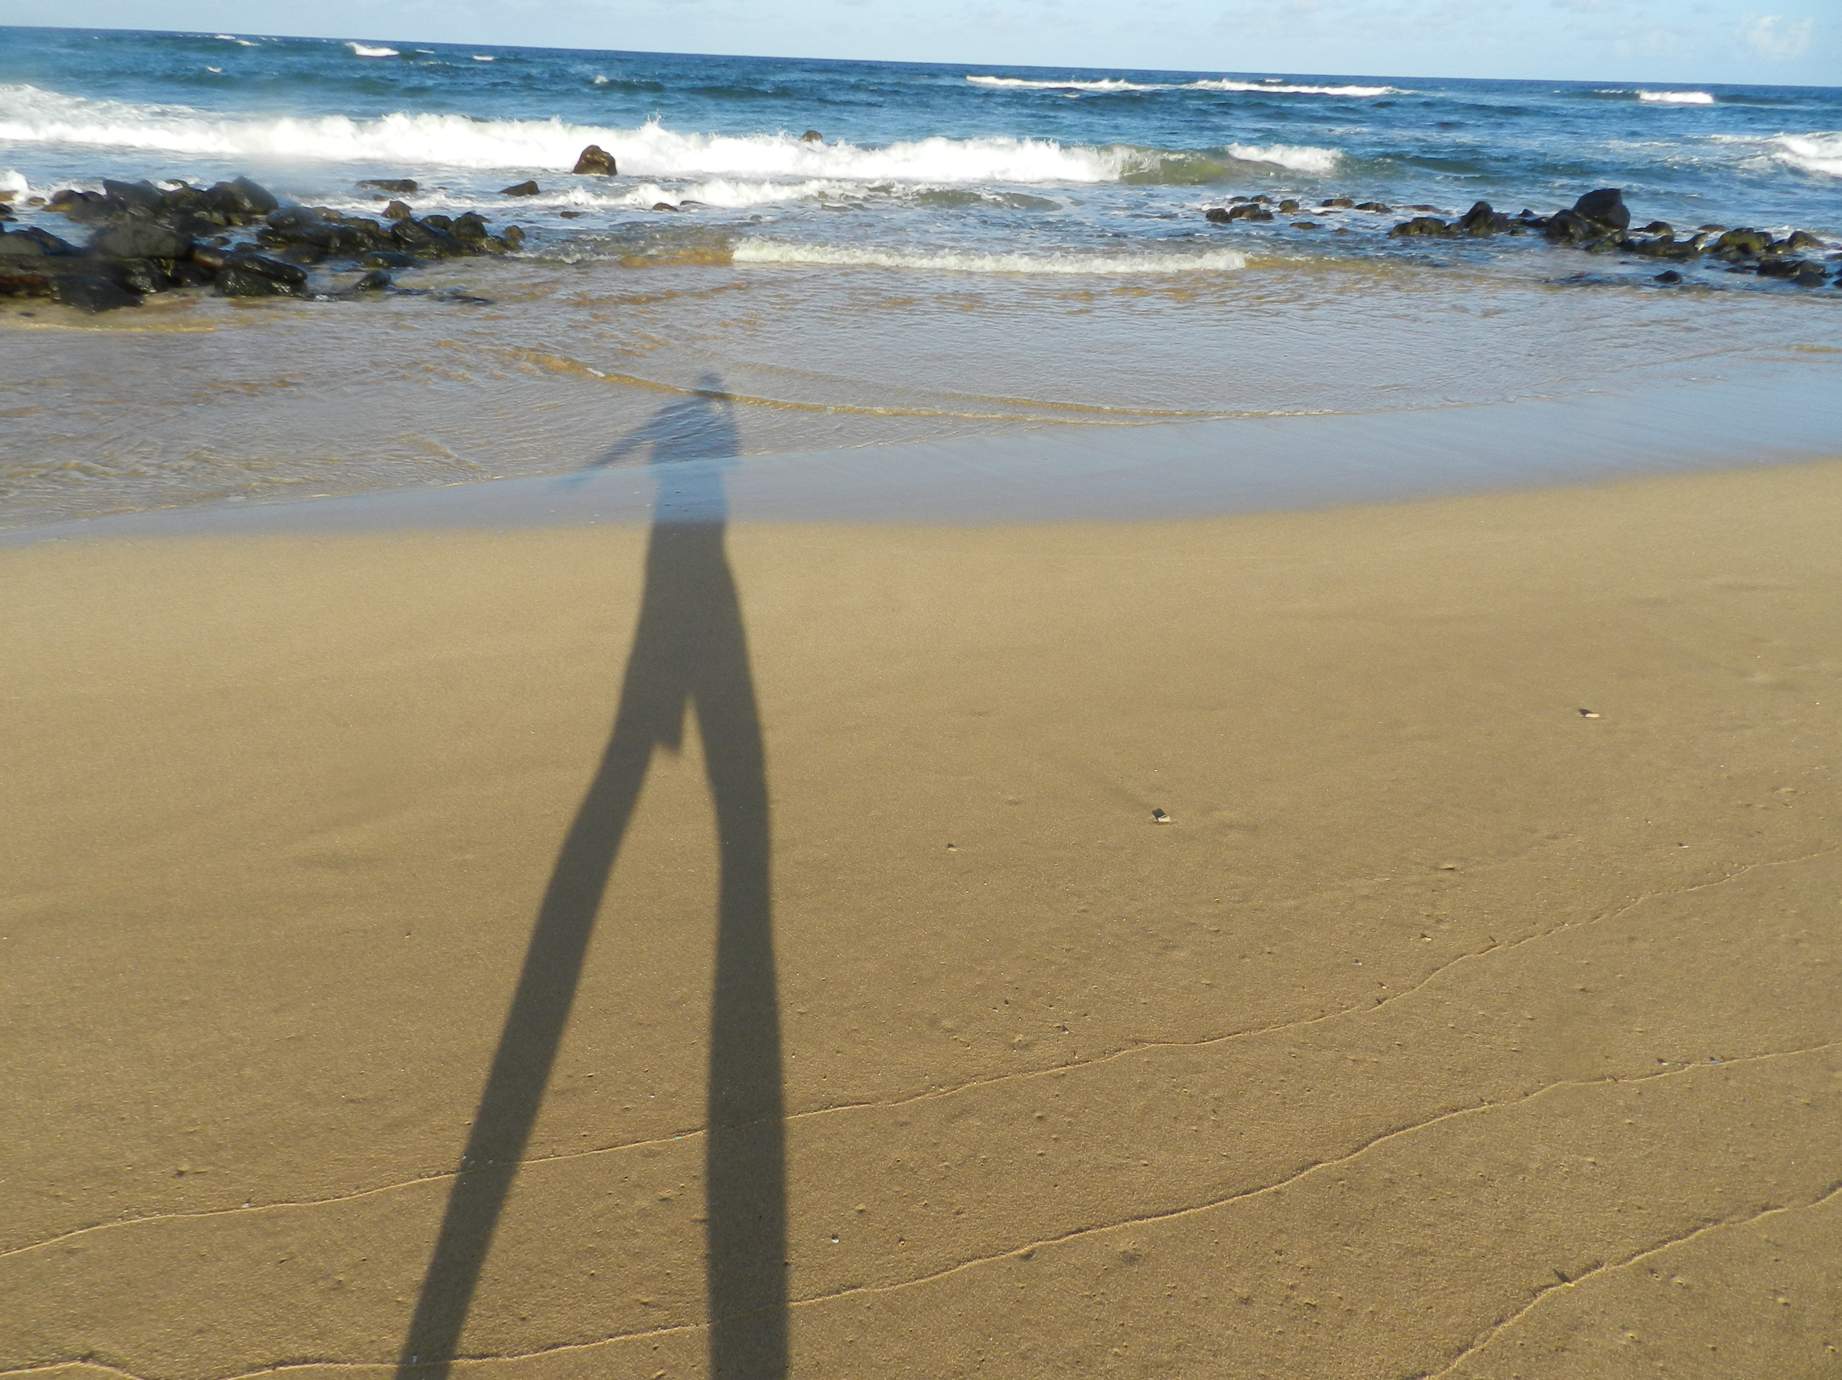
Thanks

