Slide 1
2015 Joint Region 4 and Region 6 Section Chair Training
January 24, 2015
Wyndham Bayside Hotel, San Diego

Slide 2
IEEE Organization
MEMBERS
Board of Directors
Assembly
PSPB*
IEEE-USA
Educational Act.
Standards Assoc.
Member & Geographic Act.
Technical Act.
Executive Comm.
Regions & Sections
Societies & Tech. Councils
Staff & Society Executive Directors
*Publication Services & Products Board

Slide 3
MGA Board Vision
Ensure quality
member opportunities
for continuous engagement.
Notes:
Here is the vision of MGA, to ensure quality member opportunities for continuous engagement.

Slide 4
MGA Board Mission
Inspire, Enable, Empower and Engage Members of IEEE
For the purposes of:
fulfilling the mission of IEEE;
enhancing the members growth and development through their life cycle;
providing a professional home.
Notes:
Here is the mission of MGA, to Inspire, Enable, Empower and Engage Members of IEEE
For the purposes of:
fulfilling the mission of IEEE;
enhancing the members growth and development through their life cycle;
providing a professional home.

Slide 5
Geographic & Technical Unit Relationships
Regions
Affinity Group Parents
(WIE, CN, GOLD)
Sections
Councils
Student Branches
Student Branch Chapters
Societies
Affinity Groups
Chapters
Notes:
This slide represents one part of the IEEE
It is intended to help you visualize the relationships between the Technical and Geographic organizations of the IEEE.
For example, a technical Chapter is the responsibility of both the Section where it is located and the particular technical Society, while Student Branch Chapters are the responsibility of the particular Student Branch and the Society.
Note that Councils can have Chapters and/or Affinity Groups, just like a Section.

Slide 6
Geographic Unit Relationships
Regions oversee Sections
Section Chair reports to Region Director
Sections oversee Subsections, Chapters, Student Branches and Affinity Groups
Councils are comprised of Sections, and exist at the pleasure of the member Sections
Some Councils (but not all) have Chapters and Affinity Groups, and therefore oversee them
Notes:
In an effort to better understand the way the IEEE volunteer organization works, it’s important to understand the relationships between units as explained here.
Note that while Councils can have subunits just like Sections, they are managed by their member Sections, and, as per IEEE Bylaws, exist at the pleasure of the Sections.

Slide 7
Geographic Unit Relationships
Affinity Group Parents also oversee Affinity Groups
Women In Engineering (WIE)
Consultants’ Networks
Young Professional Organization (YPO)
Life Members
Student Branches oversee Student Branch Chapters and Affinity Groups
Societies also oversee Chapters and Student Branch Chapters
Notes:
In the last three years, we have seen the growth of Affinity Groups. Right now, there are three types of approved Affinity Groups: Women in Engineering, Consultants’ Networks and Graduates of the Last Decade, or GOLD. Like Chapters, the Affinity Groups have two “parents” . . . The Section and the sponsoring parent committee.

Slide 8
Region Goals/Objectives
Respect and enable the volunteer
Enhance membership and improve retention
Enhance our on-line experience
Create active alliances with industry and VCs
Create active alliances with academia
Create active alliances with technical cultural groups and STEM
Recognize and celebrate our history
Make our Region cool, be creative
Notes:
The Goals and Objectives of the Section should follow the Goals and Objectives of the Region

Slide 9
IEEE Ethics & Member Conduct
IEEE Code of Ethics
All items relevant, but remember to:
treat fairly all persons regardless of such factors as race, religion, gender, disability, age, or national origin;
avoid injuring others, their property, reputation, or employment by false or malicious action;
assist colleagues and co-workers in their professional development and to support them in following this code of ethics.
http://www.ieee.org/web/aboutus/ethics/
Notes:
Before addressing the issue of the individual tasks of Section Volunteers, I’d like to take a moment to remind you of the IEEE Code of Ethics. The Code of Ethics was last revised & approved by the IEEE Board of Directors in 1990.
Although all 10 points are relevant to every member and volunteer of our organization, I would like to bring to your attention the last three items in particular. These are especially important for our volunteers to remember: to treat fairly all persons regardless of such factors as race, religion, gender, disability, age, or national origin;
to avoid injuring others, their property, reputation, or employment by false or malicious action; and
to assist colleagues and co-workers in their professional development and to support them in following this code of ethics.

Slide 10
Questions?

Slide 11
I’m a Section Chair, I . . .
Know about: IEEE Bylaws; IEEE Policies; MGAB (Members and Geographical Activities Board) Operations Manual
Chair meetings
Work with ExCom, Committee, Chapter and Affinity Group Chairs to support activities
Represent Section at Region meetings
Am the point of contact for Region Director
Am a signer on bank account
Know where section archives are located
Maintain mailing address
Notes:
Before I talk about what the Section Chair does, I should mention that this is also what the Vice Chair does when the Chair is not around. It’s a training ground for the Vice Chair to take over, as is often the case.
As Section chair, you are expected to be familiar with the IEEE bylaws, Policy and Financial Operations Manual as well as the MGA Operations Manual. You will chair the Section meetings, not just the ExCom, but also, if appropriate, Section general meetings.
As Chair you should work with the ExCom and other officers to support the activities of the Section’s subunits.
You represent your Section at Region meetings, and should be authorized to sign checks against the Section’s bank account.

Slide 12
I’m a Section Vice Chair, I . . .
Chair meetings in absence of Chair
Am familiar with the policies relating to the activity of the Section and subunits, including IEEE bylaws, IEEE Policies, MGAB Operations Manual
Assume additional authority, responsibility or activity as designated by Chair
Notes:
As Vice Chair you do everything the Chair does on call, but you are also responsible for additional duties as maybe assigned by the Section Chair or Section Executive Committee. Some Sections have structured their organization such that the Section’s Vice Chair is the liaison to the Section’s Chapters. Perhaps your Vice Chair should be responsible for volunteer recruitment? Or maybe conferences – tracking conference activity within the Section and attracting conferences to your Section? If the role of Vice Chair in your Section isn’t clearly defined, consider the possibilities.

Slide 13
I’m a Section Treasurer, I . . .
Prepare the annual budget
Record all financial activity
Reconcile bank statements/activity
Report status of unit’s finances to the Section ExCom on a regular basis
Prepare and submit Annual Financial Report (L-50)
Signer on bank account
Notes:
As the Section Treasurer, you are responsible for drafting the annual budget for presentation to the Section Executive Committee prior to the beginning of the budget year.
In addition, you record all expenses and income, and any other financial activity. On a monthly basis, you reconcile the bank statements. At every Section Executive Committee meeting, you should provide a brief report on the status of the Section’s finances. If possible and appropriate, you should share concerns or triumphs with regard to subunit finances, such as Chapters that are struggling financially, or a Chapter that was recently awarded a grant.
The Treasurer prepares the annual financial report, known as the “L50,” to IEEE Headquarters. The Treasurer is also an authorized signer on the Section’s bank account.

Slide 14
I’m a Section Secretary, I . . .
Record minutes of ExCom and other Section meetings
Handle correspondence
Distribute meeting notices
Maintain Section records and archives
Submit officer and meeting reporting, including officer changes during the year, to IEEE Operations Center
Know mailing address
Notes:
The Section Secretary is expected to record and publish the minutes of the Section’s Executive Committee meetings, and when appropriate, Section general meetings. The Secretary handles all general correspondence for the Section, including notifying officers of Executive Committee meetings and the membership of general meetings.
The Section Secretary maintains the Section’s records, including officer reporting and meeting activity reports. The Secretary accumulates this information for submission annually to IEEE Headquarters.
If there is a change in officers during the year, it is the responsibility of the Secretary to notify IEEE as soon as possible.

Slide 15
I’m a Chapter Chair, I . . .
Preside at Chapter ExCom and other meetings
Work with other Chapter officers to determine program of activities for Chapter
Represent Chapter at Section ExCom meetings and Society-sponsored meetings
Am familiar with IEEE Bylaws, IEEE Policies, MGAB Operations Manual, and any Society requirements for activity
Submit or ensure submission of required reporting to Section and Society
Notes:
Chapter chairs are responsible for the smooth operation of their Chapter, and that includes chairing the meetings. In addition, the Chair should be working with their fellow Chapter officers to determine a program of activities. Chapter Chairs may also find it advantageous to keep track of the general activities of the other Chapters in the Section. There maybe opportunities for collaboration.
The Chapter Chair represents the Chapter at Section and Society meetings, if called upon to do so. Some Sections have so many Chapters that they have one individual designated as a Chapter representative. In that case, the Chapter chair should be proactive in keeping the Chapter representative informed.
The Chapter Chair is familiar with the appropriate governance documents, as well.
Last, the Chapter Chair should either submit or make sure that the appropriate volunteer is submitting their reports, copying the Section Secretary.

Slide 16
New Officer Training
As an ExCom team, ensure all new officers get the training they need to succeed
IEEE CLE (Center for Leadership Excellence)
https://ieee-elearning.org/CLE/
25 Volunteer Positional Training Modules
http://www.ieee.org/web/geo_activities/units/Resources/Officer_Training/index.html - HQ training
http://ewh.ieee.org/reg/4/training.php – R4 training

Slide 17
Requirements of each Section
Monthly Officer Duties
http://www.ieee.org/web/geo_activities/units/Resources/calendar_.html
All Sections are required to operate according to the MGAB Operations Manual (see 9.4)
www.ieee.org/portal/cms_docs_iportals/iportals/volunteers/mga/home/MGAOPSMAN/MGA-Manual-Jan2008.pdf

Slide 18
Requirements of each Section
Sections are allowed to have an addendum or separate governance document
Section bylaws are no longer required. But, if required by local law, Sections and Councils may create their own addendum/bylaws, using the MGAB Operations Manual as a guideline.

Slide 19
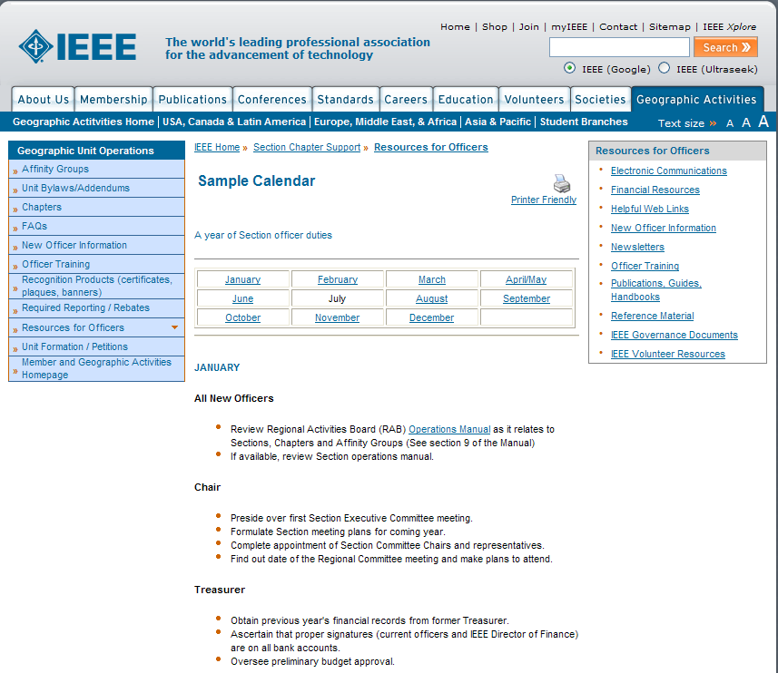
Monthly Section Officer Duties

Slide 20
Section Operations Manual
Provides logistical information for management of Section
Vendors or venues used
Handling of reimbursements
Officer transition
Newsletter & web page management
And more . . .

Slide 21
Is Your Section in Compliance?
Calendar year term of office
Fiscal year = calendar year
Signature of IEEE Staff Director on bank signature cards
Use of Concentration Banking system
Notes:
Here is a list of recent policy changes which should be included in an update of your Section’s bylaws. As I said, non-US units maybe constrained by government or banking regulations. If that is the case, please keep staff informed of your Section’s status.

Slide 22
Leading your Section
Chair ExCom leadership
Planning
Organizing/structure/guidance ->
ExCom meetings
Section/Chapter meetings
Coaching & Mentoring
Section officers
Succession planning
Delegating
Section reporting
Financial – Treasurer
Meetings & Officers – Secretary
Section meetings – speaker/topic/food
PACE Activities
Student Activities
Educational Activities
Awards & Recognition
Membership Development
Pre-University Activities
Outreach
Historian
Newsletter Editor
Web master

Slide 23
Ex-Com Meetings
Section ExCom meetings
Lead time
Agenda
Section event timeline ->
Food
Execution
Follow agenda
Hold people accountable for action items
Pre-meeting lobbying

Slide 24
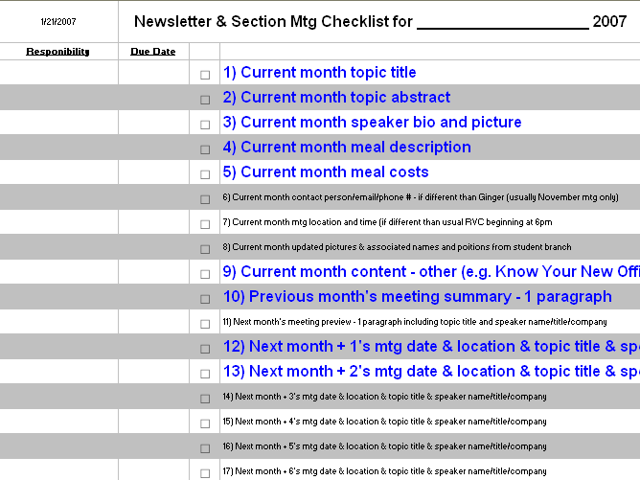
Monthly Planning

Slide 25
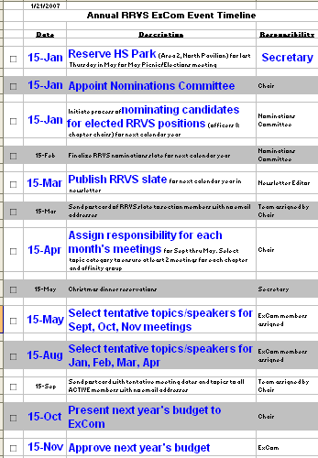
Sample Planning Task List

Slide 26
Required Reporting to IEEE
Officers
Within 20 days of election
Section reporting requirements
Meetings – L31 Form
Electronic submittal
Report all meetings, including social & administrative
Joint meetings
Counts as two separate meetings
Submit form for each entity
Qualification for rebate
5 meetings for section and subsections
2 technical meetings for Chapters
Financial– L50 Form by March 31

Slide 27
Section Operations
Running a section
Section meetings
Adequate lead time
Location
Facility
Equipment
Food
Speaker
Meeting notices
Newsletter

Slide 28
Questions?
Brief guidelines summary

Slide 29
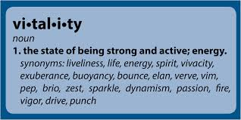
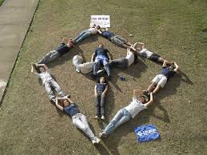
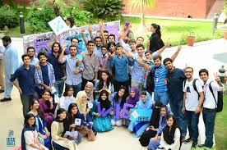
Section Vitality
Providing the answer to
“Why I joined IEEE”

Slide 30
Section Metrics/Vitality
Use the IEEE Vitality Dashboard provided by your Area Chair
Within meeting season, and year to year
Section membership
Section/chapter/affinity group meeting attendance
Number of meetings
Section
Chapter
Joint
Affinity group
Number of ExCom members

Slide 31
Vitality Dashboard
www.ieee.org/societies_communities/geo_activities/dashboard.html
Enables you to track all meetings and activities in the section including:
Technical
Professional (continuing education, professional development, industry relations
Non-technical (social, awards, pre-university)
Administrative (ExCom, OpCom, training)

Slide 32
Dashboard measures
A Dashboard can have one or more instances of the following kinds of widgets:
Metric — displays a simple numeric representation
Timeline—displays a graph of the selected metric over time
Geomap—displays a map of the selected region
Table—displays up to 2 metrics describing the selected dimension
Pie—displays a pie chart of the selected metric
Bar—displays a bar chart of the selected metric

Slide 33
Section metrics
You select your key metrics based on your section goals. What do you want to accomplish?
Number of section and chapter meetings
Outreach activities (PACE, SPAx, PreUniversity, corporate, social, etc.)
Membership growth or engagement
Awards and Recognition activities
Web hits

Slide 34
GEO UNIT VITALITY – DASHBOARD example
Goal
Progress
Develop a Section Vitality Dashboard to enable Section leaders to easily monitor the activities and health of the Section
Milestone | Target Completion | % Complete
Launch Phase 1 | Q1 2014 | 100%
Launch Phase 2 | Q2 2014 | 100%
Create Scope and Business Requirements for Phase 3 | Q3 2014 | 10%
Design | Q3 2014 | 0%
Develop | Q4 2014 | 0%
Perform usability testing and QA | Q4 2014 | 0%
Launch Phase 3 | Q4 2014 | 0%
Member Experience Improvement
Volunteer experience improvement
Create a structure within the SAMIEEE environment
Minimize the use of Ad Hoc reporting
Uses data from SAMIEEE (data warehouse)
Project Success - Metrics
Budget
Engaged volunteers
Improved volunteer satisfaction
Increased Geo Unit activity
 | MGA | Notes
2014 |  | Included in IBP Enterprise Release budget. Additional funding may be required for any vTools development

Slide 35
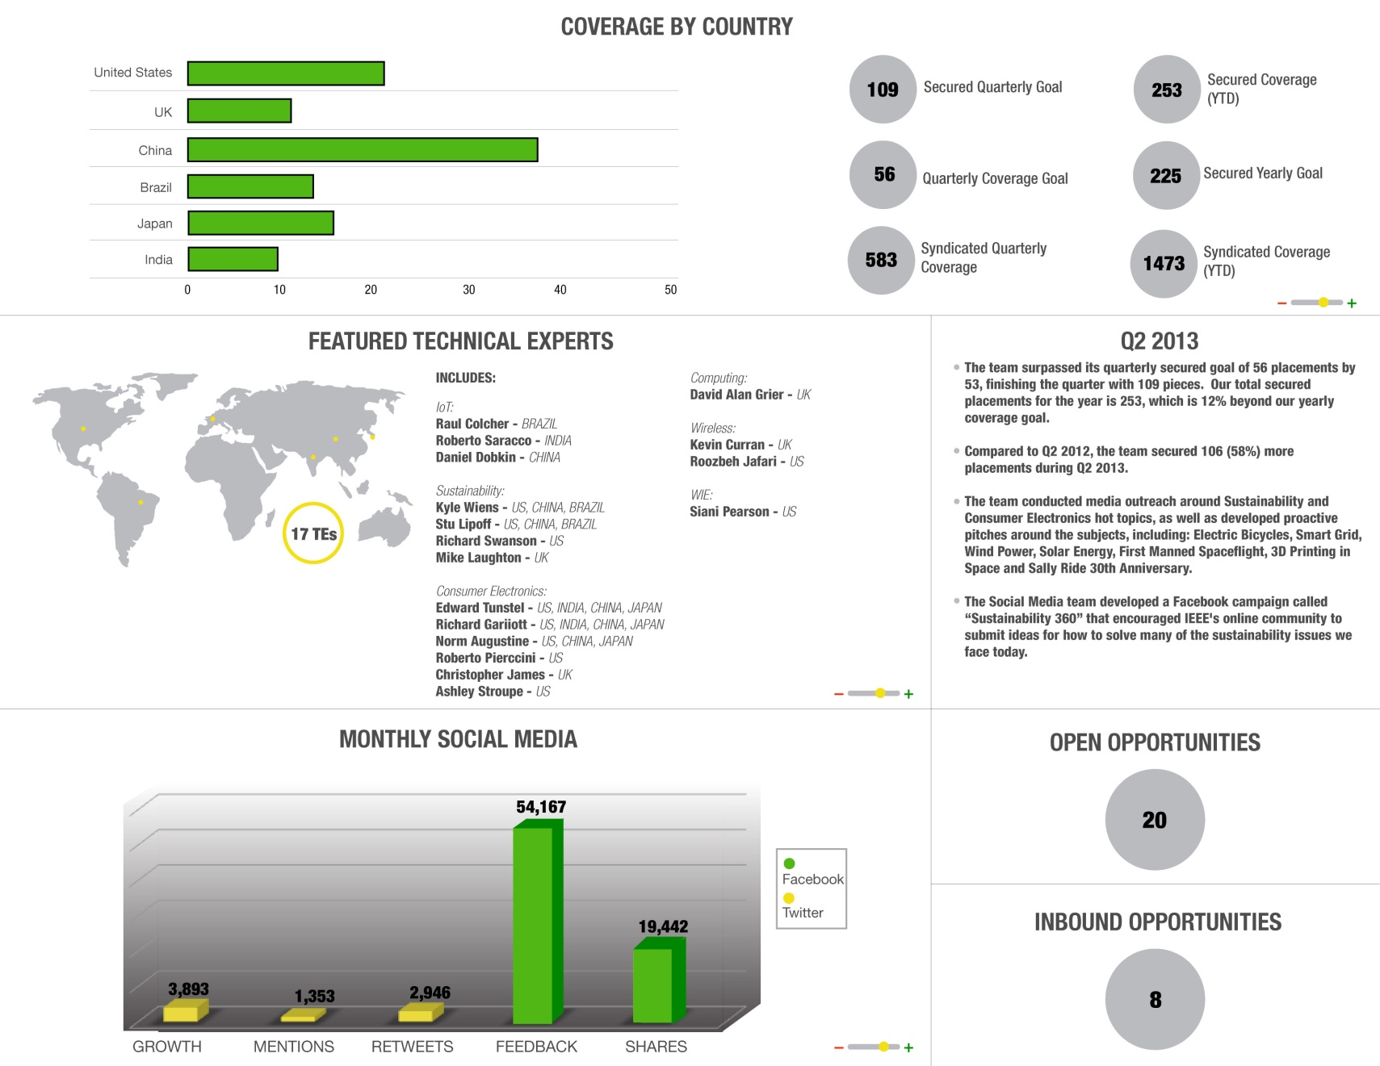
Q2 Dashboard - example

Slide 36
MGA Initiatives
Increase the value of IEEE membership.
Utilize member life cycle concept.
Provide a simple, consistent interface to members and prospective members.
Track member involvement and development.
Notes:
The overall planning for your Section, Region and all IEEE Operating Units should reflect the Initiatives that MGA is trying to accomplish.

Slide 37
MGA Initiatives
Make the process of joining and maintaining membership simple and straightforward.
Facilitate member collaboration.
Become more transnational in look, feel, and language, consistent with the IEEE bylaws.
Strengthen the relevancy of IEEE membership to industry.

Slide 38
Section Goals
Planning should reflect both MGA Goals/Initiatives and Region Goals/Initiatives
Use Vitality Dashboard to track your progress in becoming a stronger Section.
NOTE: create and promote a Calendar of Events
NOTE: create a 90-day plan that tracks 3-4 initiatives
Assure fun, excitement, interaction, development
Notes:
The overall planning for your Section, Region and all IEEE Operating Units should reflect the Initiatives that MGA is trying to accomplish.

Slide 39
Section Programs
It is your responsibility to implement a diverse number of activities that will engage your membership.
Some considerations include:
Aspects of successful meetings
Technical programs
Educational programs
Professional programs

Slide 40
Website
Section/Chapter/Branch Pages:
Information and knowledge
Marketing tool
Easy to navigate
Communication conduit
Resource center
Media attraction
Funding and support sources
Key events

Slide 41
Event planning
Sample PACE event
Event Title: (insert event name)
Officer: Position or Person responsible
Location:
Date/Time:
Topic:
Networking for the Career You Want
Job Search
Difference Makers
Leadership
Interviewing Skills For Engineers

Slide 42
Successful Meetings
Select a topic
What interests your members?
Do not limit subject matter - related fields may be appropriate and of interest (technical, educational, professional)
Select a format
Seminar, tutorial, conference, lecture?
Select a location
Offices, university, school, library, church, public building
Notes:
The subject and format are easy to establish. You will usually have a good idea of the kinds of subjects that most interest your Section, Chapter and Affinity Group members. In addition, it is helpful to ask the members to submit suggestions. Keep in mind that the subject matter need not be limited to electrical engineering – any related technical field is appropriate, as long as it interests the membership.
Choosing the format for the meeting – seminar, tutorial, conference or lecture – will largely depend on your objectives. Do you wish to present diverse opinions on a current topic? Will your members benefit most from the knowledge of several authorities or the expertise of a single individual? How much time do you have available? Answering questions like these will help determine the most appropriate format for your meeting.

Slide 43
Logistics
Centrally located, conveniently accessible
Sufficient parking
Select a regular schedule for meetings
Plan ahead for 6 months or a year
Post meeting info on Web, newsletters or emails

Slide 44
Technical Programs
Find a good speaker
Distinguished Lecturers Program
www.ieee.org/portal/pages/tab/cha/lectweb2.html
Authors of papers with appropriate interesting material
Consult other Chapters or your Society members
Local colleges and universities
Local professional associations
Corporations in your area
Other Adjacent Sections/Chapters
Notes:
An excellent tool available to facilitate the process of finding speakers is the IEEE Distinguished Lecturers Program. This program lists the names, topics and contact information for lecturers from participating IEEE Societies and Technical Councils. To find out more, send an email to society-lecturers@ieee.org. You may also want to consider the following mechanisms for finding speakers:
Survey recently published papers and contact authors of appropriate or interesting material.
Consult other Chapters or your Society.
Check with other professional associations in your area.
Contact local colleges or universities. Faculty members who belong to IEEE will be glad to recommend possible speakers. Calling on the head of the Electrical Engineering Department could be a first step. The Student Branch of the IEEE is also a good resource for identifying speakers on campus.
Corporations in your area are another possible source of speakers. The Director of Engineering, who might also be an IEEE member, can probably tell you if the company has a suitable candidate on staff. You may even discover that the company has a speaker referral service for just this purpose.

Slide 45
Educational Programs
Find a course
www.ieee.org/web/education/ceus/organize.html
IEEE Expert Now
www.ieee.org/web/education/Expert_Now_IEEE/modules.html
IEEE Standards Education
www.ieee.org/portal/cms_docs/education/setf/index.html
Apply for CEUs (if applicable)
Notes:
Technical Societies offer tutorials and short courses at conferences; Sections and Chapters sponsor short courses and talks at their meetings.
IEEE Expert Now is a course collection designed for those in the engineering sciences, research and technology. The courses are selected from IEEE conference tutorials, presented by esteemed experts, one or two hours long, web accessible and offer CEUs. They fit well in Career and Professional Development, and as a way to enhance organizational Performance Management.
Standards Education is an IEEE web portal that provides instructional resources to assist in the teaching of Standards in universities. Standards are exemplified by 802.11g for cell phones, and hundreds of others that were developed by IEEE and applied extensively in the world of technology.

Slide 46
Professional Programs
Professional Development Seminars
www.ieeeusa.org/volunteers/pace/mpac.asp
Non-technical meeting topics
Local Congressman
Business leaders
Nonprofit organizations – community service
Career enhancement topics
Government relations

Slide 47
Funding Sources
Technical Programs
Technical Societies/Chapters
Educational Programs
Ticket Prices for offering CEUs
Online training available for minimal cost
Professional Programs
PACE Funds from Region
www.ieeeusa.org/volunteers/pace/funding.asp

Slide 48
Questions?

Slide 49
How to Run an Effective Meeting

Slide 50
Acknowledgement
Acknowledgement:
The information in this presentation has been gathered from Santa Clara Valley Section, Slides by April Nakamura (IEEE Society Chapter Coordinator), Tracy Hawkins, and Jim Lamb.

Slide 51
Outline
Why are we having a meeting?
Who controls the agenda?
Who should attend the meeting?
What is the expected outcome?
How meetings get derailed.
Managing a disturbance.

Slide 52
Why Are We Having a Meeting?
What is the purpose of meeting?
Business
Technical
Social
Who should attend the meeting?

Slide 53
Who Controls the Agenda?
Formation of the agenda is the responsibility of the meeting’s chair.
Have an ordered agenda
Establish time budget and send it with the meeting agenda.
Prepare material to be distributed to the meeting attendees.

Slide 54
Who Should Attend the Meeting?
The more people you invite, the more input you will get, the longer it will take.
If guests are invited, do they know their role?
If discussions are going to be held, who has the information?, Who is affected?
Should business and technical meetings be combined?

Slide 55
What Is The Expected Outcome?
Are decisions expected to be made?
Action Items
How will meeting minutes be documented and distributed?
How will the results be measured?
How will objectives be met?

Slide 56
How Meetings Get Derailed
No agenda.
Time schedule is not followed.
Can not arrive at common solutions
Discussion is uncontrolled; Roberts Rules not implemented.
Poor definition of the objectives.
Participants not prepared.

Slide 57
Managing A Disturbance
Defer the discussion to take place after the meeting.
If the conversation is not relevant, it should be cut off.
Guest input should be kept to a minimum.
Delay the discussion to take place at a later date.

Slide 58
Summary
State the purpose and mission of the meeting.
Make sure there is an agenda.
Stick to the agenda and finish on time.
Cut off unnecessary discussions.
Try to conclude with the expected outcome.

Slide 59
Questions?

