Slide 1
Rising Stars

Slide 2
Conference Attendees
The target audience included:
University students
Young Professionals
Overall attendance was over 155 individuals
Offered a section rebate program similar to Sections Congress
Attendee gets approval from Section
Section reimburses attendee
Region/Conference provides partial support to the Section (~50%)

Slide 3
Program focus
Innovation
Professional Development

Slide 4
innovation
in·no·va·tion
inəˈvāSH(ə)n/
a new method, idea, product
change, alteration, revolution, upheaval, transformation, metamorphosis, breakthrough

Slide 5
Participants were asked to look for….
New applications
Creative ideas
Things applicable to you….now
Value enhancers
Opportunities to network

Slide 6
Program
NASA application
Entrepreneur
Vehicular safety systems
Internet of Things
Engineering Excitement
Rapid development tools
The NEXT BIG THING
Jobs of the Future
Personal Brand
Mentor-Mentee
Professional Networking
Corporate culture
Outreach opportunities

Slide 7
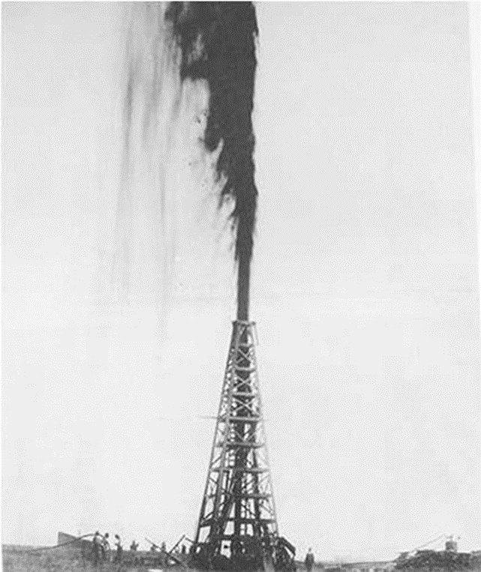
Saturday – 9:00
The program provided recognized experts that assured a mix of technical innovation and professional development topics

Slide 8
Sunday – 9:00
The major Agenda item for the conference closing was
the Next BIG Thing
The addressed Entertainment, Power and the Internet of Things
Where is technology taking us?
Importantly, where will you lead the next generation?

Slide 9
Conference fun
Resume review session
Arduino demonstration
Wild speakers
KÀ show by Cirque du Soleil Backstage Engineering Tour
Conference linkage to Storage Visions and CES

Slide 10
Each participant was asked to create a personal Action Plan
Think big picture
Make non-linear connections
Think long term versus today
Be able to:
Inspire
Connect
Share results
Continue development
Measure outcomes

Slide 11
A final Conference expectation: Image transformation
If you were going to “pitch the brand”, what attributes about yourself would you highlight?
What does your marquee look like?
Exercise: You have 500 people in an auditorium waiting for you to speak about yourself, your school, your company. Write a title for your presentation.

Slide 12
Andrews Productions and IEEE Films
Present
Assuring an Outstanding Life
Starring Michael Andrews and
delightful newcomer Tom Coughlin
and a cast of 1000’s

Slide 13
Spindletop

Slide 14
Thank you !

