Slide 1
Region 6 Membership Development
Executive Committee Presentation
Presented by Chris Wright
IEEE Membership Marketing Specialist

Slide 2

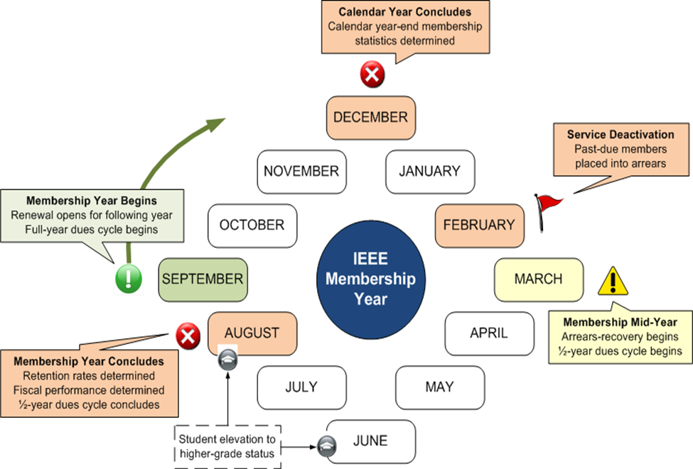
Membership Development Cycle
Time to start planning what we are going to do to develop membership
We Are Here

Slide 3
2015 Region 6 Membership Stats
Total Region Members = 55,163 (Down 2.6%)
So Far..
  Renewed 58% of members
    UP 1.4% compared to 2014
    BUT… Non-Renewing Members = 21,739
  Recruited 2,319 members
    Compared to 2,520 in 2014 (-8.0% Decrease)
How are we going to Improve/Maintain for 2015?
NOTE: All Membership Statistics are based on the December 2014 data and are available via the Monthly Region Membership Development Report

Slide 4
New for 2015 –Section MD Goals
Section-level goals for recruitment & retention
  Will roll up to region goals
  Based on three-year Section performance
Tracked monthly in Regional MD reports
Quarterly & annual formal recognition for achievement
http://www.ieee.org/about/volunteers/membership_development/secure/md_goals.html

Slide 5
Why is Membership Important?
Affects Your Region/Section Budget
http://www.ieee.org/societies_communities/geo_activities/required_reporting/rebate_schedule.html
Expands Your Network
Increases Your Members’ Network
Larger Pool of Volunteers

Slide 6
Questions?
Contact Info:
Chris Wright Adrienne Hahn
732-562-3894 732-562-5528
wright.c@ieee.org a.hahn@ieee.org

