Slide 1

Joint Region 4/Region 6 Meeting
Region 4 Director Bob Parro
Region 6 Director Tom Coughlin
Welcome
Plan for rest of meeting

Slide 2
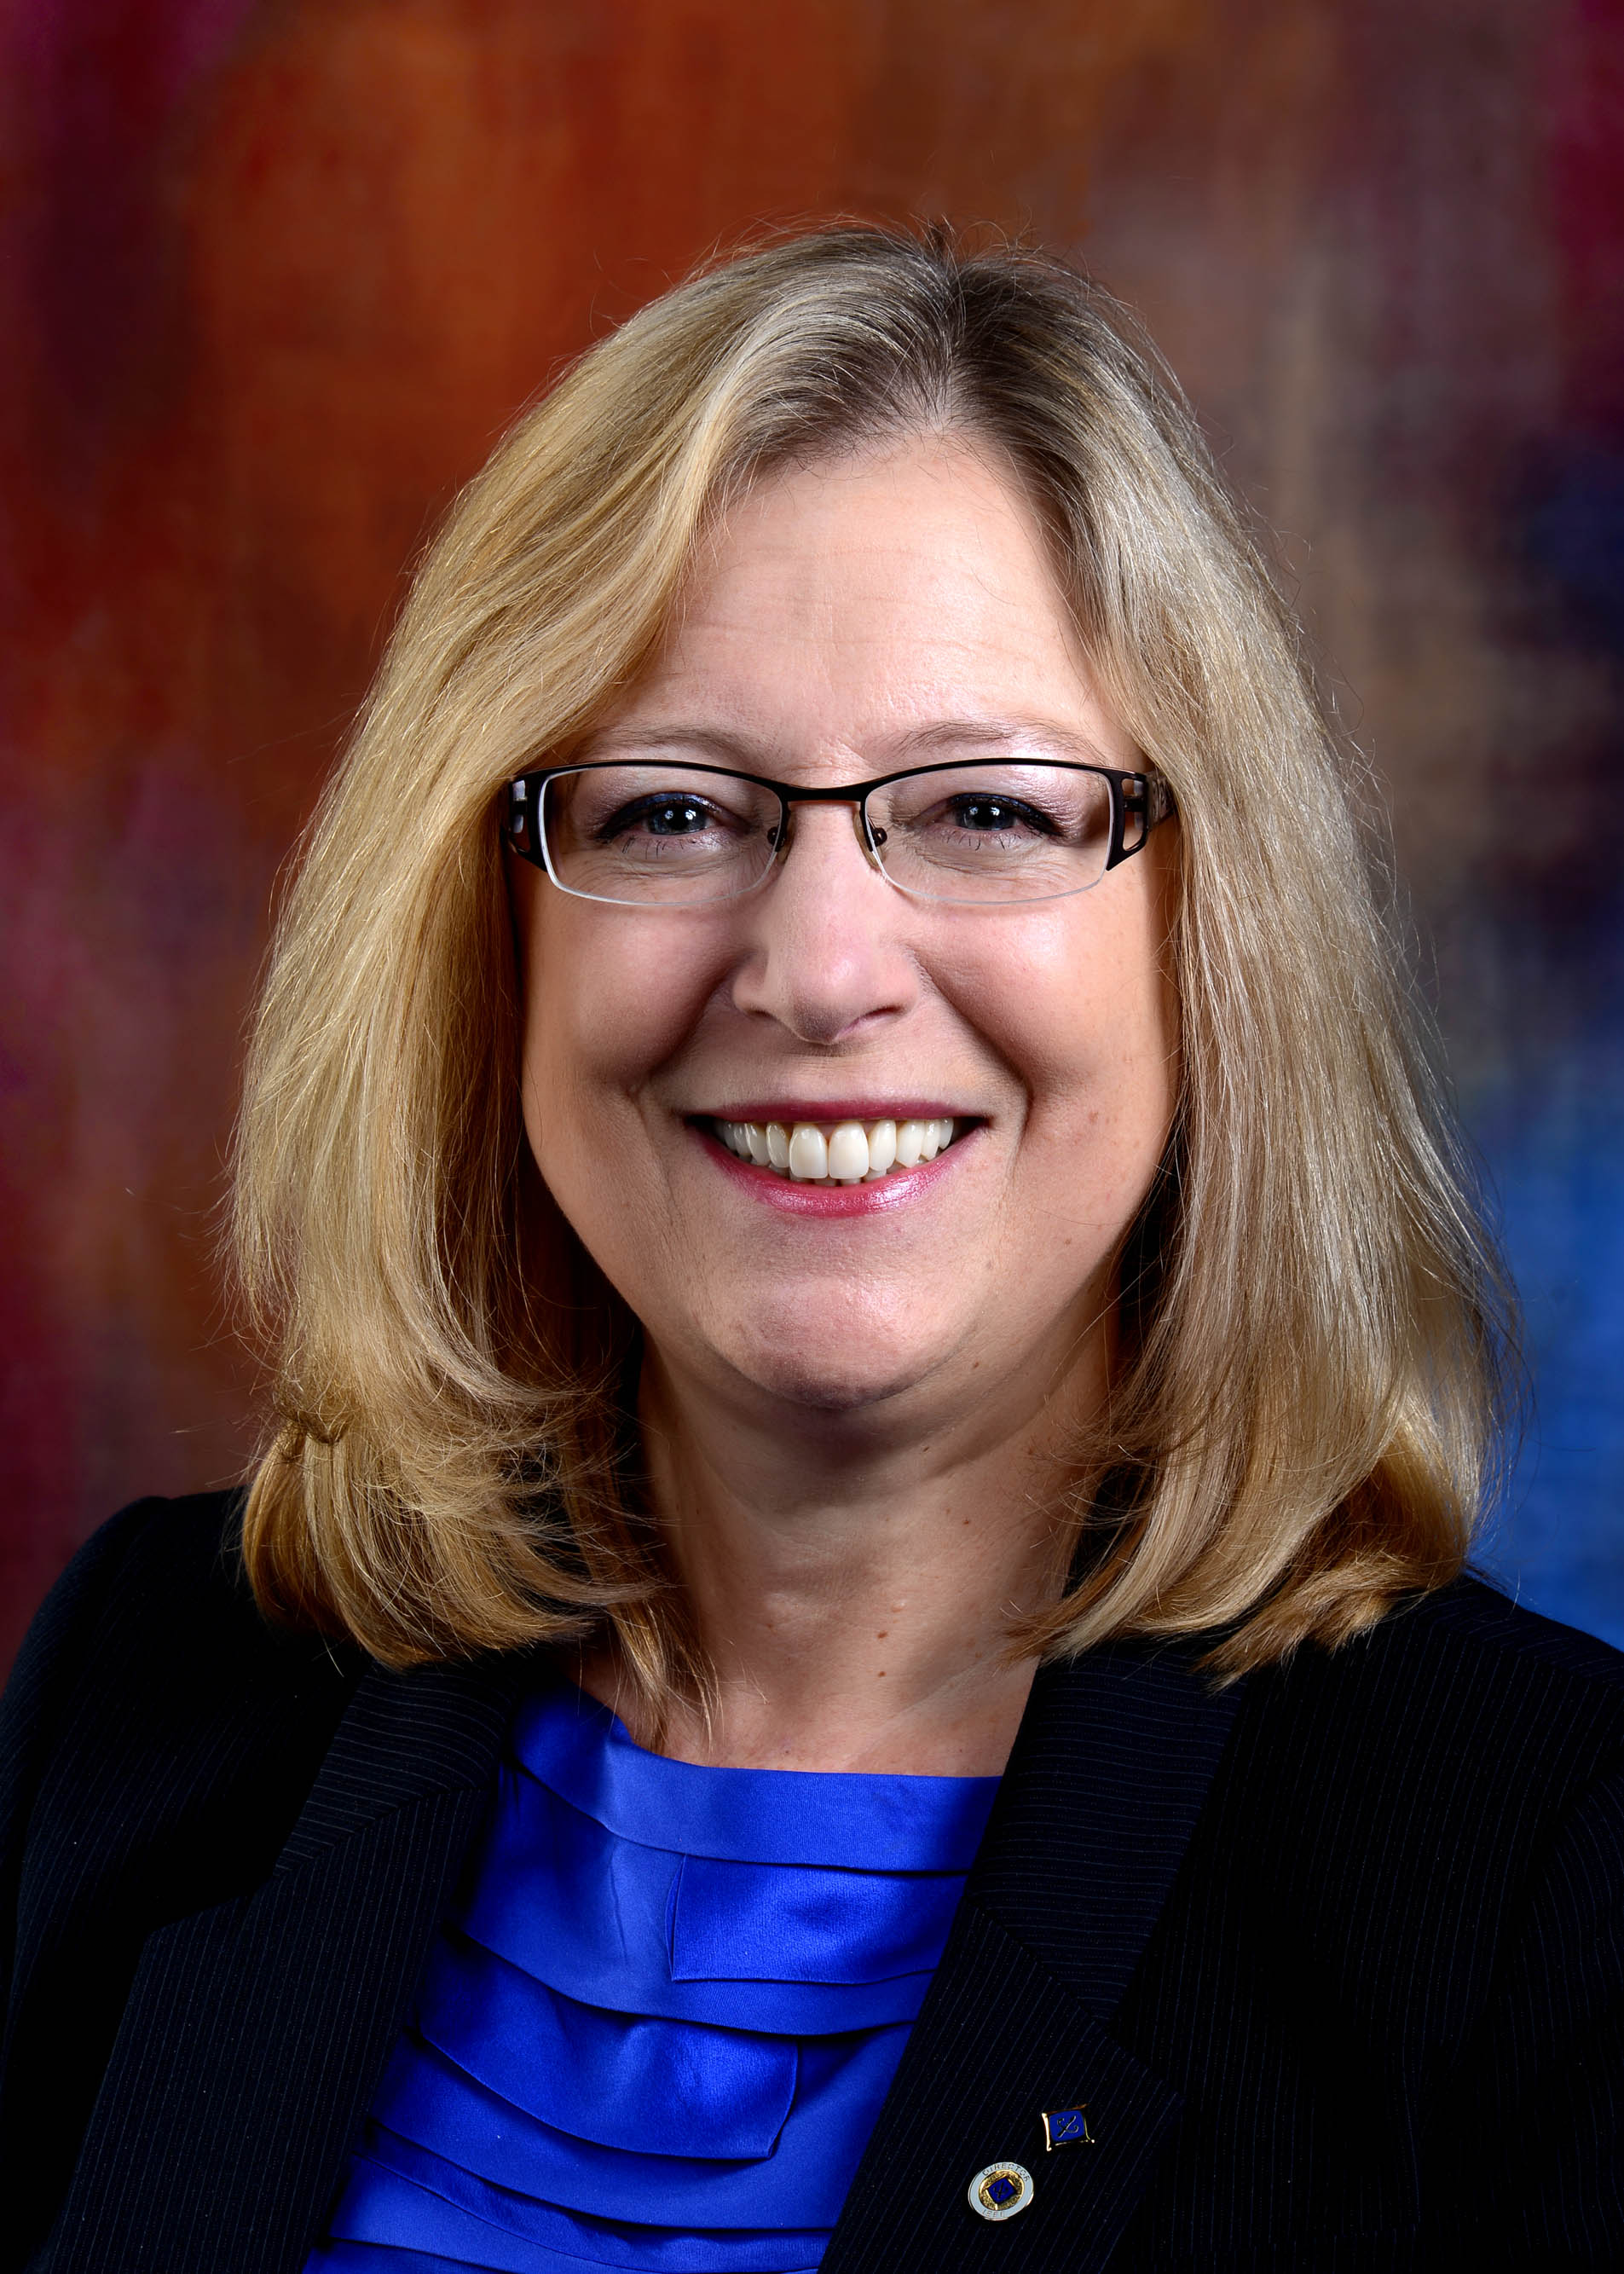
Karen Bartleson
2016 IEEE President-Elect Candidate
Senior Director at Synopsys, an electronic design automation company
Technical standards development, software tool interoperability, relationships with universities and research institutions worldwide, and customer engagement through social media

Slide 3
Karen Bartleson
2016 IEEE President-Elect Candidate
2013-2014 President of the IEEE Standards Association
Led their new strategic plan, furthered the OpenStand™ market-driven standardization paradigm, and finalized IEEE’s membership in the Global Standards Collaboration
Chaired IEEE Internet Initiative, chartered to raise IEEE’s influence in Internet governance, cyber-security, and cyber-privacy policy

Slide 4
Karen Bartleson
2016 IEEE President-Elect Candidate
Member of IEEE’s strategy committee, overseeing role of IEEE in global public policy
Received 2003 Marie R. Pistilli Women in Electronic Design Automation Achievement Award and authored The Ten Commandments for Effective Standards: Practical Insights for Creating Technical Standards
BS in engineering science with an electronic engineering concentration from California Polytechnic State University

Slide 5
2016 President-elect Candidate Address
Karen Bartleson
IEEE Region 6 and Region 4 Meeting
January 24, 2015
Notes:
Good evening, everyone. Thank you for this opportunity to present to you:
a little bit about myself,
why I’m interested in serving as President-elect,
and what I can bring to the IEEE

Slide 6
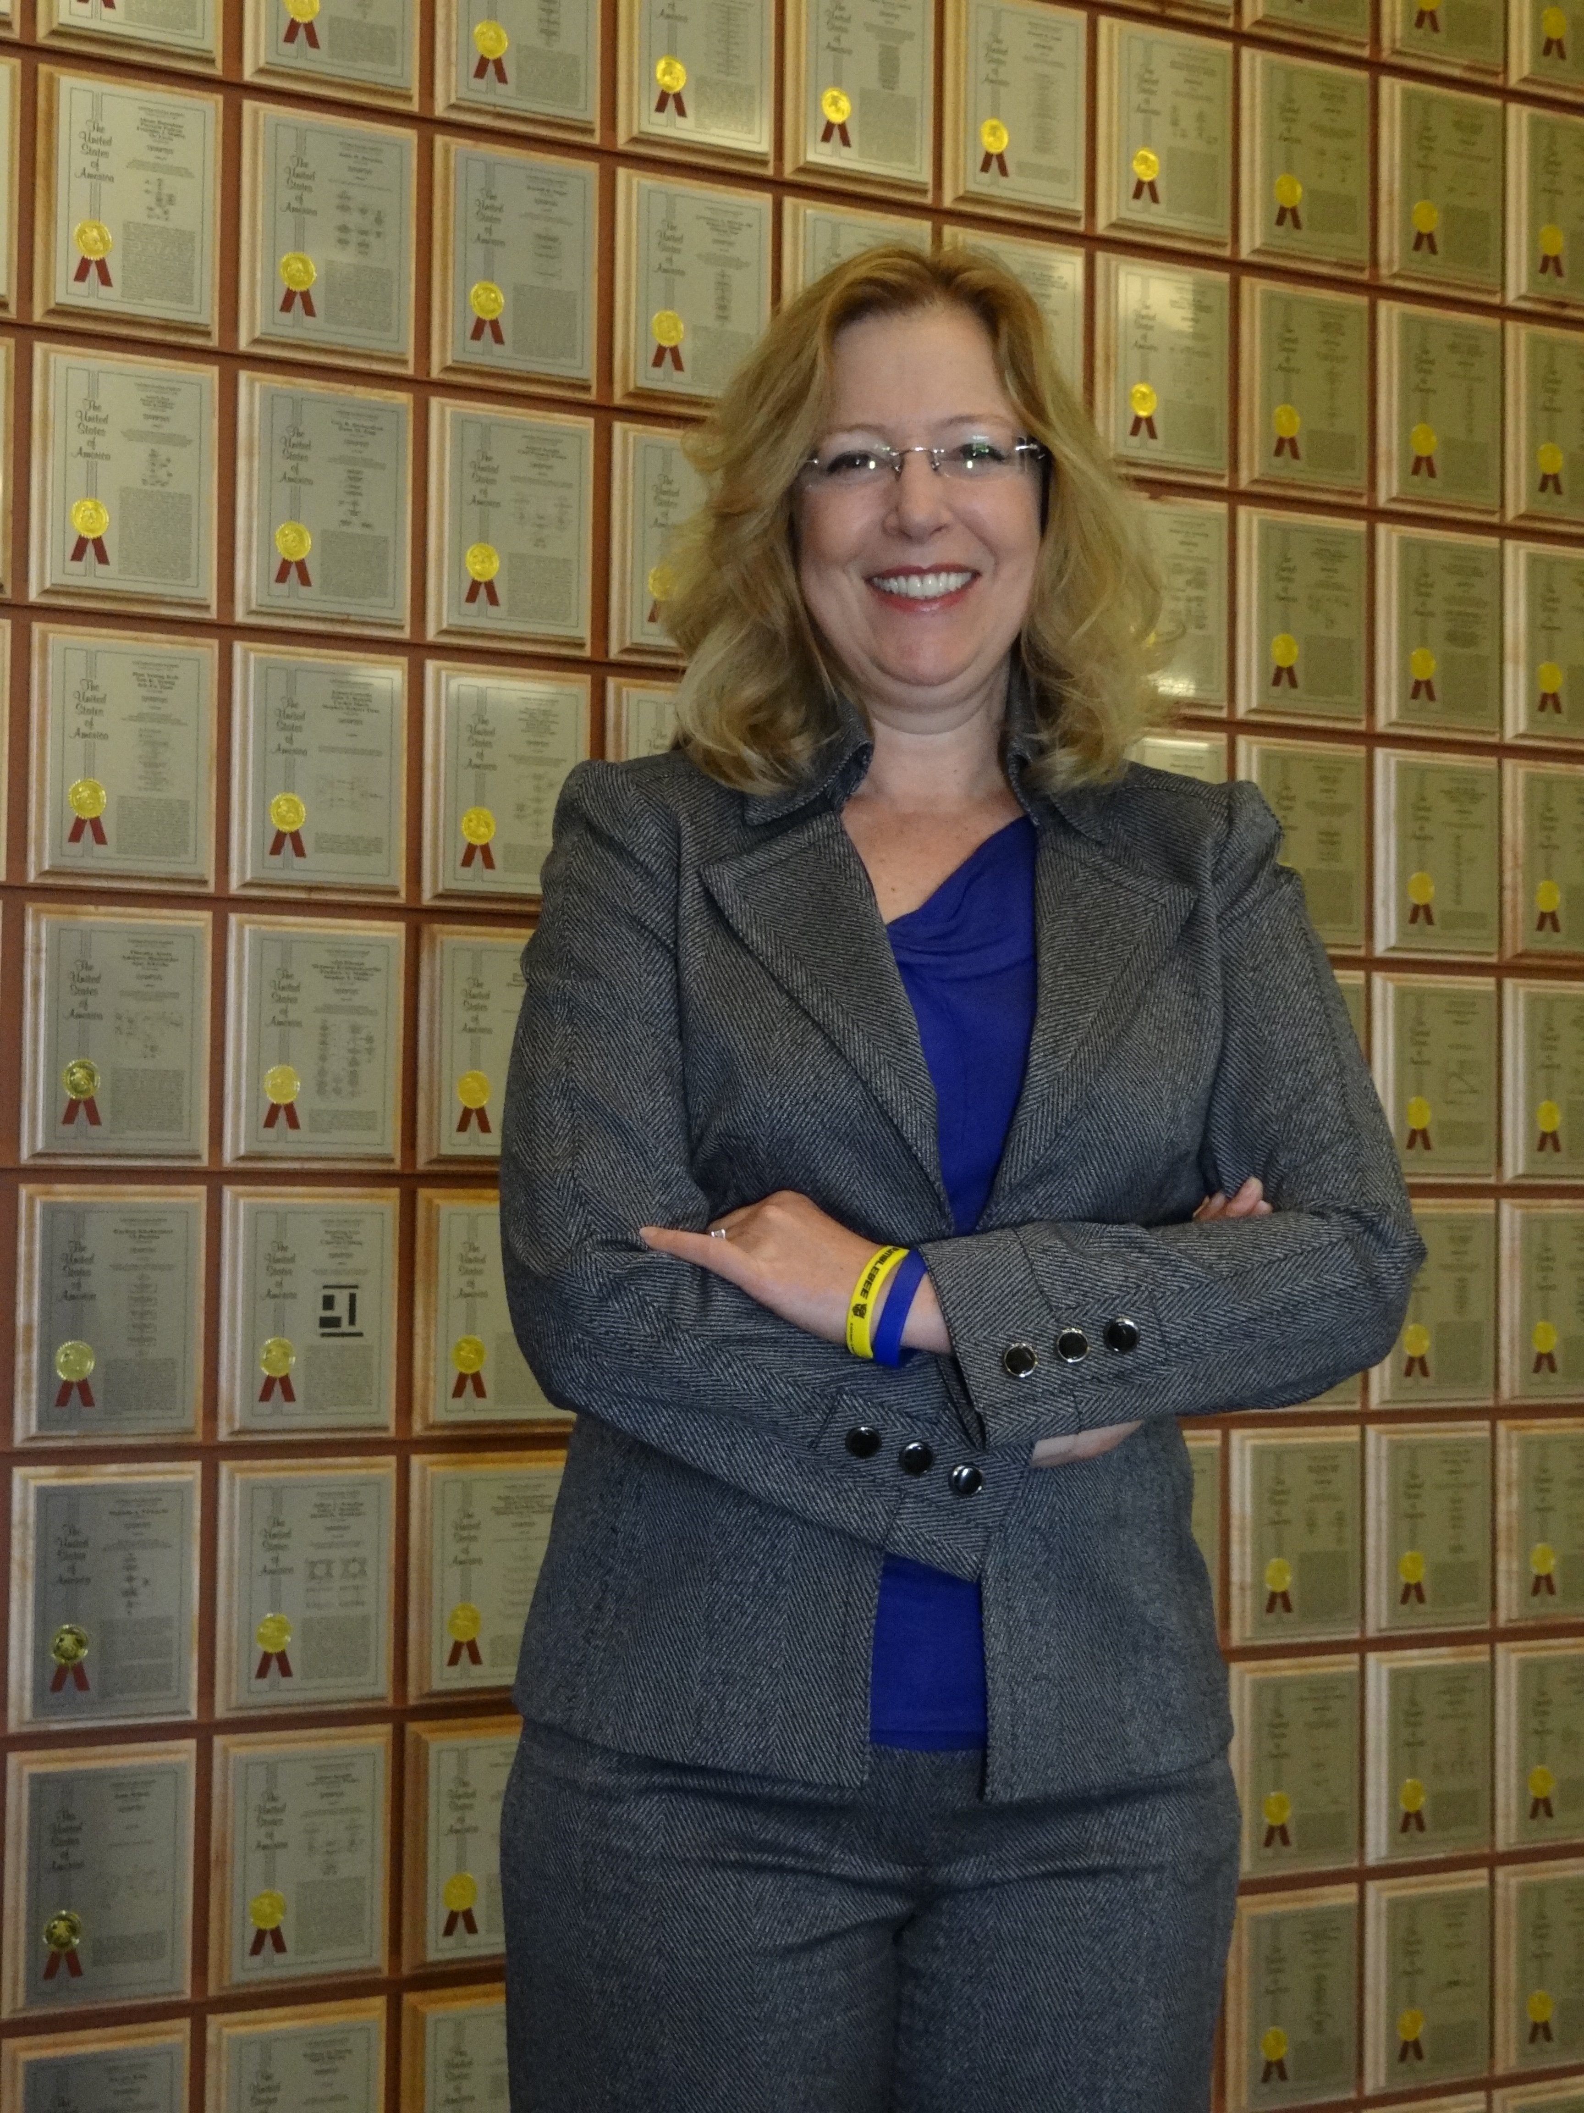
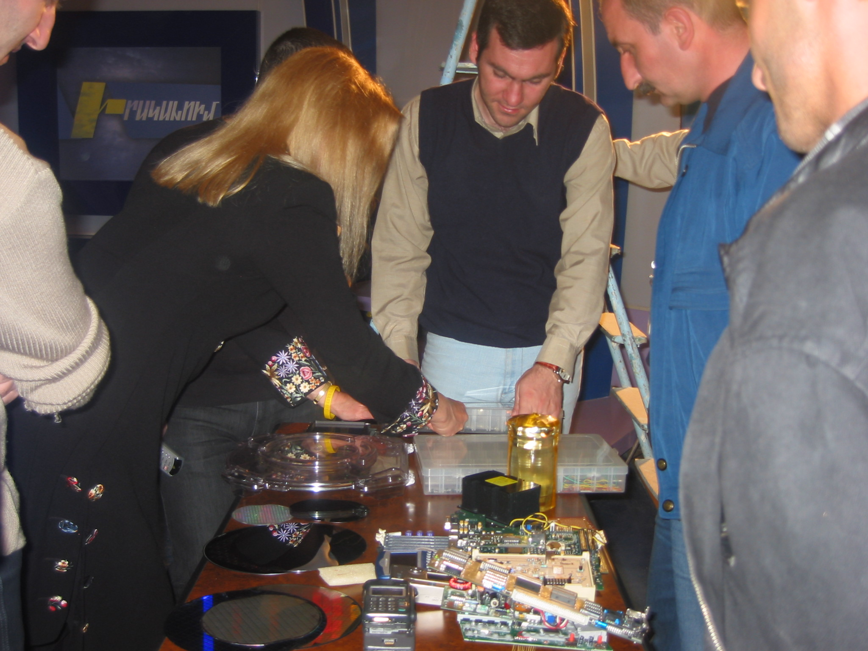
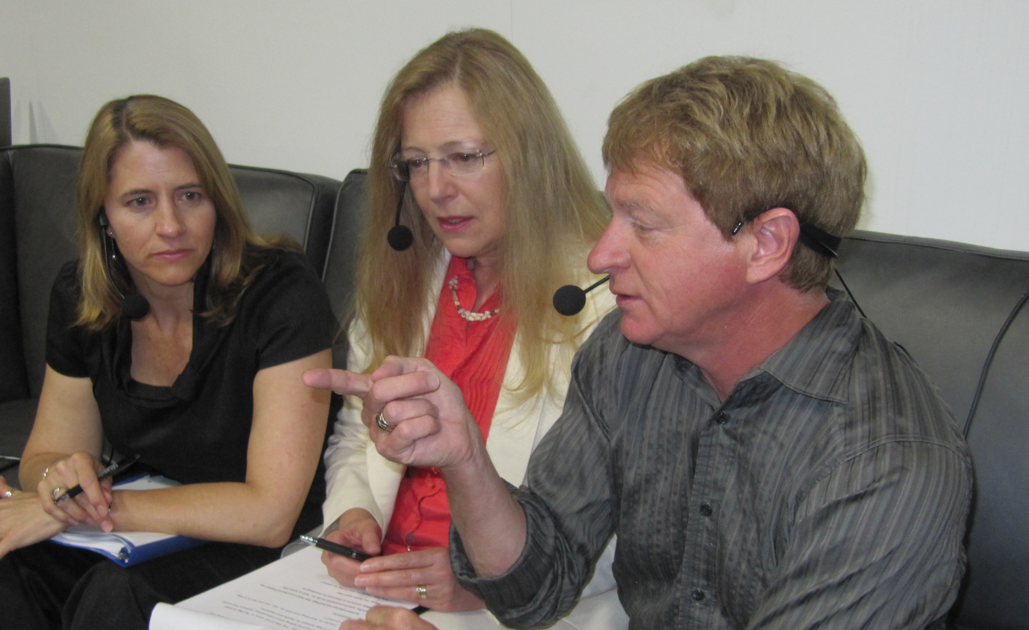
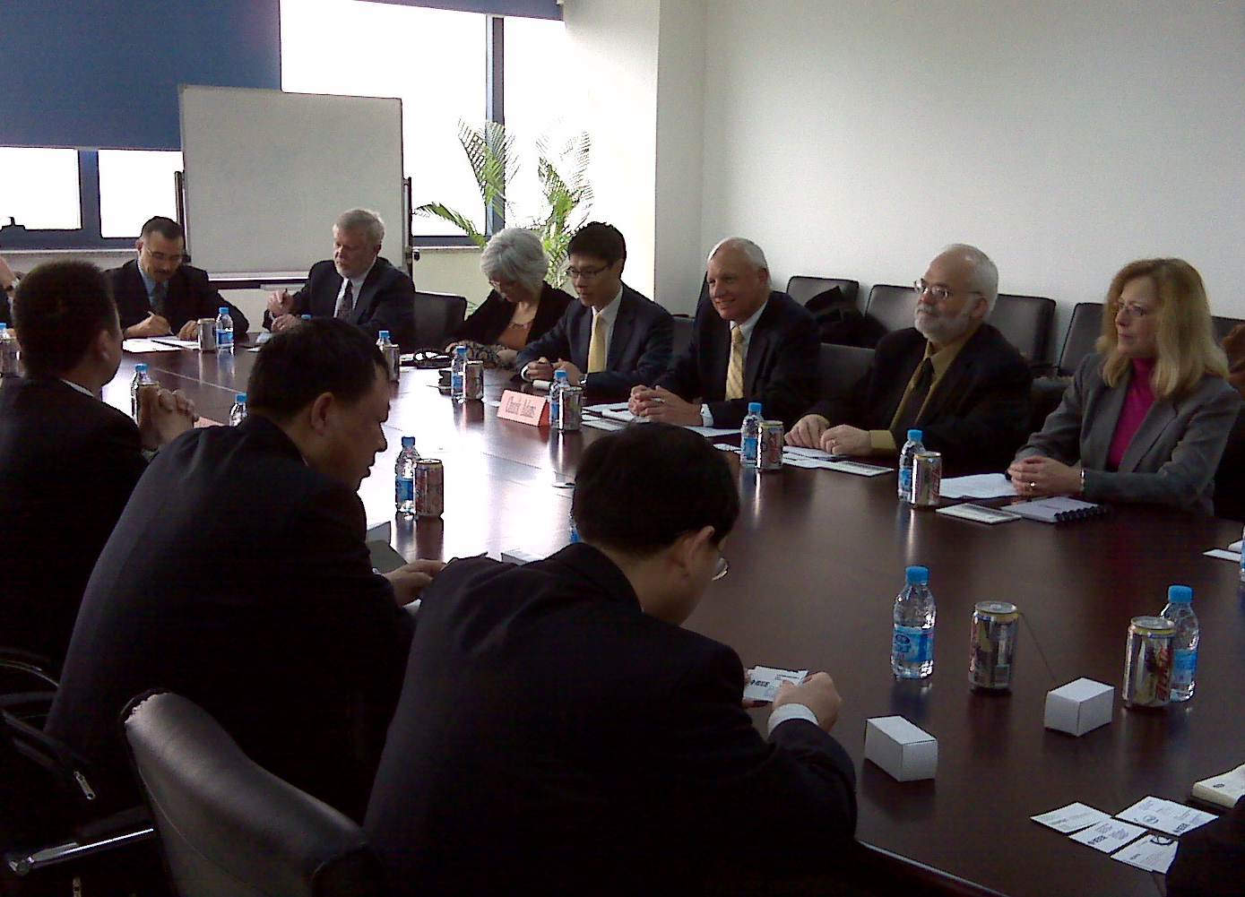
Background
IEEE member since mid-1970s
Recent IEEE participation
  Internet Initiative, President IEEE-SA, Open Access, Board of Directors, Strategic Planning Committee
“Advancing Technology for Humanity”
Engineering Science major
Well-organized and process-oriented
Collaborator
Notes:
As I’ve worked with the IEEE over the past couple of decades - and especially the last few years - as President of the IEEE Standards Association, as chair of the IEEE Internet Initiative, with the Open Access effort, on the IEEE Board of Directors, and the IEEE Strategic Planning Committee – I’ve come to deeply appreciate the IEEE: what we do and what we *can* do.
To me, the phrase “Advancing Technology for Humanity” is not just a tag line – it’s the reason I became an engineer.
In college, I studied Engineering Science to obtain a broader education than just a single engineering discipline. This included electrical, electronic, mechanical, and civil engineering. I enjoyed all aspects of engineering so this was an ideal field of study for me.
I consider myself well-organized, and I like clear and concise thinking and communication.
I believe in establishing and improving processes for managing large or complex activities.
When I need help, I don’t let pride get in the way. I bring in the experts.
I’m outgoing, respectful of others, and work hard to understand the various aspects of an issue before making decisions and taking action.

Slide 7
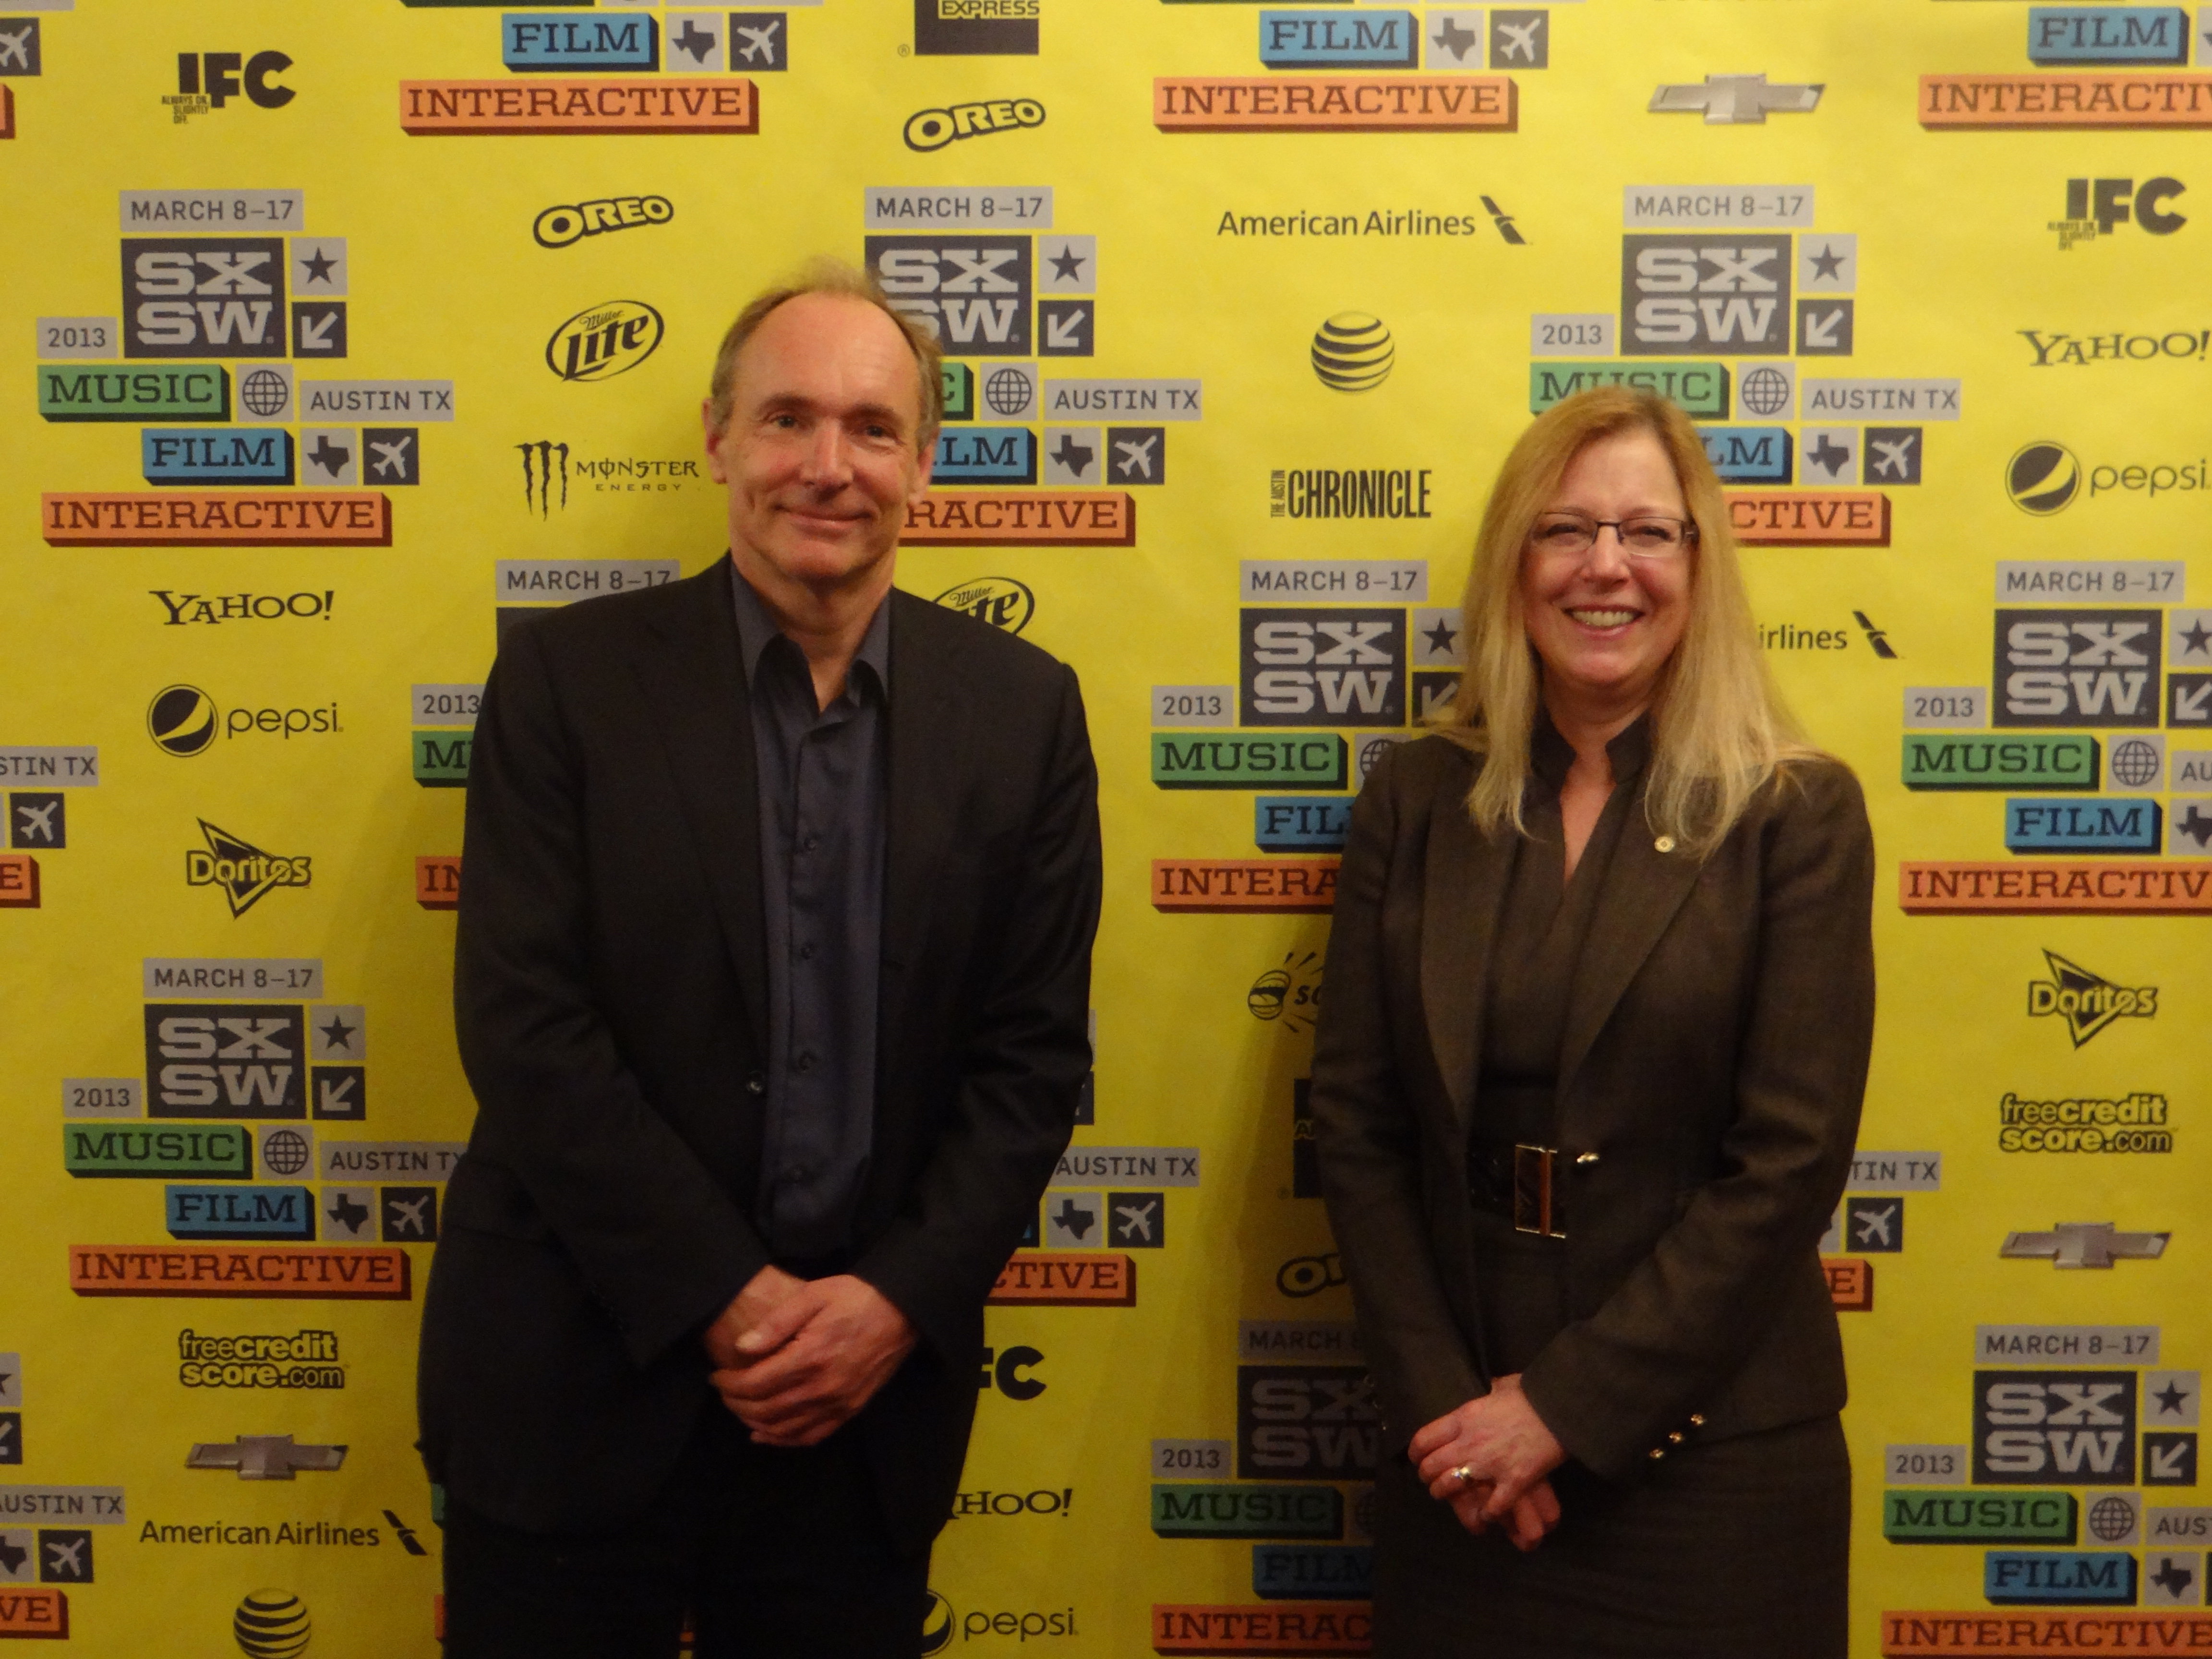
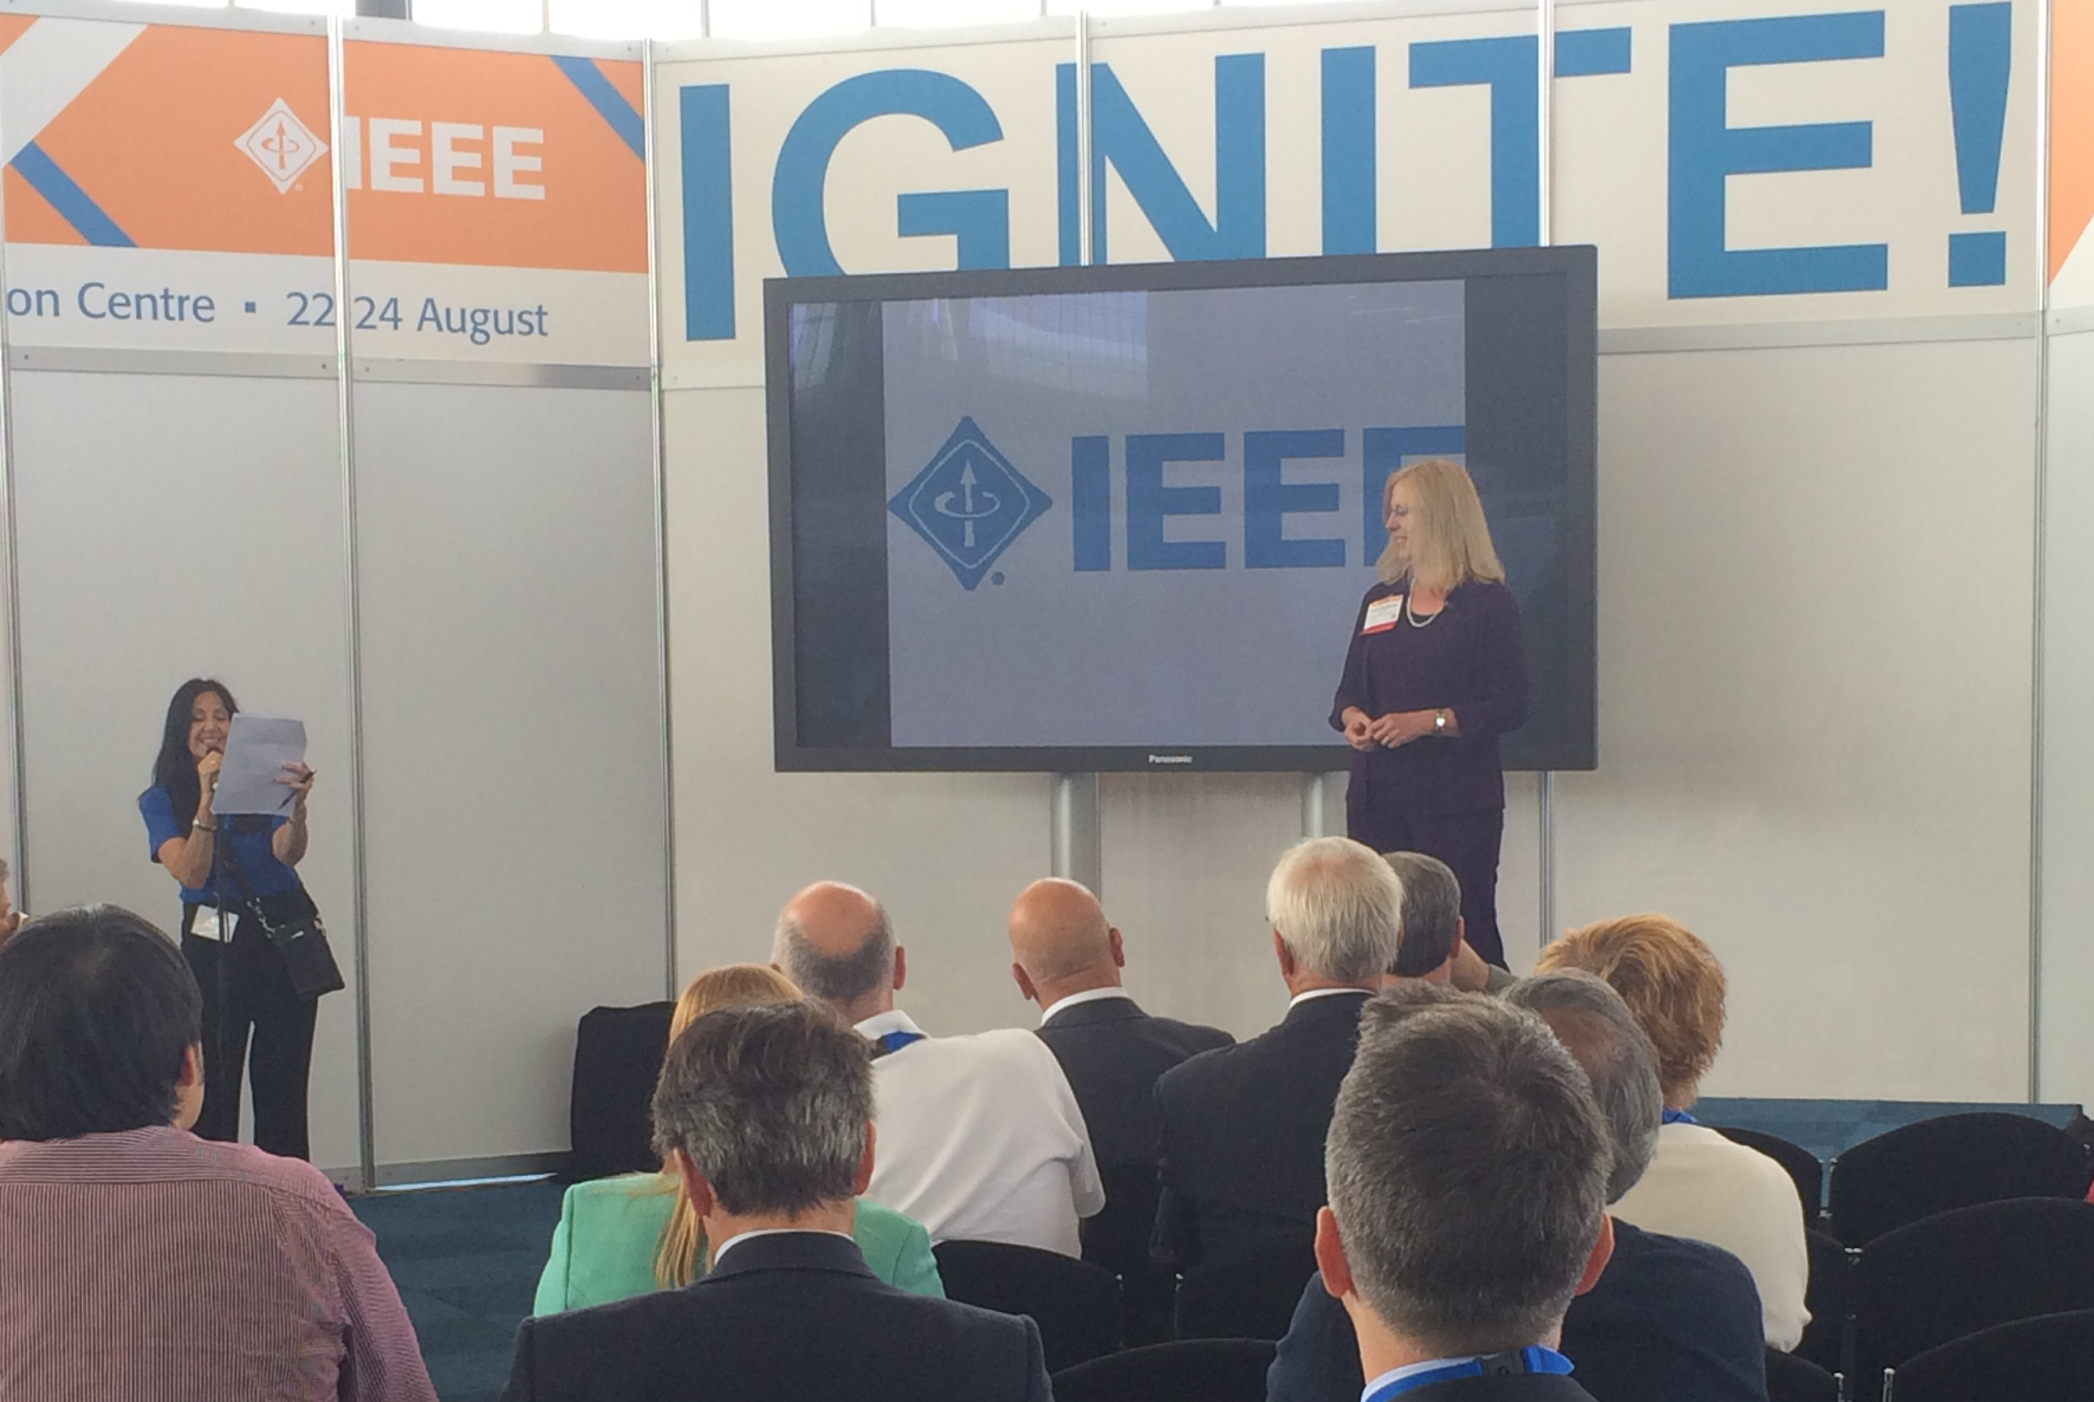
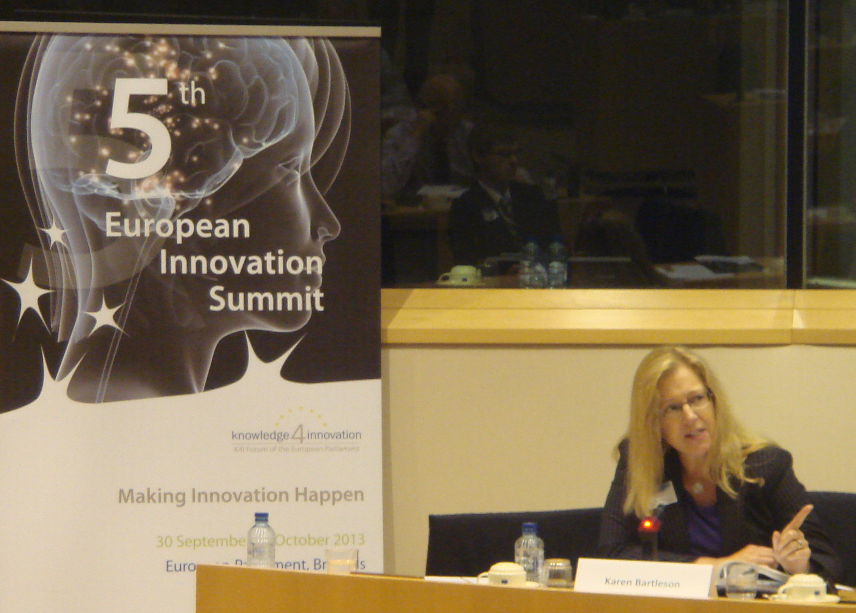
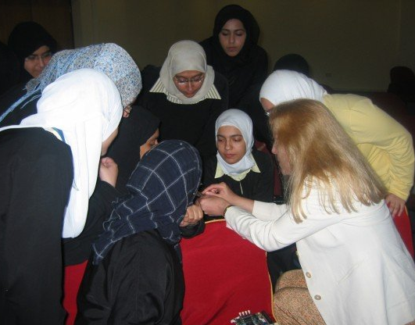
Interest in Serving
Proud member of IEEE
IEEE’s potential
IEEE’s involvement in global public policy
Give back to my profession
Help drive positive change in the world
Notes:
Why am I’m interested in serving as President-elect? I’m a proud member of the IEEE and I see us as full of potential and possibilities.
I’m now a member of IEEE’s global public policy committee, which is exploring how the IEEE can become more involved in public policy, which is one of the main goals in our strategic plan. This is a powerful opportunity for IEEE to contribute to a better future, and I’m grateful to be part of it.
I’m at the point in my career where I want to give back to my profession and help drive positive change in the world. I can’t think of a better way to do it than as President of the IEEE.

Slide 8
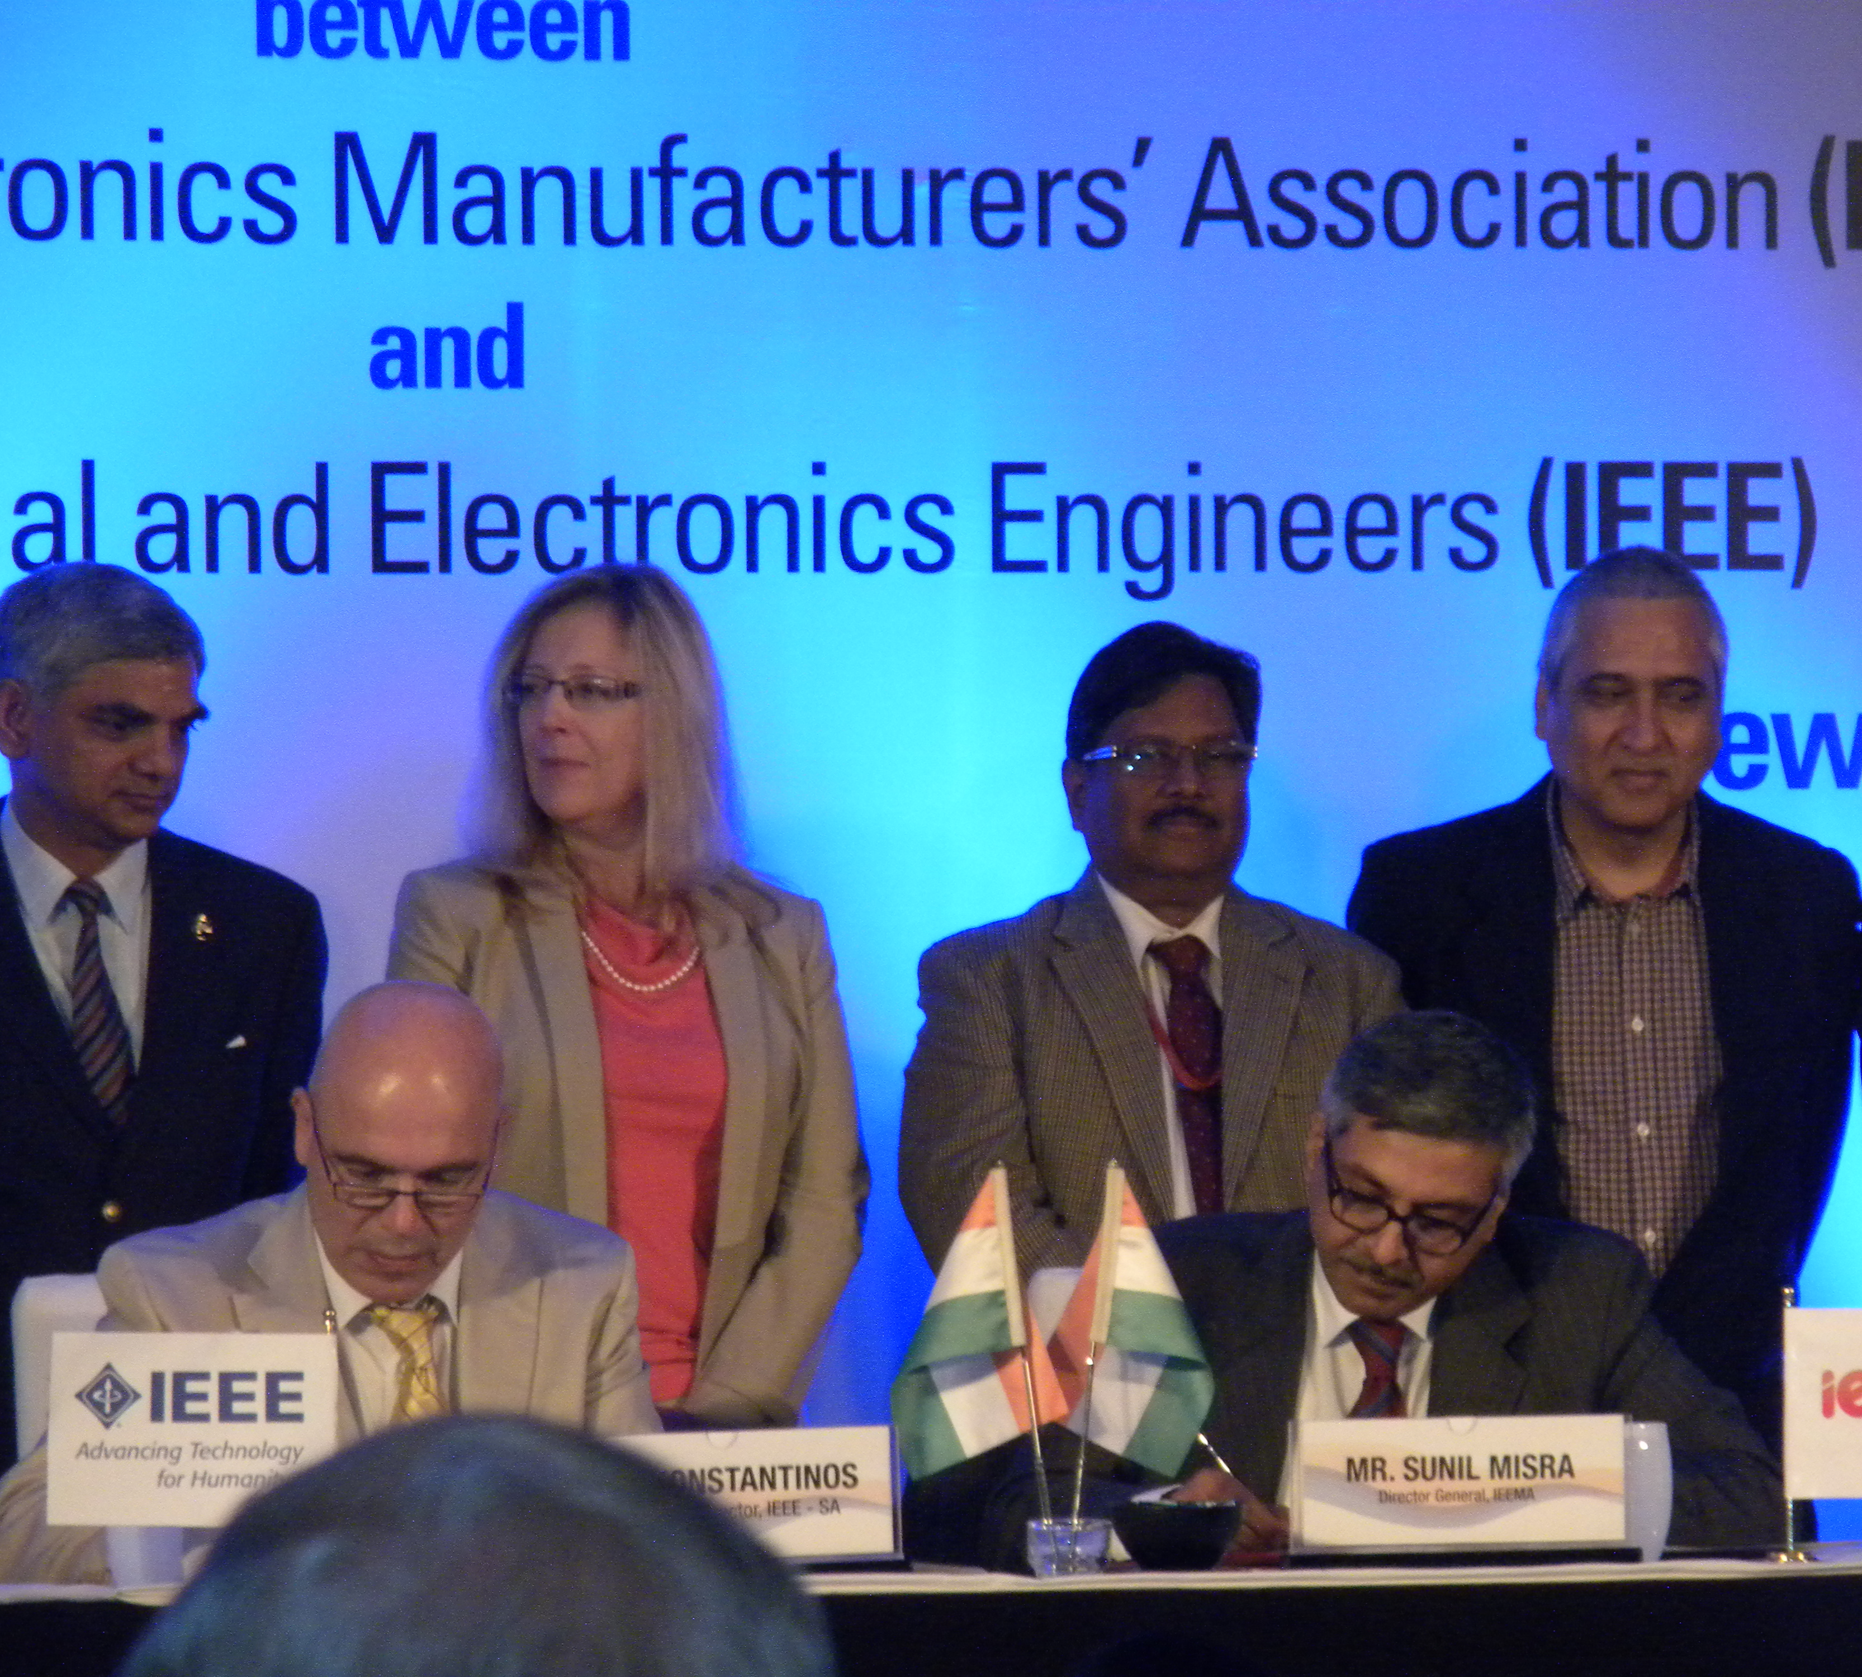
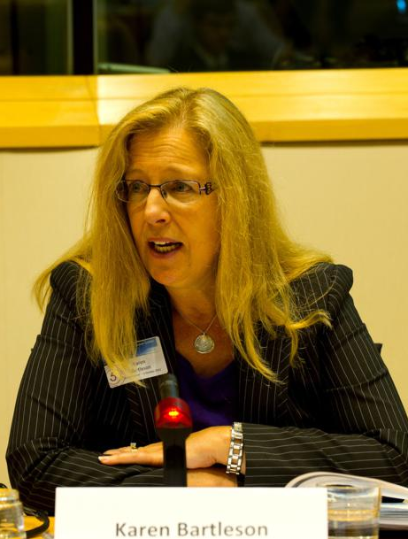
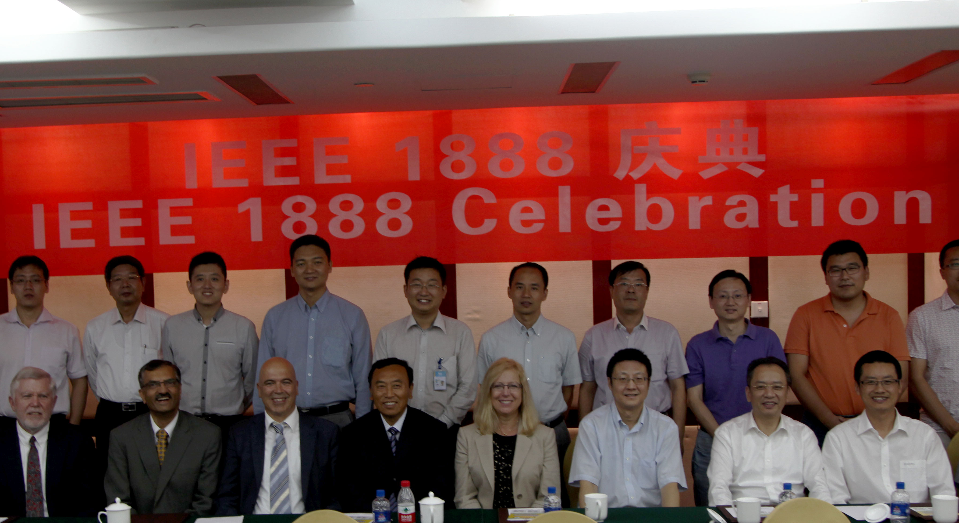
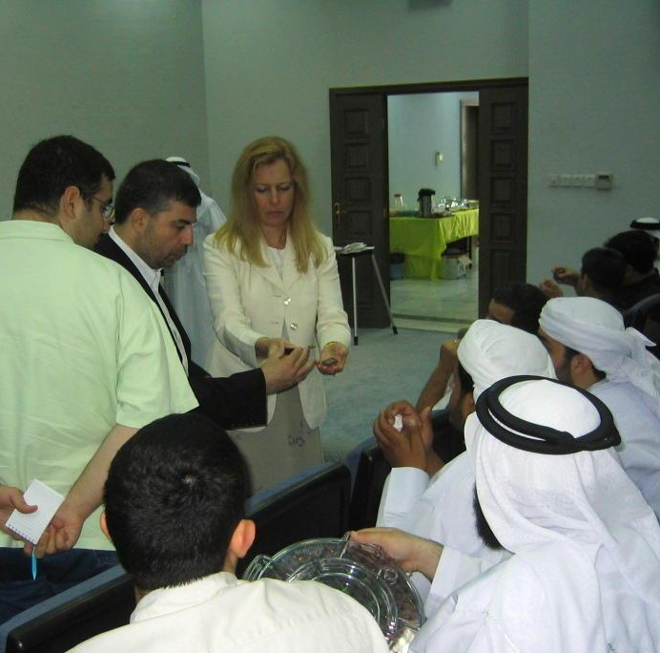
Qualities for IEEE
Consensus building
Industry perspective
Customer focus
Partnership between volunteers and staff
Globalization
Notes:
What can I bring to the IEEE?
Coming from the standards world, I’m experienced with consensus building. In standards, we bring diverse opinions, multiple technologies, and conflicting agendas together. It’s work that’s difficult but rewarding. I can apply consensus-building techniques to all of our activities to help keep us moving forward.
I bring an industry and customer perspective to the IEEE. In my industry, semiconductors, we have to get things done in a timely manner. We leverage academia to produce actual goods and services for our customers. The IEEE’s customers are, of course, you as members and society as a whole. I apply my attitude of “let’s make tangible accomplishments” to all of my IEEE endeavors.
I have a strong desire for a continuous and synergistic partnership between volunteers and IEEE’s professional staff. Hopefully, you’ve had a chance to work with some of the outstanding members of the IEEE staff. They possess our organizational memory and bring full-time resources to bear on IEEE activities. As volunteers, we bring our technical and business expertise and slices of our time, which range from full engagement to occasional contributions. Keeping volunteers and professional staff in alignment, around our common goals, is one of the keys to the continuing success of the IEEE.
If I had to choose the biggest challenge the IEEE faces today, it would be globalization, i.e., moving beyond the perception of a U.S.-centric organization
Over 50% of our members are outside of the United States – a good trend that I will work to continue. There is a difference between IEEE being a global organization – which means IEEE is present everywhere with uniform goals – and globalizing the IEEE – which is IEEE addressing diverse needs at local levels. By enabling emerging technologies that span multiple societies, providing technology-related insights into public policy, and using powerful communication tools, we can be both global and globalizing.

Slide 9
Thank You www.karenbartleson.net
Notes:
In closing, this is one of the most exciting and prestigious opportunities I’ve ever had, and I truly appreciate your consideration.

Slide 10
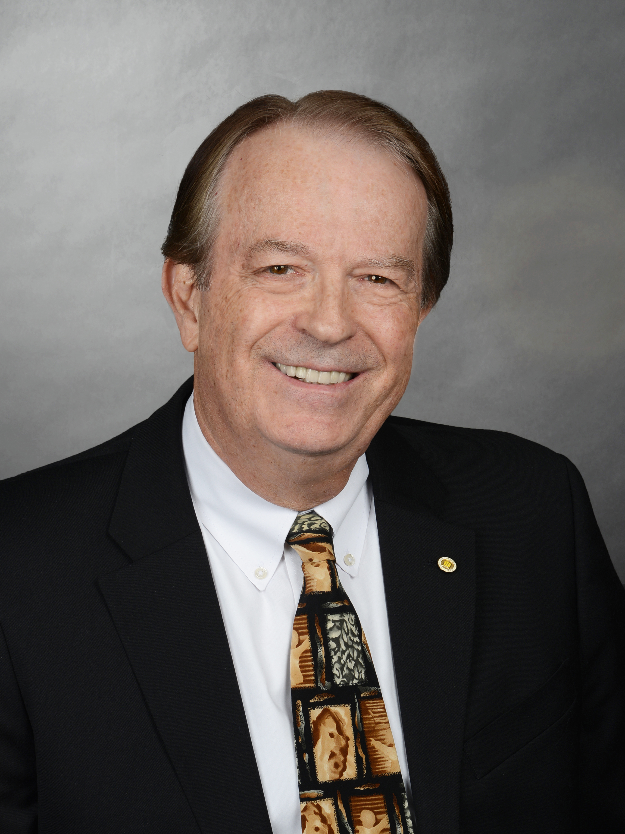
Fred Mintzer
2016 IEEE President-Elect Candidate
Retired IBM Research Master Inventor
Developed new technologies for image database applications
Validated them against cultural institutions
  Vatican Library
  Russia’s Hermitage Museum
  Egyptian Museum in Cairo
Developed new technologies for digital imaging, computer graphics and data visualization

Slide 11
Fred Mintzer
2016 IEEE President-Elect Candidate
>25 patents, 50 publications, several IBM product offerings
Member of IBM Academy of Technology
IEEE Life Fellow
BSEE from Rutgers University
PhD in EECS from Princeton University

Slide 12
Fred Mintzer
a candidate for 2016 IEEE President-Elect
  R4/R6 joint meeting
  San Diego, CA 24 January 2015
  Fred Mintzer
12
1/24/2015

Slide 13
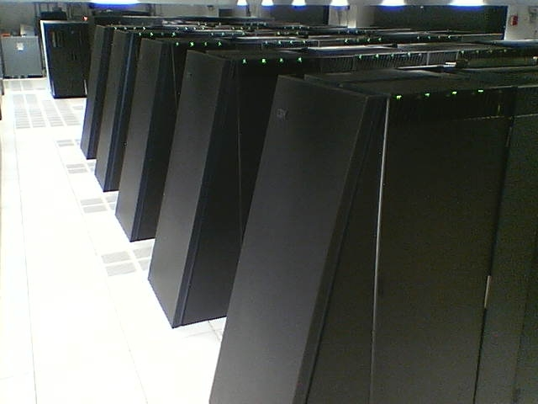
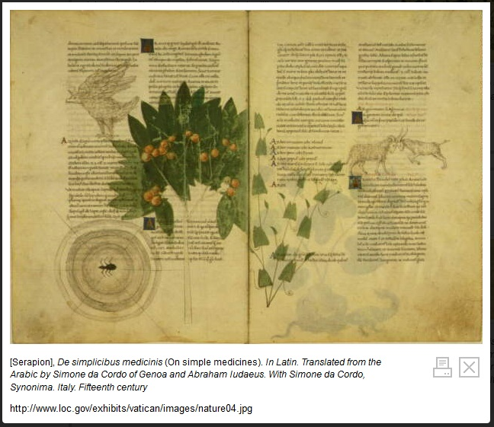
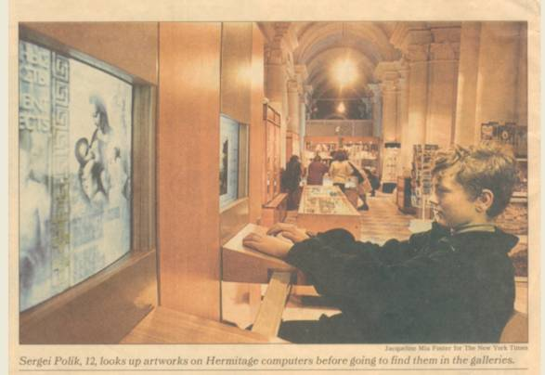
Professional Biography
k
Employed at IBM’s T.J. Watson Research Center, 1978-2013
  Program Director for IBM’s Blue Gene Watson supercomputer
  facility
    a Top500 supercomputer center, ranked as high as #2
    simulations of human biology, new materials for computing
  Department Manager, Visual Technologies
    data visualization, 3D graphics, image processing
  Manager, Image Library Applications
    digital libraries, with high-quality imaging and digital rights management, often for web sites of cultural institutions; well-publicized projects with the Vatican Library, the Hermitage Museum, the Egyptian Museum in Cairo
  Manager, Signal Processing Applications
    signal processing theory, applications, hardware
over 50 technical papers, 25 U.S. patents
key features of many IBM offerings
IEEE Fellow
member, IBM Academy of Technology
an IBM Research Master Inventor (twice)
PhD in EECS from Princeton; BSEE from Rutgers

Slide 14
IEEE Accomplishments
Division IX Director 2008-09 / member IEEE TAB / IEEE BoD
Pres. of IEEE Signal Processing Society (SPS) 2004-05 / member IEEE TAB
VP of Technical Activities 2012 / IEEE BoD
The three-pronged Open Access strategy
  Shaped it in TAB SPC, presented to TAB, PSPB & IEEE BoD, secured its approval
Collaboration tools to help our members better network and collaborate
  Participated in its requirements, co-presented to TAB, PSPB, MGA & IEEE BoD to secure its approval, continue to guide
Increased IEEE activity in emerging technologies, which now include Smarter Cities, the Internet of Things, Clean Transportation
  Secured increased TAB funding to support more activities
  Created on-line technical communities to involve more participants in them – free to all
  Created IEEE Technical Community Spotlight to publicize them – free to all members
  Contributed to the framework for transitioning emerging technology efforts into TAB entities, where appropriate

Slide 15
Other IEEE Activities & Accomplishments
Strategy
  Initiated TAB effort that created a new TA mission statement - Inspire, Foster and Empower Technology-Centric Worldwide Communities – and secured its adoption
  Chaired TAB Awareness and Branding Ad Hoc that developed TAB value proposition
  IEEE NIC; SPS Long Range Planning (Chair)
Finance
  VP Finance for SPS - a financially-sound society
  IEEE Audit Committee; IEEE Investment Committee; IEEE Marketing and Sales; IEEE Employee Benefits and Compensation Committee (Chair) that vetted Jim’s offer package
Publications
  Charter EIC, IEEE Technical Community Spotlight
  Proposed IEEE Trans. on Info. Forensics and Security and secured its adoption
  Added language processing to scope - IEEE Trans. Audio, Speech and Language Processing
Conferences
  Finance Chair of ICIP95
Membership
  Initiated Membership Models Ad Hoc, which proposed the bundled membership experiment, now underway; Membership Development Committee
Awards
  Chaired Ad Hoc that created the TAB Hall of Honor - and secured its approval

Slide 16
My Vision, If Elected
Priority – create and provide more value for our members
Provide enhanced networking and collaboration opportunities for our members within IEEE communities, i.e., regions, sections, chapters, conferences, affinity groups, publications
  The Collabratec™tools are only the beginning
Increase global relevance
  More visible projects (incl. Smarter Cities, humanitarian) in more regions
  Closer ties to the tech industry
  Global public policy
Develop crisper value propositions for important member audiences
  Industrial employees/practitioners
  Young Professionals
  Author/researchers
  Tech professionals in emerging economies
16
1/24/2015

Slide 17
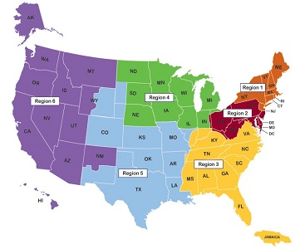

In summary
Thank You
web: www.fredmintzer.net
facebook: http://on.fb.me/12zS3qu
LinkedIn: www.linkedin.com/pub/fred-mintzer/12/125/404
17
1/24/2015

Slide 18
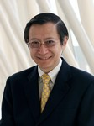
Lawrence Wong
2015 VP MGA
Professor of Electrical and Computer Engineering, National University of Singapore
Deputy Director of the Interactive and Digital Media Institute
Formerly with AT&T Bell Laboratories, Crawford Hill Lab, NJ
B.Sc. (1st class Honors) and Ph.D. degrees in Electronic and Electrical Engineering from Loughborough University, UK

Slide 19
MGA –
2015 Goals & Directions
Wai-Choong (Lawrence) Wong,
IEEE R4 & R6 Meeting
23 - 25 January 2015

Slide 20
2015 MGA Board
Wai-Choong (Lawrence) Wong - VP, MGA
Ralph Ford - Past Chair
Dane Watson - Treasurer
Cecelia Jankowski - Secretary
Martin Bastiaans - VC, Geo Unit Operations
Francisco Martinez - VC, Info Management
Ron Jensen - VC, Member Development
Toshio Fukuda - VC, Strategic Mgt & Analysis
Jozef Modelski - Member-at-Large
Enrique Tejera - Member-at-Large
Vince Socci - Region 1 Director
Timothy Kurzweg - Region 2 Director
Mary Ellen Randall - Region 3 Director
Bob Parro - Region 4 Director
J. Derald Morgan - Region 5 Director
Tom Coughlin - Region 6 Director
Amir Aghdam - Region 7 Director
Costas Stasopolous- Region 8 Director
Norberto Lerendegui - Region 9 Director
Ramakrishna Kappagantu - Region 10 Director

Slide 21
MGA Mission & Vision
Vision: Ensure Quality Member Opportunities Through Continuous Engagement
Mission: Inspire, Enable, Empower and Engage Members of IEEE
  For the purpose of…
    - Fulfilling the mission of IEEE
    - Enhancing the member’s growth and development through their life cycle
    Providing a professional home
21
Notes:
21

Slide 22
MGA Winning Aspiration
Ensure Quality Member Opportunities Through Continuous Engagement
  Delivering an exceptional membership experience (50% or more of members rating as IEEE membership “top box” or "very satisfied")
  Expanding IEEE's global membership presence.
  Developing and supporting a positive professional development experience for volunteers who deliver the IEEE experience.

Slide 23
MGA Strategy
What is our winning aspiration?
Delivering an exceptional membership experience measured by member satisfaction
Expanding IEEE’s global membership presence
Developing and supporting a positive professional development experience for volunteers who deliver the IEEE experience
Where will
we play?
Customers: Young professionals, women and “practitioners”
Product: Membership, conferences, local programs in emerging technologies
Geography: China, India, Japan, United States
How will
we win?
High quality IEEE branded products and services to meet gaps in member satisfaction
All Sections/Chapters participating with the aspiration and objectives
Locally authentic strategies and experiences
Exploring and implementing innovative & experimental models for member engagement
What capabilities must we have?
Excellent volunteers and volunteer leadership
Close working relationships between volunteers and staff
Effective and timely communications
What management systems do we need?
Modern and effective IT tools
Policies and operational procedures that meet IEEE’s global diversity

Slide 24

A look into the future

Slide 25
Challenges
IEEE breadth of activities is wide, but may lack cohesiveness
OUs have their own strategies but may lack common alignment
Value to Young Professionals & “practitioners” is elusive
Overall membership growth is positive but not for all segments
Membership retention for certain segments is problematic
Strong volunteerism but variable quality
MGA needs to respond to these challenges
  Increase cooperation and collaboration
  Better understanding of the needs of Young Professionals and “practitioners” and to reach out to them
  Strengthen volunteer capabilities and enhance experience
  → Better local visibility & relevance

Slide 26
Higher Grade* Members
For comparison, in 2001:
Private Industry: 60%
Educational Institution: 14%
Self-employed/consulting: 7%
Source: 2012 Member Segmentation Survey
*not including Graduate Students

Slide 27
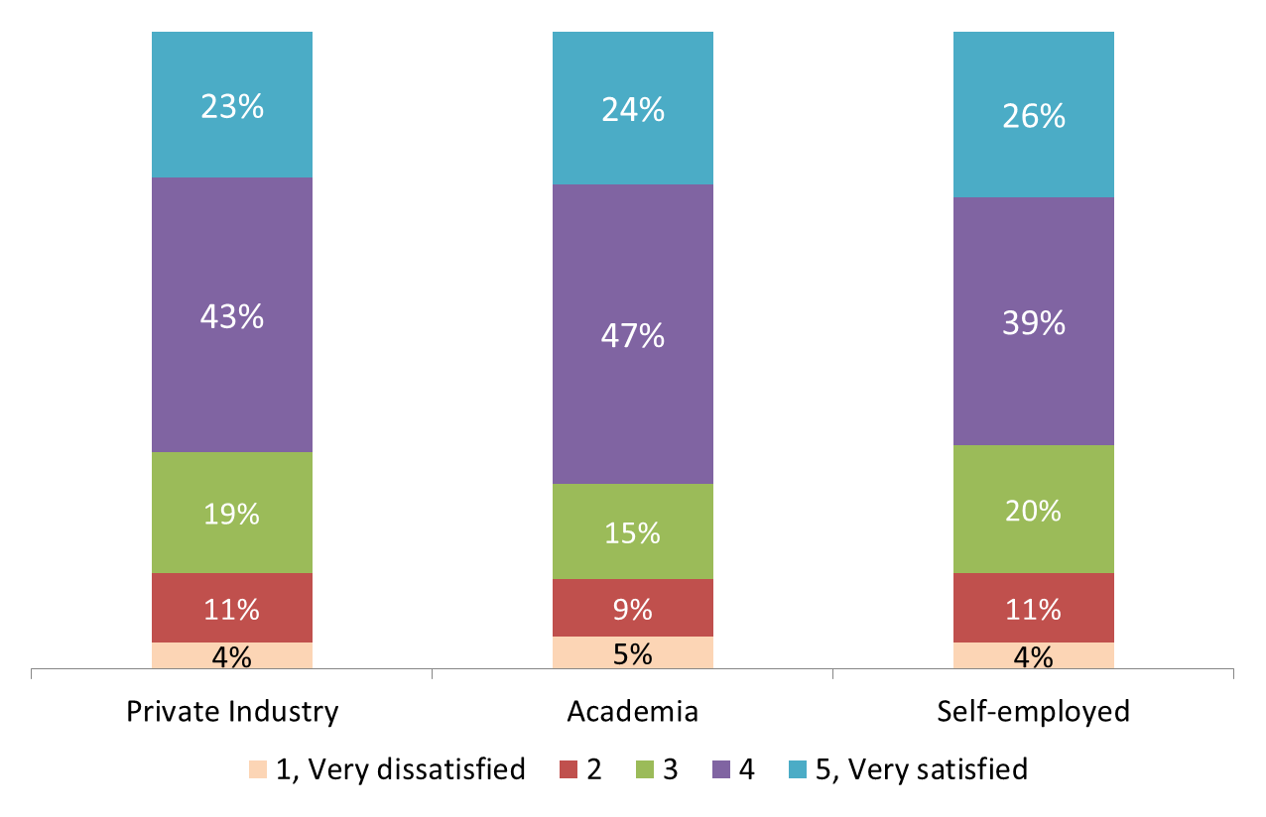
Overall Satisfaction
with IEEE Membership
Source: 2012 Member Segmentation Survey

Slide 28
A glimpse of our potential …
Actions | What members should feel from the experience
Join & Renew | Easy, and makes me feel like IEEE cares about me
Navigation & Discovery | I can find what I need easily I can get help from a person when I need it It saves me time
Using Products & Services | Offerings are relevant to my needs My expectations are exceeded when I use products Benefits consistently exceed the costs IEEE makes good on their reputation for quality
Attending Events | I can easily find and register for events I feel welcome and part of the organization I get valuable information
Getting support | I can get support when & how I need it Staff/Volunteer(s) understand & exceed my needs
Volunteering | I can easily find valuable opportunities I get proper training & recognition

Slide 29
Opportunity (High Level)
Exceptional Member Experience
Fine-tune recognition and incentive mechanisms for member recruitment and retention
Refine IEEE value proposition to diverse membership segments
Emphasis on Young Professionals & Practitioners
  Improve networking opportunities
  Understanding professional & career growth aspirations & coming out with relevant programs
  Identify and deliver relevant products and services
  Collaborating with other OUs (e.g. TA, EA, SA, …)
Aspirations:
  New ideas for programs/activities/initiatives
  Fine-tune related priority projects
  Work with other OUs to identify value enriching products & services for Young Professionals & practitioners

Slide 30
Opportunity (High Level)
Improve Inter-OU Cooperation
Improve inter-OU communication
Mechanisms for inter-OU coordination and collaborations (e.g. Joint Adhoc Committees/Task Forces)
Possible areas of common interest:
  Products and services relevant to Young Professionals
  Products and services relevant to Practitioners
  Invigorating chapters
  Career enhancement
  Conferences
Aspirations:
  Ideas relevant for inter-OU collaboration targeted at YPs & practitioners
  Formulate framework for sustained inter-OU collaboration
  Identify 1 or 2 high impact joint programs/initiatives/projects

Slide 31
Opportunity (High Level)
Modernize & Improve Volunteer Experience
Enhance volunteer skills
Better volunteer training platforms and relevant content:
  CLE+ and beyond; vTools+; Mobile content
Beyond dashboards to performance management
Leverage on Collabratec:
  To improve volunteer networking & sharing
  Increase use of social network and online volunteer tools
Roadmap of Collabratec that aids volunteers:
  Wiki-like tool; Volunteer Navigator (Tech Navigator-like)
Aspirations:
  New ideas for programs/initiatives/activities
  Fine-tune related priority projects
  Direction of online tools (Collabratec, vTools, ICX,… )
  Direction of CLE

Slide 32
Opportunity (High Level)
Cohesive & Coordinated Global Strategy
Membership development tuned to local characteristics
Sustained engagement in US, Japan, India and China
Ensure a consistent basic level of member experience
Provide knowledge, skills and tools for volunteers
Relevance to Industry:
  Careers plan and Collabratec are designed to address this
  Explore ways to engage industry
Aspirations:
  Establish clear roles of Global offices, particularly in terms of level of support to volunteers and geo-units
  Identify methods to improve inter-OU engagement with geo-units
  Learning lessons from India, Japan, China & US, and develop strategies for membership growth globally
  Implications of IEEE 2030 on MGA

Slide 33
MGA Priority Projects in 2015
Collabratec
Career Experience
Execution of Women in Engineering Business Plan
  2015 Leadership Conference
Volunteer Training
Improving YP Committee’s Focus on the Member
MGA Presence in Global Offices
Implement Japan and India Growth Plans
Metro Area Workshops (MAW)
Facilitating volunteer Initiatives
Free access to IEEE Digital Library (SC14 Recommendation)
Incentive & Recognition Program for Companies (SC14 Recommendation)
Loyalty Rewards (SC14 Recommendation)
Promotion tool for local events (SC14 Recommendation)
Enhance vTools (SC14 Recommendation)

Slide 34
Additional Items under Consideration
Fine-tune Collabratec to meet needs of “practitioners”
Working group to identify models for IEEE global offices to provide baseline support to volunteers and geo-units
Joint Adhoc Committee (MGA, TA, EA, …) to focus on young professionals & practitioners with pilots in 2015
Young Professional tracks at regional conferences
Develop Cookbooks and capture staff knowledge helpful to volunteers
Making VLT recordings more accessible to volunteer community

Slide 35
End of Presentation

Slide 36
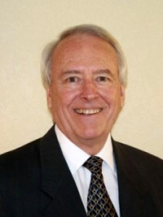
Jim Jefferies
2015 IEEE-USA President
33 years at AT&T and Lucent Technologies in engineering and executive positions
  Fiber optic cable development
  Manufacturing
  Quality Assurance
  Supply Chain Management
Managed delivery of first commercial fiber optic cables for the Bell System

Slide 37
Jim Jefferies
2015 IEEE-USA President
Entrepreneurial sector as COO for USBuild.com in San Francisco, CA
BS in Electrical Engineering University of Nebraska
MS in Engineering Science Clarkson University
Sloan Fellow at Stanford University Graduate School of Business, MS in Management

Slide 38
Overview
What is IEEE-USA?
Career & Member Services
Government Relations & Policy
Communications
Your Questions
Notes:
SDG

Slide 39
IEEE History of
Professional Activities
In 1973, IEEE-United States Activities Committee was established to address employment and national policy issues of concern to U.S. IEEE members.
The mission of IEEE-USA is to recommend policies and implement programs specifically intended to serve and benefit the members, the profession, and the public in the United States in appropriate professional areas of economic, ethical, legislative, social and technology policy concern.
Notes:
SDG

Slide 40
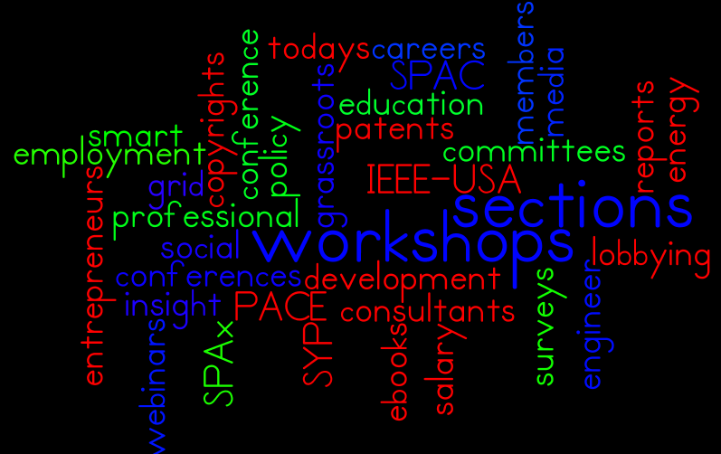
What do you think of when you think IEEE-USA?

Slide 41
Overview of
Career Resources

Slide 42
Career and Professional Resources
Employment
Development
Planning
IEEE Job Site
IEEE Consultants Networks
Entrepreneurs Activities
Student Professional Activities (SPA|x)
IEEE MentorCentre
IEEE-USA Salary Service
IEEE ResumeLab
Career Resources area in The Institute
Today’s Engineer
Webinars
eBooks
Webinars
eBooks
Notes:
SDG

Slide 43
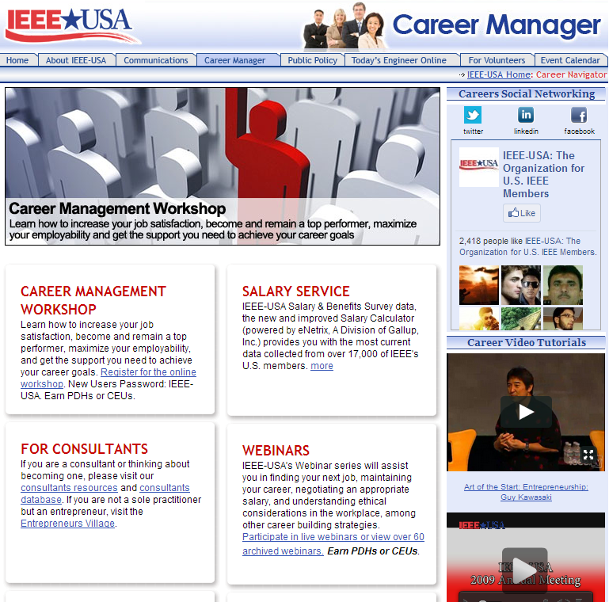

Career Navigator
One Stop Shopping
  Employment Assistance
  Career Development
  Consulting
  Business Needs
  Products & Services
www.ieeeusa.org/careers

Slide 44
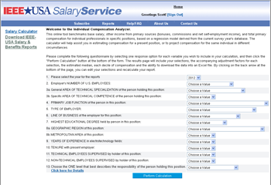

Salary Service
Salary Calculator
Salary & Benefits Reports
Salary Report by Technical Discipline
salaryservice.ieeeusa.org

Slide 45

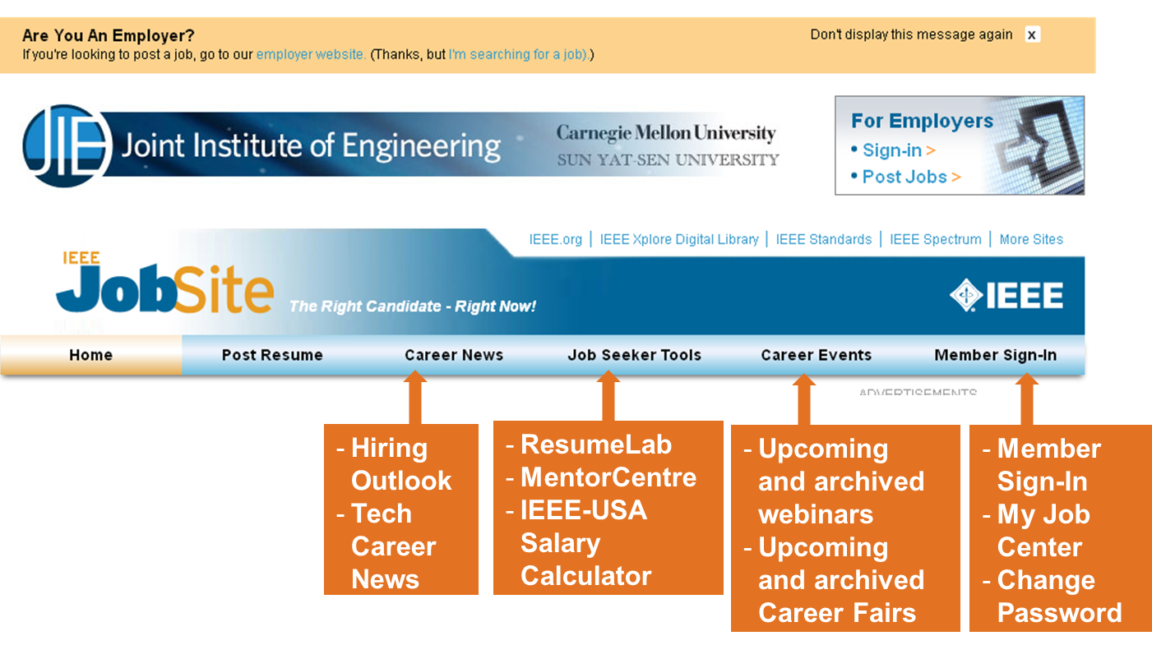

JobSite
Completely re-designed for better usability
Adds additional resources for job seekers
Thousands of jobs from organizations around the world
Internship Opportunities
careers.ieee.org

Slide 46

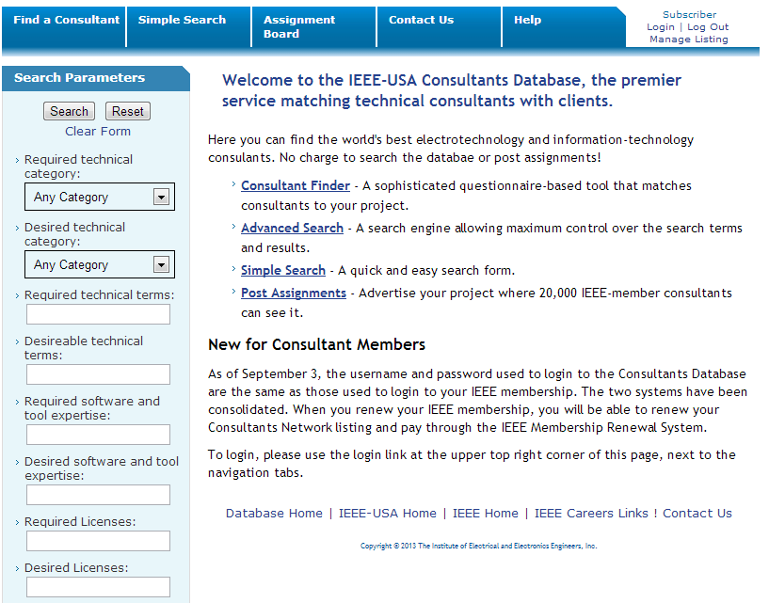
Consultants Database
Consultants Database
Local Consultants Networks
  43 U.S. Local Networks
  8+ Networks Outside of U.S. Consultants Workshop
  How to Become A Consultant
  How to Market Yourself
  Intellectual Property
Quarterly Newsletter
Annual Fee Survey
ieeeusa.org/business/consultants

Slide 47
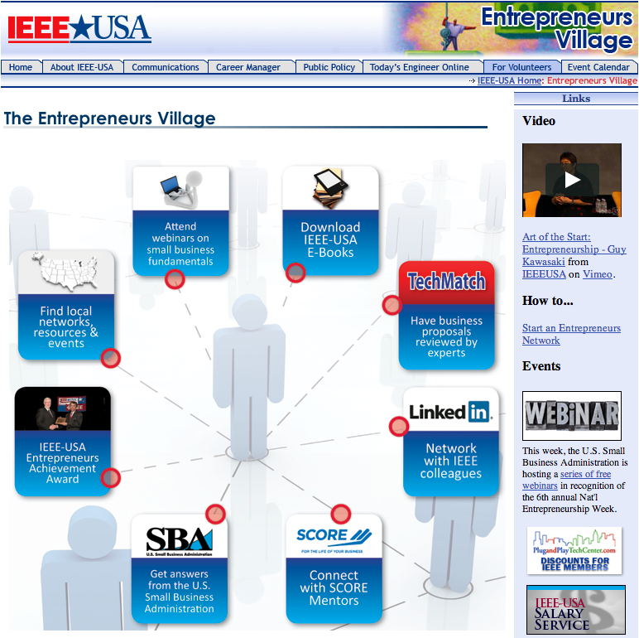
Entrepreneurs Activities
Establish Local Networks (Guide)
Webinars
eBooks
TechMatch
LinkedIn
SCORE
SBA
Policy Symposium
Entrepreneurs Award
ieeeusa.org/careers/entrepreneurs

Slide 48
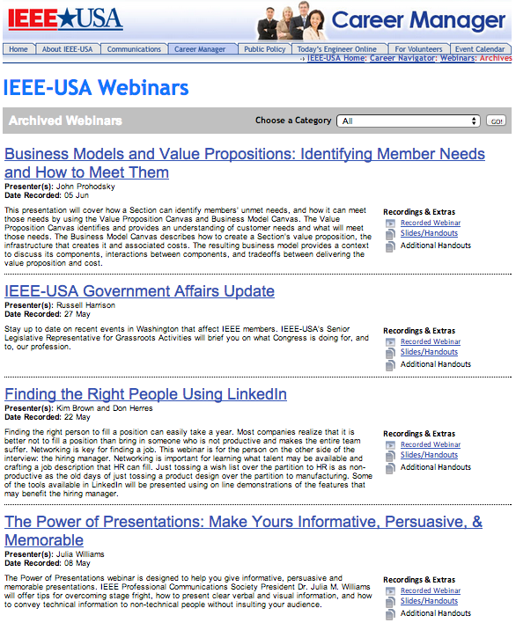
Webinars
How to Win in a Competitive Job Market
Interviewing Types and Preparation
Finding a Job that Fits Skills and Interests
Consulting 101
Mentoring: Your Career's Competitive Advantage
Exploring Career Options
Networking Solutions for Career Success
ieeeusa.org/careers/webinars

Slide 49
Emphasis on Engagement of Students and Young Professionals

Slide 50

Student Professional Activities (SPA|x)

Slide 51
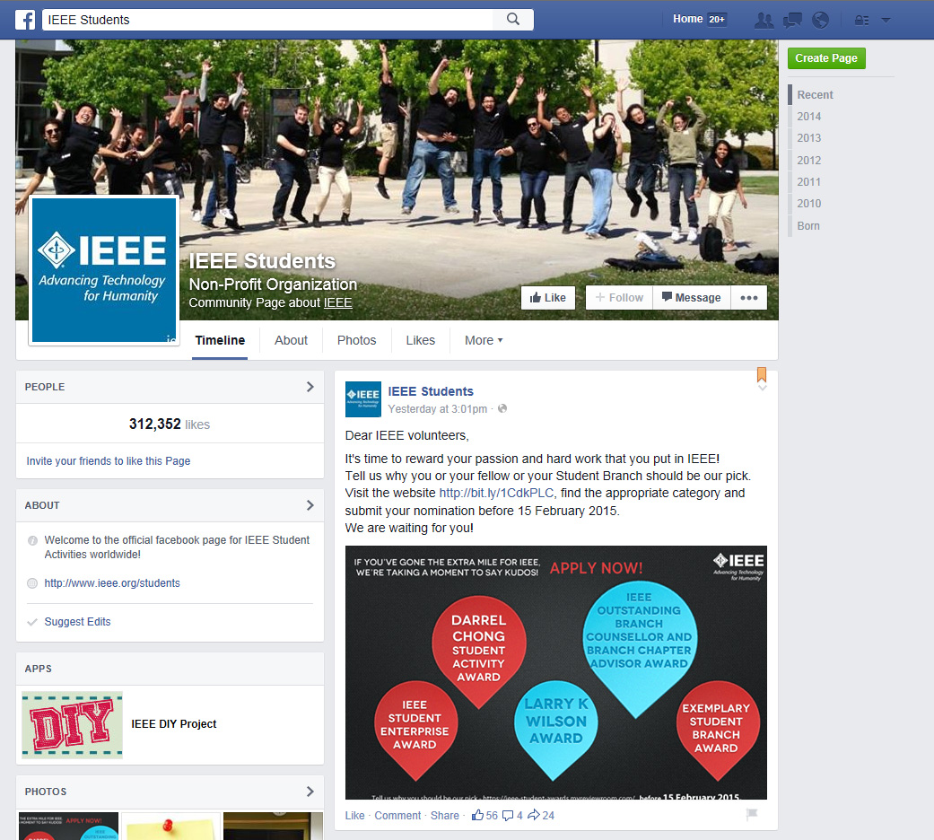

Student Professional Activities (SPA|x)
Facebook Page for Students
Student Resources

Slide 52
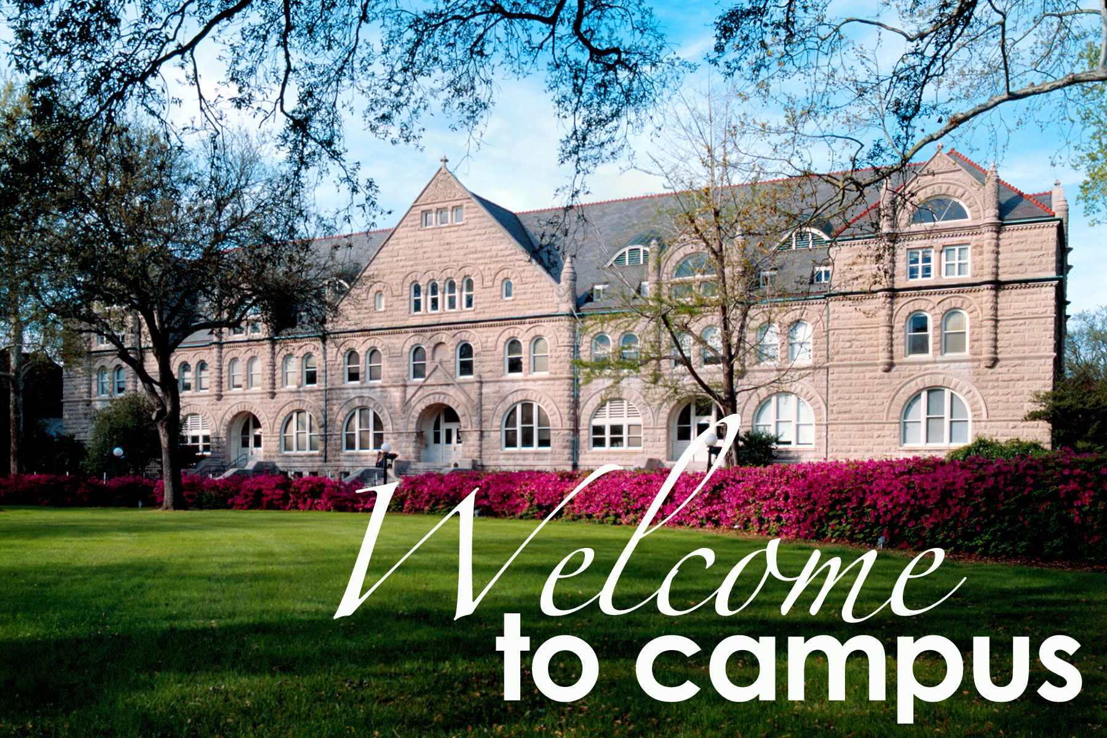
2016 Student | Young Professional Conference
First ever SYP Conference in U.S.
July 2016
Tulane University
Students, Young Professionals, Industry
Professional, Technical, Career Fair, K-12 STEM

Slide 53
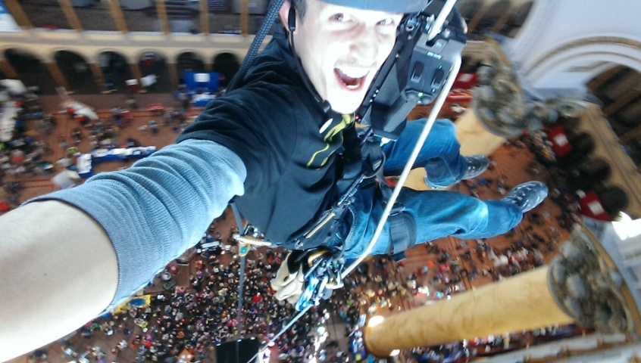
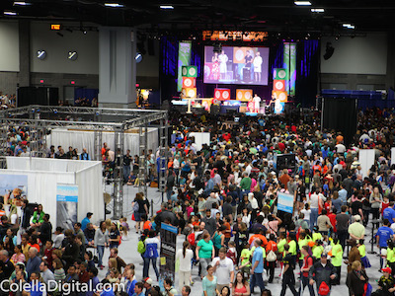
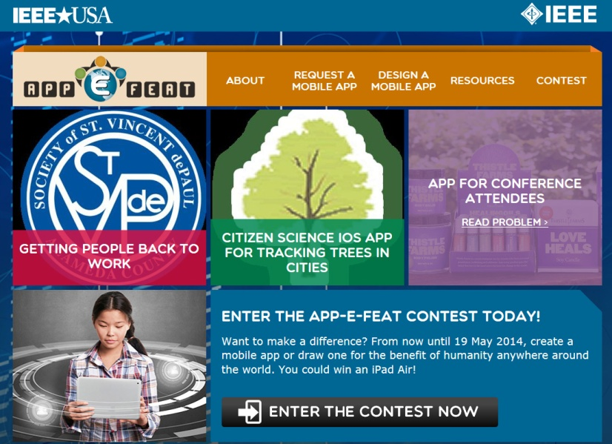
K-12 Stem Education
Discover Engineering
Family Day
9,271 visitors
USA Science & Engineering Festival
325K attendees
2014 App-E-Feat
Apps for Humanity Competition

Slide 54
Overview of
Government Relations

Slide 55
Types of Gov’t Relations Activity
We Educate
We Advocate
We Lobby
White Papers
Testimony
CARE Network (Grassroots)
Amicus Briefs
Position Statements
Action Alerts
Letters to policy-makers on bills/ regulations
Congressional Briefings
Gov’t Fellowships
WISE Internships
Region/Section Talks
SmartBrief
Webinars
Notes:
SDG

Slide 56
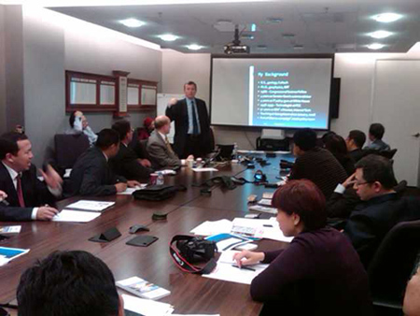
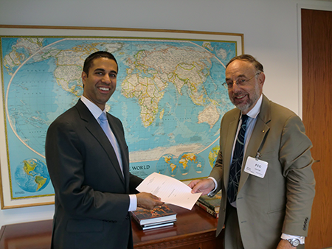
IEEE-USA Gov’t Relations Committees & Issue Networks
Government Relations Council
Communications Policy
Transportation and Aerospace Policy
Energy Policy
Gov’t Fellows
Intellectual Property
R&D Policy
Immigration Reform Policy Network
Medical Technology Policy Network

Slide 57
Policy Priorities
114th Congress (2015-2016)
Patent Reform (improving patent quality, addressive demand letter abuses, and leveling the playing field for small business/entrepreneurs).
Energy (follow-up on recommendations of the President's Quadrennial Energy Review, which IEEE-USA/IEEE PES provided extensive input into).
Skilled Immigration Reform (supporting green cards for foreign STEM grads from qualified U.S. institutions and conditional entrepreneur visas, while opposing massive H-1B visa increases.

Slide 58
Policy Priorities
114th Congress (2015-2016)
R&D Budget (work to ensure continued strong federal investments in R&D, including extension of the tax credit for industry R&D investments)
Cybersecurity (collaborate with IEEE Internet Initiative to advocate enhanced cybersecurity for critical infrastructures)
Federal Travel Policy and Technical Conferences (work with affected science and engineering groups to prevent further legislative or regulatory restrictions on participation of federal scientists/ engineers in STEM-related conferences.)

Slide 59
2014 Highlights/Outcomes
IEEE-USA’s skilled immigration reform proposals were incorporated in several bills and considered by White House before breakdown of comprehensive immigration reform effort in Congress.
IEEE-USA lead effort that convinced Air Force not to relocate their Office of Scientific Research as a cost reduction measure.
Successful passage of Cybersecurity Enhancement Act of 2014 (Public Law 113-274)
House-passed STEM Education Act (H.R. 5031) includes IEEE-USA-backed provisions to enhance the Noyce Teacher Scholarship Program and expand definition of STEM education to include K-12 instruction in computer science.
Invited by National Science Foundation to co-host Congressional Briefing on Cybersecurity and Privacy.

Slide 60
2014 Highlights/Outcomes
Congress declined to move on proposed patent reform legislation in the wake of concerns raised by IEEE-USA and other organizations and companies.
IEEE-USA contacted by the President’s Office of Science and Technology Policy, the U.S. Army Research Laboratory and the Gov’t Accountability Office for assistance in assessing impact of federal travel policies on federal S&T capabilities.
IEEE-USA and PES Joint Working Group input to first Quadrennial Energy Review described as “very, very helpful” by Department of Energy officials.
The U.S. Supreme Court upheld patentability of software in CLS vs. Alice decision; IEEE-USA’s amicus brief had outlined rationales in favor of software patentability.

Slide 61
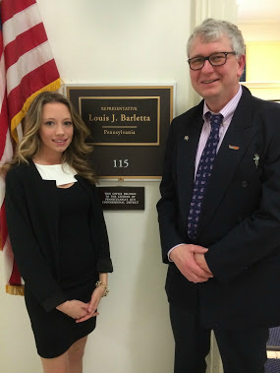
SET Congressional Visits Day
Annual two-day event that brings scientists, engineers, researchers, educators, and technology executives to Washington to raise visibility and support for science, engineering, and technology.
Set for 17-18 March 2015
(Register by 1 March)
ieeeusa.org/policy/cvd

Slide 62
Government Fellowships
Congress
State Department
U.S. Agency for Int’l Dev.
(USAID)
Congressional Fellowship
Engineering & International Development Fellowship
Engineering & Diplomacy Fellowship
One year as a staff S&T adviser to a Member of Congress or Committee
One year as a S&T adviser to a State Dept. bureau or office
One year as an S&T policy adviser in the Office of Science and Technology
ieeeusa.org/policy/govfel
Notes:
SDG

Slide 63
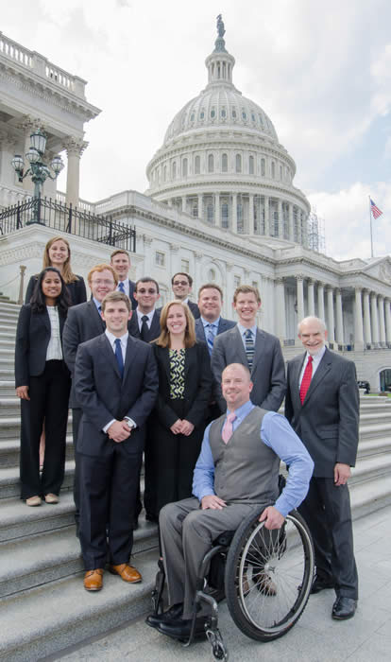
Washington Internships for Students of Engineering
Each year, three outstanding IEEE student members are selected to spend nine weeks in Washington, D.C., learning about the public policy process, including how government officials make decisions on complex technological issues and how engineers can contribute to legislative and regulatory public policy decisions.
The WISE Program is ranked as one of the best Internship opportunities in the U.S. by the Princeton Review.
wise-intern.org

Slide 64
Overview of
Communications

Slide 65
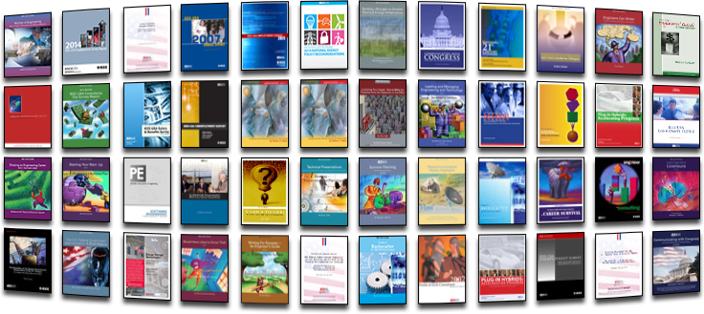
eBooks
157 eBooks in catalog
(available in our new shop)
350K+ downloads
ieeeusa.org/communications/ebooks/

Slide 66
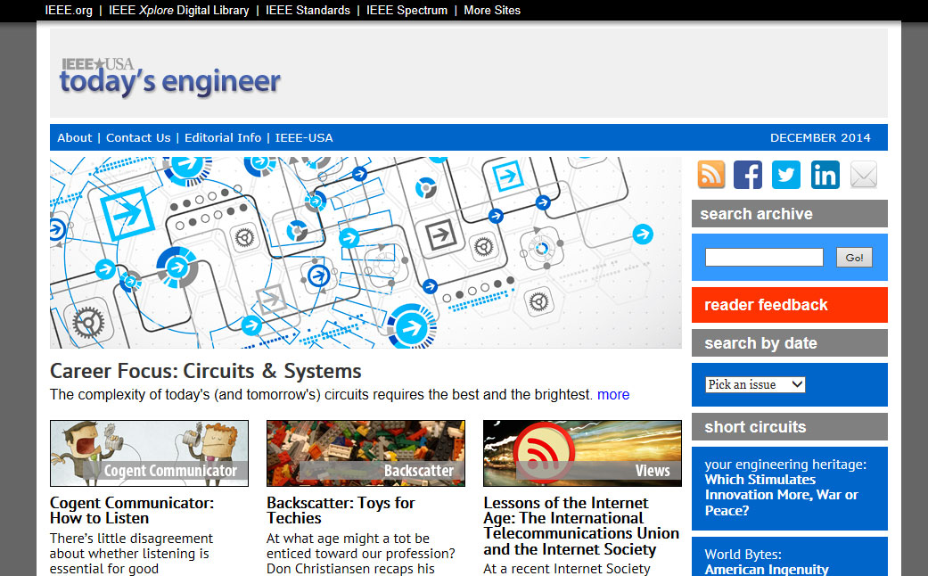

Web Presence: Legacy/Sunsetted
Today’s Engineer
First a magazine, transitioned to e-Zine
Published: 1998-2014
IEEE-USA in ACTION
Interactive PDF
Published: 2010-2013
Notes:
RMC

Slide 67

Web Presence: InSight
Flagship IEEE-USA Publication
Launches Late January 2015
More than a year in development, combines the best of TE and In Action.
Clean, Modern, Responsive Design built from the ground up – scales to any size browser including mobile
Interactive elements - polls, commenting & more
Social Enabled
IEEE Single sign-on
New Ecommerce Shop!
insight.ieeeeusa.org
shop.ieeeusa.org

Slide 68

Web Presence: IEEE-USA Website
ieeeusa.org
New Site Development
Begins late February with expected launch in early 2016

Slide 69

Social Media
Facebook – 3000+ Likes.
Twitter – 11,300+ followers &
expanding rapidly. Since 2012
Twitter follows are up 151%.
LinkedIn – IEEE-USA Group
5141 Members, Entrepreneurs Group 396 Members.
Flipboard “Career & Employment Issues” – 14k Viewers, 21k Flips, 246 Articles.

Slide 70

What’s On Your Mind?
Jim Jefferies
jjefferies@ieee.org

Slide 71
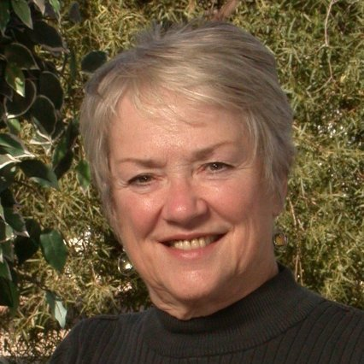
Karen Pedersen
2016 IEEE-USA President-Elect Candidate
35 years of power industry experience across a wide swath, focusing on electric system planning, distribution planning standards and related areas
BSEE in Electronics and Computers, Iowa State University
MBA with concentration in Economics from Bentley College, Massachusetts

Slide 72
IEEE-USA
2016 President-Elect Candidate
Karen S Pedersen, PE
Region 4/6 Annual Meeting
San Diego, Calif.
January 24, 2015

Slide 73
My IEEE Experience
2013-2014 Region 4 Director
2014 Ad Hoc IEEE Code of Conduct and Policy Review Committee Chair
2013 Ad Hoc IEEE Ethics and Compliance Committee Member
2007-2014 Awards and Recognition – Region 4 – MGA – IEEE Awards Board
2010 MGA Strategic Direction and Environmental Assessment Committee
Section Chair of Central Iowa Section 1983-84 and Iowa-Illinois 2003

Slide 74
My vision for IEEE-USA
The average age of IEEE-USA members is younger than it is today
  IEEE Total 44.3 – Higher Grade 47.8 – Students – 26.8
  IEEE-USA Total 48 – Higher Grade 50.6 – Students - 28
The future IEEE members consist of equal #s of Young Professionals, Mid-Career Professionals and Experienced members
An IEEE-USA that attracts young professionals as part of their career path.
Notes:
At the end of 2014:
Average age of Overall Membership: 44.3
Average age of Higher Grade Member: 47.8
Average age of Student Member: 26.8
The range is trending slightly upwards, but at a very slow rate, in general it is quite stable. This is probably because of our high attrition rate (low retention) of new members and students.
I don't have easy access to the breakout of US age, but in general I think it is probably slightly higher (maybe a year or two) for Higher Grade, and slightly lower for Students since we have so many students and Graduate Students outside the US.
Hope this is what you need. If you need exact numbers on the US let me know and I can work on that next week.

Slide 75
My vision for IEEE-USA
Leadership opportunity that works in the today’s careers.
Volunteer advancement based on experience regardless of boundaries.

Slide 76
How do we get there?
Focus groups to recommend changes in IEEE-USA to take us to the future.
IEEE-USA structure that not only works for the volunteer, but the companies that employ our volunteers.
An IEEE-USA that adds value to the USA volunteer that is not already available.

Slide 77
Charge the focus groups with the following goals
  An average volunteer age that is 10% younger.
  A structure the allows volunteers to succeed in IEEE as they advance in their careers.
  What else should IEEE-USA do or be to attract the volunteer of the future?

Slide 78
I am asking for your vote.
As 2016 President-Elect I would support your efforts to move IEEE-USA towards the future.
Please join me.
Karen S. Pedersen, P.E.
kspedersen@ieee.org
Kspedersen@kspedersenpowersolutions.com
563 340-2139

Slide 79
IEEE-USA
Focus on programs that bring value to volunteers and members.
Make IEEE-USA the technical society of choice to the career engineer.
IEEE-USA’s strength is in being able to influence government on behalf of the engineer

Slide 80
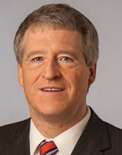
Keith Grzelak
2016 IEEE-USA President-Elect Candidate
Director, Wells St. John PS
Spokane, WA, USA
www.keithgrzelak.com
Patent lawyer representing engineers and scientists
Safety and crashworthiness engineer at GM and Ford
Technical experience in electrical, mechanical and medical systems
Employed at Fortune 100 companies to start-ups

Slide 81
Keith Grzelak
2016 IEEE-USA President-Elect Candidate
BS Mechanical Engineering &
MS Engineering Mechanics
Michigan Technological University
MS Electrical Engineering
Wayne State University
JD from Michigan State University
Teaches courses to STEM workers on technology policy and legal issues

Slide 83
IEEE Accomplishments and Activities
(S’93-M’95-SM’09)
IEEE Accomplishments and Activities (S’93-M’95-SM’09)
COMMITTEES/BOARDS: IEEE-USA Vice President for Government Relations (2012-2013); IEEE-USA Board of Directors (2012-2013); IEEE-USA Intellectual Property Policy Committee (IPC), member 1993-2015, Vice-Chair (2005-2006), Chair (2007-2010 and 2014-2015); IEEE-USA Committee on Communications Policy (CCP), member 2012-2015; Participant in preparing IEEE-USA position on the Administration's cyber-security policy proposal; Government Relations Council (GRC), member (2009-2015), chair (2012-2013)
REGION: Presenter at Region 6 annual meetings (2010, 2013 and 2014)

Slide 84
IEEE Accomplishments and Activities
(S’93-M’95-SM’09)
SECTIONS/CHAPTERS: Participant in local Spokane and Palouse Section meetings and activities; actively conducted educational seminars at local section meetings across country on key STEM policy issues.
SOCIETIES: IEEE Computer Society, member (1993-2015); IEEE Circuits and Systems Society, member (1994-2015)
CONFERENCES: Presenter at IEEE-USA Annual Meeting (2007, 2011, 2013 and 2014); Organizer of IEEE IP Professionals seminars for members on technology law (http://www.ieeeusa.org/IP-Pros/events.asp)

Slide 85
IEEE Accomplishments
Representative to IEEE-USA board on numerous Supreme Court briefs filed behalf of IEEE-USA members.
Spokesman for IEEE-USA on STEM policy issues to national press.
Active participant in setting/revising immigration policy strategy.
Active member in submitting extensive rule-making comments to Federal agencies relating to technology policy.
Co-founder of IEEE IP Professionals initiative.
Organizer of conferences on technology law and policy for members.
Lecturer for IEEE-sponsored seminars at national, regional, and section meetings.
Active participant in Congressional visits and meetings with Judiciary Committee staff and Federal Agencies regarding legislative and public policy issues.
Organizer and participant in Congressional staff presentations on technology issues.
Active promoter of IEEE-USA membership to non-members.
Active lecturer on technology policy issues to outside organizations.

Slide 86
IEEE Accomplishments
Actively supported local, regional and national level programs for IEEE-USA members ranging from technology policy, innovation, public policy, education and entrepreneurship. Served on ad hoc committee to identify membership issues and trends. Identified member, committee and staffing changes while serving as IEEE-USA Vice President for Government Relations, as well as while serving on IEEE-USA Board.

Slide 87
Statement
IEEE-USA membership is on the decline.
Our members face challenges trying to maintain steady career paths.
IEEE-USA needs to listen to those members and ensure that value and results are provided in a way that supports their education, careers and retirement.
IEEE-USA is a valuable component of our parent, IEEE, and we need to share what we have learned to do well to support our U.S. member interests with other Regions outside of the U.S.
IEEE-USA needs to acknowledge operating concerns of our parent, IEEE, and further needs to contribute in order to ensure that the IEEE and IEEE-USA brands remain “first-rate” in the eyes of STEM workers.
To carry out this mission, I will initiate a plan as President-Elect to listen to our member concerns, engage members, and identify changes that can be adopted during my tenure as President.

Slide 88
Plan
Communicate with our members in ways that they communicate.
Make our committees dynamic so they follow current issues.
Continue to improve how we educate our members on career and public policy issues.
Expand our training of volunteers so that value can be visibly delivered at the local section level to members.
Lead on proposing and supporting legislation that encourages worthy STEM careers in the U.S., including immigration and intellectual property policies.
Work on public policy issues that our members feel are important.
Investigate affiliate membership to expand potential membership base.
Continue to improve our member engagement with Congressional representatives so they present clearly identified policy issues.

Slide 89
Platform Goals
Speak in a language that our members understand.
Talk with our members in a way that they hear us and we hear them.
Show our members value by working on things that directly touch their concerns.
Share our members skills with Regions outside of the U.S. to enhance the IEEE brand.

Slide 90

For additional information, visit my website: www.keithgrzelak.com; contact me on Skype: patentlake; or reach out to me on LinkedIn www.linkedin.com/pub/keith-grzelak/0/183/676/

