Slide 1
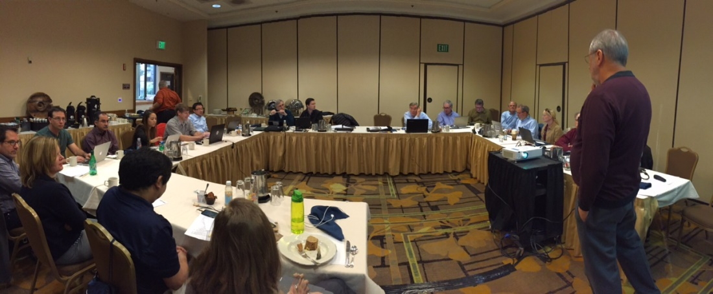
Project Planning for initiatives
For
Region 6 – Op Com
Jan 23rd, 2014
Karen Day - PM

Slide 2
Project Planning for initiatives
Since November (my appointment as PM)
Joined additional committees GHTC & SusTech
Looking at them from the eyes of a PM to identify Strengths, Weakness, Opportunities, & Threats.
Reading through the mountains of docs
Communication Methods that work and those that don’t.
Wrote up a project scenario (approx 15 pages)
All sub projects are either in existence or currently in planning
WEB SITE updating
Mobile App development ( ComSoc has an awesome one)
Calendar app being created by a student
Dashboard utilities in Region 6 website appearing vacant

Slide 3
Need to create a project Committee:
Conferences
Communication
Web Design
Samieee
Vtools
Please take down my contact information
Karen J Day
Program/Project Manager
karen.j.day@ieee.org
503-867-2267

