Slide 1

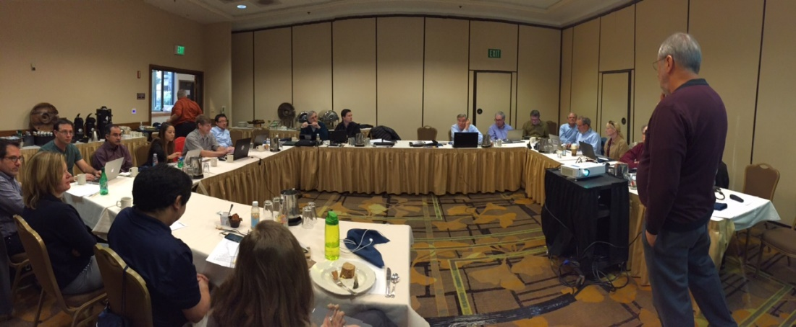

Project Planning for Region 6
For
Region 6 – Region 4 Joint Meeting
Jan 24rd, 2014
Karen Day - PM

Slide 2
Contents
Introduction – Who am I?
About our Regions 4 & 6
Project & Program Management – Defined
COMMUNICATION
Cases – Samples of Current Programs
Conclude PM
Needs Become Goals
Region 6 – Goals
Region 6 Aspirations
My IEEE Experience
Where do we Go from Here?
Lessons Learn – Take to your Sections
References used and contact information

Slide 3
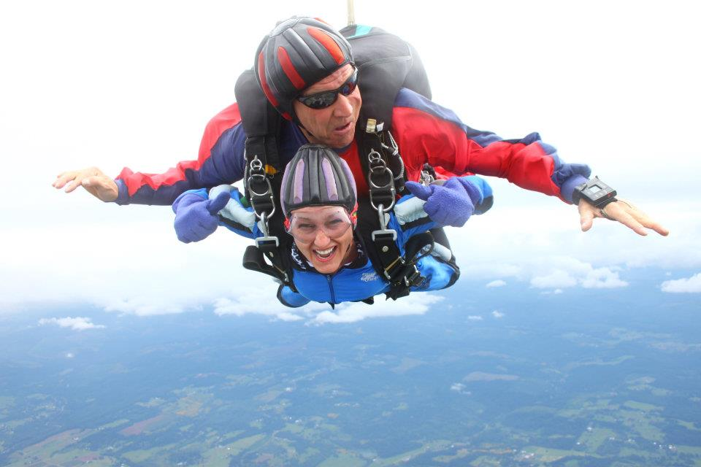

Introduction
Brief History & Early Education
Family & Hobbies
Professional Career
Government Projects
A New Beginning
Recent Education
IEEE Membership
The Future

Slide 4
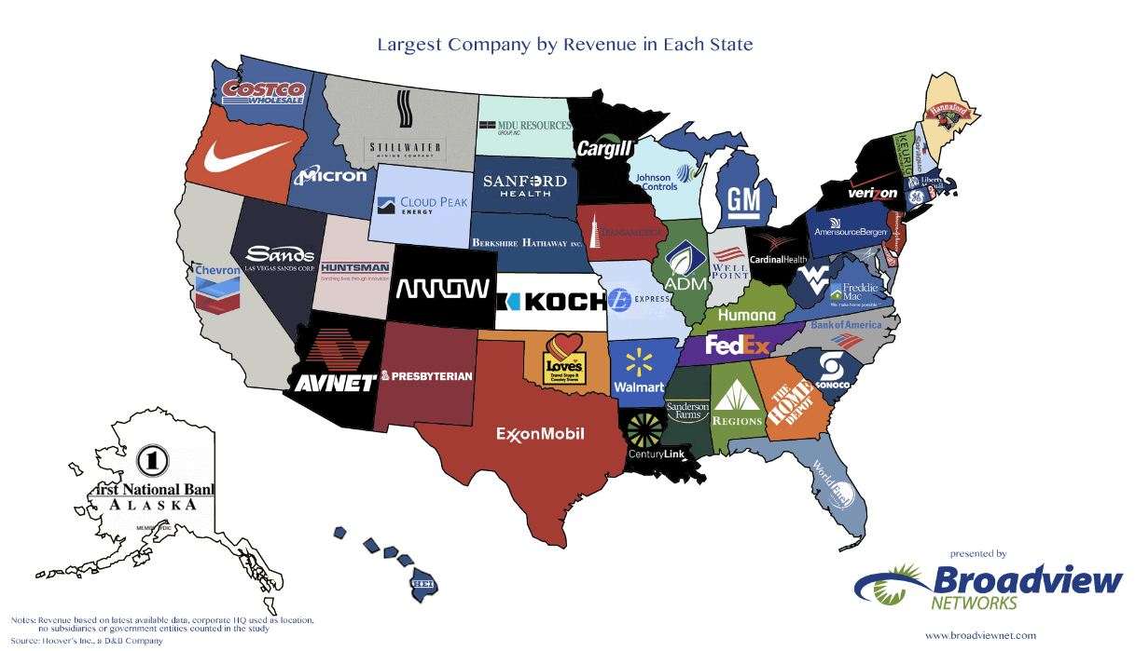
About our Regions 6 & 4
Who and what is in our area
REG 4 | Per Million |  | REG 6 | Per Million
ND | 0.739 |  | WA | 6.97
SD | 0.853 |  | OR | 3.97
NE | 1.88 |  | CA | 38.8
MN | 5.45 |  | AZ | 6.73
IA | 3.1 |  | NV | 2.84
WI | 5.75 |  | UT | 2.94
IL | 12.88 |  | ID | 1.61
MI | 9.9 |  | MT | 1.02
IN | 6.59 |  | WY | 0.563
 |  |  | NM | 2.08
Totals | 47.142 |  |  | 67.523

Slide 8

I visited the web sites for our regions but found region 4 has a great web site. Region 4 had a superior web site.
Your calendar was more informative and a useful tool.
It is my pleasure to work with Lance – Reg 6 Web master on making some improvements to our web site.
Be sure that the Web Site Committee gets on the PM list as well.

Slide 9
Our Region (Reg 6) has some of the biggest and best companies to work for containing 26 of the best company HQs (per fortune mag)
My personal goal is to tap into the vast array of industry professionals right out our back door.
The level of educated and experience people among us is amazing, all have the understanding of Project Management.

Slide 10
3 Words describing Project Management
Other Ideas:
= Planning, Communicating, Delivering
= Plan, Schedule, Control
= Plan, Execute, Measure
= Herding Wild Cats
= Accomplish Business Objectives
= Make Things Happen
= Manage Your Mess
= Bring Future Present

Slide 11
Project & Program Management
PMI defines Project Management as a temporary group activity
Designed to produce a unique product, service, or result.
Project Management, then, is the application of knowledge, skills, and techniques to execute projects effectively and efficiently. It’s a strategic competency for organizations (IEEE) enabling the to tie project results to business goals – and thus, better compete in the markets.
Mike Andrews ask a question last year that resonates:
What would your section be like if you (the leaders) acted like the CEO
What are your section Goals, Priorities, or Initiatives?

Slide 12
Project & Program Management
Project Management Processes:
Project Life Cycle - The PMI process groups are called:
Initiating
Planning
Executing
Control & Monitoring
Closing
You may need to repeat these processes repeatedly in a large project. These processes will integrate with your particular organizational or industry project management methodology.

Slide 13
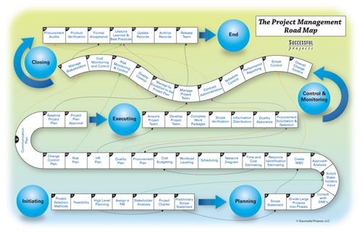
Project & Program Management
Project Management Processes:

Slide 14
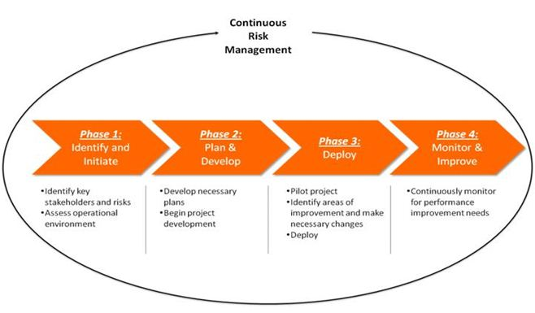
Project & Program Management
Project & Program Management Processes: Simplified

Slide 15
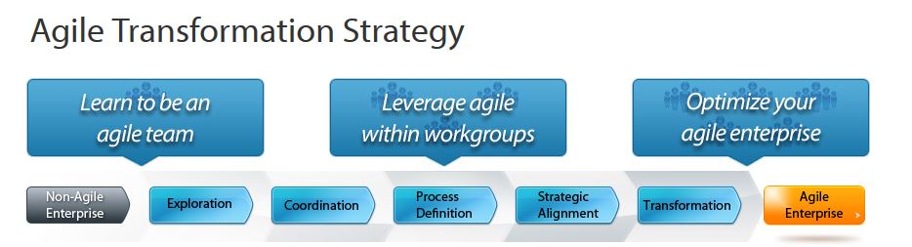
Project & Program Management
I have seen groups within IEEE use this method very effectively !! But, I have also seen many areas ,where, if this were adopted groups, chapters, sections, and committees could run more effectively.

Slide 16
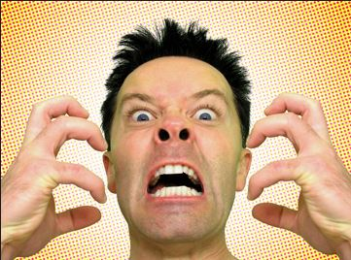
Communication
The methodologies are useless without teams that have an open line of communication. The most amazing plans, ideas, and initiatives are less likely to accomplish milestone timely, experience scope creep / changes, project burn out, and higher rate of failure. Y I K E S !!!

Slide 17
Communication
Virtual Project Management ~ Seven Best Practices
Establish a Clear Communication Plan
  Communication Matrix with escalation plan
Account for Informal Discussion
  Establish a personal rapport with team members
Be a Master of Technology (IMPORTANT)
This seams obvious, but I have seen it catastrophically occur 2 x in the last two months.
Know your software (WebEx) and how to use it to share control or present your material efficiently

Slide 18

Communication
Virtual Project Management ~ Seven Best Practices
Establish a Clear Communication Plan
  Communication Matrix
2. Account for Informal Discussion
  Establish a personal rapport with team members
3. Be a Master of Technology (IMPORTANT)
This seams obvious, but I have seen it catastrophically occur 2 x in the last two months.
Know your software (WebEx) and how to use it to share control or present your material efficiently.

Slide 19
Communication
Virtual Project Management ~ Seven Best Practices
4. Conduct Structured Meetings
5. Leverage Video When Needed
6. Determine a Range for Time-Zone Differences
7. Use Email Effectively – This could be a 90 min discussion that could lead to the need for paramedics.

Slide 20
Business Case
Review :
GHTC
Chapter Recordings Project

Slide 21
Conclude PM Section
Ultimately, as leaders, you are Project Managers. You are responsible for setting the tone and leading your team through COMMUNICATION leading to ACTION and CHANGE.
Your ability to collaborate, mitigate, delegate, follow through, and most important to Inspire your members will define you as a leader.
Initiating
Planning
Executing
Control & Monitoring
Closing
REMEMBER: What would you do if you are the CEO?

Slide 22
Needs become Goals
What members want
Ability to network, personal contact
Continuing education through IEEE publications
STEM outreach
Career development opportunities
Support humanitarian projects
Public understanding of who we are and what we do
Partnering

Slide 23
Region 6 Goals
ɡōl/
noun
plural noun: goals.
1. (in football, soccer, rugby, hockey, and some other games) a pair of posts linked by a crossbar and often with a net attached behind it, forming a space into or over which the ball has to be sent in order to score.
an instance of sending the ball into or over the goal, especially as a unit of scoring in a game. "the decisive opening goal"
    a cage or basket used as a goal in other sports.
2. The object of a person's ambition or effort; an aim or desired result.
"going to law school has become the most important goal in his life“
synonyms: | objective, aim, end, target, design, intention, intent, plan, purpose;

Slide 24
Region 6 Goals
Region~Area plans/actions/challenges
1. Improve member engagement
2. Communications improvements
–Website, social media, SEO, architecture, e-mail, newsletters, etc
3. Utilize IEEE resources (CLE, PACE, Student branches, STEM volunteers)
4. Inspire the public
What members want
Ability to network, personal contact
Continuing education through IEEE publications
STEM outreach
Career development opportunities
Support humanitarian projects
Public understanding of who we are and what we do
Partnering

Slide 25
Region 6 Aspirations
as·pi·ra·tion
ˌaspəˈrāSH(ə)n/
noun
plural noun: aspirations
1.
a hope or ambition of achieving something.
"he had nothing tangible to back up his literary aspirations"
synonyms: | desire, hope, dream, wish, longing, yearning;

Slide 26
Region 6 ~ Aspirations
1. Create and Implement a model for Area meetings
2. Improve Communication and Coverage with Members and the Public. (Continuation/Expansion of 2014 Action Item)
3. Develop the capability and Expand the use of Virtual or Hybrid Events
4. Create a STEM and affinity group
5. Increase industry and public sector outreach that will increase IEEE visibility and clearly state IEEE value and attributes to decision makers. (Continuation of 2014 Action Item)
6. Enhance Officer training and create an officer mindset that places them as the CEO of their geographic unit, improve the relationship between sections and chapters, utilize CLE, improve communication conduit to the members, expand the use of the Region 6 speakers bureau (distinguished lecturers, PACE speakers, etc.). (Continuation/Expansion of 2014 Action Item)
7. Increase the localized support for outstanding and diverse Student, Young Professional and PACE activities.

Slide 27
MY IEEE Experience
Use the tools I was given – What that looked like
Project Profile – If I was the CEO I would come up with the following:
Mobile app for our region that includes a calendar program.
Dashboard Utility that links to my most visited IEEE sites, videos, and email
Revise the website so I can see what is going on throughout my region. (what I learn from other sections)

Slide 28
Where do we Go from Here?
What I have learned from this:
All of these ideas already exist.
My ideas are not unique
How do we accomplish these types of projects:
TEAMS – We need teams to accomplish one small chunk at a time. These teams will communicate regularly using virtual meetings for task completion.

Slide 29
From out break out sessions, area meetings or sections congress
Lets take a look at some of the ideas that came from our break out sessions.
What can we start right now!!
Is there a few items that fit in our aspirations or goals that we can start TODAY!

Slide 30
Lessons Learn – Take to your Sections
We have a few tools that would improve the Region 6 communication plan immediately.
Utilize and update our database SAMIEEE
Post all meetings, gatherings, clubs, competitions, and conferences in Vtools.
Lets take a few minutes for Lance to show us a
Quick 30 +/- min on posting meetings and
Using this tool.

Slide 31
References in Presentation
Definitions from PMBOK found at www.pmi.org
Article by Hassan Osman, PMP “The Virtual Project Manager: Seven Best Practices for Effective Communication” from PMI Virtual Library
Agile Transformation Strategy – White Paper, Collaabnet
www.fortune.com/magazines/fortune/best-companies/2012/states/CA.html
http://www.washingtonpost.com/blogs/govbeat/wp/2014/06/23/map-the-largest-company-by-revenue-in-every-state/ Broadview Networks provided maps for article written by Niraj Chokshi on June 23, 2014
Region 4 & 6 Membership data from Samieee done by Vickie A Ozburn - Reg 4 (Manager, Quality & Inventory Mgmt, Women's Forum Enterprise Communication Chair, IEEE Region 4 Membership Development Chair)

Slide 32
Thank you
If you are working on a project specific to your section. Please share your plan. Perhaps your plan is something we would like to try in other sections or chapters.
Contact Info
Karen J. Day – Oregon Section Executive Officer
Region 6 Program & Project Manager
karen.j.day@ieee.org
(503)867-2278

