Slide 1
IEEE Collabratec™ Direction & Training
IEEE Member & Geographic Activities
Updated: 12 January 2015

Slide 2
Introductions
Justine Spack Community Specialist justine.spack@ieee.org
Terence Martinez Product Manager t.c.martinez@ieee.org

Slide 3
Today’s talk
Transition underway – please ignore references to project name ‘PPCT’
IEEE Board Direction
Highlights – Network Experience
Communities
Onward to Launch
Appendix
Collaborative Authoring & Research Tools
Notes:
*** BREAK-OUT SESSION

Slide 4
IEEE Board Direction
Notes:
*** BREAK-OUT SESSIONS

Slide 5
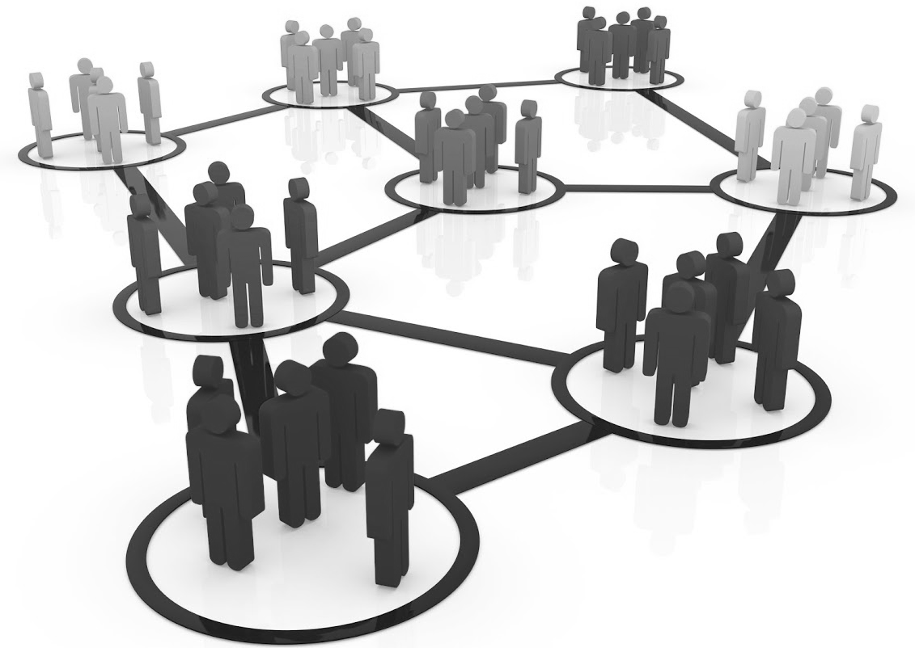
What is IEEE Collabratec™ ?
IEEE's professional networking / collaboration platform
Open network, with exclusive member privileges
Facilitates interactive communities and collaborative research
Competitively positions IEEE for the future of professional networking, publishing, and career development…
Specialized service with a scope and depth of expertise in engineering and technology not found in general social networks

Slide 6
Motivation: Member and Author Satisfaction
Need to meet member expectations with a 21^{st-}century, professional networking experience
25% gap between importance and satisfaction with IEEE opportunities for professional networking
Need for IEEE to maintain its position as a world-class publisher
Increasing number of mergers and integrations by publishers with collaborative authoring platforms
2011 IEEE Member Segmentation Study | Importance | Satisfaction
Opportunities for Professional Networking | 71% | 46%
Gap in Service | 25%

Slide 7
Objectives
Serving the professional needs of IEEE audiences to:
strengthen connections with the global community of technology professionals
facilitate professional development and networking
remotely collaborate in a seamless way
access and manage the information they need in their profession in an efficient way
accelerate research and publication with improved tools
Notes:
*** BREAK-OUT SESSION & LEARNING LABS

Slide 8
Development Progress
June 2013 – MGA, PSPB, TAB agree to start work on a single integrated solution
Summer 2013 – Evaluation conducted of several options for building the service
Oct. 2013 – Decision to go with in-house built solution based on GoogleApps and Google+
Nov. 2013 – Board adds to 2014 budget – asks for full business plan by February
Feb. 2014 – Board receives and approves business plan
Aug. 2014 – Demonstration at Sections Congress of development progress (to date)
Dec. 2014 – Launch of Pilot – Review and incorporate pilot user feedback prior to full launch
Late 1Q-2015 – Full Launch

Slide 9
Building on Who We Are
Global Network
400k+ IEEE members
Vibrant Communities
38 Technical Societies, 2200+ technical chapters, Future Directions communities
300k+ Society members
Annually, 250,000 conference attendees
World Class Publisher
Monthly, 3.5-million, unique IEEEXplore users
300+ Sections, 400+ Affinity Groups
250,000+ authors
175 periodicals
300k+ former members on file
2,500+ Student Branches
Potential Users of IEEE Collabratec™

Slide 10
Re-Thinking the Engagement Model
Traditional Organization Unit Perspective
IEEE Collabratec™ Perspective: One person with one or more affinities
IEEE Members
Section Members
INDIVIDUAL
Xplore user
Society Members
Volunteers
Conf. Attendee
Xplore Users
Consultant
Consultants
INDIVIDUAL
Authors
IEEE Member
Author
Conference Attendees
Volunteer
Standards Developers
Conf. Attendee

Slide 11
Highlights – Networking Experience
Note
Screenshots reflect work-in-progress activity, and may be tweaked prior to Pilot launch
Screenshots of research experience included in Appendix
Notes:
*** BREAK-OUT SESSION

Slide 12
Features at a Glance (March 2015)
functions | All | Members | Volunteers
Networking | Professional Profiles Privacy settings Peer-to-peer connecting Activity stream Communities Notifications Integration w/ 3rd-party networks | Member grade badges Enhanced privacy settings Exclusive communities | Volunteer badging Vtools integration
Career Development | Profile management / career history Communities | Preferential placement in recruiter search results Exclusive communities | n/a
Research | Content discovery, library management; importing citations and documents from multiple services Private collaboration groups Cloud-storage
Authoring | Collaborative document development Profile management / published works Bibliography generation Communities Cloud-storage
Today’s focus
IEEEXplore
Google Scholar
Microsoft Academic
For example…
Requirements or design specifications,
Application notes,
Consulting proposals

Slide 13
Google Plus
Extended Community Experience
Other External Network & Library Integrations
(LinkedIn, Mendeley, Zotero, ORCID & Facebook)
Google Account - Other Google Services
(Hangouts, Groups, YouTube, Picasa)
Connections
Library
Profile
Communities
User-Defined visibility options & connected services
Communities
(Q&A, File Posting, Calendar & Events)
Library & Research Groups
(Meta-Data, Search IEEE Xplore, MS Academic, Google Scholar)
Activities, Events & Recommendations
People
(Profile, Interests & Connections)
IEEE Collabratec™
Optional, 3rd party service integrations enhance an already robust IEEE Collabratec™ user experience
Library Content Storage Google Account - Drive
(additional storage options – future)
Public Profile Page Option
(If enabled. Only Name is externally indexed)
Email, Calendar
(IEEE Gapps, Other Gapps Acct
Other email/calendar)

Slide 14
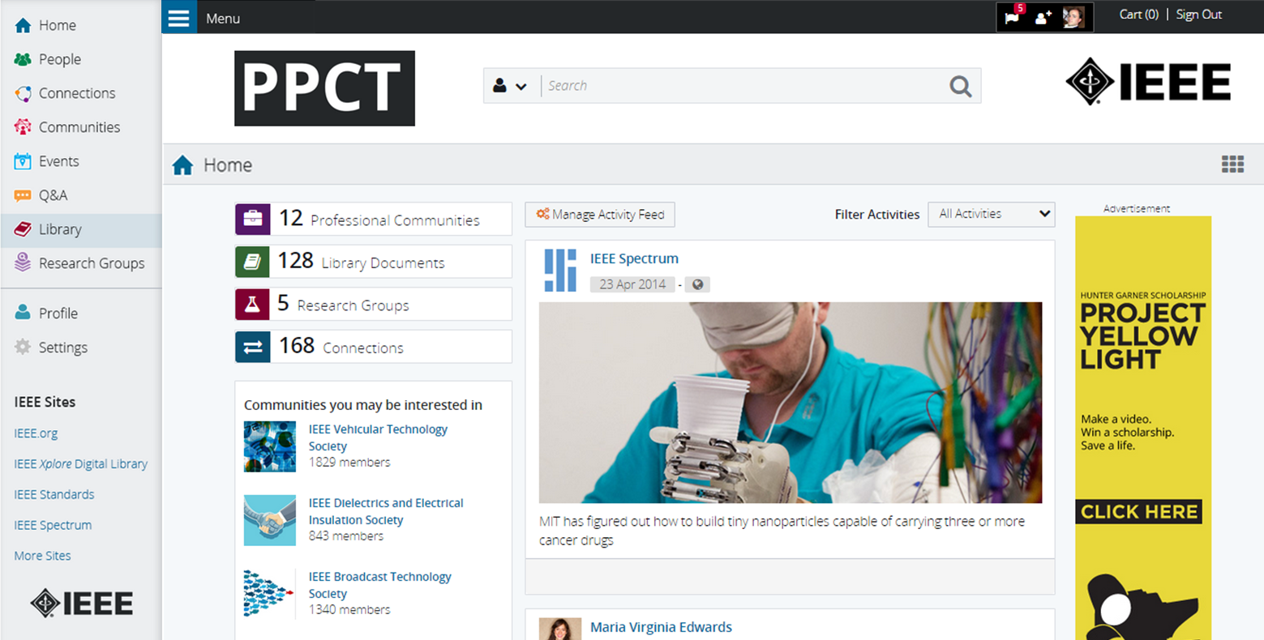
Home Page w/ menu extended
Today’s Focus: Networking Experience

Slide 15
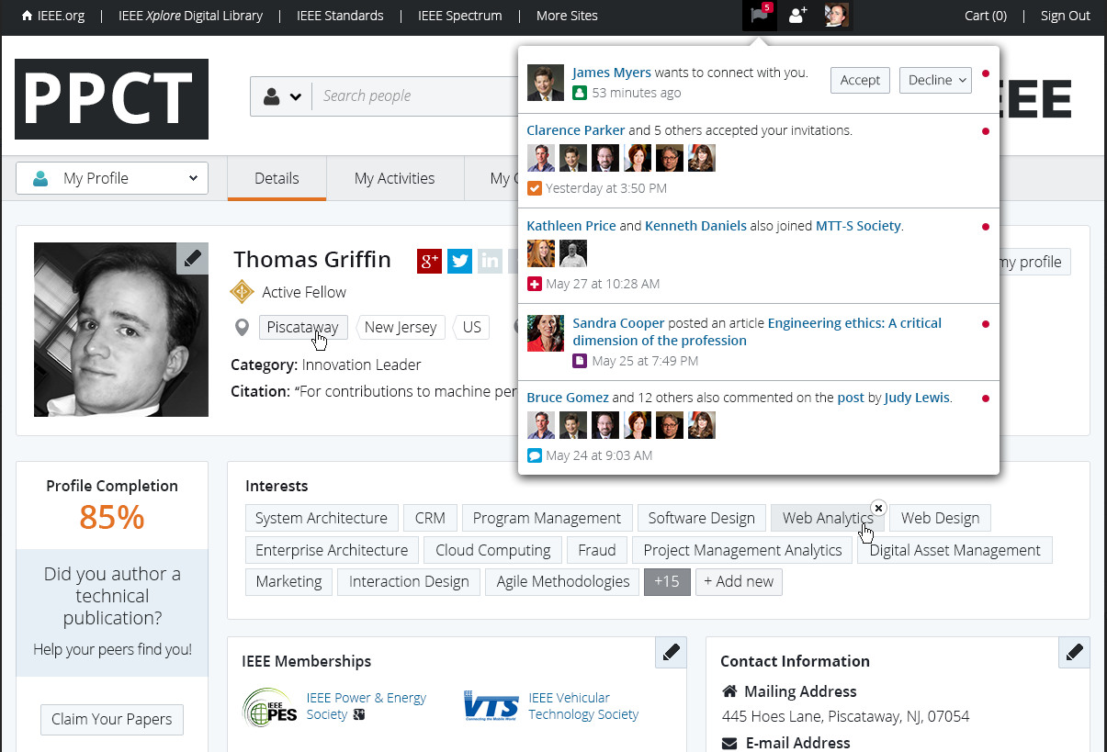
Profile Management
Profile > Details… Standardized layout for multiple constituencies who engage with IEEE, enabling robust professional networking.
Key Features
Consolidated view into individual interests, biography, and connectivity
Nick Lehotzky
User updates per engagement with others and activities
Linkage to profiles on other professional and social networking platforms
Notes:
*** BREAK-OUT SESSION

Slide 16
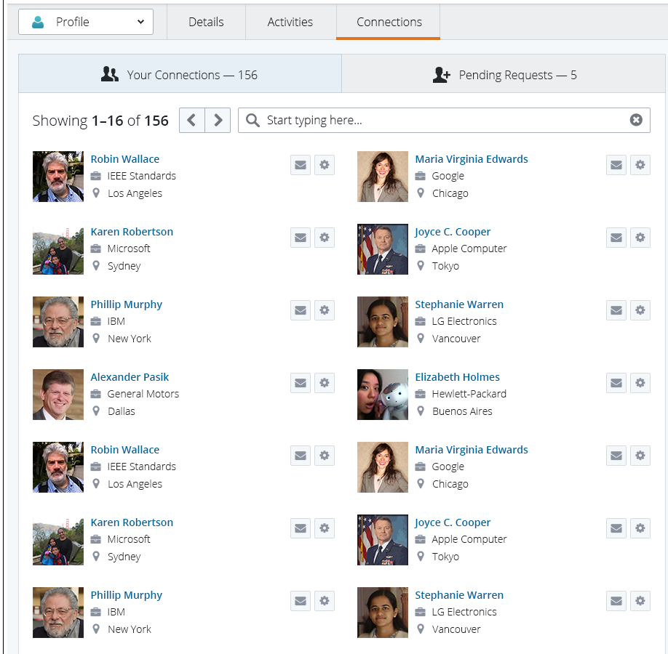
Profile Management (cont’d)
Profile > My Connections… Personalized list of professional contacts, members and non-members, within the PPCT experience.
Key Features
Recommendations based on profile attributes and engagement in IEEE
Management of existing and pending connection requests
Messaging capabilities with IEEE Collabratec™ contacts
John Day
Notes:
*** LEARNING LAB

Slide 17
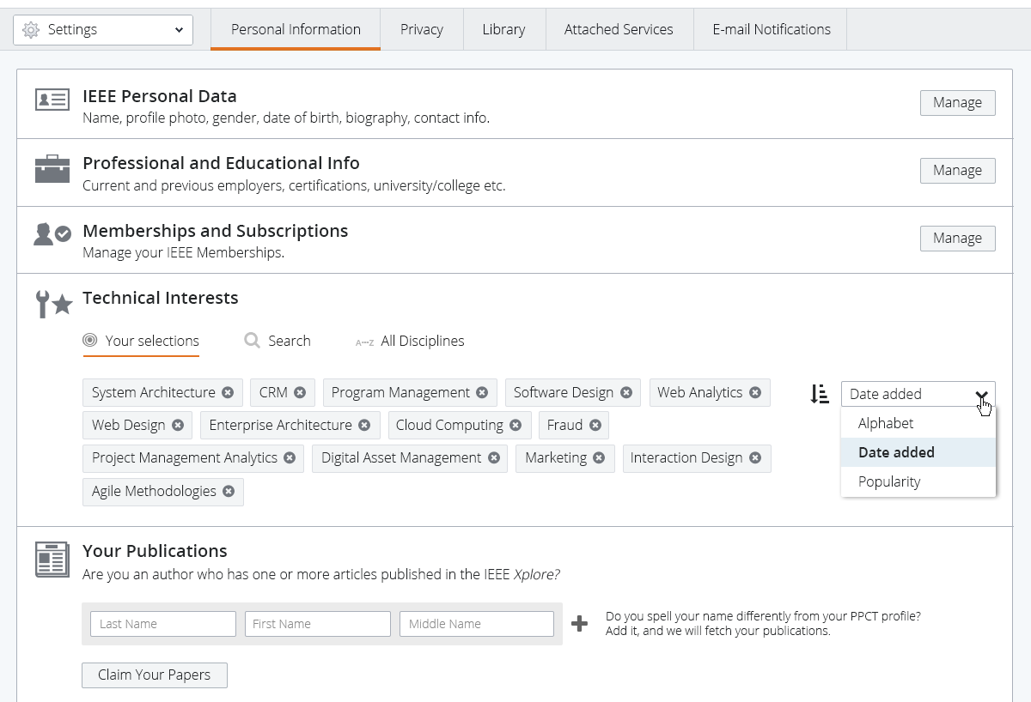
Settings
Settings > Personal Information… Convenient console for users to manage their engagement with IEEE Collabratec™
Key Features
Technical interests management to tailor feeds and recommendations
Privacy controls to manage visibility within platform and beyond
Attached services to manage connectivity with other tools and resources

Slide 18
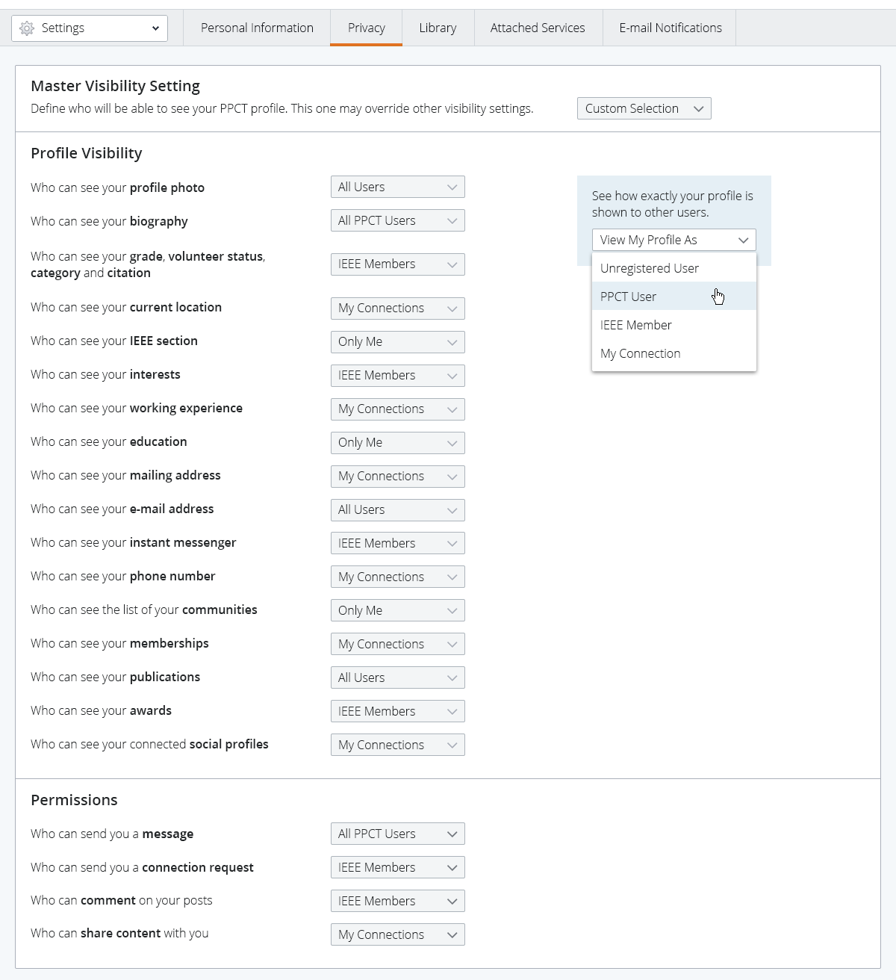
Settings (cont’d)
Settings > Privacy… Flexibility in managing the scope and breadth profile visibility and engagement with others.
Key Features
Five settings ranging from private to publicly indexed by search engines
Customized settings enabling variable visibility by field
Permissions control over messaging and engagement options
Notes:
*** LEARNING LAB

Slide 19
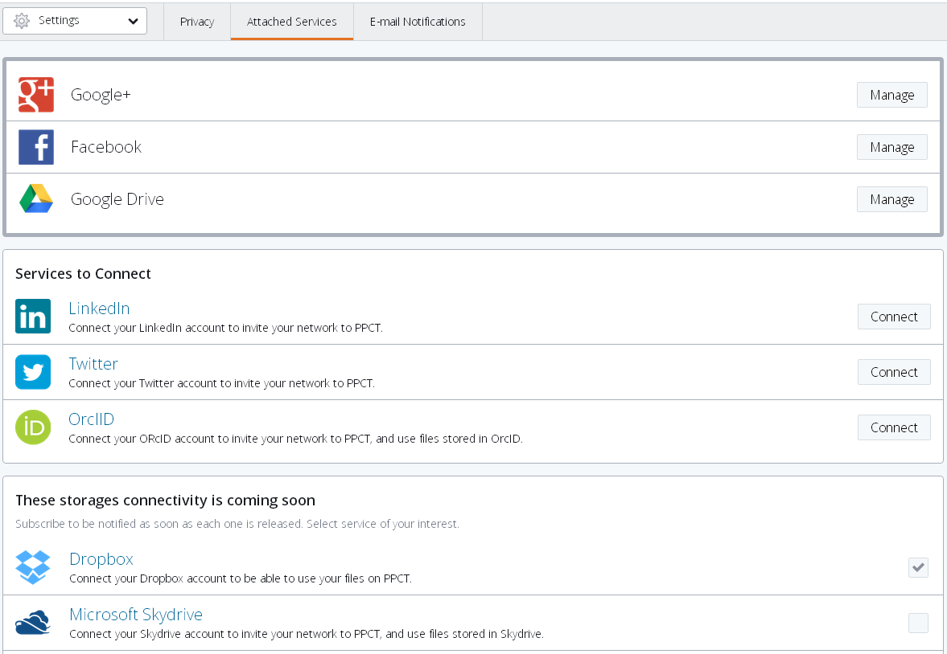
Settings (cont’d)
Settings > Attached Services… Enhanced experience through the ability to integrate utilities, resources, and/or social networks.
Key Features
One-stop management of services connectivity with other networks
Supports aggregation of feeds from other networks into IEEE Collabratec™
Cloud storage connectivity regardless of location or device
Notes:
*** BREAK-OUT SESSION

Slide 20
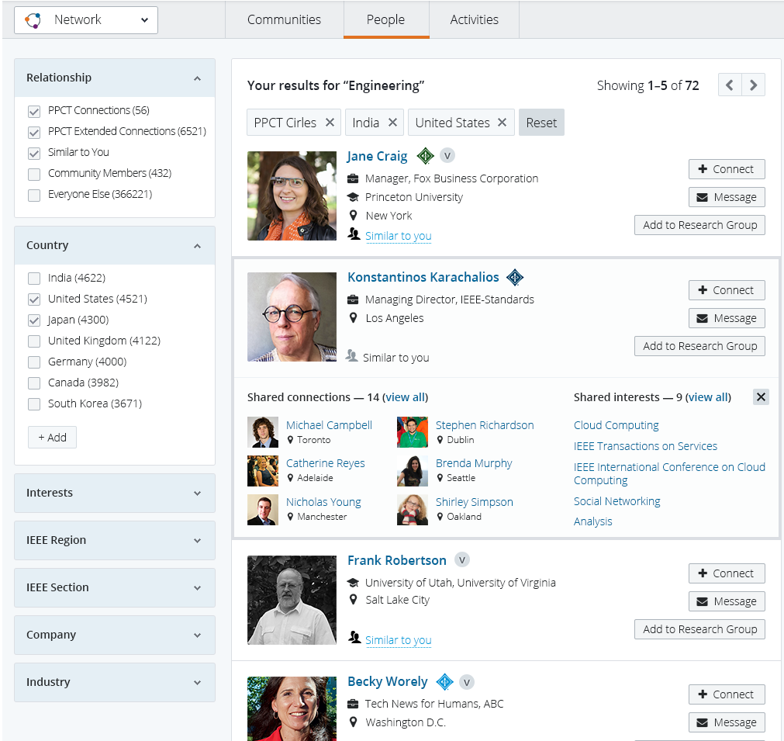
Networks & Collaboration
Networks > People… Access to the people engaged in the world’s largest, technical professional society.
Key Features
Grade badging to distinguish IEEE members among each other and other users
Search faceting to locate users by specific criteria and level of engagement
Connectivity through shared interests, invitation management, and messaging
Notes:
*** LEARNING LAB

Slide 21
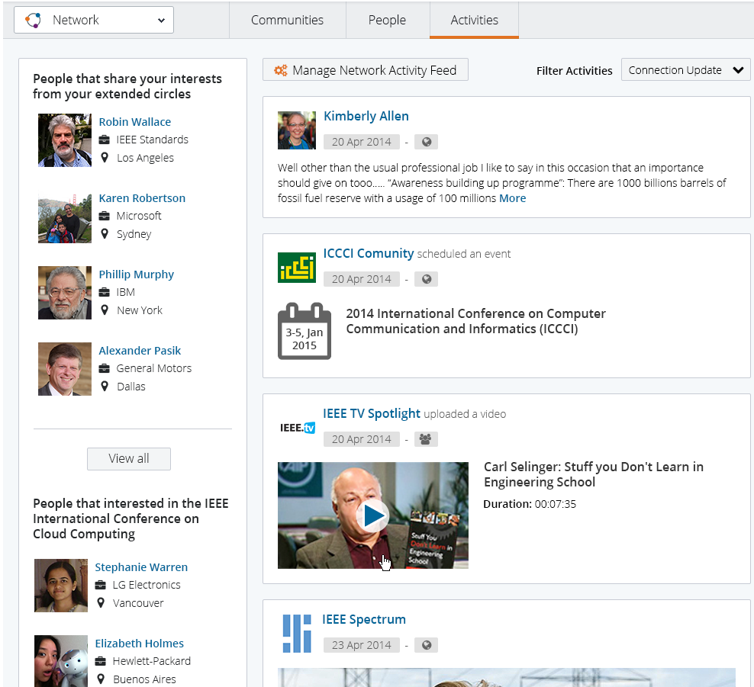
Networks & Collaboration (cont’d)
Networks > Activities… Updates from people, resources, and events of interest to you and your connections.
Key Features
Targeted opportunities to users by their defined interests and engagement
Aggregation of updates from contacts and connected services
This is
Filtering settings to expand or contract scope and breadth of activity feed
Notes:
*** BREAK-OUT SESSION, LEARNING LAB

Slide 22
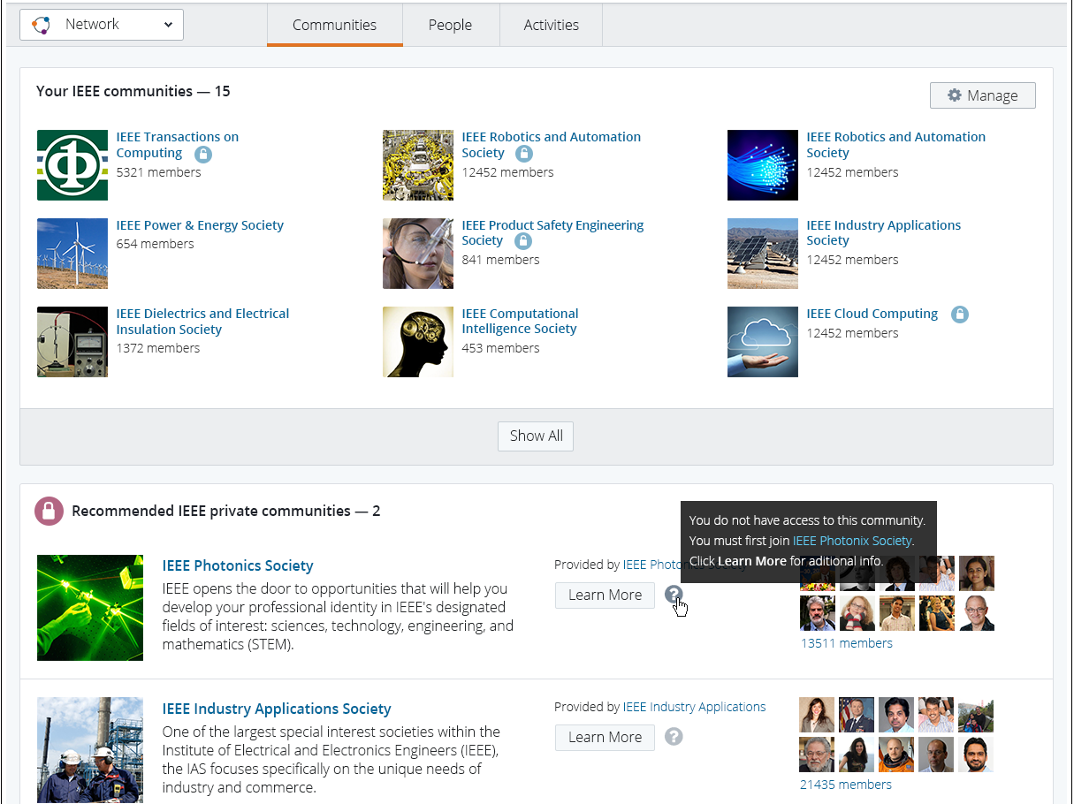
Networks & Collaboration (cont’d)
Networks > Communities… Harnessing self-defined and shared interests to foster peer-to-peer dialog and collaboration.
Key Features
Discover technical, professional or geographic communities
Access to communities based on IEEE or Society membership
Consistent user experience and feature-set across communities
Notes:
*** BREAK-OUT SESSION, LEARNING LAB

Slide 23
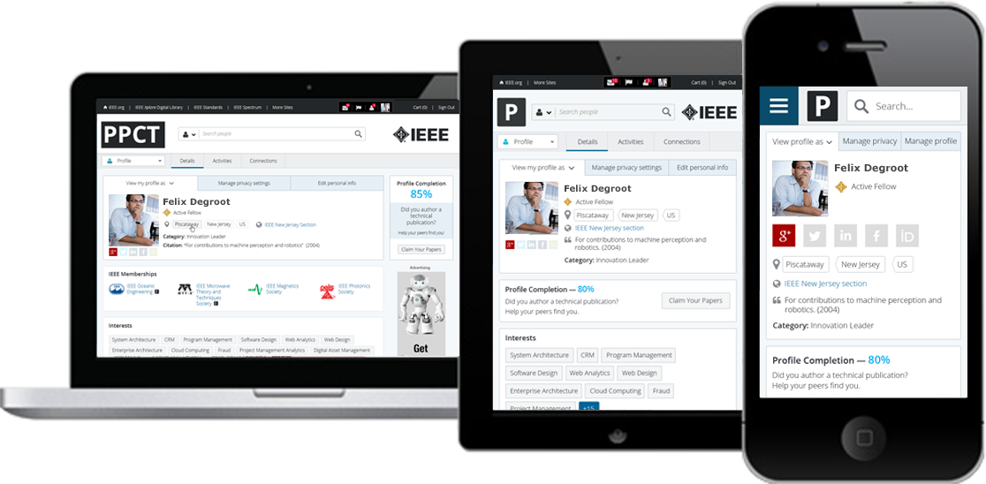
Mobile-Accessible at Launch
Device Compatible… Ubiquitous access through mobile and tablet formats to meet user preferences.
Key Features
Responsive design to adapt to viewer device
Optimized navigation offering dashboard and drill-down usage
App-version to be assessed for future releases
Notes:
*** BREAK-OUT SESSION

Slide 24
Communities
Notes:
*** BREAK-OUT SESSION

Slide 25
Communities Strategy
Embracing a 21st-century model for business-to-consumer and peer-to-peer engagement
Offering venues for members and non-members to virtually congregate and interact based on shared interests (technical, geographic, vocational)
Enabling IEEE to nimbly serve individuals working burgeoning technologies—and reaching individuals regardless of physical location or proximity
Awareness
Interest
Action

Slide 26
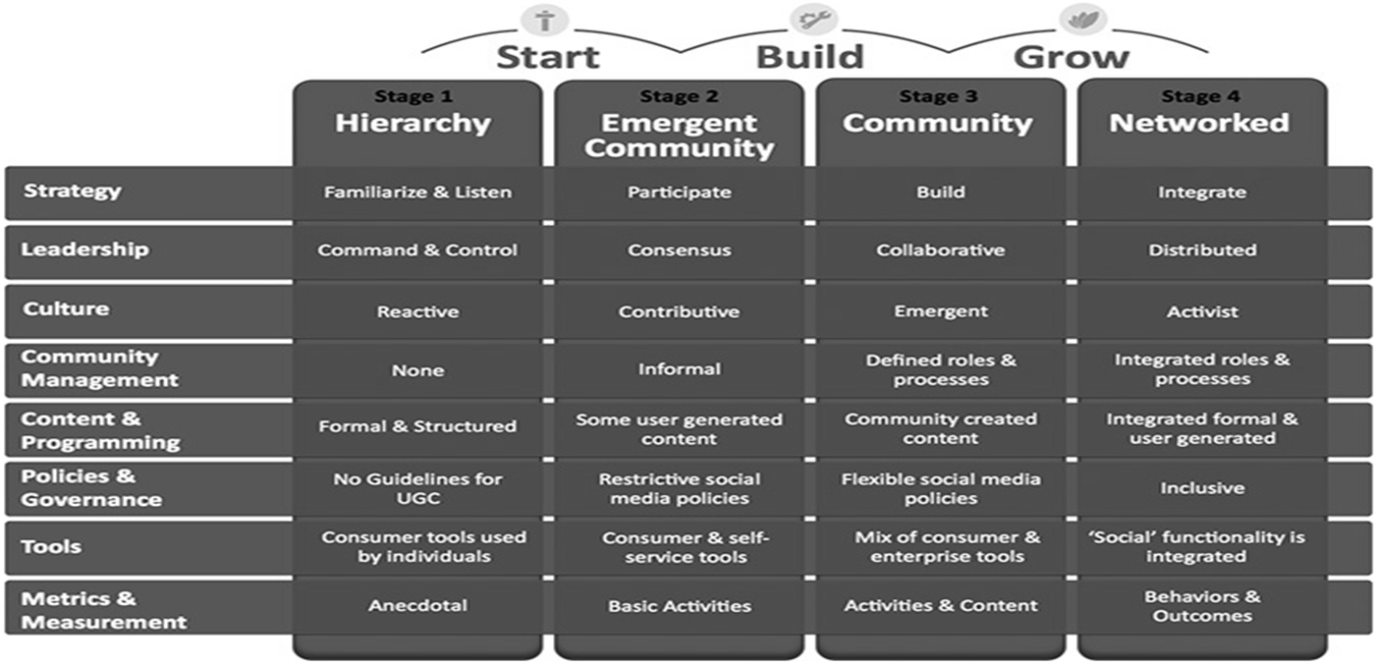
Strategic Framework
Community Maturity Model® by The Community Roundtable
Consortium of industry practitioners; Methodology based on competencies and maturity levels
Sets expectations for both community managers and stakeholders across the organization
Helps execute an enterprise performance gap analysis
Articulates community management’s cross-functional nature
Roadmap for organizational planning
Way to organize training
Individual communities
IEEE Collabratec™ platform

Slide 27
Leadership
Volunteers
MGA outreaching to Region Directors to identify municipalities and partnering Sections
Technical Activities outreaching to Society leadership for technical communities, and Volunteer-oriented topics
Operations
MGA identifying high-profile, event-based initiatives (Women in Leadership, IEEEXtreme) for which communities would offer synergy

Slide 28
Sponsored Communities (functional view)
Two spheres of the community experience: IEEE Collabratec™ and G+ (optional attachment)
G+ offers additional capabilities, and extends community visibility within Google ecosphere
Community Landing Page
Calendar / Events
Q&A
File Postings
Extended Experience (G+ / Google)
invitation mgt
Advertising
Participants
Participants
Discussion Strings
Video chat
Messaging
Polling
IEEE Collabratec™
Community
Community
Community

Slide 29
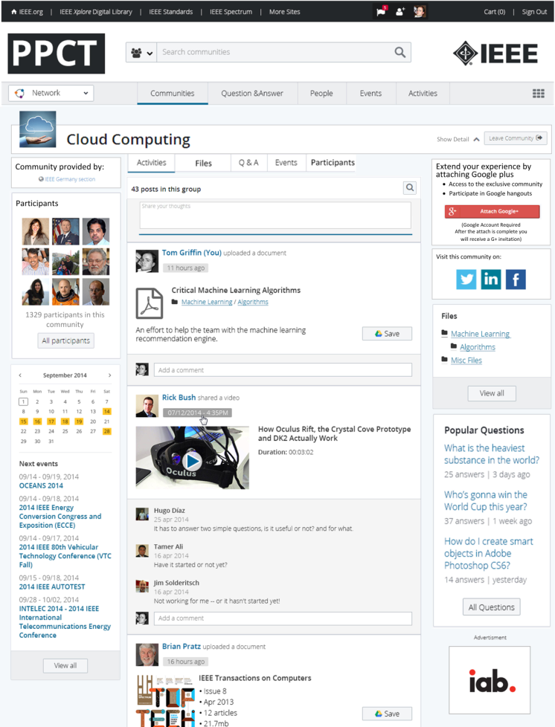
Sponsored Communities (user interface)
IEEE Collabratec™ Experience
Landing page
Community provider (sponsor)
Participants
Calendar
Activities
Files
Q&A
Advertising
Extended experience
Extended experience
Participants
Discussion strings
Polling
Messaging
Video Chat
(optional, attached G+ / Google account)

Slide 30
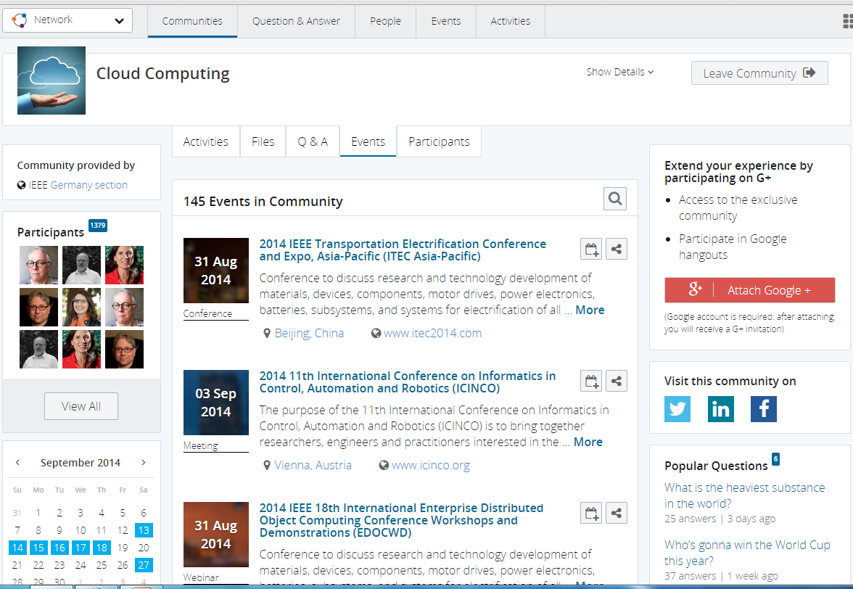
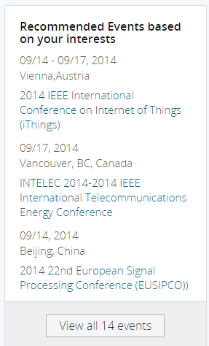
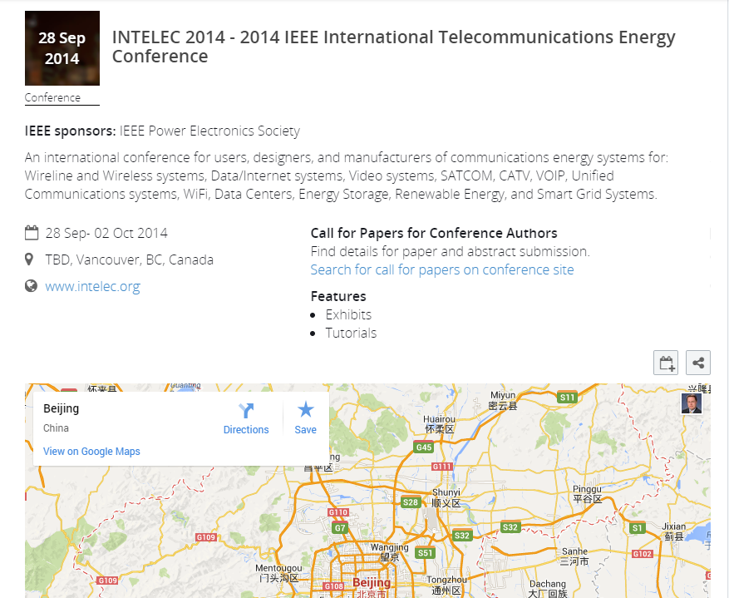
Community | Events (within IEEE Collabratec™ proper)

Slide 31
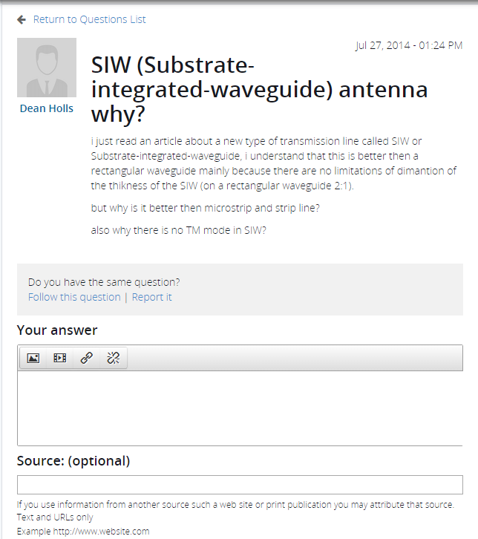
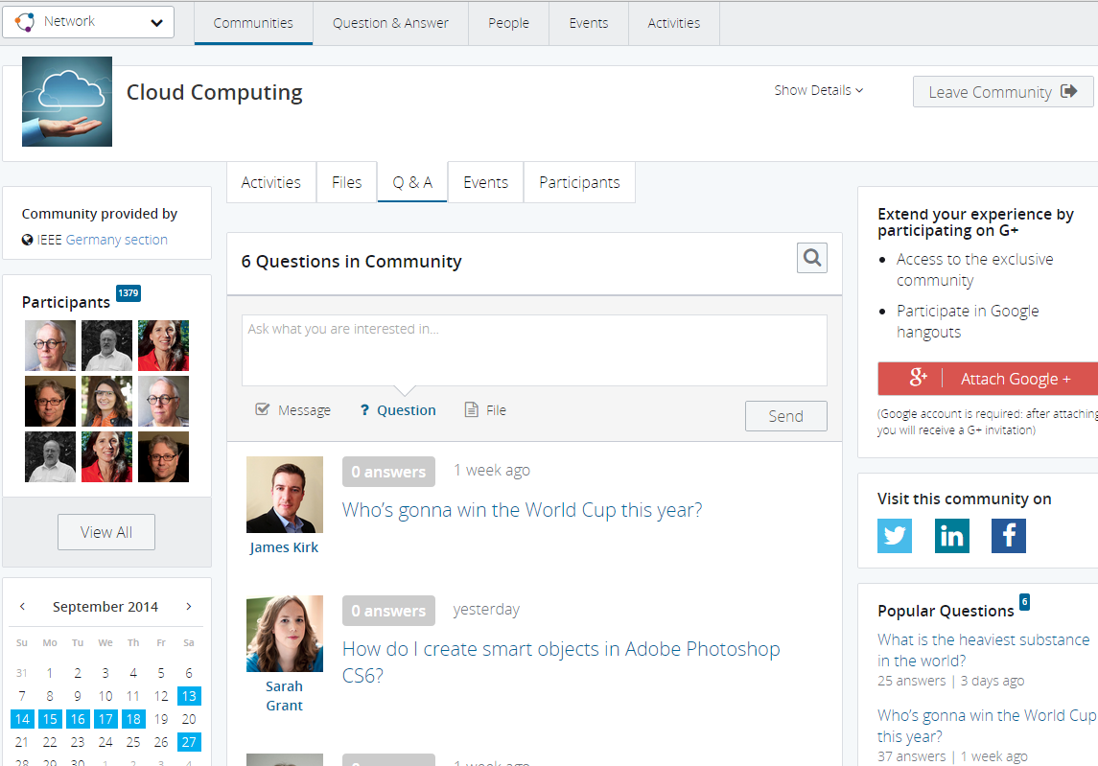
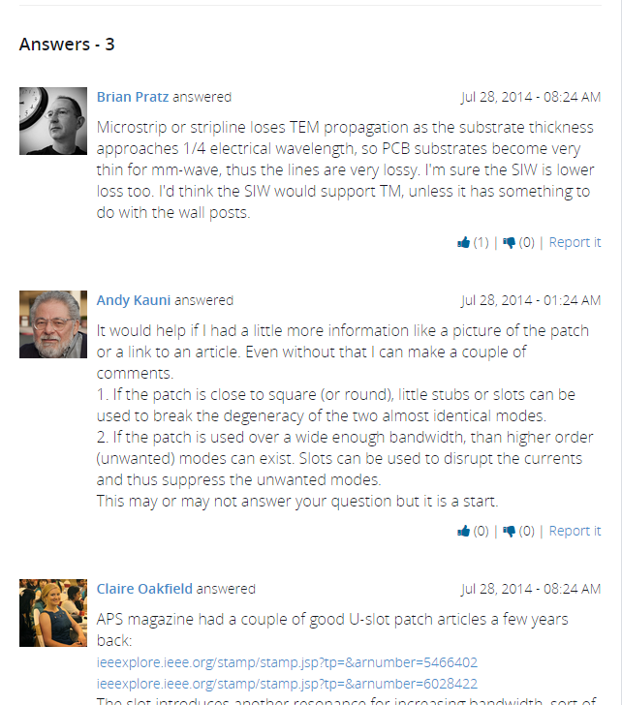
Community | Q & A (within IEEE Collabratec™ proper)

Slide 32
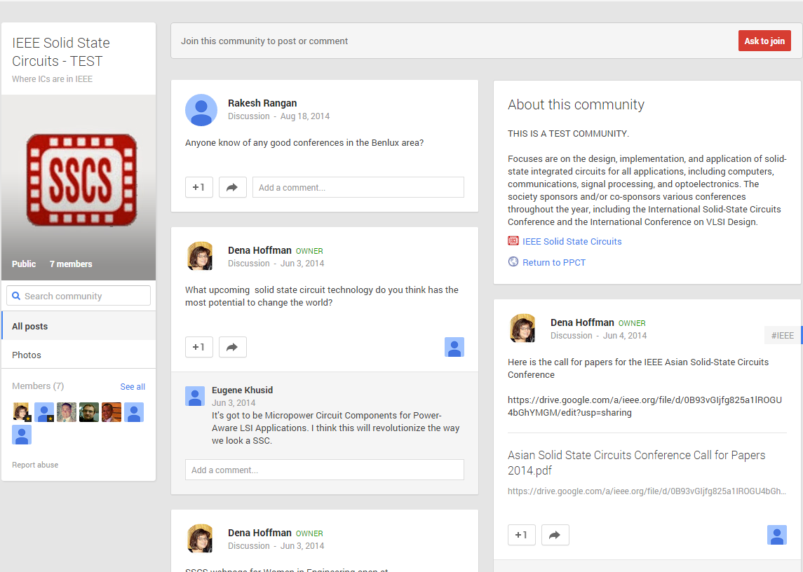
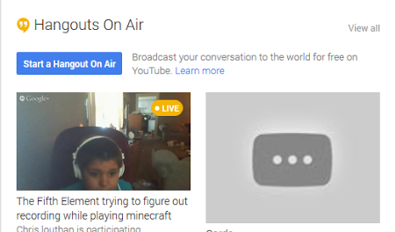
Extended Community Experience (within G+ / Google, optionally attached)
Features
Participants; Discussion strings; Polling; Messaging; Video Chat
Community name and graphic (same as IEEE Collabratec™)
Community overview and links to respective community on IEEE Collabratec™, and community sponsor(s)

Slide 33
Community Discovery & Access
IEEE PROMOTION
IEEE Collabratec
IEEE Collabratec™ Community
(e.g. Chicago, Editors in Chief)
G+ Community
(e.g. Chicago, Editors in Chief)
USERS INVITE
SEARCH ENGINE RESULTS
(Google, Yahoo, Bing, etc.)

Slide 34
Users Can Drive Growth
Users can invite colleagues into IEEE Collabratec™
Minimum requirement an IEEE web account (members or non-members)
Anticipate peer-to-peer referrals will likely:
Occur first in the workplace
Accelerate adoption internationally
Extend IEEE visibility into the non-IEEE audiences
Anne
Joan
Rafael
Tonya
Juan
Nan
Member Sign-up
Member-Driven Viral Sign-ups
Viral-Driven Viral Sign-ups
Gerard
To be propelled by large-scale, IEEE marketing push

Slide 35
Onward to Launch

Slide 36
Pilot Communities
Variety of communities representing different interests, audiences, and participation requirements
Communities may be sponsored by one or several entities
Technical-oriented
Cloud Computing, Big Data, Biomedical, ‘All-Society Tech Lounge’ concept, TAB Volunteer-oriented, possibly SSIT; Phased roll-out during Pilot
Geo-based
Organized around municipalities, with Sections serving as administrator; Open to all users of IEEE Collabratec™
Event-oriented
Women in Leadership, IEEEXtreme (persistent communities for annual events)
Awareness
Interest
Action

Slide 37
Pilot Invitation Process
Through list selection and targeted invitations, all Pilot participants will find other users and communities relevant to them
Members, Former Members (In and near Pilot municipal communities; Demographic/ interest per Pilot technical or event communities)
Targeted campaigns
Targeted campaigns
Targeted campaigns
IEEE Collabratec™ (pilot communities)
Cities X, Y, Z
Peer-to Peer-Connectivity
Technical-Based affinity
Municipal-Based
affinity
Cloud Computing
City X
City Y
Biomedical Engineering
City Z
Big Data
Authors (published in fields of Pilot technical communities)
Targeted campaigns
Targeted campaigns
Targeted campaigns
Persona-Based
affinity
Event-Based
affinity
Authors
IEEEXtreme
All Society Members
Women in Leadership

Slide 38
Community Features & Timeframe*
At Pilot - Early Dec 2014
Sign-in/promotion page
Community landing page
Participants module (people)
Events (reference, details page, recommended)
Corresponding G+ community, and all features contained therein
During Pilot - Jan to Mar 2015*
Incorporation of user testing feedback
Q&A
File posting
Tutorial overlay
*Awaiting release planning dates

Slide 39
User & Volunteer Support for IEEE Collabratec™
Users / Members
Contact Center website
FAQs
Video tutorials
Getting started PDFs
Webinars
Contact Center staff
Phone, Email, Online chat
Volunteer Moderators
Community specialists / Staff liaisons
Moderator training webinars
Moderator FAQs files
Best practices tool kit
Staff contact

Slide 40
Thank You! Questions?
Notes:
*** BREAK-OUT SESSION

Slide 41
Appendix Collaborative Research & Authoring Tools

Slide 42
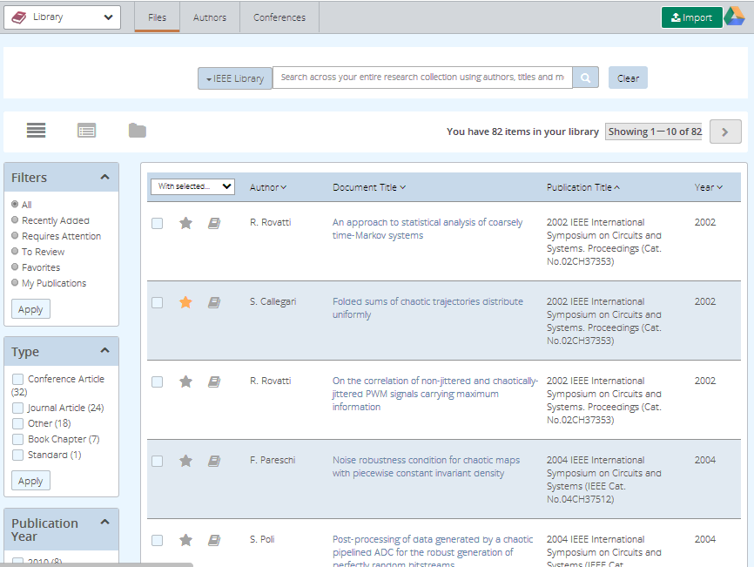
Research & Document Mgt
Research > Library… provides tools for authors and researchers to manage their personal research collections.
Key Features
Organize research and flag items as favorites for further review
Filtered contents of library by type, publication year, keywords, or collections
Search type-ahead for suggestions to easily locate research
Notes:
*** LEARNING LAB

Slide 43
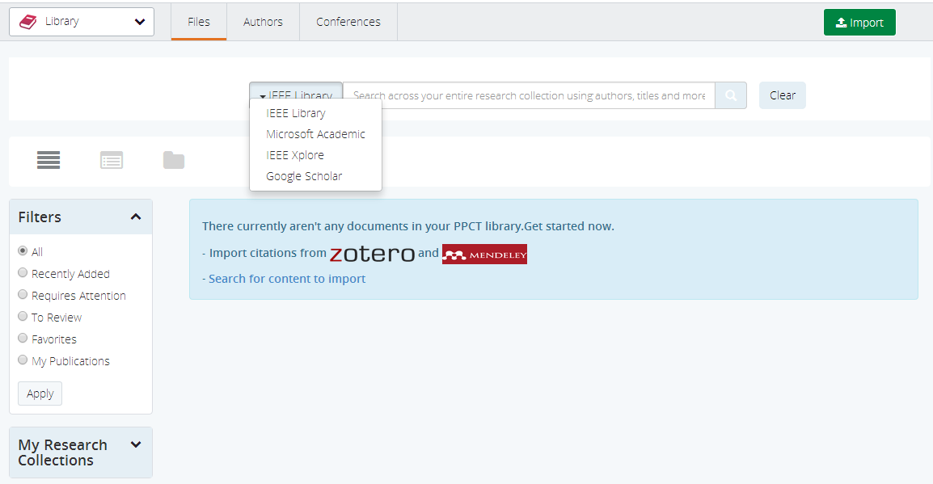
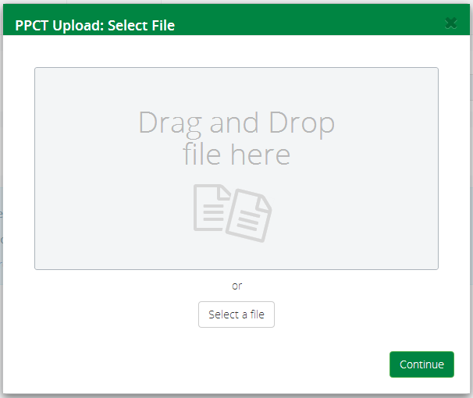
Research & Document Mgt (cont’d)
Research > Importing… Import and upload content using a variety of methods; Ability to search and claim documents authored.
Key Features
Import local files in a variety of formats including PDF and Word
Synchronize existing research collections from Mendeley or Zotero
Search IEEEXplore, Google Scholar or Microsoft Academic

Slide 44
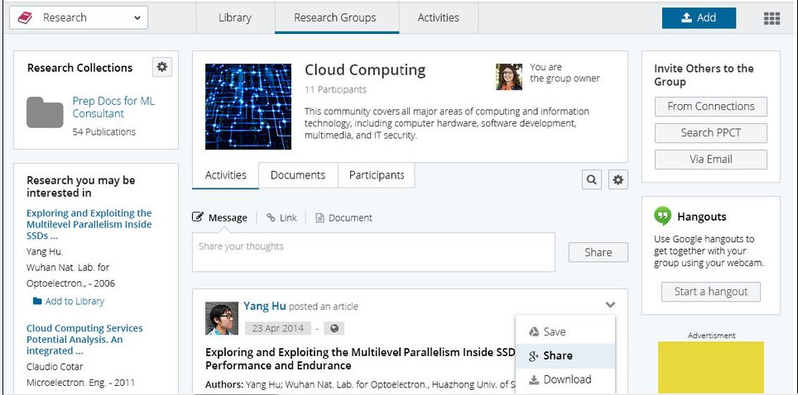
Research & Document Mgt (cont’d)
Research > Research Groups… Engage in collaborative authoring with peers in private groups on topics of mutual interest.
Key Features
Activities that chronicle group discussions related to the research
Documents related to the group’s research collaboration
Participants actively involved in the research group
Notes:
*** LEARNING LAB

