Slide 1






Technical Activities
IEEE Future Directions Internal Update for November
Green ICT
IEEE Green ICT
IEEE Big Data
W. Tonti, K. Clark-Fisher, K. Grise, B. Hoang,
H. Tepper, B. Wong
26 December 2014

Slide 2


FDC Maturity Model
Where we are today?
Incubation
Phase 1:
Coordinate across IEEE OUs
Phase 2: Position as “One Face” to Customers
Phase 3: Position as “Thought Leader”
Operationalize
IEEE Green ICT

Slide 3
FDC-TAB Incubator Project Metrics
Technology | Web Portal | Tech Community* | SME Lead(s) | New or Existing IEEE Standards Inclusion | IEEE Steering Committee | IEEE Event | 2014 FDC Support
RC | Yes | Yes 908 members | E.Track T.Conte | No | Yes | Yes | Yes
GICT | No | Yes 2,573 members | J.Elmirghani C. Despins | Yes | Yes | No | Yes
SDN | Yes | Yes 1,391 members | A.Manzalini | Yes | Identified | Yes | Yes
CbS | Yes | Yes ** 70 members | G. Shannon | No | Yes | Yes | Yes
BD | Yes | Yes ** 237 members | D. Belanger J. Moura | No | No | Yes | Yes
**Launched 30 Sept 2014
Value increase since 2/14

Slide 4
External Impressions as of 30 September 2014
Initiatives/Working Groups | Technical Community | Web Portal |  |  | eNewsletter | Social Media
 | Total Subscribers | Monthly Visits | Monthly Page Views | Monthly Duration of Visits | Total Subscribers | LinkedIn Members | Twitter Followers | Facebook Likes | Klout Score
Big Data | 237 | 1,088 | 1,817 | 1:32 | N/A | 10 | 69 | 202 | N/A
Cloud Computing | 5,983 | 6,508 | 13,562 | 2:11 | 7,594 | 4,153 | 1,553 | 5,560 | 49
CyberSecurity | 70 | 2,710 | 6,481 | 2:30 | N/A | N/A | 296 | N/A | N/A
Green ICT | 2,573 | N/A | N/A | N/A | N/A | N/A | N/A | N/A | N/A
Internet of Things | 6,274 | 5,321 | 10,151 | 1:59 | 6,223 | 2,163 | 1,960 | N/A | 53
Rebooting Computing | 908 | 330 | 935 | 2:48 | N/A | 18 | 160 | N/A | N/A
Smart Cities | 1,986 | 2,557 | 5,377 | 2:22 | N/A | 110 | 539 | N/A | 48
Software Defined Networks | 1,391 | 841 | 1,909 | 2:12 | N/A | 24 | 148 | 599 | 43
Transportation Electrification | 3,481 | 3,762 | 9,900 | 2:17 | 9,287 | 4,193 | 452 | 719 | 49
Notes: As of 30 November 2014
The Internet of Things and Smart Cities Initiatives formally commenced 1/1/2014

Slide 5
Societies Proposals: FDC-TAB Incubator Projects
Society | Topic | Status
CES | Safe Advanced Mobile Power | Approved
PES | INTELECT Conf and Expo | Approved
RS | Tutorial Certificate Program on Sw Reliability | Approved
CS | Advanced Best Practices Learning Pack | Approved
ComSoc | Two-day continuing education courses | Approved
PHO | International Year of The Light | Approved
5
Notes:
The speed of evolution is addictive: although it remains basically the same it capitalizes on previous results and the multiplication of sources lead to an exponential increase of knowledge and alternatives. The Web has dramatically lowered the transaction cost, the shift from atoms to bits is killing the value of organizations and enabling underdogs. In turns this results in an abundance of technology and in the market taking the upper hand on evolution.
A consequence is a shift of the perceived value, that moves from raw data (like published papers) to meta-information, and from verticals to the relation among verticals.
We are seeing new needs emerging as new ways are becoming available to fulfill previous needs.
All of this threatens our biz models but opens up new opportunities, in terms of new audiences previously not interested in technology and new revenue sources but at the same time it requires new biz models. The new is not killing the old, it is flanking it, but as value shift it requires a correspondent shift in biz models. Notice that the low transaction cost is not leading to a zero sum in value generated. The new is not going to generate sufficient value to compensate for value loss in the old. Increased market audience and dramatic cost reduction are necessary to remain successful.

Slide 6
IEEE Future Directions:
2014 TAB and NIC Initiatives
Big Data
Cloud Computing (*)
Cybersecurity
Green ICT
Internet of Things (*)
Rebooting Computing
Smart Cities (*)
Software Defined Networks
Transportation Electrification (*)
(*) = NIC Funded

Slide 7
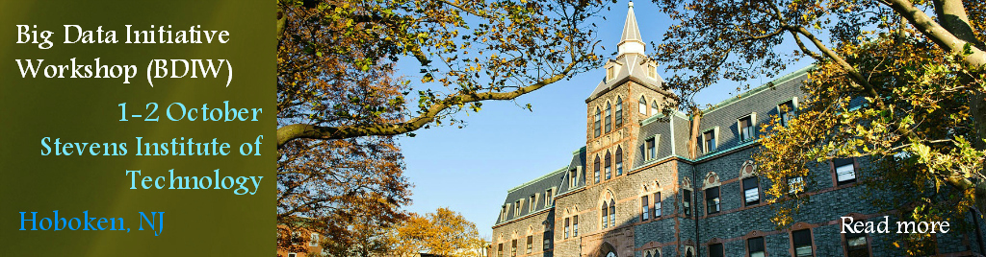
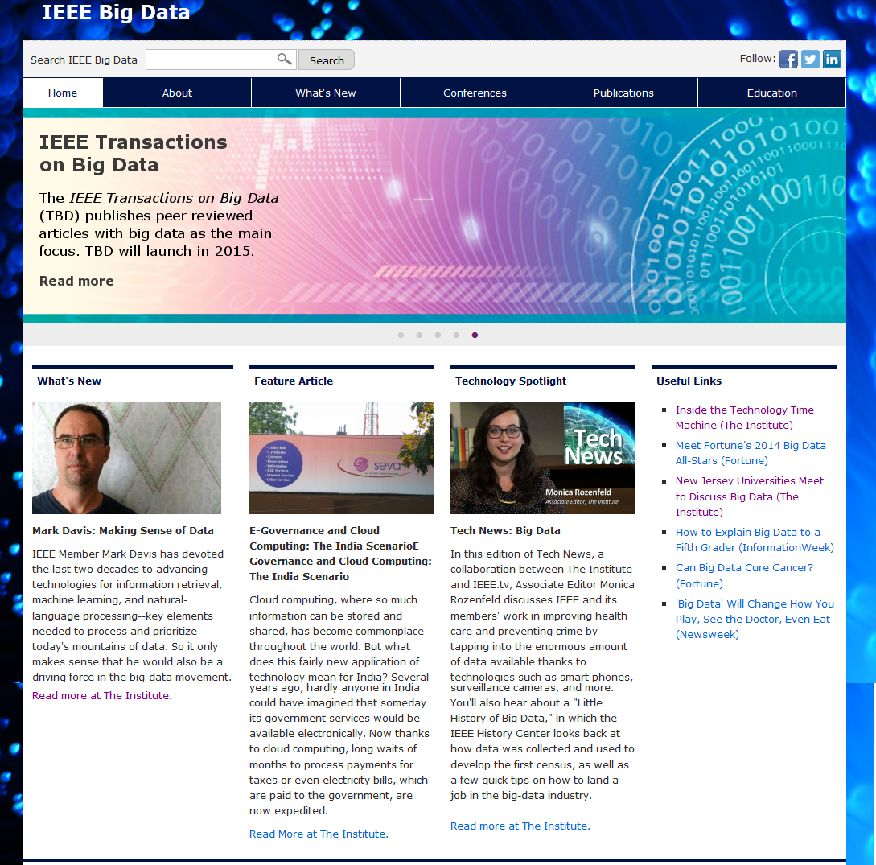
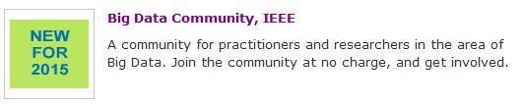

Big Data Initiative
Phase 1 NIC request approved, submitted phase 2 NIC proposal
Big Data Initiative Workshop (BDIW) held 1-2 October at Stevens Institute of Technology, Hoboken, NJ
  Excellent line-up of invited speakers across IEEE
  Good attendance
  The Institute and IEEE.tv coverage
September hard copy issue of The Institute focused on Big Data
New IEEE technical community added to IEEE Memberships and Subscriptions catalog
Big Data web portal and social media launched
  bigdata.ieee.org

Slide 8
2015 BDI Project Plan - Milestones and Roadmap
1Q15
2Q15
3Q15
4Q15
2016
Overall Roadmap and Coverage Planning
BDI Workshop 2/IC2E
BDI Workshop 3
FD Convergence Event ICCE,CCNC
Applications (New Components)
Competition on IEEE data analysis and recommended opportunities (planning)
Investigate leveraging IEEE data
Investigate IEEE as a repository for selected, curated datasets
Collaboration with NSF – Samir El-Ghazaly
Conferences (selected)
ICC
Compsac
  GlobeCom
Digital Presence & Outreach
Increase portal traffic, SEO optimization
Expand technical community
Signed agreement with NJBDA
eNewsletter
Logo via crowdsourcing
Education
Plan MOOCs, starter set from BDIW material
Develop MOOC
Develop MOOC
Marketing/Communications
Press Release
Editorial opportunities
Editorial opportunities
Editorial opportunities
Editorial opportunities
Editorial opportunities
New Publications & Conferences
Support Transactions on Big Data
Develop new pubs (Magazine, Transactions) & new conferences
Special issues in existing journals, special sessions in existing conferences
Standards
Identify need in collaboration with Standards Association
Joint SA Workshop
Notes:
Search of IEEE Conferences DB resulted in 17 conferences scheduled for 2015 on “big data” as search term.

Slide 9
Cloud Computing Initiative
Transition and sustainability - Overall hand-off on track
MOU agreement fully approved and signed by all eight OUs
Computer Society porting of cloud portal from joomla to liferay progressing well
Planning started among IEEE Cloud Steering Committee on initiative owned Cloud Computing for Emerging Markets (CCEM) conference for next year's CCEM
In person cloud steering committee meeting being held on Thursday, 20 November, during IEEE Meeting Series
Final report submitted to NIC, 10 November
  Conferences
  Two panels organized by CCI, held at IEEE GlobeCom, Austin, TX
Digital Presence and Outreach
Cloud portal is highly successful and well received. Since launch, almost 134,000 visits, averaging 5,000 to 6,000 visitors monthly
Volunteer managed digital bi-monthly newsletter: Cloud-Link, blog posts
Active social media: >1,400 twitter, >5,200 facebook, >3,900 linkedin
Wikipedia page
Technical community ~6,000
Education
Completion of all 40 eLearning modules geared towards practitioner
Standards
IEEE Intercloud Testbed continuing under SA Industry Connections Program

Slide 10
2014 CC Project Plan - Milestones and Roadmap
1Q14
2Q14
3Q14
4Q14
2015
Transitioning to Sustainability
Initiative oversight, transition committee, handoff to existing infrastructures ➔
Plan Complete
Big Data
Continue Big Data infrastructure & promotion ➔
Continue conference contributions ➔
e-learning modules
Transactions on Big Data EIC Search, CFP, launch preparation
Conferences (selected)
Steering Committee Planning ➔
Convergence Event ICCE
Cloudscape VI
OFC, IC2E, PTC
CLOUD
NOMS
ICC
CCEM, India
CloudNet
Latin America Cloud
  GlobeCom/NA Cloud
  CloudCom/AP Cloud
Compsac/European Cloud
Photonics
Progress
Bar
Education
Expand video of conference talks, section/chapter talks ➔
Promote society tutorials, workshops, seminars on portal ➔
eLearning modules
eLearning modules
eLearning modules

Slide 11
2014 CC Project Plan - Milestones and Roadmap
(Cont)
1Q14
2Q14
3Q14
4Q14
2015
Publications
Cloud Magazine launch
Transactions on Big Data (TBD) EIC Search, CFP, launch preparation
TBD Launch
Digital Presence & Marcom
Continue support of societies/councils/OUs ➔
Social Media, Blogs, “Cloud Link”, eNewsletter ➔
Technical Community ➔
Steering Committee Planning, co-leadership with CS ➔
Advertisements ➔
Standards and Intercloud Testbed
Progress
Bar
P2302 Balloting and public comment ➔
P2301 Working Group ➔
Adaptive management study group ➔
Continue engineering development with 22+ members ➔
Standards Vision project
Testbed online

Slide 12
Cloud Committee Timeline
2014
2015
Jan
Feb
March
April
May
June
July
Aug
Sept
Oct
Nov
Dec
Jan
*IEEE Meeting Series
Transition Plan Execution
Participating BoG approvals
Agreement Sign-off
TA/Societies Discussions
TAB Review
Coordinating Committee assumes responsibility
TMC Review
Details
Create coordinating committee of society/council/OU reps (Complete)
Establish regular meetings via teleconference/webex (Scheduled, ongoing)
Review all products and services, its respective ownership and management into 2015 and beyond, and resources needed (Complete)
Identify revenue opportunities (On track)
Create agreement document (Complete))
Review and secure, if needed respective society board approvals (Complete)
Secure all agreement signatures before IEEE Meeting Series, 20 November (Complete)
Transition Principles Defined
Transition Plan Complete
Establish guidelines

Slide 13
Cybersecurity Initiative
Center for Secure Design
  Spanish version of Flaws document to be released/promoted Jan 2015
  First 2015 workshop will be in March; exploring design in mobile, client-server, IoT, among others.
    Nov. Building Code workshop well attended--explored a “building code” in medical devices
  Embedded systems, regulators, security professionals and others gave input
  Goal to produce a deliverable aimed at best practices in field; report due early Jan.
    Steering committee in person meeting Jan 14 in DC; plan to produce concrete 2015 project roadmap
    Cybersecurity portal will transition from IEEE to CS servers in early January
    Several interviews/articles on initiative including FierceIT, CSO, and Dark Reading
    NIC Phase 2
  Presentation to NIC on Dec. 19

Slide 14
2014 CbS Project Plan - Milestones and Roadmap
1Q14
2Q14
3Q14
4Q14
2015
Center for Secure Design
Steering and operational committee set up
Workshop ➔
Artifacts
Timeline
Roadmap of Center activities
Flaws document launch
CSD planning meeting in late Oct for 2015 in Sunnyvale, CA (HP)
Next CSD artifacts workshop in March; topic TBD
Building Code Track
CFP created; steering committee formed
Large workshop in New Orleans to create best practices artifacts for medical devices
Report due early Jan.
Expand Steering Committee/Call for Projects
Progress
Bar
Phase 1 NIC
Portal
Steering Committee expansion/Call for Projects
Portal launch development
Security testing ahead of launch
Updates ongoing
Site will move to CS in Jan
Technical Community / Social Media/Newsletters
Twitter account created, has followers; tech community active; newsletter planning launch 1st Qtr

Slide 15
Green ICT Initiative
NIC funding submission for 2015 (phase 1 accepted, phase 2 on December 1st).
An IEEE Green ICT technical community is already in place now with over 2,500 members. There is sufficient broad interest in this opportunity to foster an IEEE-wide approach.
Phase 1 proposal approved - Transactions on Green Communications and Networking

Slide 16
2014 Green ICT Project Plan –
Milestones and Roadmap
1Q14
2Q14
3Q14
4Q14
1Q15
Conferences
Convergence Event: ICCE
IC2E
Greentouch workshop
DAC
CLOUD
ICC
Compsac
Photonics
Greentouch workshop
CloudCom
GlobeCom
Education
Survey on need in collaboration with S/C’s & EAB
Collaboration
IEEE Societies/Councils/OUs
Greentouch
GICT
Global e-sustainability initiative (GeSi).
Progress
Bar
Publications
Transactions LOI
Phase 1 Transactions
Phase 2 Transactions
Portal & Marcom
Technical Community expansion
Portal
Social media
Standards
Idea creation
Working group creation
1Q14
2Q14
3Q14
4Q14
1Q15

Slide 17
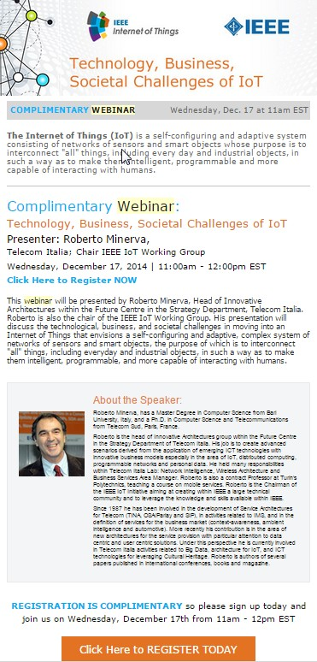
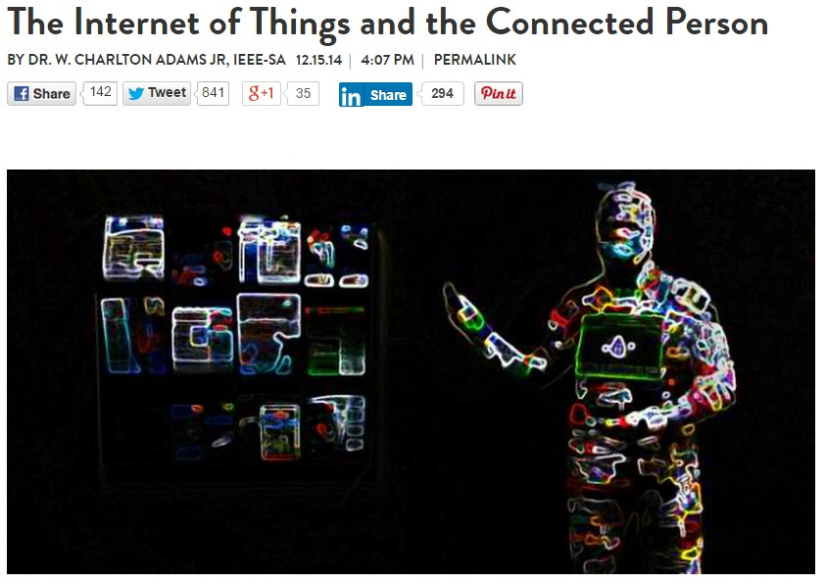
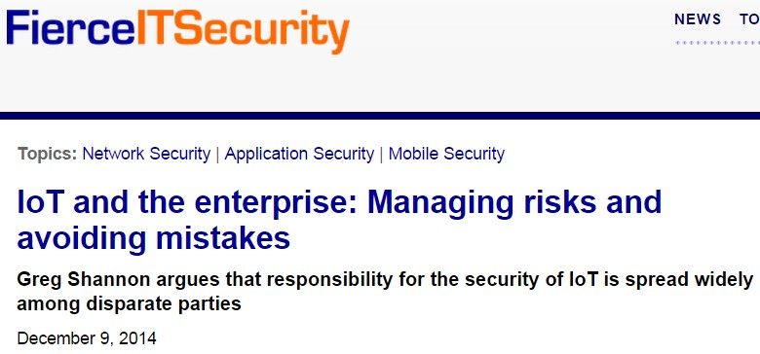

Internet of Things Initiative
Webinar on: Technology, Business, Societal Challenges of IoT, conducted by Roberto Minerva, Initiative Chair
  115+ attendees
New by-lined articles placed
  Wired Innovation Insights – 12/15 – The Internet of Things and the Connected Person; Chuck Adams
  Fierce IT Security – 12/9 - IoT and the Enterprise: Managing Risks and Avoiding Mistakes; Greg Shannon
Portal Update Highlights
  New IEEE Talks IoT Q&A – 12/13 - with YK Chen
  Video interview Oleg Logvinov and Mary Lynne Nielsen at Cisco IoT Forum – 12/13
Selected Milan, Italy for the 2015 IoT Initiative Conference

Slide 18
2014 IoT Project Plan
1Q14
2Q14
3Q14
4Q14
Portal Launch (soft)
Design/Format
Content Parameters
Content Development / Acquisition Plan
Refresh Schedule
Staff Support “Webmaster”
Volunteer “editor”
Content Development / Refresh
Content Development / Refresh
Content Development / Refresh
Web Portal
Develop Initiative Launch Plan
  IEEE Staff
  IEEE Members
  External Audiences
Portal Launch Plan
PR/Comm
Social Media Execution
PR/Comm Campaign
  Editorial Calendar
  Press Plan
  Analyst Plan
  Media Plan
    By-lined articles
    Q&As
    Columns
Social Media Launch
PR / Comm / Brand Launch
Social Media Plan
  Twitter
  Facebook
  LinkedIn
  Lanyrd
  AMAs
  You Tube
PR / Comm / Brand Execution
Progress
Bar
Brand Strategy/Logo

Slide 19
2014 IoT Project Plan (Continued)
1Q14
2Q14
3Q14
4Q14
Keynote, Special Sessions
Conferences
Plan for WF-IoT 2015
WF-IoT
Assessment of 2014 conference activities
eNewsletter
Design/Format
Editor Appointment
Author Recruitment
Pipeline Development
Select 2014 conferences for participation
IoT Journal Launch
Publications
eNewsletter Launch
Standards
P2413 Approval
Roundtable
Workshop
Education
eLearning Strategy / Method / Process
Webinar/AMA
Progress
Bar
Scenarios

Slide 20
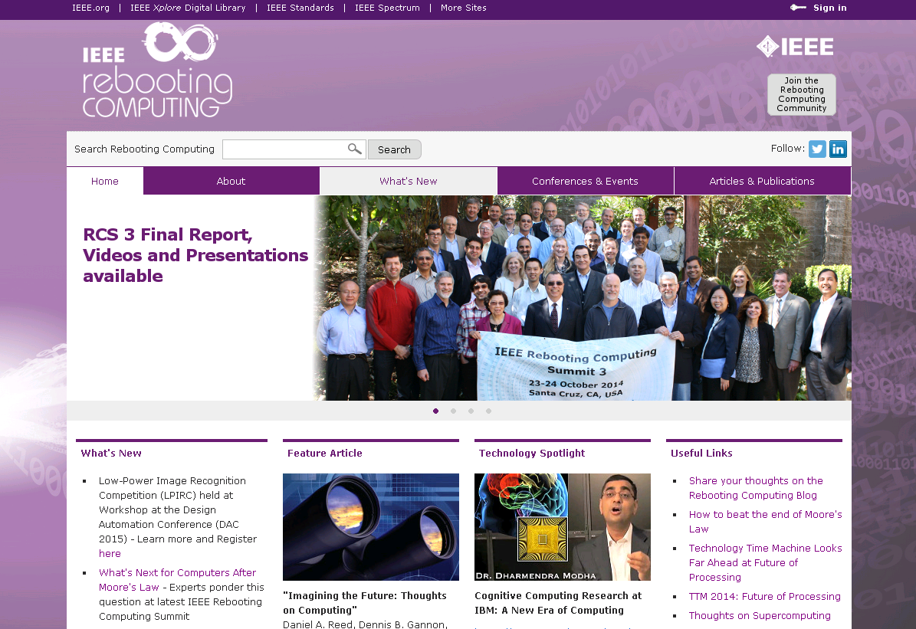
Rebooting Computing Initiative
Rebooting Computing Summit 3 (RCS 3), 23-24 October 2014, Hilton, Santa Cruz, CA
    RCS 3 Final Report, videos and presentations available on RC portal
    RCS 3 Media coverage
      What’s Next for Computers after Moore’s Law
      How to beat the end of Moore’s Law

Slide 21
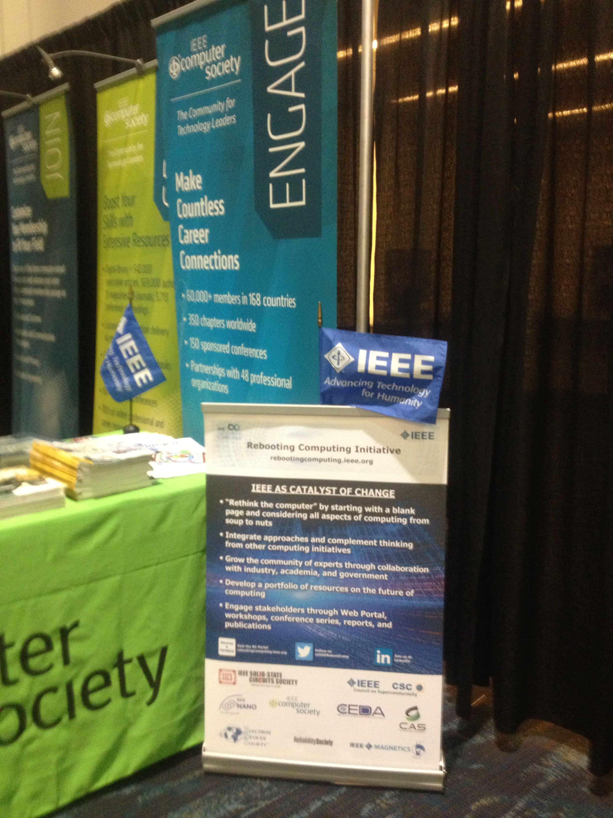
Rebooting Computing Initiative
RC exhibit in Computer Society booth in SC 14, 16-21 November, New Orleans
  Live tweets contributed to #IEEERebootComp reaching 180 followers to date
Working with IEEE.tv on a promotional RC Video to be released Jan 2015

Slide 22
2014 RC Project Plan - Milestones and Roadmap
1Q14
2Q14
3Q14
4Q14
2015
Conferences
RCS 2 held in Santa Cruz, CA
Plan for second RC Summit (RCS 2)
Plan for third RC Summit (RCS 3)
RCS 3 held in Santa Cruz, CA
OutReach
RC Blog Started in Jan and Ongoing ➔
Start promoting “Competition for Low Power Image Recognition”
Engage IEEE Societies – Presentation at February Presidents Forum
Socialize RC Initiative at International Conferences and Sections Congress )
Launch Social Media
Portal
Launch Portal (March)
Monthly Portal Updates with new articles, etc. ➔
Progress
Bar
Technical Community ➔
Publications
Summary Report of 2013 RCS 1 (end of Feb)
Summary Report of RCS 2 (July 9)
Summary Report of RCS 3 (Dec 12)
Form RC SubCommittees
Form RC Promotion Subcommittee
RC Website Subcommittee formed
Form RCS Subcommittee

Slide 23
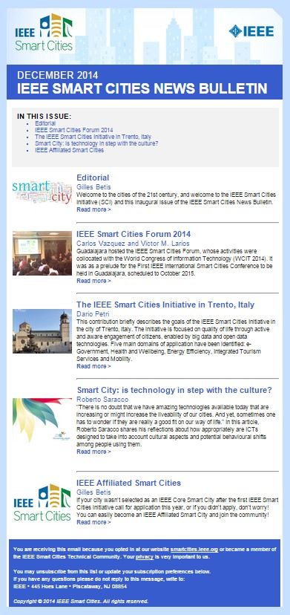
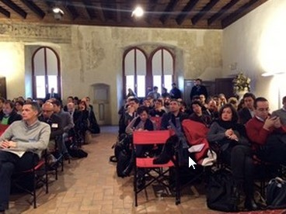
Smart Cities Initiative
Launched Smart Cities News Bulletin
  Contributors to the inaugural issue include:
    Gilles Betis of EIT (European Institute of Innovation and Technology) ICT Labs on the IEEE Smart Cities Initiative
    Carlos Vázquez and Victor Larios of the University of Guadalajara, Mexico on the IEEE Smart Cities 2014 Forum
    Dario Petri of the University of Trento with an overview on Trento, Italy
    Roberto Saracco of EIT ICT Labs with Smart City: is technology in step with culture?
Trento, Italy kick-off workshop held 10-11 December
  Attended by representatives of local institutions, the Municipality of Trento, other Italian cities and IEEE experts
  Themes included: Big and Open Data, e Government, Health and Well Being, Energy Efficiency, Tourism and Mobility
  The workshop was followed on 12 December by a forum for students from four high schools where Roberto Saracco, IEEE Smart Cities Initiative Champion, spoke about innovation in the urban environment and the future internet

Slide 24
2014 Smart Cities Project Plan
1Q14
2Q14
3Q14
4Q14
Background Tasks
Portal Prototype
Online Technical Community
New Cities Selected
Guadalajara Pilot
Workshop
Whitepapers
MOOCs
New Cities (2)
Workshops
Workshops
Generic Timeline:
Workshop
Whitepapers: +1Q
MOOCs (Part 1): +4Q
University Course Development: + 5Q
Masters Theses (supported students): +6Q
MOOCs (Part 2): +7Q
Conference: +8Q
PhD Dissertations (supported students): +10Q
Generic timeline for follow-on cities is defined below
Progress
Bar

Slide 25

Software Defined Networks (SDN)
SDN Working Group Formation
  Committee chairs appointed and members formation completed
    All sub-committees chair/Co-chair in operation
SDN4FNS Nov 2013 Trento workshop Whitepaper
  Whitepaper was published in Feb, 2014 with greater than 1000 downloads
Conferences and Events
  NetSoft logo created
  SPS changes from technical co-sponsor to financial co-sponsor
  NetSoft 2015 Conference Organizing committee completed; Planning continues.
Standards
  2 study groups (continues)
    Security, Reliability and Performance study group
    2nd study group formed under NGSON project
  2 research groups (continues)
    Software Defined and Virtualized Wireless Access
    Structured Abstraction
Publication
  IEEE Institute published December special edition on SDN
  Antonio wrote an article on 5G Meets Cloud Robotics to be published on Network Computing magazine.

Slide 26
2014 SDN Project Plan - Milestones and Roadmap
1Q14
2Q14
3Q14
4Q14
2015
IEEE/IFIP NOMS 2014 (SDN mgmt & Orchestration workshop ) (May)
Future Internet Assembly (March)
Conferences
SDN(Apr)
EUCNC (June)
ewsdn(Sep)
CNSM(Nov)
Out Reach
Open Flow, ICIN, EU Commission -- Ongoing ➔
Progress
Bar
TBD Launch
Portal
Portal Launched
Communication materials
Engage IEEE Societies
Technical Community ➔
Launch Social Media
SDN Blogs
Publications
Plans for
Journal
Magazine
eNewsletter
SDN4FNS workshop whitepaper
Institute feature SDN (Dec)
Conference Comm
Education Comm
Standards Comm
Publication Comm
Publicity Comm
Out Reach Comm
Pre-Industrial Track Comm.
Form SDN Sub-Committees
NIC phase 1 proposal
Society survey – Invite additional Societies and Councils to join the SDN Committee
NIC phase 2 proposal

Slide 27
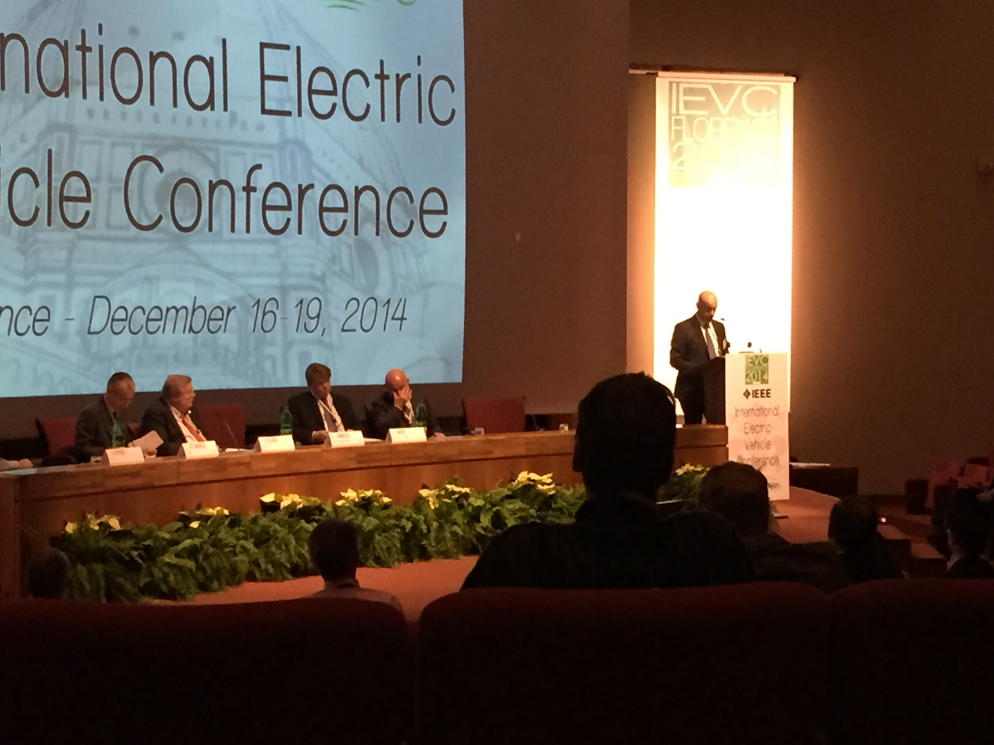
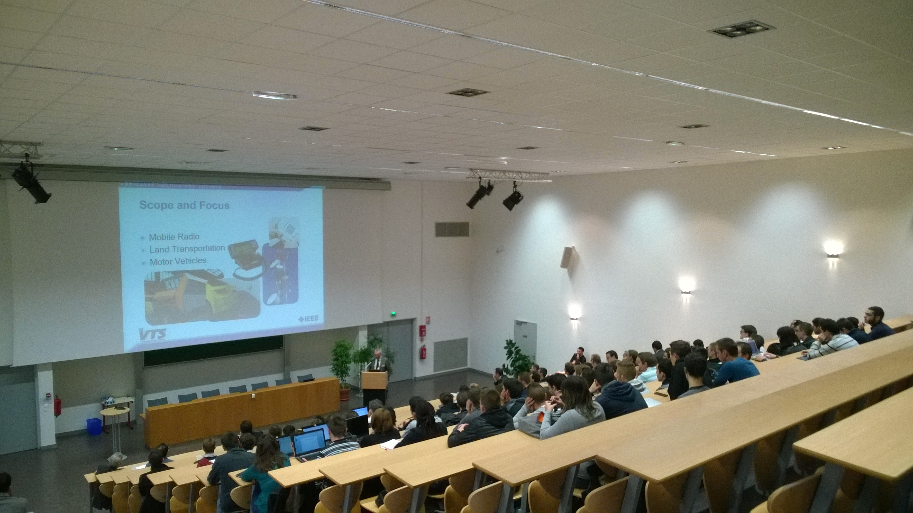
(TEI) Transportation Electrification Initiative
Transportation Electrification Initiative started its third year as an Initiative striding toward thought leader for Electric vehicles.
  Conferences
    ICCVE 2014 was held in Vienna from Nov 3rd to 7th
    IEVC 2014 was held in Florence from Dec 16th to 19th with 280 attendees
  Test Track (Greenville and Sonoma)
    Sonoma Dec 2nd event was postpone to 2015 by Organizing committee due to insufficient preparation time.
  DL Series
    4 DL Series held in 2014 (U Mich, ASU, UTBM and McGill University)
  Education
    Partnering with EA to repurpose DL video recording to webinar in process.
      Delivery Quality issue was resolved; currently explore options for monetize selective webinar
    3 eLearning modules completed development; Wireless Charging of EV and PHEV by Chris Mi; Fuel Cell technology by Fai Geo; Electric Machines and Drives in Electrified Transportation Systems by Mahesh Krishnamurthy. EA in process of preparation for release in 2015
  Communication
    eNewsletter special edition on “Wideband Gap Devices” was published on TEI Portal.
    3 Xplorer articles linked to eNewsletter theme is enabled for Technical community member to access.
    Technical Community continues to grow to 3480+ members
  Publication
    TE Transaction paper submission infrastructure in full operation and accepting papers.
  TEI to TEC Transition MOU signoff completed
    Standards Association board approved to become Core Member of TEC.

Slide 28

2014 TEI Project Plan - Milestones and Roadmap
1Q14
2Q14
3Q14
4Q14
2015
Transitioning to Sustainability
Initiative oversight, transition committee, handoff to existing infrastructures ➔
Conferences
Plan Complete
FD Convergence
ITEC-Detroit
ITEC-ASIA
IECON
ISGT
IOT
ECCE
ICCVE
VTC Fall
IEVC
Test track
UCICAR Event
Sonoma Raceway Technology Exhibit
Out Reach
SAE
EDTA
ITS America
SAE World Congress
SAE Convergence
Progress
Bar
EDTA Conf
ITS World Congress
Education
eLearning
(Fuel Cell)
eLearning
(Wireless Charging)
eLearning
(Electric Machine
DL@MI
Power Xfer
DL@ASU
DL @ UTBM
DL@UT Dallas
DL @ McGill

Slide 29
2014 TEI Project Plan - Milestones and Roadmap
1Q14
2Q14
3Q14
4Q14
2015
Portal & Marcom
On Going Portal Refresh ➔
Technical Community (retain and growth)➔
Continue support of societies/councils/OUS➔
By Line Articles
By Line Articles
By Line Articles
By Line Articles
By Line Articles
Social Media ➔
Publications
eNewsletter ➔
eNewsletter ➔
eNewsletter ➔
eNewsletter ➔
eNewsletter ➔
eNewsletter ➔
eNewsletter ➔
Institute TE Special Edition
EV Book Series ➔
Institute TE Blog
EV Magazine ➔
EV Magazine ➔
EV Magazine ➔
EV Magazine ➔
TE Transactions CFP, launch preparation ➔
Standards
ANSI workgroups ➔
ANSI workgroups ➔
ANSI workgroups ➔
ANSI workgroups ➔
Gap analysis workgroup ➔
Dynamic Wireless Charging workgroups ➔
Transportation Electrification SCC started
IEEE P2030.1 Draft Guide for Electric-Sourced Transportation Infrastructure ➔
Progress
Bar

