Slide 1
IEEE SusTech 2015
Campus visit Friday January 16th (photo by Prof . Fred Chiou)
Prof. Julie McCulley
President Wight
Prof. Jennifer MacAdam (USU)
Dan Donahoe
January 24, 2015

Slide 2
Summary Status
Web site set up
  Call for papers posted in December
Papers – EDAS set up
Committee established
  Need more help from experienced IEEE members
  Monthly conference calls underway
  On-site meeting last week
  Discussion at IEEE/UT section meetings
  IEEE/YP YP presentation in February
Conference site selected
Hotel contracts signed
Sponsors being actively sought
Short courses being arranged

Slide 3
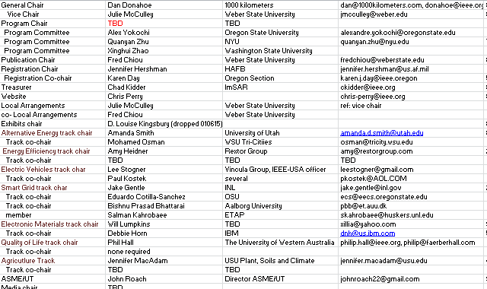
Conference Core Committee

Slide 4
Meeting Agenda

Slide 5
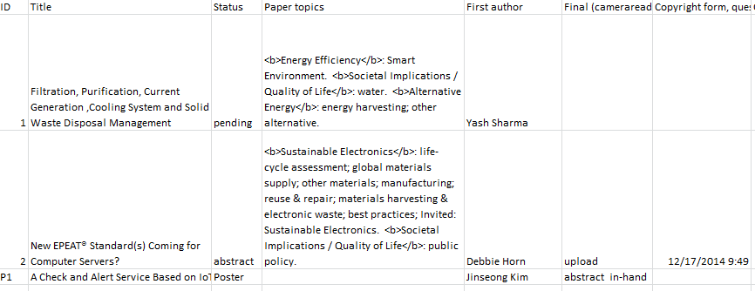
Paper Status (EDAS)

Slide 6
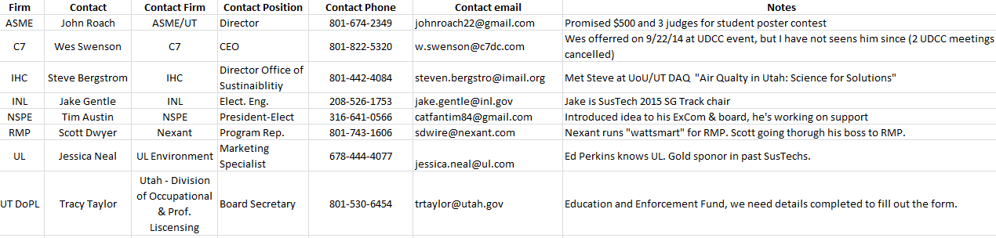
Targeted Sponsors to Date
Text is small, I know. Point is that there is progress.

Slide 7
Pacing Dates

Slide 8
Simple Cost Model
Undergraduate Poster Contestant fee: $25
Attendees: $300 member/$350 nonmember/$200 student & LM
Short Course $150 member/ $75 student

