Slide 1
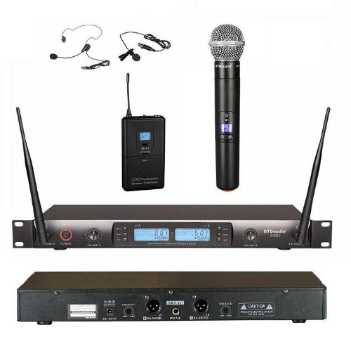
Audience/Audio Basics
For small venues (~20-30 people or less) House Audio is Not Required BUT may be used if available
Use of the built-in laptop microphone is not recommended
The recommended wireless microphone system supports all presenter styles
Podium/fixed
Lavaliere
Headset
Set up wireless mic’s and receiver in accordance with system manual
Recommend headset mic for presenter and handheld for audience

Slide 2
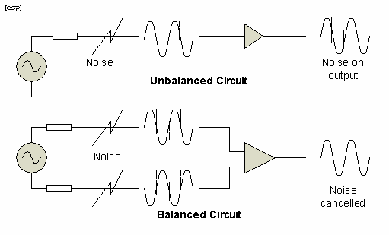
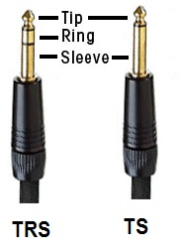
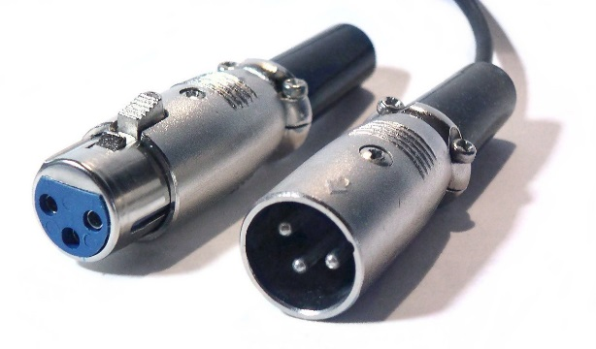
Connection to PC and Mixer
Use of balanced cables is only necessary with very long cable runs or when the audio cable is run alongside ac power cables

Slide 3
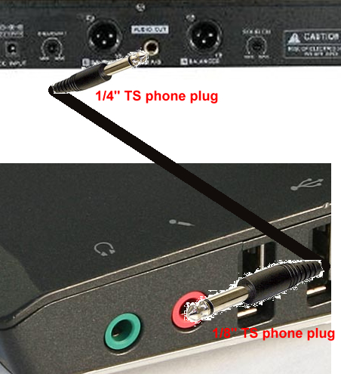
CASE 1 - No house audio (small group) Hookup to Camtasia PC Only

Slide 4
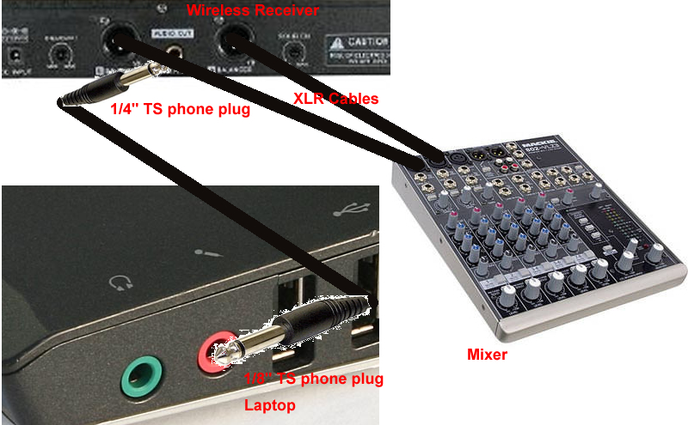
CASE 2 - Using House audio With access to mixer

Slide 5
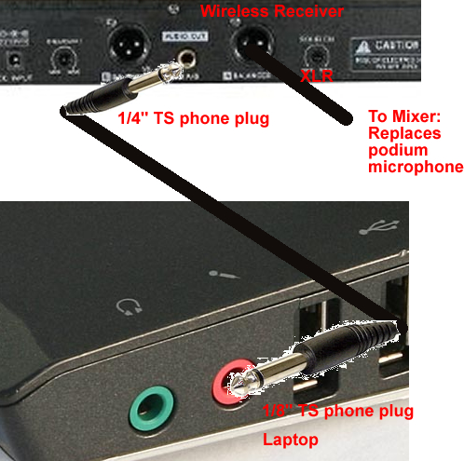
CASE 3 - Using House audio WITHOUT access to mixer

Slide 6
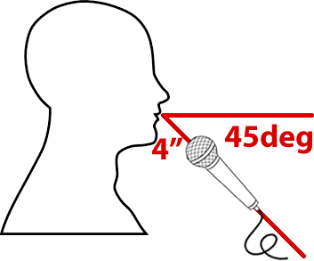
Microphone and Recording Basics
Distance/Position is everything!
Each Microphone has different/unique requirements
Handheld dynamic microphone 4” ~45 degrees out of plane

Slide 7
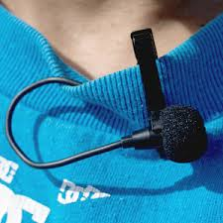
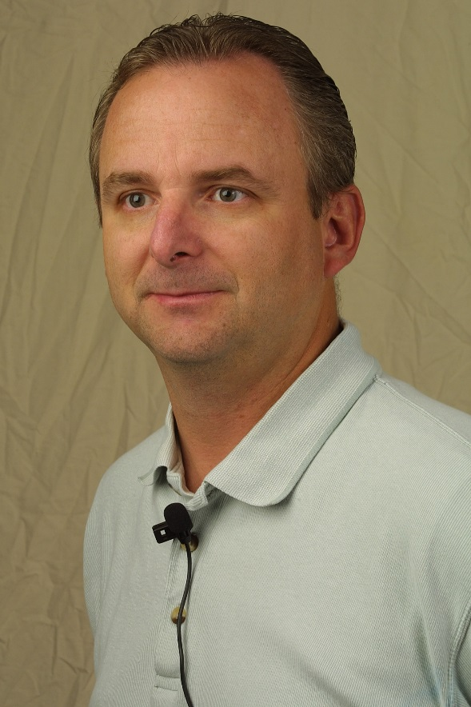
Lavaliere (midline as close to throat as possible)

Slide 8
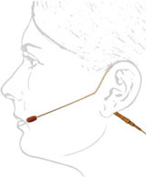
Headset - corner of mouth, flat/front of transducer facing and parallel to face

Slide 9
Putting it all together
Make a short test recording
Check level, clarity
5 volume/gain controls
Avoid highest gains due to potential distortion
Troubleshooting

